Slide 1
Git branch oriented feature toggling
GOFT

Slide 2
Why feature toggling
Pros
Decouple development from release
Runtime configurable feature toggling
a/b testing
…

Slide 3
What is a feature?
Only specifc to the feature toggling context
Has a life span
Not the feature branch we normally talke about
From now on, it is better to differentiate the name:
Feature branch
Story branch
Bug branch
…

Slide 4
Feature toggles life cycle
formalize
In progress
Off
On
deprecate

Slide 5
Cons: tech debts
2 (even 3) manual versions of the same feature:
Old + new feature
New feature
Old feature (in case we switch back)
What about testing?
https://launchdarkly.com/guide/cleanup.html
… a short-lived feature branch off of master(call it pk/awesome-xyz)…
…create a second branch, off of the first (call it cleanup/awesome-xyz) …

Slide 6
How to solve the cons?

Slide 7
Part1: git strategy & hook

Slide 8
master
conflict_detect
feature1
feature2
Push hook
Push early, push often

Slide 9
Push webhook
Get the branch name, committer name and email, SHA
If (branchName.substring(0, 7)===`feature_` || branchName.substring(0, 5)===`master`){
// merging: https://developer.github.com/v3/repos/merging/
Call github to merge the branch into conflict_detect branch
If (success) then
return;// all good
Else
// Update a Reference: https://developer.github.com/v3/git/refs/
call github to rollback the merge
contact the committer with SHA
}
Note: For requests using Basic Authentication or OAuth, you can make up to 5000 requests per hour.

Slide 10
Sanity check
Run full merge from scratch N time/day

Slide 11
Until now, we are confident that there are no conflicts, then we can merge whatever features combination with master by our wish

Slide 12
Part2: elastic CI/CD pipeline

Slide 13
Naming convention
Feature branch name: feature_???
Others branchs: story_???, bug-???
Comment in commit:
Not finished: ???
Finished: finished_???

Slide 14
How many features got finished?
Const branches= Call github to get branches // GET /repos/:owner/:repo/branches
Const featureBranches= branches.filter(branch=>branch.name.substring(0, 7)===`feature_` || branch.name.substring(0, 5)===`master`);
Const finishedFeatureBranches=[];
featureBranches.forEach(
branchInfo= Call github to get branch info //
If (branchInfo.commit.commit.message .substring(0, 8)===`finished_` )
finishedFeatureBranches.push(branchInfo) // GET /repos/:owner/:repo/branches/:branch
)
return finishedFeatureBranches;

Slide 15
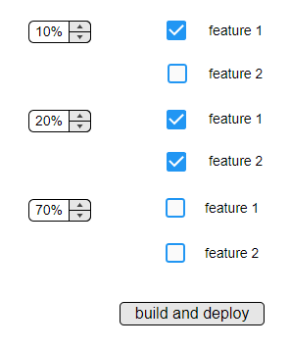
I want
10% user get feature1
20% user get feature1+feature2
70% user without features

Slide 16
Groups.forEach(group=>{
const concatName=`dyna_`+ group.selectedFeatureBranches.reduce(
(total, branch)=>total+`_`+branch.name
,``);
// GET /repos/:owner/:repo/branches/:branch
if (exist(concatName)){
// DELETE /repos/:owner/:repo/git/refs/:ref
delete the branch;
}
// POST /repos/:owner/:repo/git/refs
create the branch from master;
group. selectedFeatureBranches.forEach(
// merging: https://developer.github.com/v3/repos/merging/
Call github to merge the selectedFeatureBranche into concatName branch
If (conflict) then {
// Update a Reference: https://developer.github.com/v3/git/refs/
call github to rollback the merge
return;
}
)
Run build// got a artifact with name like dyna_feature1_feature2
}
)
Github api
Bamboo api
Octopus api
Azure api

Slide 17
Part3: adaptive webpack

Slide 19
Part4: dynamic runtime

Slide 20
Option 1 multi-instances (not bad, but not ideal)
we get 3 artifacts: dyna, dyna_feature1, dyna_ feature1_feature2
Azure instances
dyna
dyna_feature1
dyna_ feature1_feature2
Load balancer?

Slide 21
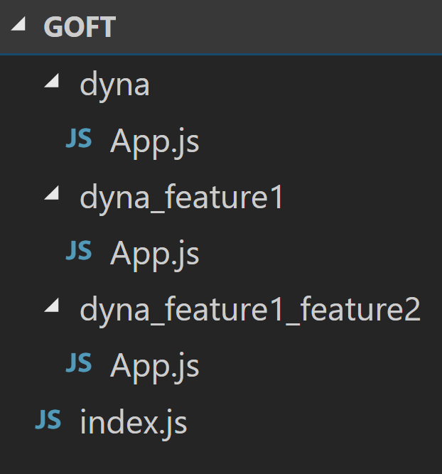
Option2: Dynamic import ( TC39 stage 3) babel-plugin-syntax-dynamic-import, babel-plugin-dynamic-import-webpack, react-loadable https://developers.google.com/web/updates/2017/11/dynamic-import
We get 3 folders in the same project/artifact

Slide 22
Index.js
import LoadableVisibility from 'react-loadable-visibility/react-loadable';
const App= LoadableVisibility({
loader: () => import(`./dyna_${features.join(‘_’)}/app`),
// get dyna_feature1_feature2/App.js
loading() {
return <div>Loading...</div>;
}
});
render(
<Provider store={store}>
< App />
</Provider>,
document.getElementById(`root`)
);

Slide 23
Summary
Git strategy & hook
elastic CI/CD pipeline
adaptive webpack
Dynamic runtime
Apparently only happy path considered
Not runtime, but click-build-deploy, still quick enough?
What about backend?

Slide 24

devops

