Slide 1

House Price Prediction System
Leveraging Property Features, Location Intelligence, and Regression Models to deliver accurate, data-driven residential property valuations for buyers, sellers, and real estate professionals.
MACHINE LEARNING
REAL ESTATE ANALYTICS
LOCATION INTELLIGENCE
Name: M.CHAITANYA
Regno:-323129510064

Slide 2

The Valuation Problem
Residential property valuation remains highly manual, subjective, and inconsistent. Multiple interdependent factors make accurate pricing a persistent challenge for all market participants.
Manual Assessments
Market Volatility
Multi-Factor Complexity
Appraisals rely on expert opinion, introducing bias and variability.
Rapid fluctuations render static valuations quickly outdated.
Location, size, amenities, and infrastructure interact in non-linear ways.

Slide 3
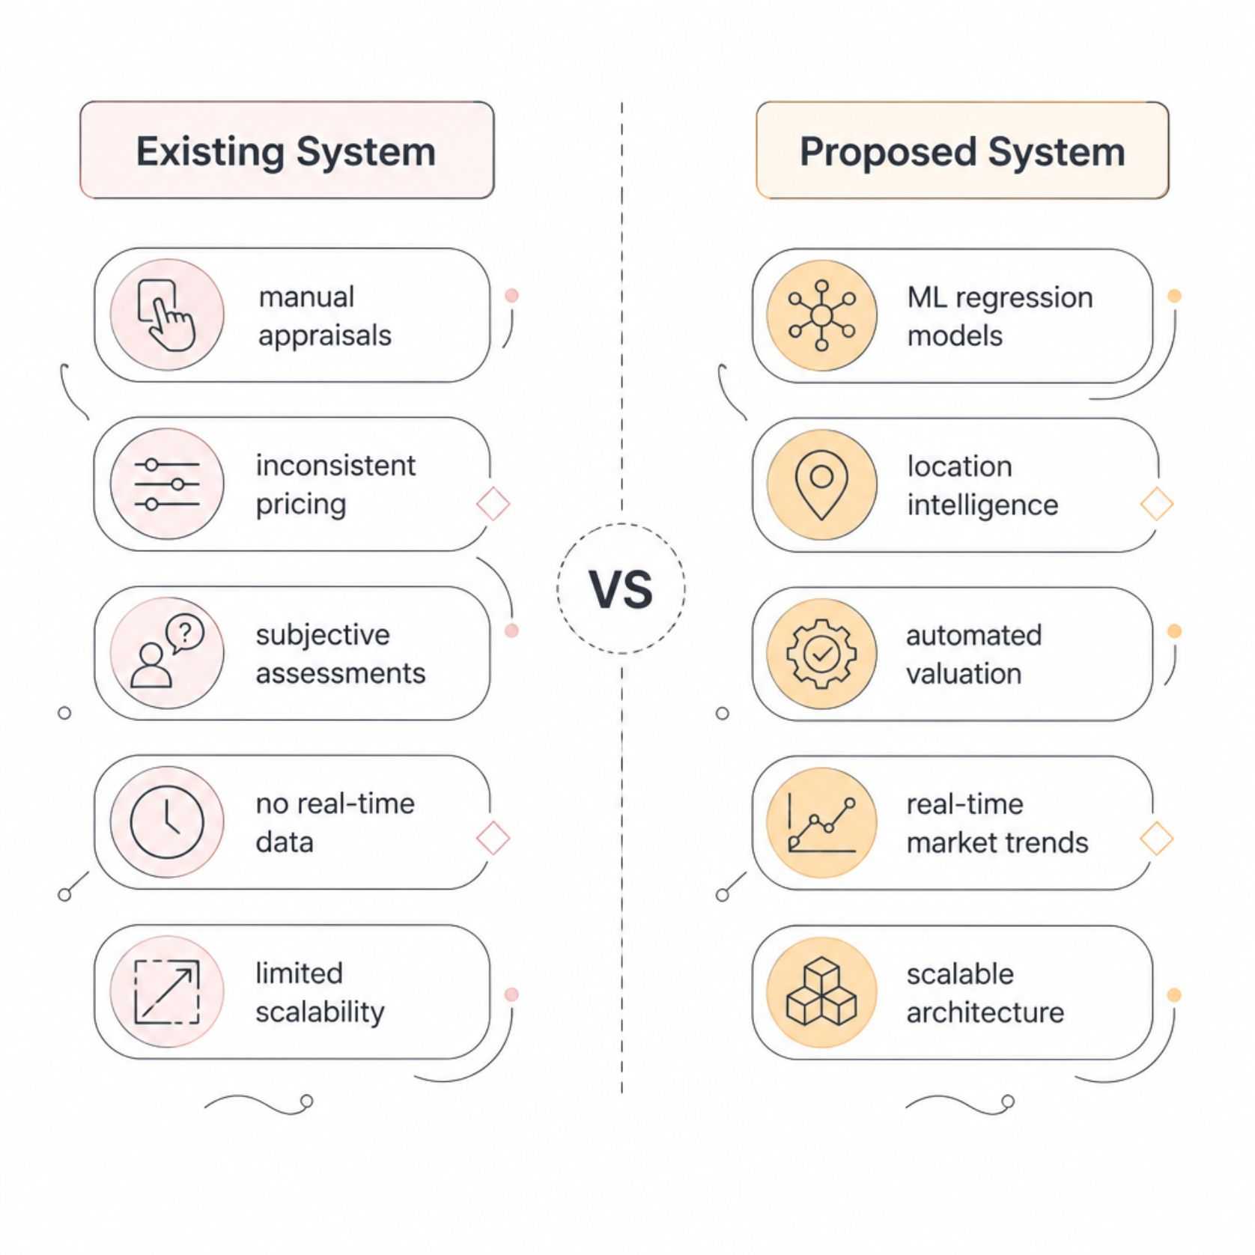

Existing System vs. Proposed Solution
Why a New Approach?
Traditional methods cannot scale to meet modern real estate demands. Our proposed system replaces guesswork with predictive intelligence — analyzing thousands of historical transactions, property attributes, and geographic signals to estimate market value with statistical rigor.
The system is designed to assist — not replace — professional judgment, providing a reliable data-backed starting point for every valuation.

Slide 4
System Objectives & Key Features
Accurate Valuation
Location Intelligence
Predict property prices using trained regression models with measurable error metrics.
Incorporate geographic factors — proximity to amenities, schools, and transit — into pricing.
Market Trend Analysis
Multi-Role Access
Visualize historical price trends and comparative market analysis for informed decisions.
Support Buyers, Sellers, Agents, and Administrators with tailored dashboards and tools.

Slide 5




User Roles & System Access
Buyer
Seller
Real Estate Agent
Administrator
Search properties, view predicted prices, compare listings, and access market trend reports.
List properties, receive ML-based price estimates, and track listing performance.
Manage multiple listings, generate client reports, and access comparative market analysis.
Manage users, monitor system health, oversee ML model retraining, and configure settings.

Slide 6
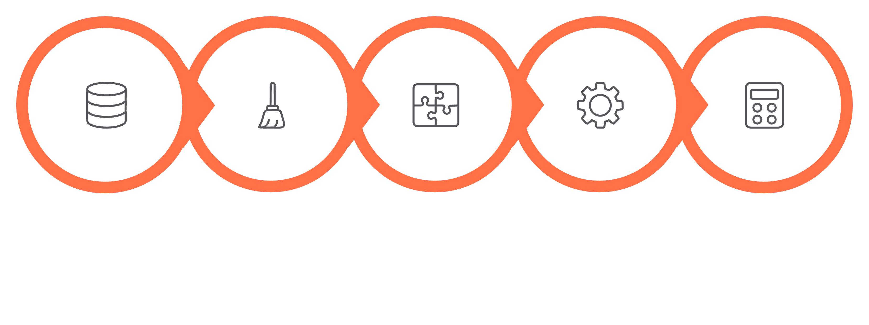
Data Pipeline & Machine Learning Workflow
Data Collection
Preprocessing
Feature Engineering
Model Training
Prediction
The end-to-end pipeline transforms raw, heterogeneous real estate data into reliable price predictions — with each stage validated for data quality and model accuracy before production deployment.

Slide 7
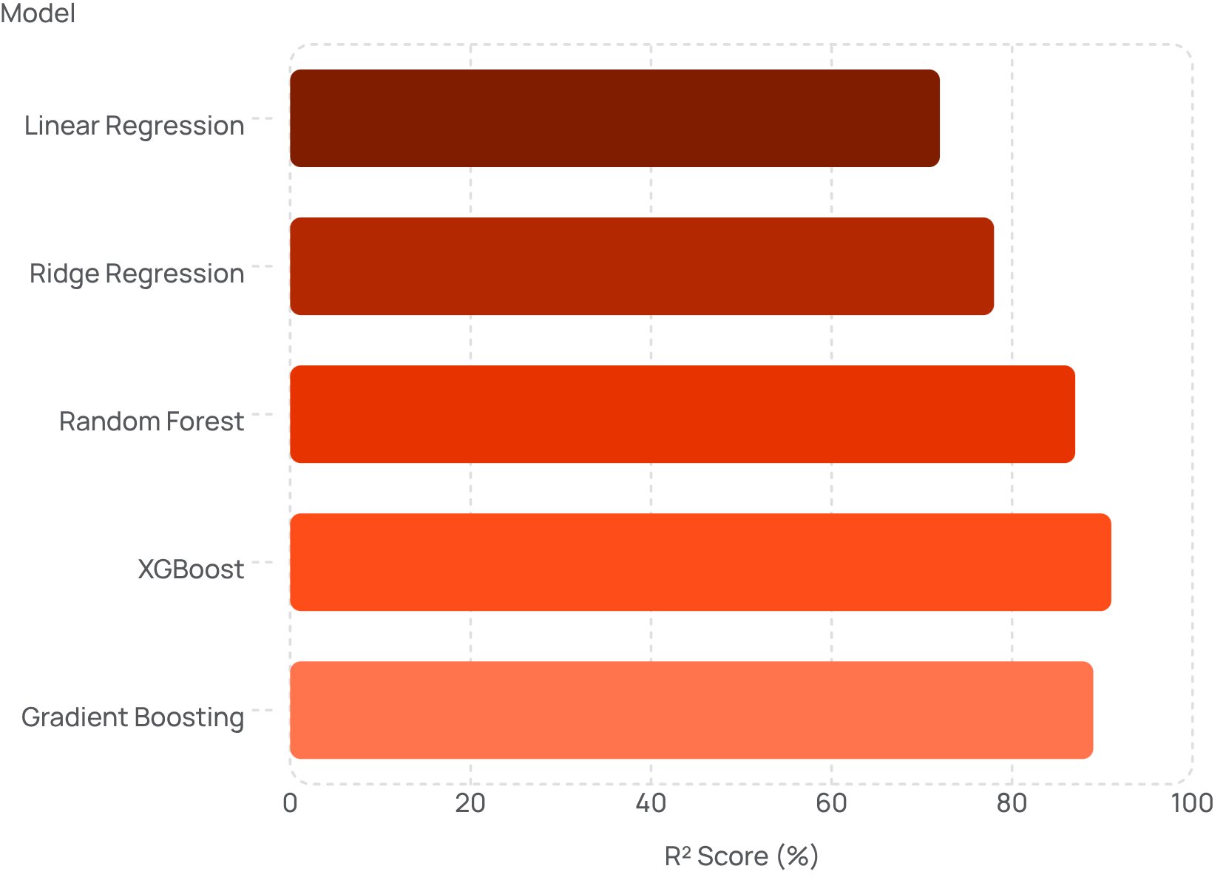

Regression Models & Performance Metrics
Evaluation Metrics
Model performance is measured across four key indicators to ensure prediction reliability:
XGBoost consistently outperforms other models, achieving the highest R² score on test data.
MAE
RMSE
R² Score
Mean Absolute Error — average prediction deviation
Root Mean Squared Error — penalizes large errors
Variance explained — model fit quality

Slide 8
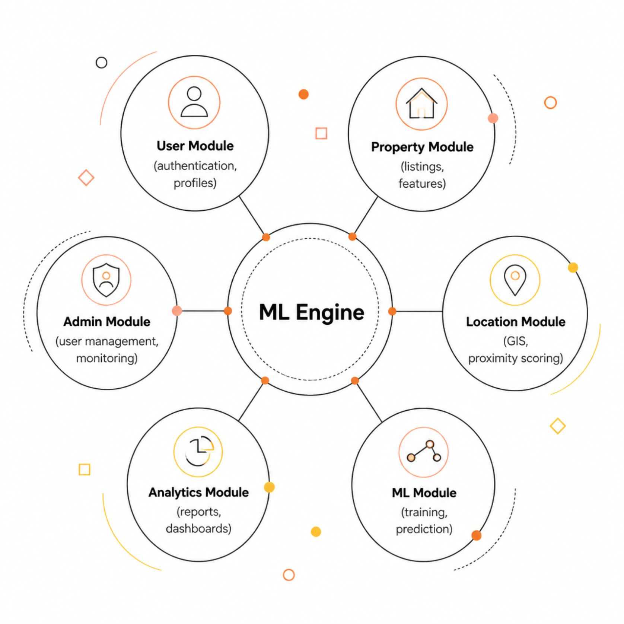
System Architecture & Data Flow
Three-Tier Architecture
Presentation Layer: React.js web interface with responsive dashboards for all user roles.
Application Layer: Python Flask/FastAPI backend hosting ML models, business logic, and REST APIs.
Data Layer: PostgreSQL for structured data, Redis for caching, and GeoServer for spatial queries.
DFD Level 0
DFD Level 1
User → System → Prediction Output
Input validation → Feature extraction → Model inference → Report generation

Slide 9

Technology Stack & Security
Core Technologies
Security Features
JWT-based authentication with role-based access control
End-to-end TLS encryption for data in transit
Input validation and SQL injection prevention
Audit logging for all administrative actions
Backend
Frontend
Database
Cloud & DevOps
Python, Flask/FastAPI, Scikit-learn, XGBoost, Pandas
React.js, Chart.js, Leaflet.js (maps)
PostgreSQL, PostGIS, Redis
AWS/GCP, Docker, CI/CD Pipelines

Slide 10


Advantages, Applications & Future Roadmap
Key Advantages
Applications
Reduced dependence on manual appraisals
Improved pricing accuracy and transparency
Scalable across cities and property types
Real-time market trend visibility
Residential property portals
Bank mortgage and loan assessment
Government land valuation systems
Real estate investment analysis
Future Enhancements
Deep learning with CNN for image-based features
Real-time API integration with listing platforms
Mobile application with AR property view
Predictive analytics for investment forecasting
Expected Outcome: A production-ready, ML-powered valuation system that empowers stakeholders with accurate, transparent, and actionable property price insights — transforming how real estate decisions are made.

