Slide 1
Data Modelling - Group Project (Grocery Bills)
Executive
Group - 1

Slide 2
Agenda
Introduction
Dimensional Model
Classification Model
Text Model
Time Series Model
Apriori Diagram
Regression and Clustering Model
Conclusion

Slide 3
Introduction
In our dataset we have information about sales of grocery products. Such as product name, product sale date, product transection number and product prices.
In our dataset there are around 800 transactions of 50 individual products.
Our aim is to use the appropriate model to optimize the given data for Upselling.

Slide 4
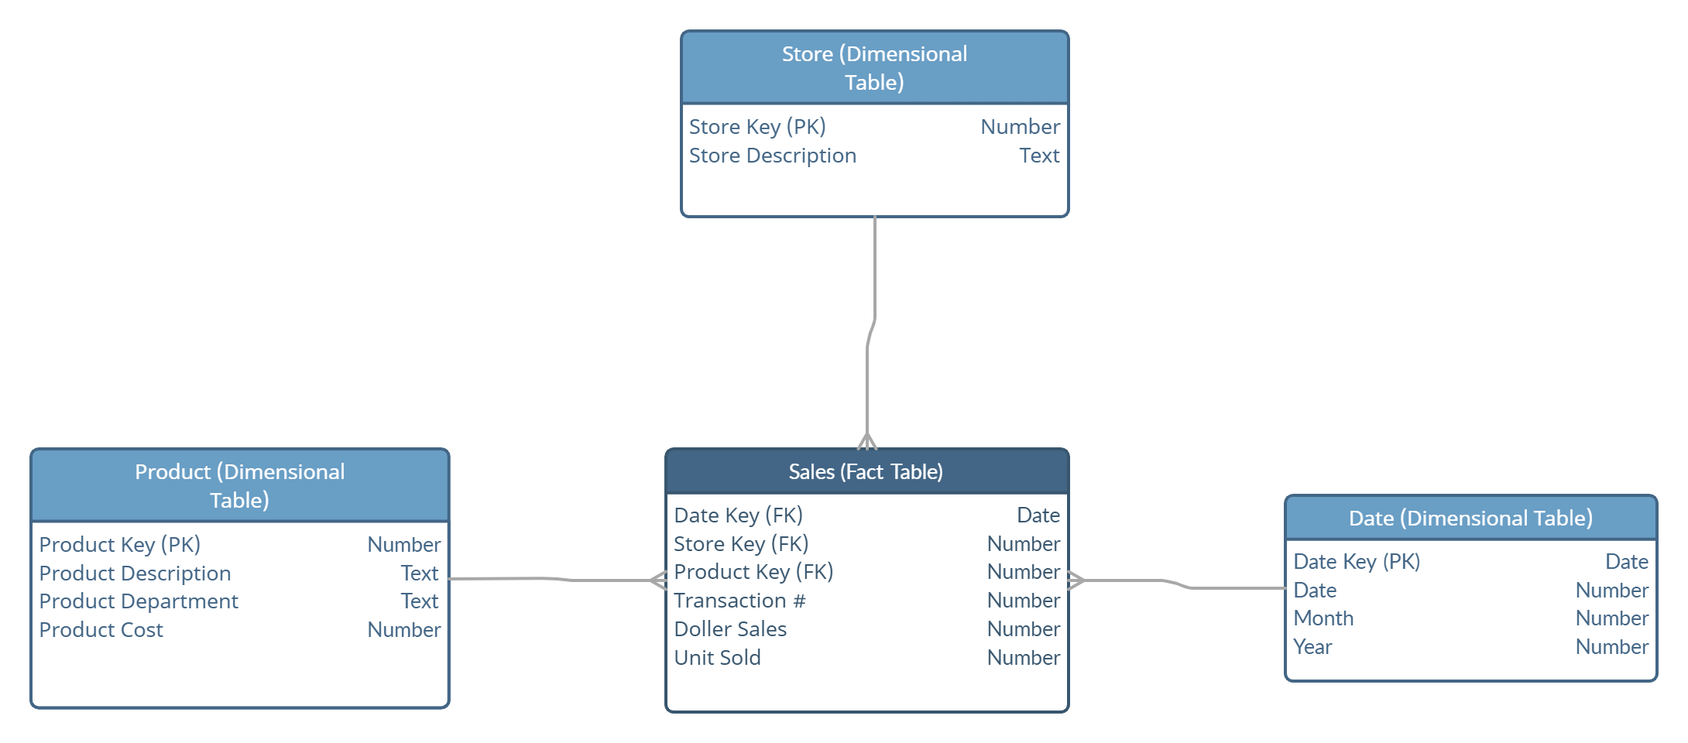
Dimensional Model – Star Schema

Slide 5
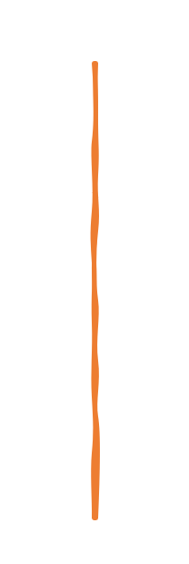
Product Key | Product Description | Product Department | Product Cost
1 | Oil - Sesame | Cooking Ingredients | $ 5.99
2 | Juice - Orangina | Beverages | $ 3.49
3 | Rhubarb | Fruits | $ 2.99
4 | Vinegar - Red Wine | Cooking Ingredients | $ 4.79
5 | Juice - Mango | Beverages | $ 2.89
6 | Tart - Butter Plain Squares | Snacks | $ 6.99
Date Table has around 430 records. This table has following attributes:
Date Key: unique primary key of a date
Day: day of the date
Month: month of the date
Year: year of the date
Product Table has 50 unique products with 17 different department. This table has following attributes:
Product Key: unique primary key of a product
Product Description: product name
Product Department: Category of the product
Product Cost: Price of a single unit product
Date Key | Day | Month | Year
2022-09-01 | 01 | 09 | 2022
2022-09-02 | 02 | 09 | 2022
2022-09-03 | 03 | 09 | 2022
2022-09-04 | 04 | 09 | 2022
2022-09-05 | 05 | 09 | 2022
2022-09-06 | 06 | 09 | 2022

Slide 6
Store Key | Store Description
1 | Loblaws
2 | Sobeys
3 | Walmart
4 | Freshco
5 | Costco
6 | Zehrs
7 | Food Basics
8 | No Frills
9 | Metro
10 | Farm Boy
Sales Table has 800 records. This table has following attributes:
Date Key: Foreign key of a date table
Store Key: Foreign key of a store table
Product Key: Foreign key of a product table
Transaction # : Transaction number of the sales.
Dollar Sales: Total cost for every product per transaction
Units Sold: Number of unit sold.
Store Table has 10 unique store records. This table has following attributes.
Store Key: unique primary key of a store
Store Description: Store name
Date Key | Store Key | Product Key | Transaction # | Dollar Sales | Units Sold
9/1/2021 | 6 | 35 | T101 | 2.49 | 1
9/3/2021 | 2 | 47 | T102 | 2.19 | 1
9/3/2021 | 1 | 13 | T103 | 9.98 | 2
9/6/2021 | 4 | 50 | T104 | 32.97 | 3

Slide 7
Classification Model- Decision tree
From this decision tree, we can conclude that majority of the individual purchase citrus fruit juice with No Preservative added.
Juice
22
60
Immunity Booster Juice
Fruit Juice
40
20
Citrus
Sweet
15
25
5
15
With Preservative
No Preservative
With Preservative
No Preservative

Slide 8
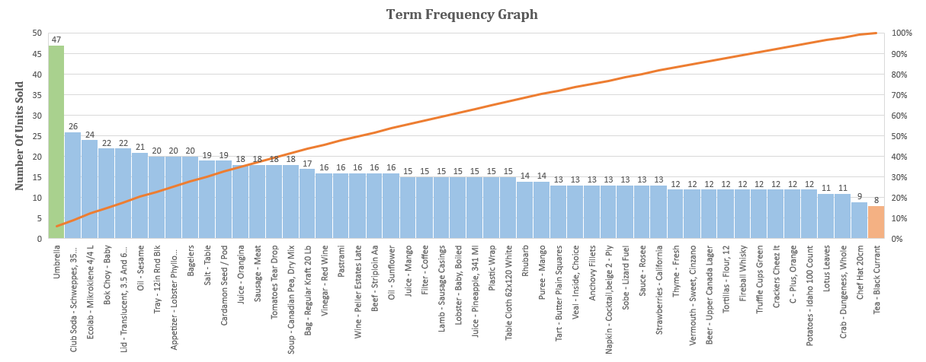
Text Model-Term frequency Graph
From this pareto chart, we can infer that Umbrella is the most frequent selling product, while Tea – Black Current is least selling product .

Slide 9
Time Series - Seasonal
From this Time Series chart, we can observe that sales of Umbrella is on peak in the month of April, May, June for both year 2022 and 2023. Therefore, we can conclude that the purchase pattern of Umbrella repeats every year for these months.

Slide 10
Apriori Diagram
From this Apriori Diagram, we can patently see that Whiskey, Club Soda and Crackers are frequently bought together.
0
Transaction Id | Products
T541 | Fireball Whiskey, Club Soda
T548 | Fireball Whiskey, Club Soda, Filter Coffee, Tomatoes, Thyme
T551 | Fireball Whiskey, Crackers, Thyme
T563 | Fireball Whiskey, Club Soda, Beer, Bok Choy
T577 | Club Soda, Crackers, Beer
T592 | Fireball Whiskey, Crackers, Thyme, Vinegar
T598 | Fireball Whiskey, Club Soda, Beef, Mango Juice
T630 | Fireball Whiskey, Crackers, Vermouth, Bok Choy, Wine
T681 | Fireball Whiskey, Club Soda, Napkin
T740 | Fireball Whiskey, Crackers
T765 | Fireball Whiskey, Crackers
T766 | Fireball Whiskey, Club Soda, Crackers, Beer
T787 | Club Soda, Crackers, Vinegar, Tart, Rhubarb
T814 | Fireball Whiskey, Club Soda, Crackers
T821 | Fireball Whiskey, Club Soda, Crackers, Strawberries
T860 | Club Soda, Crackers, Sausage, Pineapple Juice
Fireball Whiskey
Crackers
Club Soda
Whiskey, Crackers
Whiskey, Club Soda
Club Soda, Crackers
Whiskey, Club Soda, Crackers

Slide 11
Regression and Clustering Model
From this Scatter Plot, we can observe clusters of product purchased in each store.

Slide 12

Conclusion
To sum it up, most people prefer citrus fruit juice without preservatives.
Looking at the Pareto chart, we see that umbrellas sell the most, while Tea – Black Current sells less.
The Time Series chart shows that umbrellas sell a lot in April, May, and June every year.
The Apriori Diagram indicates that people often buy Whiskey, Club Soda, and Crackers together.
The Scatter Plot helps us see clear groups of products bought in each store, giving us insights into shopping habits.

Slide 13
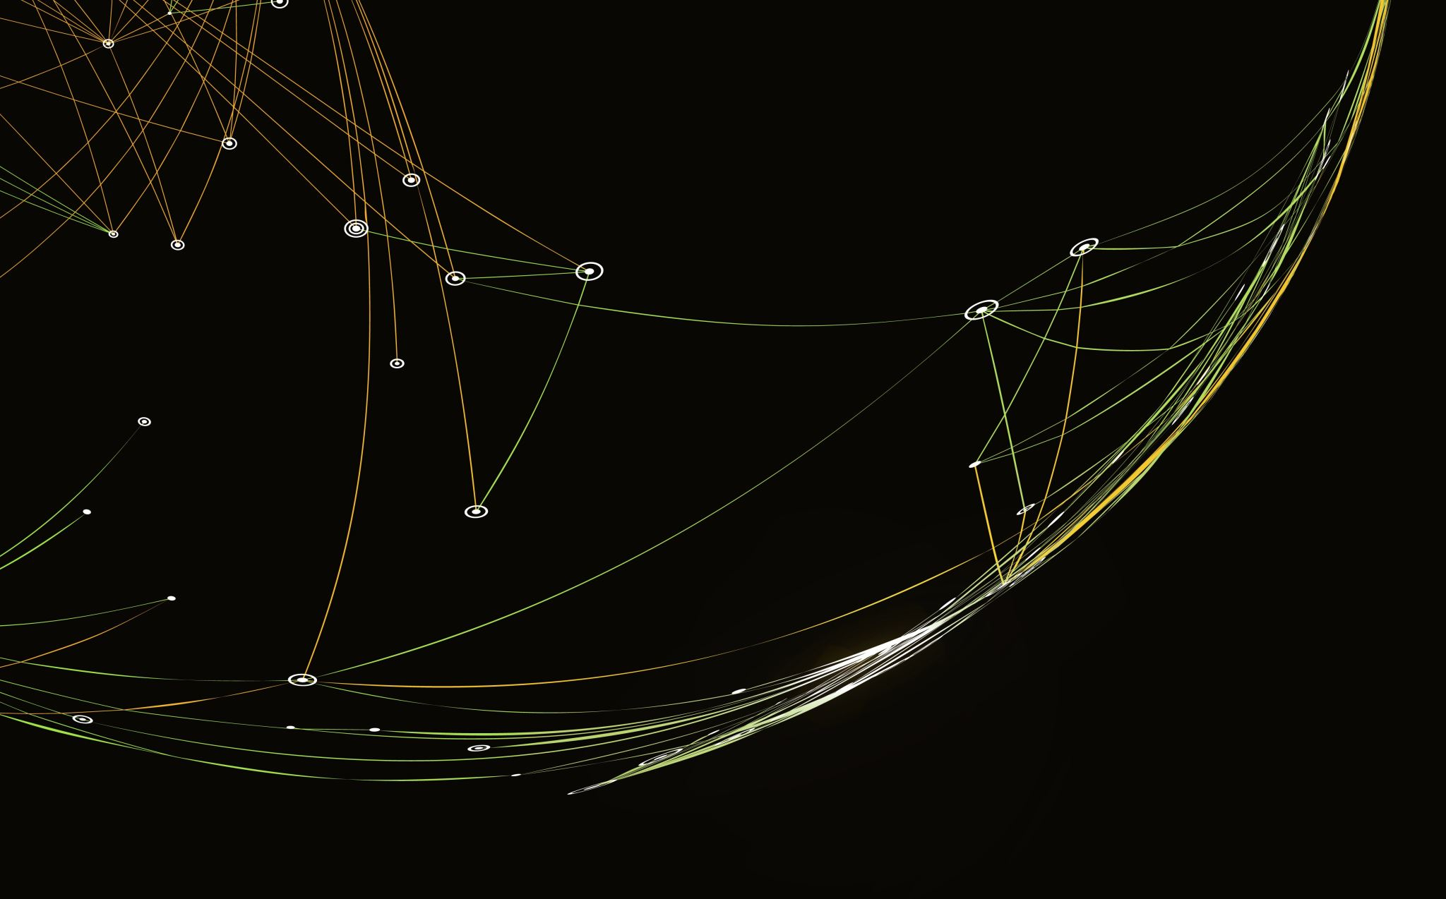
Thank You !

