Slide 1
Data Modelling - Group Project (Grocery Bills)
Non-Executive
Group - 1

Slide 2
Agenda
Introduction
Dimensional Model
Classification Model
Text Model
Time Series Model
Apriori Diagram
Regression and Clustering Model
Learnings

Slide 3
Introduction
In our dataset we have information about sales of grocery products. Such as product name, product sale date, product transection number and product prices.
In our dataset there are around 800 transactions of 50 individual products.
Our aim is to use the appropriate model to optimize the given data for Upselling.

Slide 4
Dimensional Model
Dimensional modeling is a data-structure design technique. It involves developing a model that is optimized for querying and analyzing data for business intelligence.
Dimensional models give a clear and intuitive structure for research and reporting by organizing data into dimensions and facts.
It comprise of below elements:
Facts: Facts are measurements/metrics or facts from your business process.
Dimensions: Dimension gives information about the context of a business process event.

Slide 5
Nine Steps Design Methodology
Choose the Process.
Choose the Grain.
Identify and conform the Dimensions.
Choose the Facts.
Store Precalculations in the Fact table.
Round out the Dimension tables.
Choose the Duration of the database.
Determine the need to track Slowly Changing Dimensions.
Decide the Physical Design.

Slide 6
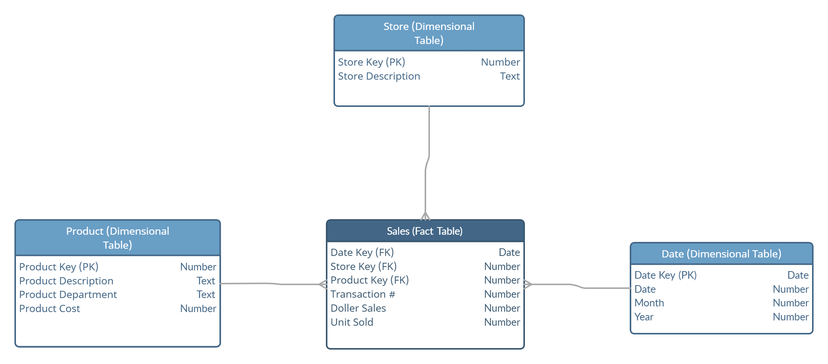
Dimensional Model – Star Schema

Slide 7

Product Key | Product Description | Product Department | Product Cost
1 | Oil - Sesame | Cooking Ingredients | $ 5.99
2 | Juice - Orangina | Beverages | $ 3.49
3 | Rhubarb | Fruits | $ 2.99
4 | Vinegar - Red Wine | Cooking Ingredients | $ 4.79
5 | Juice - Mango | Beverages | $ 2.89
6 | Tart - Butter Plain Squares | Snacks | $ 6.99
Date Table has around 430 records. This table has following attributes:
Date Key: unique primary key of a date
Day: day of the date
Month: month of the date
Year: year of the date
Product Table has 50 unique products with 17 different department. This table has following attributes:
Product Key: unique primary key of a product
Product Description: product name
Product Department: Category of the product
Product Cost: Price of a single unit product
Date Key | Day | Month | Year
2022-09-01 | 01 | 09 | 2022
2022-09-02 | 02 | 09 | 2022
2022-09-03 | 03 | 09 | 2022
2022-09-04 | 04 | 09 | 2022
2022-09-05 | 05 | 09 | 2022
2022-09-06 | 06 | 09 | 2022

Slide 8
Store Key | Store Description
1 | Loblaws
2 | Sobeys
3 | Walmart
4 | Freshco
5 | Costco
6 | Zehrs
7 | Food Basics
8 | No Frills
9 | Metro
10 | Farm Boy
Sales Table has 800 records. This table has following attributes:
Date Key: Foreign key of a date table
Store Key: Foreign key of a store table
Product Key: Foreign key of a product table
Transaction # : Transaction number of the sales.
Dollar Sales: Total cost for every product per transaction
Units Sold: Number of unit sold.
Store Table has 10 unique store records. This table has following attributes.
Store Key: unique primary key of a store
Store Description: Store name
Date Key | Store Key | Product Key | Transaction # | Dollar Sales | Units Sold
9/1/2021 | 6 | 35 | T101 | 2.49 | 1
9/3/2021 | 2 | 47 | T102 | 2.19 | 1
9/3/2021 | 1 | 13 | T103 | 9.98 | 2
9/6/2021 | 4 | 50 | T104 | 32.97 | 3

Slide 9
Classification Model
Classification analysis helps us identify relationships between different variables so that we can make better predictions and decisions
Decision tree builds classification or regression models in the form of a tree structure.
Decision trees can handle both categorical and numerical data.

Slide 10
Decision tree
From this decision tree, we can conclude that majority of the individual purchase citrus fruit juice with No Preservative added.
Juice
22
60
Immunity Booster Juice
Fruit Juice
40
20
Citrus
Sweet
15
25
5
15
With Preservative
No Preservative
With Preservative
No Preservative

Slide 11
Text Model
Text Modeling: Representing and analyzing textual information within a data model.
Importance:
Enhanced Insights: Unlocks valuable insights from unstructured text data.
Holistic Understanding: Integrates textual context with structured data for a comprehensive view.

Slide 12
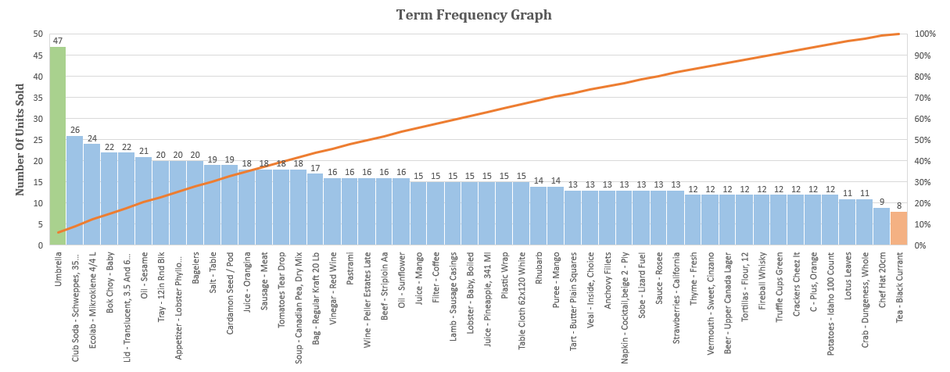
Term frequency Graph
From this pareto chart, we can infer that Umbrella is the most frequent selling product, while Tea – Black Current is least selling product .

Slide 13
Time Series Model
Time series modeling deals with time dependent data.
Elements : Secular trend, Seasonal variations, Cyclical fluctuations and Irregular variations
Goal : Identifying Patterns in Time Series Data to predicting future values of the time series variable based on historical data
Application : Sales forecast, Yield Estimation, Inventory study, Workload estimation, weather forecasting.

Slide 14
Time Series - Seasonal
From this Time Series chart, we can observe that sales of Umbrella is on peak in the month of April, May, June for both year 2022 and 2023. Therefore, we can conclude that the purchase pattern of Umbrella repeats every year for these months.

Slide 15
Apriori Model
The Apriori algorithm is employed to uncover frequent itemsets within a dataset and derive association rules among items based on their co-occurrence frequency.
Through the application of the Apriori algorithm, we examine patterns in customer shopping behavior, specifically identifying items that are commonly bought together.

Slide 16
Apriori Diagram
From this Apriori Diagram, we can patently see that Whiskey, Club Soda and Crackers are frequently bought together.
0
Transaction Id | Products
T541 | Fireball Whiskey, Club Soda
T548 | Fireball Whiskey, Club Soda, Filter Coffee, Tomatoes, Thyme
T551 | Fireball Whiskey, Crackers, Thyme
T563 | Fireball Whiskey, Club Soda, Beer, Bok Choy
T577 | Club Soda, Crackers, Beer
T592 | Fireball Whiskey, Crackers, Thyme, Vinegar
T598 | Fireball Whiskey, Club Soda, Beef, Mango Juice
T630 | Fireball Whiskey, Crackers, Vermouth, Bok Choy, Wine
T681 | Fireball Whiskey, Club Soda, Napkin
T740 | Fireball Whiskey, Crackers
T765 | Fireball Whiskey, Crackers
T766 | Fireball Whiskey, Club Soda, Crackers, Beer
T787 | Club Soda, Crackers, Vinegar, Tart, Rhubarb
T814 | Fireball Whiskey, Club Soda, Crackers
T821 | Fireball Whiskey, Club Soda, Crackers, Strawberries
T860 | Club Soda, Crackers, Sausage, Pineapple Juice
Fireball Whiskey
Crackers
Club Soda
Whiskey, Crackers
Whiskey, Club Soda
Club Soda, Crackers
Whiskey, Club Soda, Crackers

Slide 17
Regression and Clustering Model
Regression models help us understand how changes in one thing are related to changes in another thing. It's like a prediction tool.
Using scatter plots, which are visual graphs, makes it easier to see patterns. For example, we can use this to figure out which store often sells which product.

Slide 18
Regression and Clustering Model
From this Scatter Plot, we can observe clusters of product purchased in each store.

Slide 19

Learnings
Understanding data modeling and normalization.
Exploring various types of data analysis models (classification, time series, text, association, regression, clustering).
Gaining practical experience in data preparation and feature engineering.
Developing skills in data visualization and interpretation.
Extracting meaningful insights from the analysis of grocery purchase data.

Slide 20
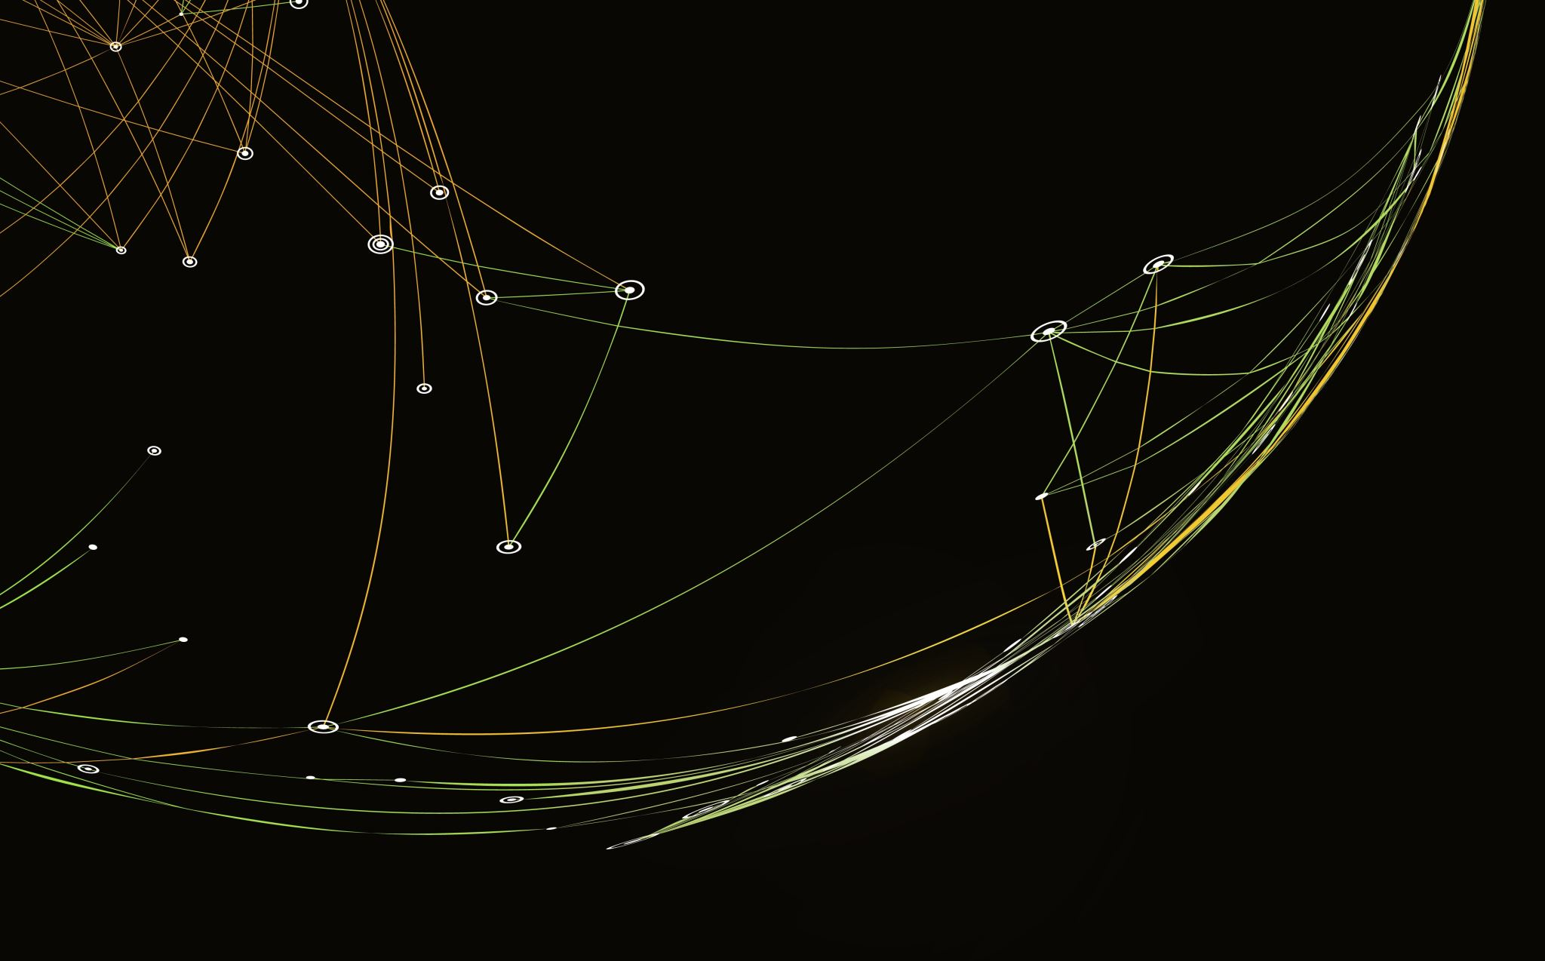
Thank You !

