Slide 1
Navigating the Future: Trend- Demand Forecasting for Strategic Insights

Slide 2

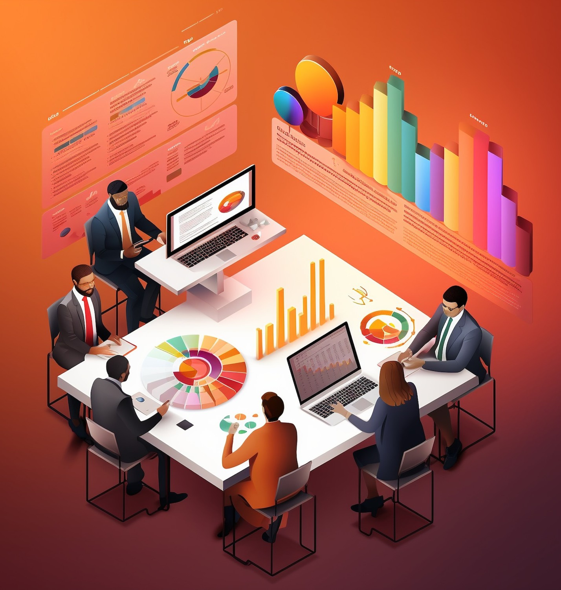

NAVIGATING THE FUTURE: TREND-DEMAND FORECASTING
Explore the power of
to uncover strategic insights and drive informed decision-making. Discover how
this analytical approach can help your organization stay ahead of the curve.

Slide 3
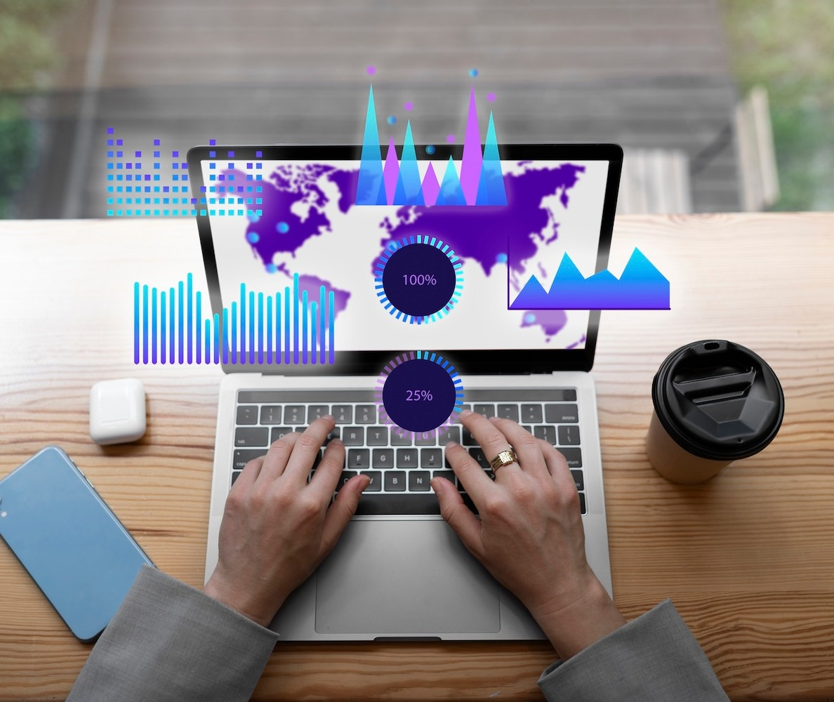

UNDERSTANDING MARKET TRENDS AND PATTERNS
Dive into the process of identifying and analyzing market trends. Learn how to leverage historical data, consumer behavior, and industry indicators to anticipate future demand and opportunities.

Slide 4

FORECASTING TECHNIQUES FOR STRATEGIC INSIGHTS
Explore a range of ,
including time-series analysis, regression modeling, and machine learning. Understand
how these methods can provide valuable foresight to guide your strategic planning.

Slide 5

INTEGRATING FORECASTING INTO DECISION-MAKING
Discover how to seamlessly integrate trend- demand forecasting into your organization's decision-making processes. Learn to align forecasts with business objectives and leverage insights to drive strategic initiatives.

Slide 6
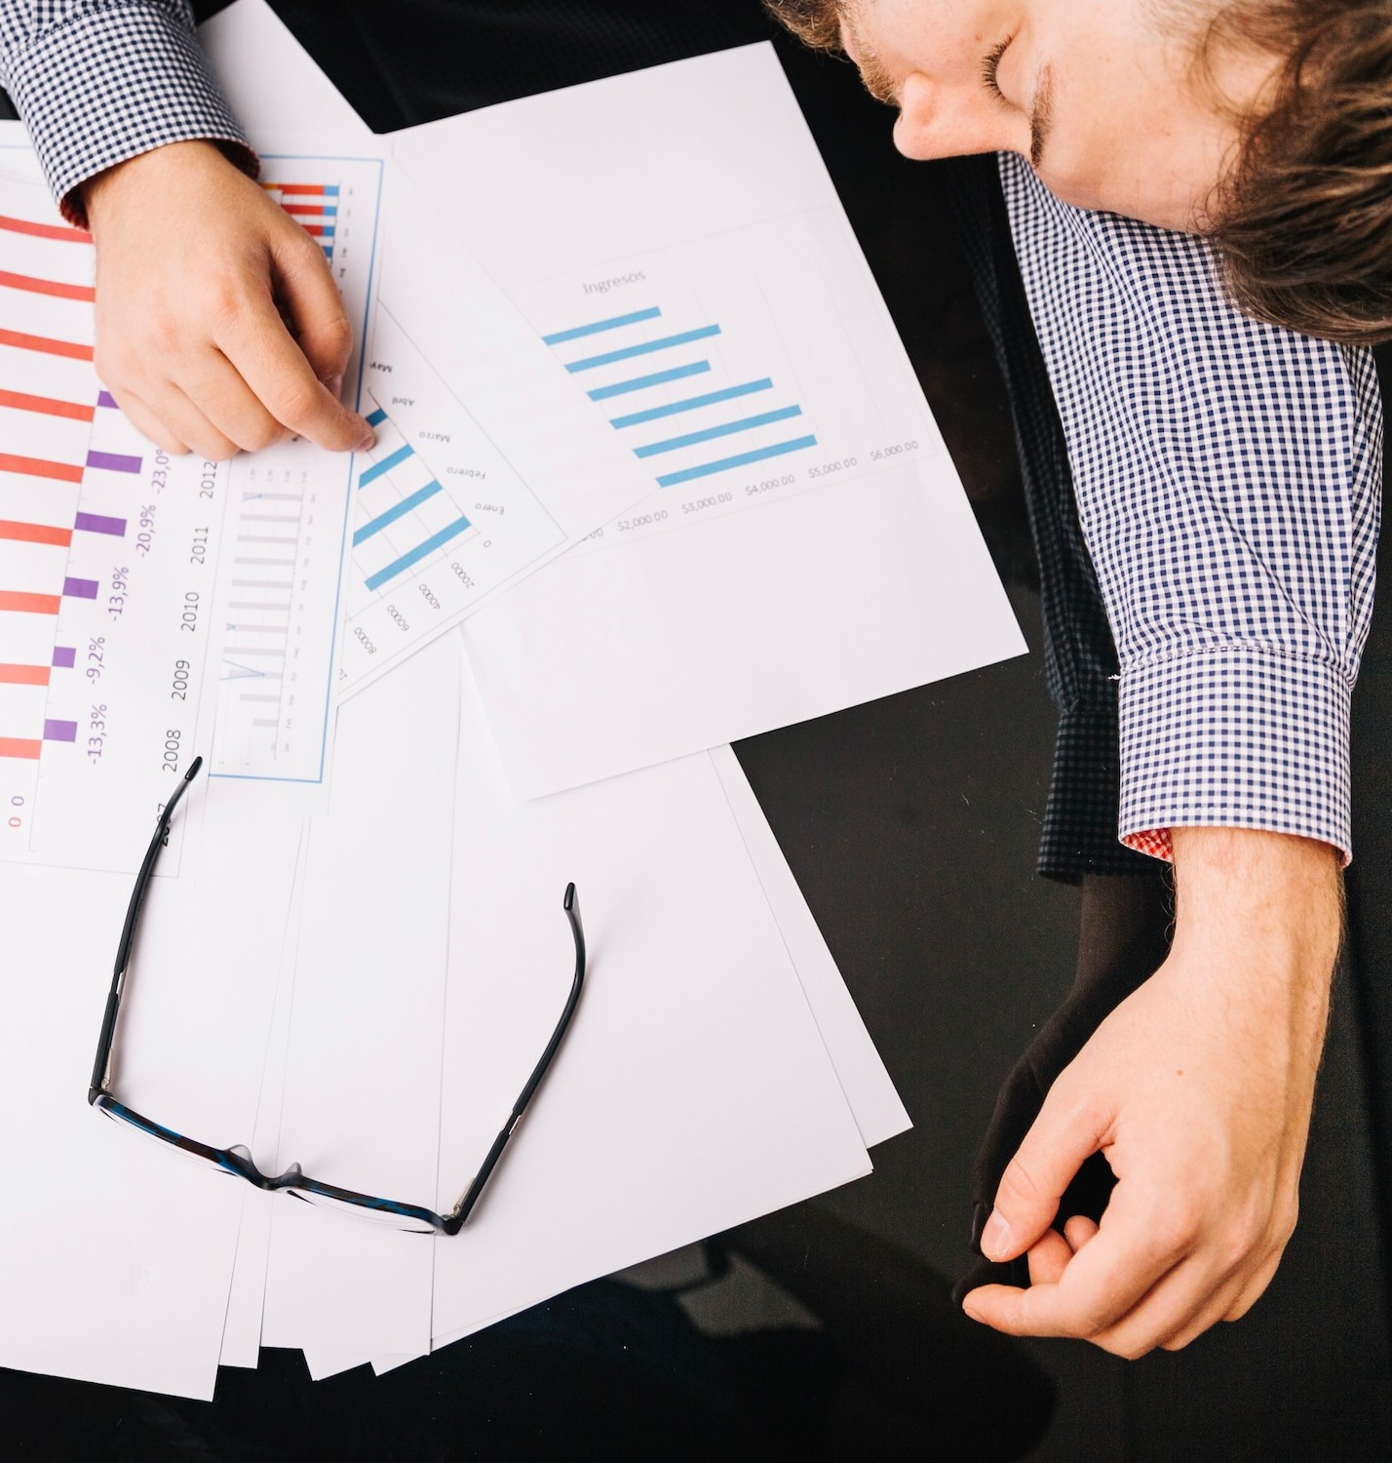
CASE STUDIES: SUCCESSFUL TREND-DEMAND FORECASTING
Examine real-world case studies that showcase the transformative impact of trend-demand forecasting. Gain insights into how leading organizations have leveraged these techniques to gain a competitive edge.

Slide 7
NAVIGATING THE FUTURE WITH CONFIDENCE
Conclude your journey by understanding how trend-demand forecasting can empower your organization to navigate the future with confidence. Embrace the power of data-driven insights to stay ahead of market shifts and drive sustainable growth.

Slide 8
Thanks!

