Slide 1
Navigating the Future: Trend- Demand Forecasting Strategies

Slide 2



Navigating the Future: Trend-Demand Forecasting
Explore the power of trend-demand forecasting to navigate the ever-evolving business landscape. Uncover strategies that leverage data-driven insights to anticipate market shifts and stay ahead of the curve.

Slide 3
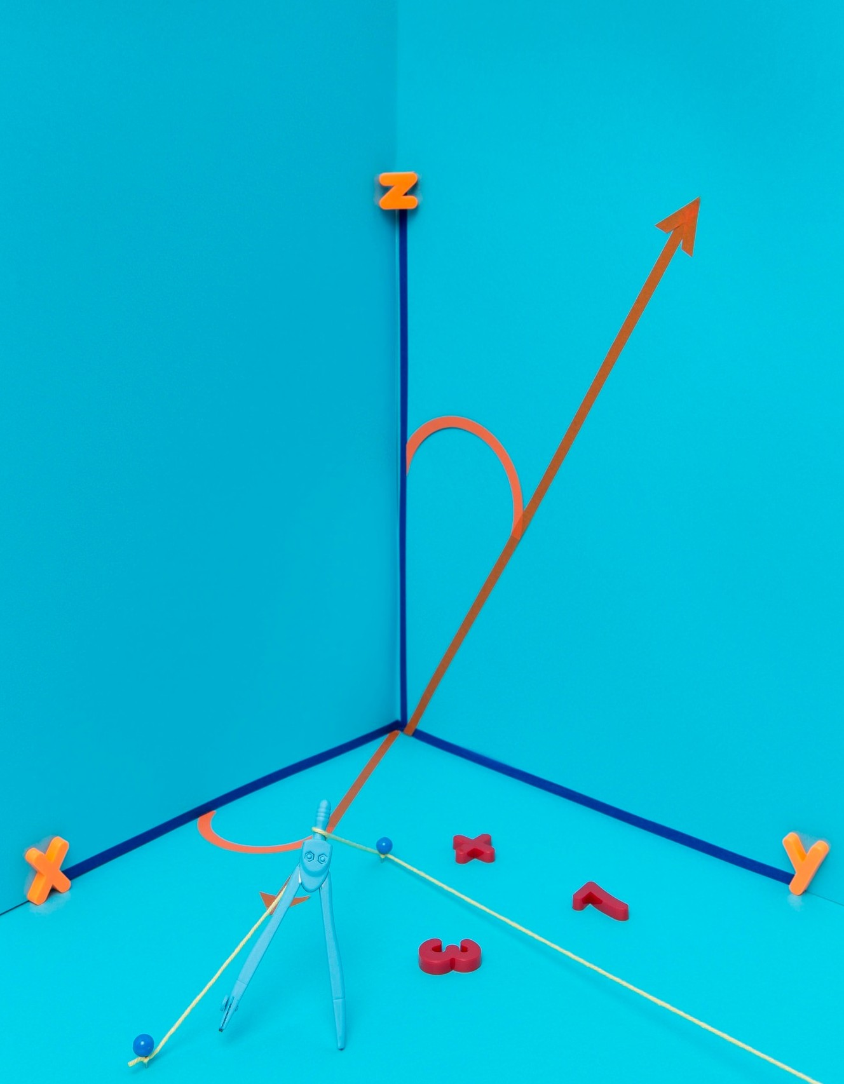
Understanding Demand Patterns
Delve into the intricate dynamics of consumer demand. Analyze historical data, identify key drivers, and develop sophisticated models to forecast future trends and optimize your business strategies.

Slide 4


Leveraging Advanced Analytics
Harness the power of data analytics to unlock the full potential of trend-demand forecasting. Leverage cutting-edge techniques, such as machine learning and predictive modeling, to uncover hidden insights and make informed decisions.

Slide 5


Explore strategies to adapt and respond to rapidly changing market conditions. Develop agile decision-making processes that enable your organization to pivot and seize emerging opportunities in a dynamic environment.

Slide 6
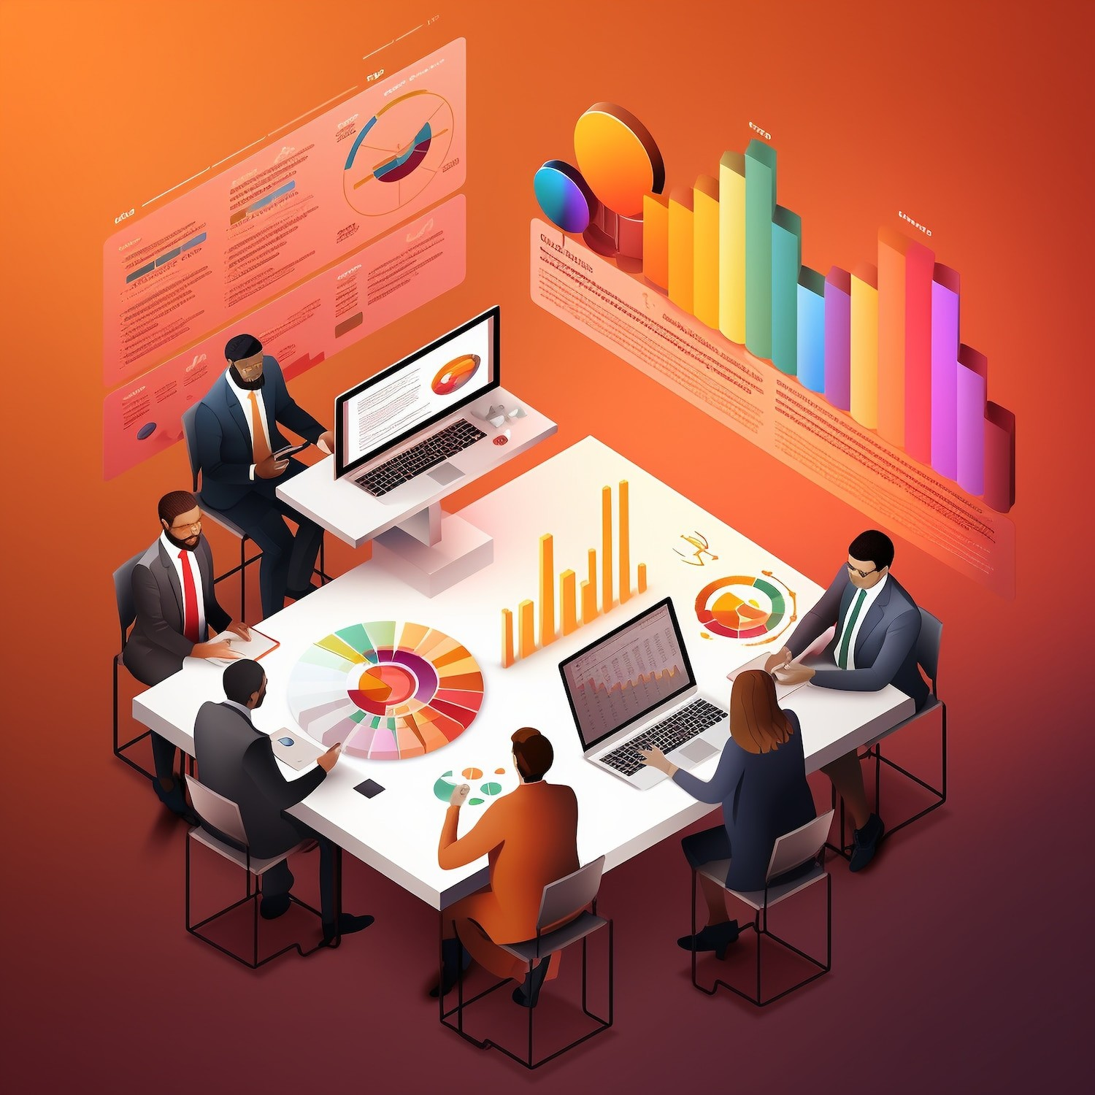

Collaborative Forecasting Approaches
Discover the beneﬁts of collaborative forecasting across your supply chain. Foster partnerships and information- sharing to enhance the accuracy and reliability of your trend-demand predictions.

Slide 7


The Future of Trend-Demand Forecasting
Envision the future of trend-demand forecasting and its transformative potential. Explore emerging technologies, such as IoT, AI, and predictive analytics, that will redeﬁne how businesses anticipate and respond to market trends.

Slide 8
Thanks!

