Slide 1
Introduction
The SDLC is a process used by developers to create secure and high-quality software.
The number of stages may vary, but the general consensus includes seven basic stages.

Slide 2
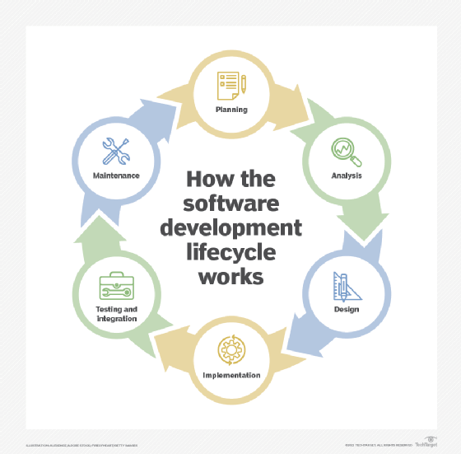

Slide 3
Stage 1 - Planning
Develop a basic plan based on business requirements.
Set goals for application features and align them with business priorities.
Identify unrealistic goals early.
Effective communication between developers and stakeholders is crucial.

Slide 4
Stage 2 - Analysis
Translate high-level plans into actionable ideas.
Perform technical analysis of plans.
Decide on architecture, programming languages, and tools.
End goal: A clear technical plan for development.

Slide 5
Stage 3 - Design
Focus on how the application behaves and looks from a user perspective.
Sketch UI elements and determine user roles.
Based on technical specifications from the analysis stage.
Ensures clear understanding of user interaction with the app.

Slide 6
Stage 4 - Implementation
Also known as the development or coding stage.
Writing actual code using defined tools and methodologies.
CI/CD processes ensure smooth code integration.
Establish coding standards for consistency and maintainability.

Slide 7
Stage 5 - Testing
Assess application performance, load, security, and usability.
Design tests aligned with project goals.
Use automation tools (e.g., Selenium, Cucumber) for efficient testing.
Address and fix issues before deployment.

Slide 8
Stage 6 - Deployment
• Move the application to a production environment.
• SaaS: Hosted in a production environment.
• Local applications: Packaged and distributed.
• Risk mitigation strategies: Blue/green deployment, canary releases, containerization.

Slide 9
Stage 7 - Maintenance
•Continuous monitoring for issues in production.
Collect user feedback for future updates.
Iterative SDLC process ensures improvements over time.
Maintenance continues until the application is replaced or retired.

Slide 10
Conclusion
The SDLC provides a structured approach to software development.
Ensures secure, high-quality, and efficient software.
Iterative updates improve functionality and user experience over time.

Slide 11
Thank You
ANY QUESTIONS

