Slide 1
CSYE7105 High-Performance ASR System with Parallel GPU Computing
TEAM-19 MEMBERS
ARNAB CHAKRABORTY
RISHABH INDORIA

Slide 2
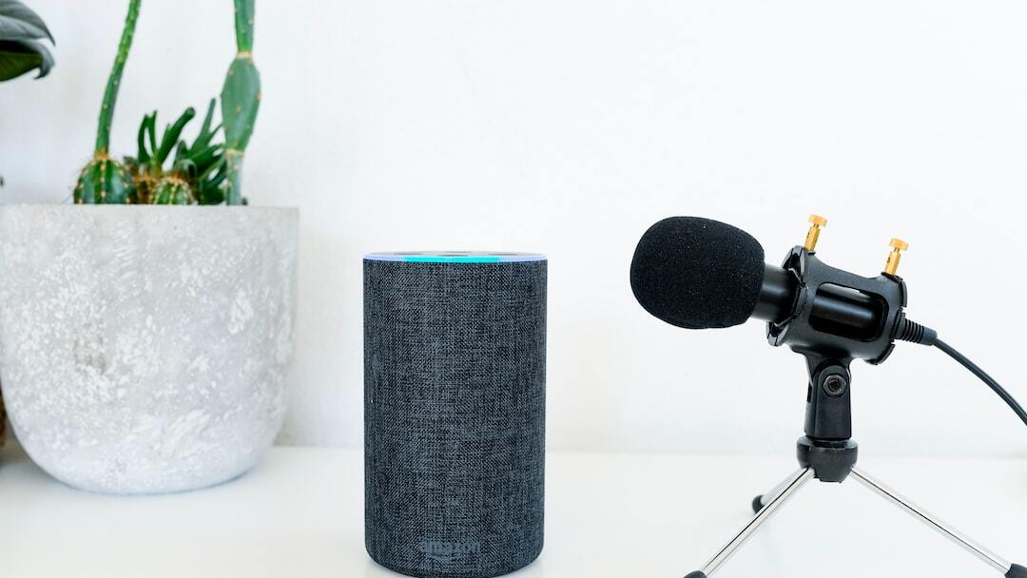
Introduction to ASR
Automatic Speech Recognition (ASR) allows computers to transcribe spoken language into text automatically.
Background & Motivation
With the emergency of LLMs, improving the quality of Call Transcripts will lead to utilization of several downstream tasks like
Summarization
Classification – Task, Sentiment
Question Answering
Pattern Mining – Intent, Issue
Conversational AI
Need for Parallelization
Faster processing
Accelerated Training and Inferences
Memory Management
Notes:
Introduction
Welcome, everyone. Today, I am thrilled to showcase the results of our groundbreaking research at Northeastern University, where our team has been focused on enhancing Automatic Speech Recognition (ASR) systems through the innovative application of parallel GPU computing. This project represents a significant leap forward, pushing the boundaries of speed and accuracy in the machine interpretation of human speech.
The Significance of ASR Systems
ASR systems are crucial in the ongoing transformation of human-computer interaction. They facilitate seamless communication with technology, from simple voice commands in smartphones to complex interactions with AI assistants. These systems are becoming indispensable across various sectors including healthcare, automotive, customer service, and accessibility technologies, making them integral to technological advancement. As reliance on ASR systems grows, so does the need for highly accurate and reliable systems that can function effectively across diverse environments and scenarios.
Background and Motivation
Our project was motivated by the evident limitations in current ASR systems, which often struggle with real-world speech variations such as accents, dialects, and background noise. These limitations can severely impact user experience and hinder the global scalability of ASR technology. Advanced neural network architectures, particularly transformer models like OpenAI’s Whisper and Facebook's Wav2Vec2, have proven to significantly enhance ASR capabilities, offering new ways to address these challenges. These models are at the forefront of speech recognition technology, providing a foundation for developing systems that can understand and process complex speech patterns more effectively.

Slide 3
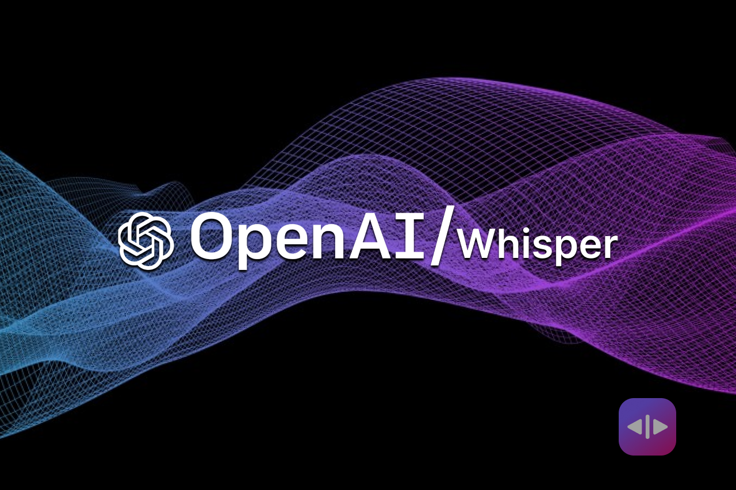
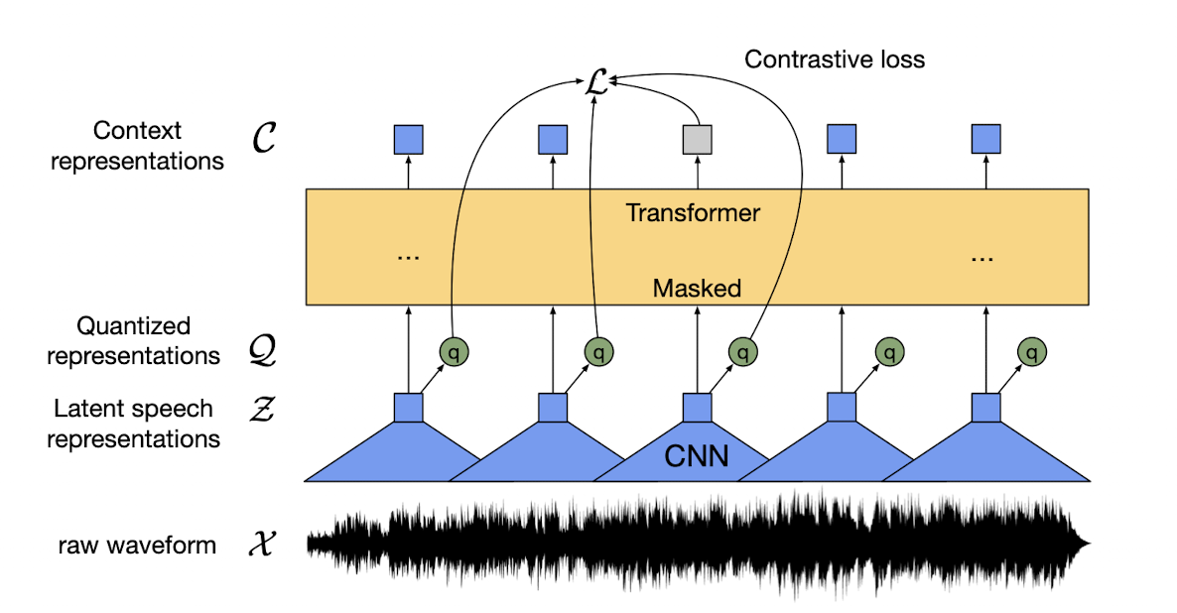
Methodology
Procuring Compute Instance
Data Pre-processing
CPU Multi-Processing using Joblib
GPU Multi-Processing using Torch DDP and Joblib
Fine-Tuning Model using Torch DDP
Whisper by OpenAI
Wav2Vec2 by Facebook
Notes:
Project Goals and Methodological Approach
Project Goals: Our project aimed to revolutionize ASR technology by achieving unprecedented levels of accuracy and speed in speech recognition, particularly across the challenging LibriSpeech dataset which features a wide variety of speech samples including different accents, dialects, and recording qualities.
Methodological Approach:
Data Handling and Preprocessing: We conducted extensive work on data preparation and normalization to ensure consistency across training and validation datasets. Our advanced audio processing techniques standardized volume, pitch, and duration of speech samples to optimize input quality for training.

Slide 4
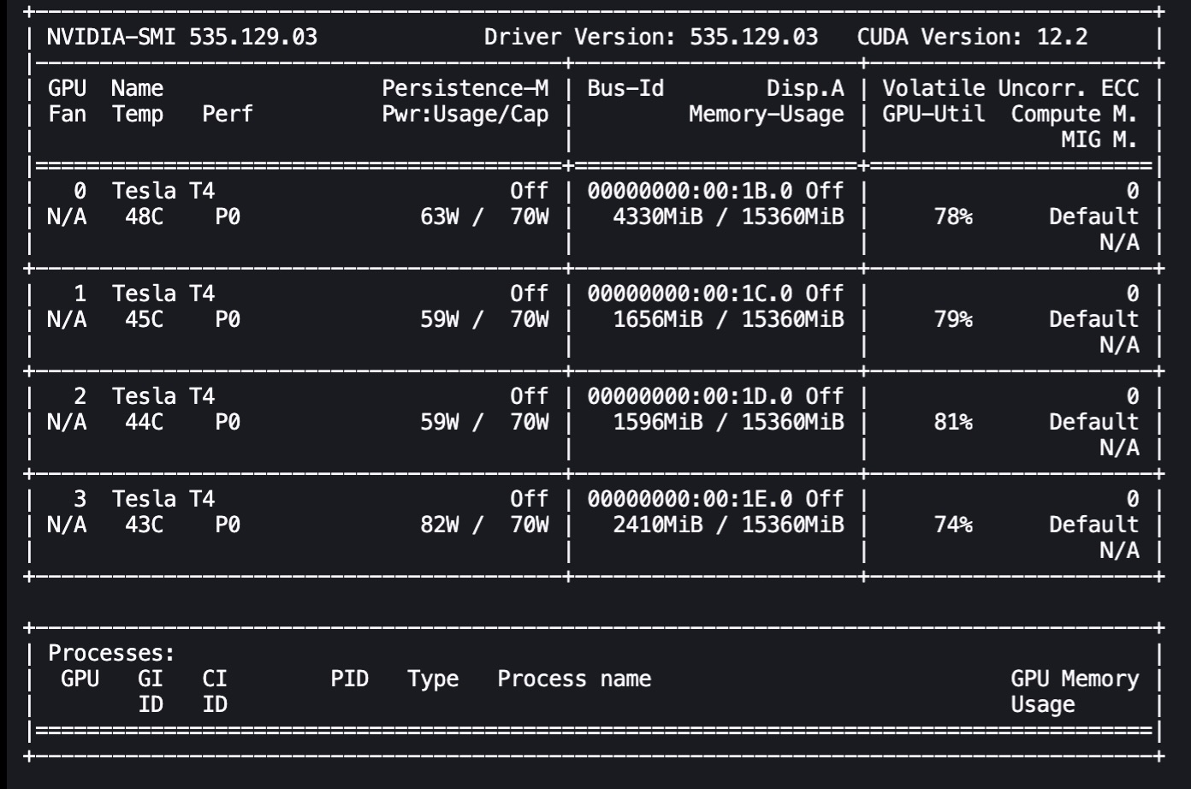
Instance Configurations
Instance Used: ml.g4dn.12xlarge
Configurations:
Instance Family: G4 instances
GPU: NVIDIA T4 Tensor Core GPU
vCPU: 48
Memory (GiB): 192
Storage: EBS only
Network Performance: Up to 25 Gbps
Processor Architecture: 64-bit
Operating System: Linux

Slide 5
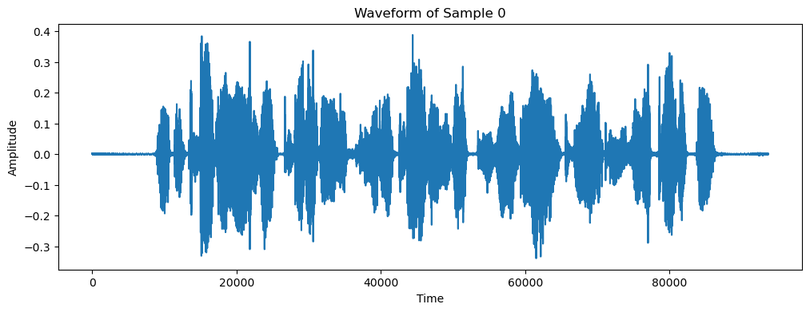
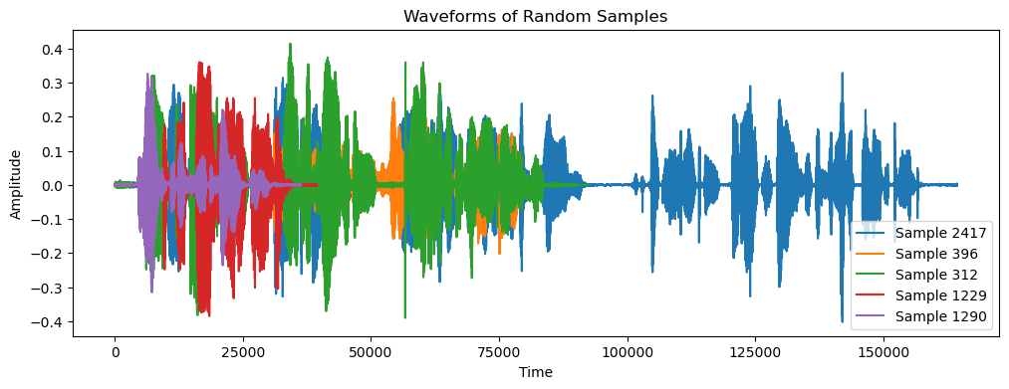
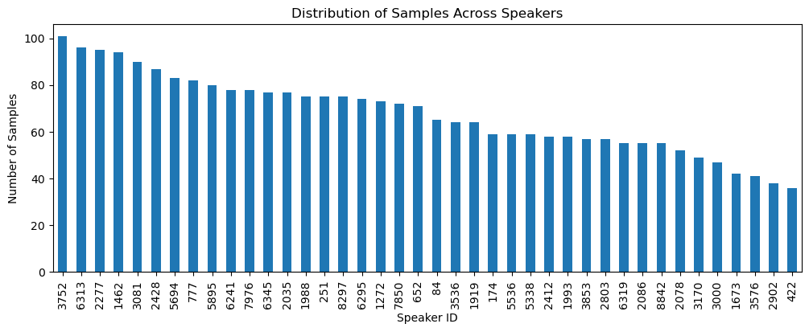
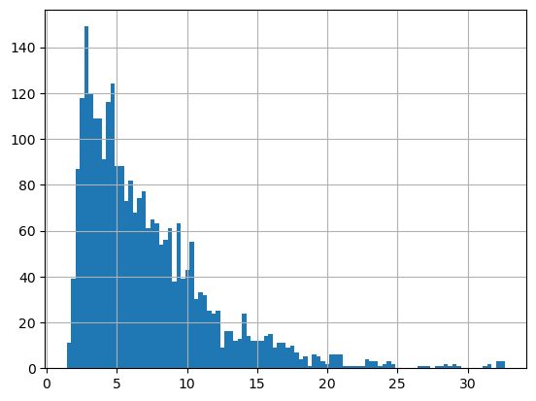
EDA
Notebook: Whisper_Wav2Vec2_Joblib
Dataset: LibriSpeech, Partition: dev clean
Observation: We have multiple speakers with all of them having at least 35 samples
Observation: Most of our data is under 5 seconds,
and as we will process them in batches

Slide 6
Approach: Running Whisper
CPU Implementation
Employ Whisper-tiny model multiple CPUs using Joblib
GPU Implementation
Employ Whisper Base model and Wav2Vec2 Model on Multiple GPUs using Joblib
Employ Whisper tiny, base and small model on Multiple GPUs using Torch DDP
Fine-tune whisper tiny using Torch DDP
Whisper Model Configurations
Size | Parameters | Model | Required VRAM | Relative speed
tiny | 39 M | tiny | ~1 GB | ~32x
base | 74 M | base | ~1 GB | ~16x
small | 244 M | small | ~2 GB | ~6x
medium | 769 M | medium | ~5 GB | ~2x
large | 1550 M | large | ~10 GB | 1x

Slide 7
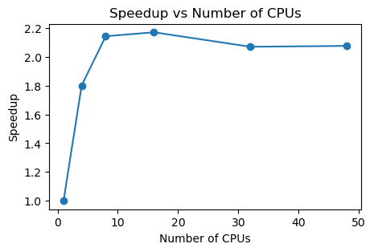
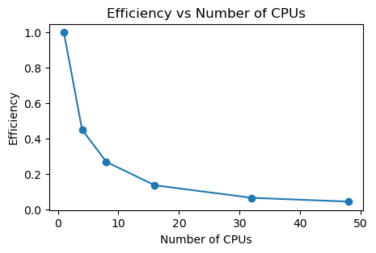
Whisper Inference on CPUs
Notebook: whisper-cpu.ipynb
CPU Implementation
Model: Whisper Tiny
By: OpenAI
No. of parameters: 35M
Batch size = 32
No. of CPUs | 1 | 4 | 8 | 16 | 32 | 48
Time (s) | 310 | 172 | 144 | 142 | 149 | 149
Speed Up | 1 | 1.8 | 2.15 | 2.17 | 2.07 | 2.08
Efficiency | 1 | 0.45 | 0.26 | 0.14 | 0.06 | 0.04

Slide 8
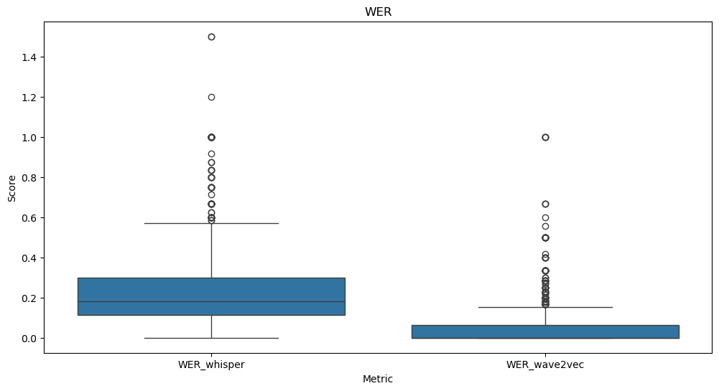
Whisper & Wav2Vec2 on GPU
GPU Implementation
Model 1: Whisper Base by OpenAI
No. of parameters: 70M
Model 2: Wav2Vec2 by Facebook
No. Of parameters: 90M
Split across 4 GPUs
Notebook: Whisper-Wav2vec2-joblib.ipynb
The Whisper model outperforms Wav2Vec2 in capturing transcript semantics despite a higher word error rate.
Wav2Vec2 has been trained on LibriSpeech data, while Whisper has not been exposed to it, showcasing Whisper's adaptability.
Normalizing transcripts can notably reduce the Word Error Rate by treating similar variations consistently, like "Mr" and "Mister."
Computation Time (s) | 1 GPU | 4 GPU | Speedup | Efficiency
Whisper | 249.12 | 70.53 | 3.5x | 88%
Wave2Vec2 | 43.90 | 18.05 | 2.4x | 60%
ORIGINAL TRANSCRIPTION​
WHISPER TRANSCRIPTION
WAVE2VEC2 TRANSCRIPTION
MISTER QUILTER IS THE APOSTLE OF THE MIDDLE CLASSES AND WE ARE GLAD TO WELCOME HIS GOSPEL​​
NOR IS MISTER QUILTER'S MANNER LESS INTERESTING ​​
THAN HIS MATTER​​
ON THE GENERAL PRINCIPLES OF ART MISTER QUILTER ​​
WRITES WITH EQUAL LUCIDITY​​
Mr. Quilter is the apostle of the middle classes, ​
and we are glad to welcome his gospel.​
Nor is Mr. Quilter's manner less interesting than his matter.​
On the general principles of art​
Mr. Krilter writes with equal lucidity​
MISTER QUILTER IS THE APOSTLE OF THE MIDDLE CLASSES AND WE ARE ​
GLAD TO WELCOME HIS GOSPEL​
NOR IS MISTER QUILTER'S MANNER LESS INTERESTING ​
THAN HIS MATTER​
ON THE GENERAL PRINCIPLES OF ART MISTER QUILTER ​
WRITES WITH EQUAL LUCIDITY​

Slide 9
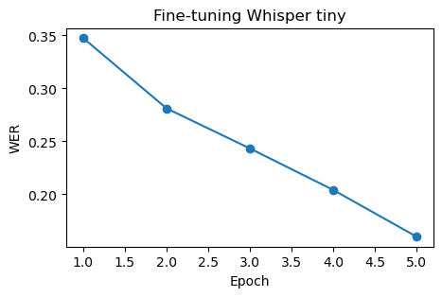
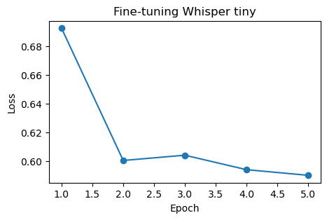
Fine-Tuning Whisper using DDP
Notebook: Working_space.ipynb
Whisper Prediction: Whisper_Inference.py
Fine-tuning File: Fine-tuning-whisper.py
We Observe That Fine-tuned Whisper tiny model significantly outperforms on the dev clean dataset with quicker inference time
Model | Time(s) | Avg WER
Tiny | 43 | 0.34
Base | 59 | 0.33
Large | 140 | 0.32
Fine-tuned Tiny | 43 | 0.16

Slide 10
Conclusion and Future Work
Project Outcomes:
The project demonstrated the efficacy of parallel GPU computing in Fine-Tuning a small model to drastically outperform large models
Next Steps
Perform Normalization before WER to capture results effectively
Fine-tune Whisper on Noisy datasets like LibriSpeech, partition dev-other
Compare against other SOTA ASR models like Canary, Parakeet & Jasper offered by Nvidia

