Slide 1

DHAGA & CO. · CXO REVIEW · 4 OCTOBER 2026
Every return tells us why.
Now we can listen.
Fit-Reason: reading every return reason and customer message, so the right person fixes the right thing first.
Presented by Somdatta Chakraborty
Notes:
Open with the business problem, not the tool. 'Thank you for the time. In the next 20 minutes I want to show you how much money is leaving through returns, why we can't see it today, and a simple way to start fixing it, with a live demo.'

Slide 2
THE PROBLEM
Customers tell us why. Nobody can read it all
48,000 orders a week
14,880 come back: 31% of orders
6,550 give the reason only as “Other”: 44% of returns
a few hundred read by hand each week
“When I read the Other box by hand, most of it is about fit, but I can only read a few hundred at a time.” Neha, Category Head
Source: Dhaga & Co. client brief.
2
Notes:
Walk the funnel top to bottom. '48,000 orders a week. Almost a third come back. Of those, 44% just say Other. Neha told us most of those are about fit, but she can read only a few hundred. So every week about 6,500 explanations go unread.'

Slide 3
WHAT IT COSTS TODAY
Returns cost crores; the cause stays hidden
₹1.25 Cr
₹9.3 Cr
22%
of sales reversed every week
a year on pickups and handling*
repeat purchase rate, flat for six quarters
14,880 returns × ₹840 average order
14,880 returns × ₹120 each* × 52 weeks
A bad fit on a first order rarely gets a second
The fixes are cheap: a corrected size chart, a better product photo, a firm word with a vendor. The expensive part is knowing which ones.
Source: Dhaga & Co. client brief. Figures marked * are our assumptions, to confirm with your finance team.
3
Notes:
Keep it to three numbers. The pickup cost is our assumption: we used the Rs 120 your supply chain team quoted for a failed cash-on-delivery order as a proxy for a return. Ask Faizan to confirm the real figure; the case only gets stronger if it is higher.

Slide 4
WHY THIS FIRST
Returns are the problem we can fix first
Problem raised | Money at stake | Do we know the cause? | Safe to start now? | Rank
Returns explained only as “Other” | ₹9.3 Cr a year in handling* | Yes: customers wrote it down | Yes: stays internal | 1st
Cash-on-delivery orders refused at the door | ₹4.75 Cr a year* | No: no reason recorded | Needs customer contact | 2nd
“Where is my order” messages (58% of support) | Agent time, slow replies | Partly: slow delivery | Yes | 3rd
6 to 9 days from sample to live listing | Missed Tuesday drops | Yes | Needs listing changes | 4th
Source: Dhaga & Co. client brief. Figures marked * are our assumptions, to confirm with your finance team.
4
Notes:
We did not pick the most exciting idea. We ranked every complaint your leaders raised on money at stake, whether we can see the cause, and whether it is safe to start. Doorstep refusals cost more, but nobody records why, so the first step there is learning the reason. Returns already come with a reason; nobody reads it.

Slide 5
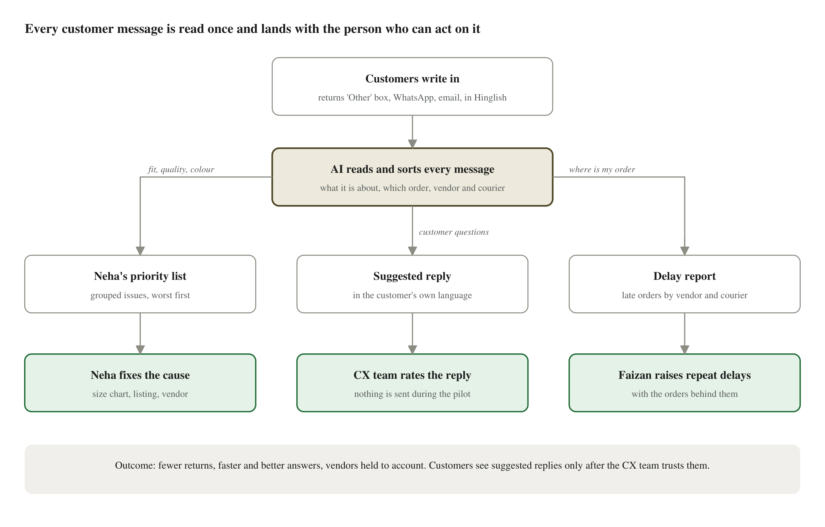
WHAT WE BUILT
One assistant reads every message for you
5
Notes:
One picture, no jargon. 'Every message is read once, in Hinglish, Hindi or English, and lands with the person who can act. Neha gets a short list of what to fix. The support team gets suggested replies to check. Supply chain gets a delay report. Nothing reaches a customer during the pilot.'

Slide 6
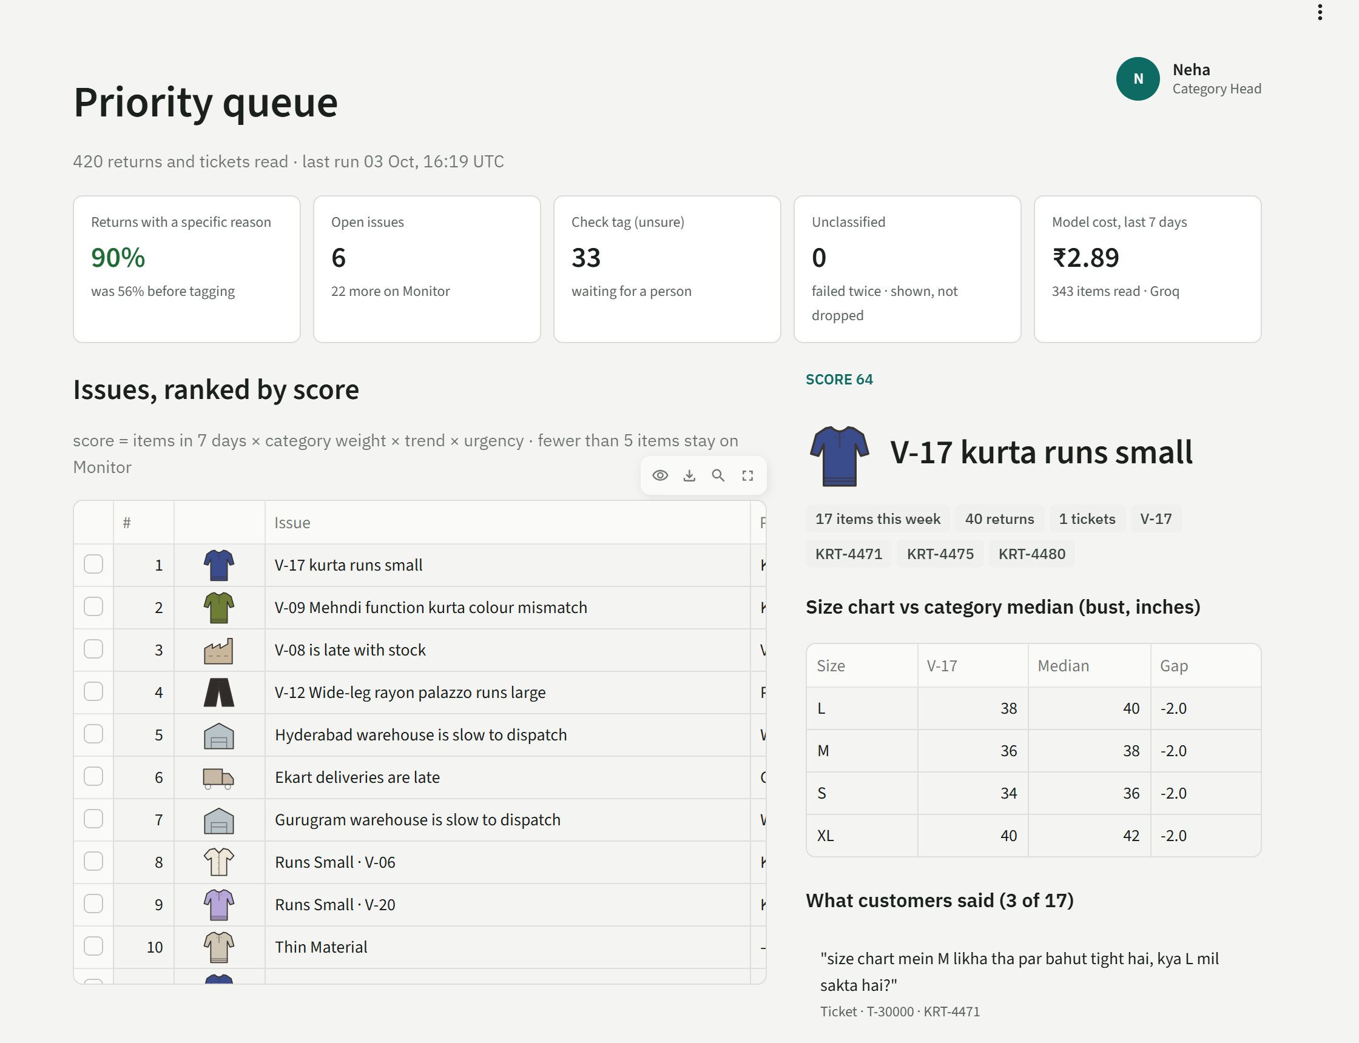
LIVE DEMO 1 OF 3
Monday morning: Neha sees what to fix first
1
90% of returns now have a clear reason
Up from 56%: the “Other” box is read for her
2
The worst problem is on top
V-17 kurtas run a size small: their chart is 2 inches tighter than standard
3
One click to act
Fix the size chart, or raise it with the vendor, with real customer words as proof
Live app on sample data shaped like Dhaga's: 31% returns, 44% “Other”.
6
Notes:
DEMO: open dhaga-fit-reason.streamlit.app, sign in as Neha. Point at the 90% tile ('was 56% before'). Click the top issue, V-17 kurtas. Show the size chart gap and read one customer quote aloud in Hinglish. Click 'Fix size chart' to show the action is recorded with her name. Say: 'This took a minute; today it takes a day of reading, if it happens at all.'

Slide 7
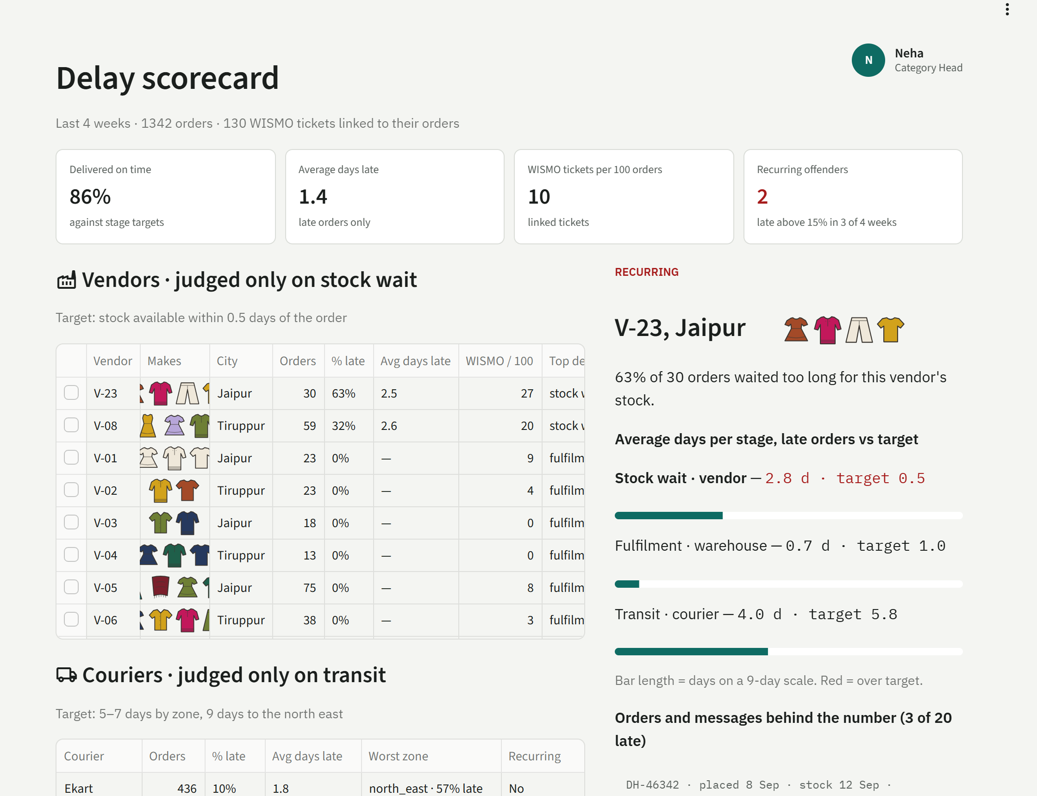
LIVE DEMO 2 OF 3
Who is really making customers wait
1
Delays are blamed on whoever caused them
Vendor late with stock, warehouse slow to pack, or courier slow
2
Repeat offenders stand out
V-23 kept 63% of its orders waiting for stock; one courier is slow to the north east
3
Every number opens the real orders
So the conversation with a vendor starts with facts, not anecdotes
Live app on sample data shaped like Dhaga's: 31% returns, 44% “Other”.
7
Notes:
DEMO: click 'Delay scorecard'. Point at V-23 at the top, marked repeat offender. Show the three bars: the time is lost waiting for the vendor's stock, not with the courier. Scroll to the orders and customer messages behind the number. Say: 'Faizan can now hold vendors to account with evidence.'

Slide 8
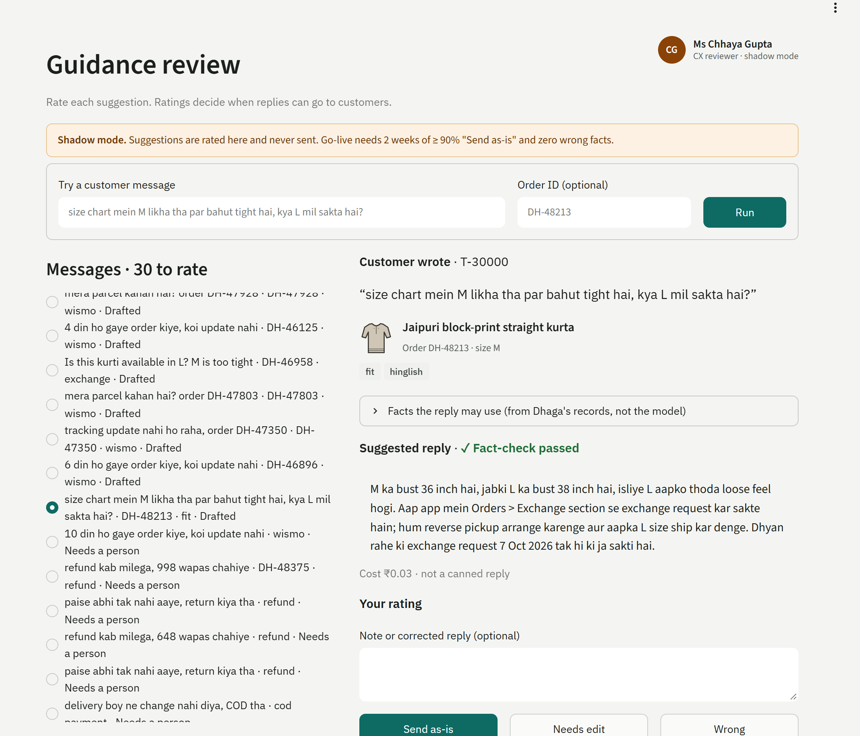
LIVE DEMO 3 OF 3
Customers get an answer to the question they asked
1
A suggested reply in the customer's own language
Using the real size chart and their exchange deadline, not a template
2
Checked against our records first
If a date or amount isn't on record, it hands over to a person instead of guessing
3
Nothing is sent during the pilot
The support team rates each reply; customers see them only once the team trusts them
Live app on sample data shaped like Dhaga's: 31% returns, 44% “Other”.
8
Notes:
DEMO: sign out, sign in as Ms Chhaya Gupta. Show she sees only this screen. Type 'size chart mein M likha tha par bahut tight hai, kya L mil sakta hai?' with order DH-48213 and click Run: a Hinglish reply quoting 36 vs 38 inches and the 7 October deadline. Then the failure on purpose: 'refund kab milega, 2000 wapas chahiye' - it refuses to promise a date and hands over to a person. Say: 'When it can't be sure, it says so.'

Slide 9
WHAT IT SAVES
Even a small drop in fit returns is worth lakhs a year
If fixes stop this share of fit returns | Cautious: 5% | Expected: 10% | Strong: 20%
Fewer returns a week | about 200 | about 390 | about 790
Pickup and handling saved a year* | ₹12 L | ₹24 L | ₹49 L
Sales kept a year (before margin) | ₹86 L | ₹1.7 Cr | ₹3.4 Cr
How we got there: 6,550 “Other” returns a week; we assume 60% are about fit* (Neha: “most of it”), about 3,900 a week. Each avoided return saves about ₹120 in pickup and handling* and keeps an ₹840 sale.
Source: Dhaga & Co. client brief. Figures marked * are our assumptions, to confirm with your finance team.
9
Notes:
Three scenarios so nobody has to trust one guess. Even the cautious case pays for itself many times over. 'Sales kept' is revenue, not profit: your finance team can apply the margin. The pilot measures which scenario is real within one 6-week catalogue cycle.

Slide 10
COST AGAINST RETURN
₹31,000 a year to run. ₹24 lakh a year back
78×
what it returns for every rupee it costs, on pickup savings alone (expected case)
5
fewer returns a week pays for it, out of 14,880 (0.03%)
Running cost: about ₹2,600 a month for reading the messages and storing the data. No new hires and no new systems for your team to learn: it runs in a web browser, on a laptop or a phone.
Source: Dhaga & Co. client brief. Figures marked * are our assumptions, to confirm with your finance team.
10
Notes:
The punchline slide. The running cost is about Rs 2,600 a month: reading the messages and storing the data. It needs about 5 fewer returns a week to pay for itself, out of 14,880. Staff time is extra: about 1 hour a week from Neha, 30 minutes a day from 2 or 3 support staff during the pilot, and a part-time owner in engineering.

Slide 11
SAFE BY DESIGN
People stay in charge; the assistant does the reading
1
Nothing reaches a customer yet
2
Each person sees only their own work
Suggested replies are rated by your team first. They go live only after two weeks of 90%+ approved and zero wrong facts.
Neha sees returns and delays; the support team sees replies. Sign-in decides what each person can open.
3
A person approves every action
4
When unsure, it says so
The assistant suggests; Neha decides what to fix or escalate, and her decision is recorded.
Unclear messages go to a short check list. A question it cannot answer from our records goes to a person.
11
Notes:
Expect Dev and Ritu to ask what happens when it is wrong. Answer: it shows its evidence, a person approves every action, and when it can't be sure it says so. Customers see nothing until the support team has rated replies for two weeks with at least 90% approved as written and zero wrong facts.

Slide 12
THE PLAN
A four-week pilot on one category, then a clear decision
1
2
3
4
Today
Weeks 1–4
Week 4
Mid-November
Approve the pilot
Run on real womenswear kurta returns and messages
Review results with Neha: issues fixed, time saved
Decide whether replies can go to customers
What we need from you
Neha: about 1 hour a week to review the list and agree what counts as a problem.
2 or 3 support team members: about 30 minutes a day to rate suggested replies. A daily export of returns and messages, and one person from engineering to own it.
12
Notes:
Make the ask small and concrete: one category, four weeks, real data, and a clear yes/no point. What we need is mostly a little of Neha's time and a data export.

Slide 13
OUR ASK
Approve a four-week pilot on womenswear kurtas.
We will measure one thing: returns on the products we fix, down 20% within one 6-week catalogue cycle. If it doesn't move, we stop.
About ₹2,600 a month · pays for itself at 5 fewer returns a week · customers see nothing until your team agrees
13
Notes:
Close on the decision. Then take questions. Likely ones: cost (Rs 2,600 a month), who runs it (one part-time engineer, no specialists), what if it is wrong (people approve everything; it says when it is unsure), 'we tried something like this before' (ask what was tried; this ties every complaint to a product and a vendor, and tracks whether the fix worked).

Slide 14
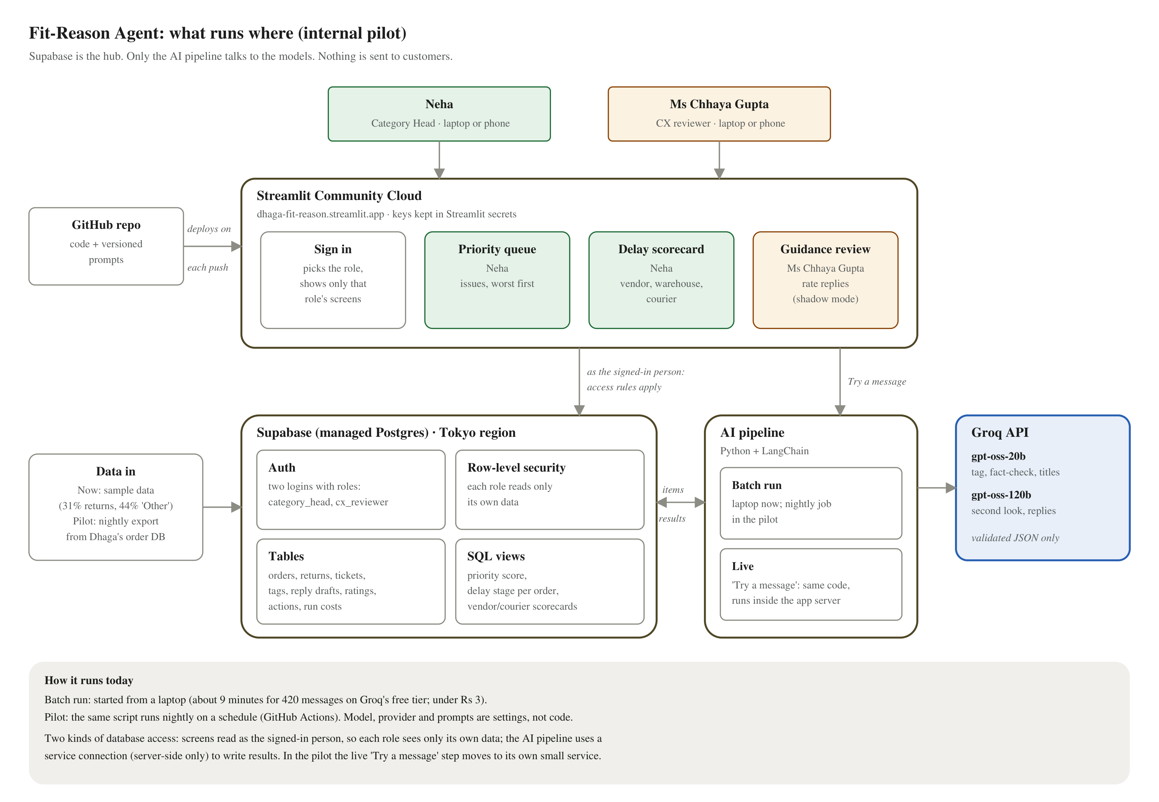
APPENDIX A1 · ARCHITECTURE
What runs where
Screens
Streamlit on Streamlit Community Cloud; redeploys from GitHub on every push
Database and logins
Supabase (Postgres): two role-based logins; access rules in the database itself
AI
Groq: gpt-oss-20b to read and check, gpt-oss-120b for unsure items and replies, via LangChain
Safety
Every AI answer must fit a fixed structure; replies are fact-checked; nothing is sent to customers
Running cost
About ₹2,600 a month: database ₹2,200, AI calls about ₹420, hosting free
Full detail: Fit-Reason Agent – Technical Architecture Document v1.2.
14
Notes:
For the evaluator. Read it top to bottom: two people sign in to one web app; the app reads the database as that person, so each role sees only its own data; the AI pipeline reads new messages, calls the models and writes results back through a server-side service connection. Nothing goes to customers. Known gap: the live 'Try a message' step runs inside the app with that service connection; in the pilot it moves to its own small service.

Slide 15
APPENDIX A2 · HOW INFORMATION FLOWS
Five steps from a customer's words to a decision
1
2
3
4
5
Information comes in
One secure store
The assistant reads it
Results on screens
People decide
Orders, returns and customer messages from Dhaga's systems, every night
Everything sits in one database; each person can open only their own part
Every message sorted by topic, product and vendor; replies drafted and checked
Neha sees what to fix first; the support team sees suggested replies
Actions and ratings are saved and shape next week's list
Nothing flows back to customers during the pilot. Suggested replies stop at the support team until they have rated them as accurate for two weeks. Names and phone numbers are hidden before the assistant reads anything.
Detailed data flow: Technical Architecture Document v1.4, Figure 3.
15
Notes:
Keep this at headline level. Information comes in from Dhaga's own systems and customers, sits in one secure place, the assistant reads and sorts it, the results wait on each person's screen, and their decisions are saved and shape next week's list. The detailed version, with every step and store, is Figure 3 in the Technical Architecture Document.

Slide 16
APPENDIX A3 · COST AND PROFIT
Full cost about ₹5.6 L a year; likely profit about ₹87 L
Cost a year | ₹
AI calls (Groq, pilot volume) | 5,000
Database (Supabase Pro) | 26,400
App hosting (Streamlit) | 0
Compute total | 31,400
Engineer, 20% of ₹15 L* | 3,00,000
Support reviewers, 375 h × ₹400* | 1,50,000
Neha, 52 h × ₹1,500* | 78,000
Total cost | ≈ 5,59,000
A year, in ₹ | Cautious 5% | Expected 10% | Strong 20%
Pickup and handling saved* | 12 L | 24.5 L | 49 L
Margin on sales kept (40%*) | 34 L | 69 L | 1.37 Cr
Total gain | 47 L | 93 L | 1.86 Cr
Minus full cost | − 5.6 L | − 5.6 L | − 5.6 L
Profit | 41 L | 87 L | 1.81 Cr
Return on each ₹1 spent | 8× | 17× | 33×
Basis: about 3,900 fit returns a week*; each avoided return saves ₹120* in pickup and handling and keeps an ₹840 sale. Reviewer time falls after the pilot, so later years cost less.
Source: Dhaga & Co. client brief. Figures marked * are our assumptions, to confirm with your finance team.
16
Notes:
How to read it: left is everything the project costs in a year, including people's time, not just computing. Right turns the savings into profit: pickup and handling saved, plus the margin on sales we no longer refund, minus the full cost. Margin, salaries and hourly rates are our assumptions (*); finance should replace them with Dhaga's numbers. Even the cautious case returns about 8 rupees for every rupee spent.

Slide 17
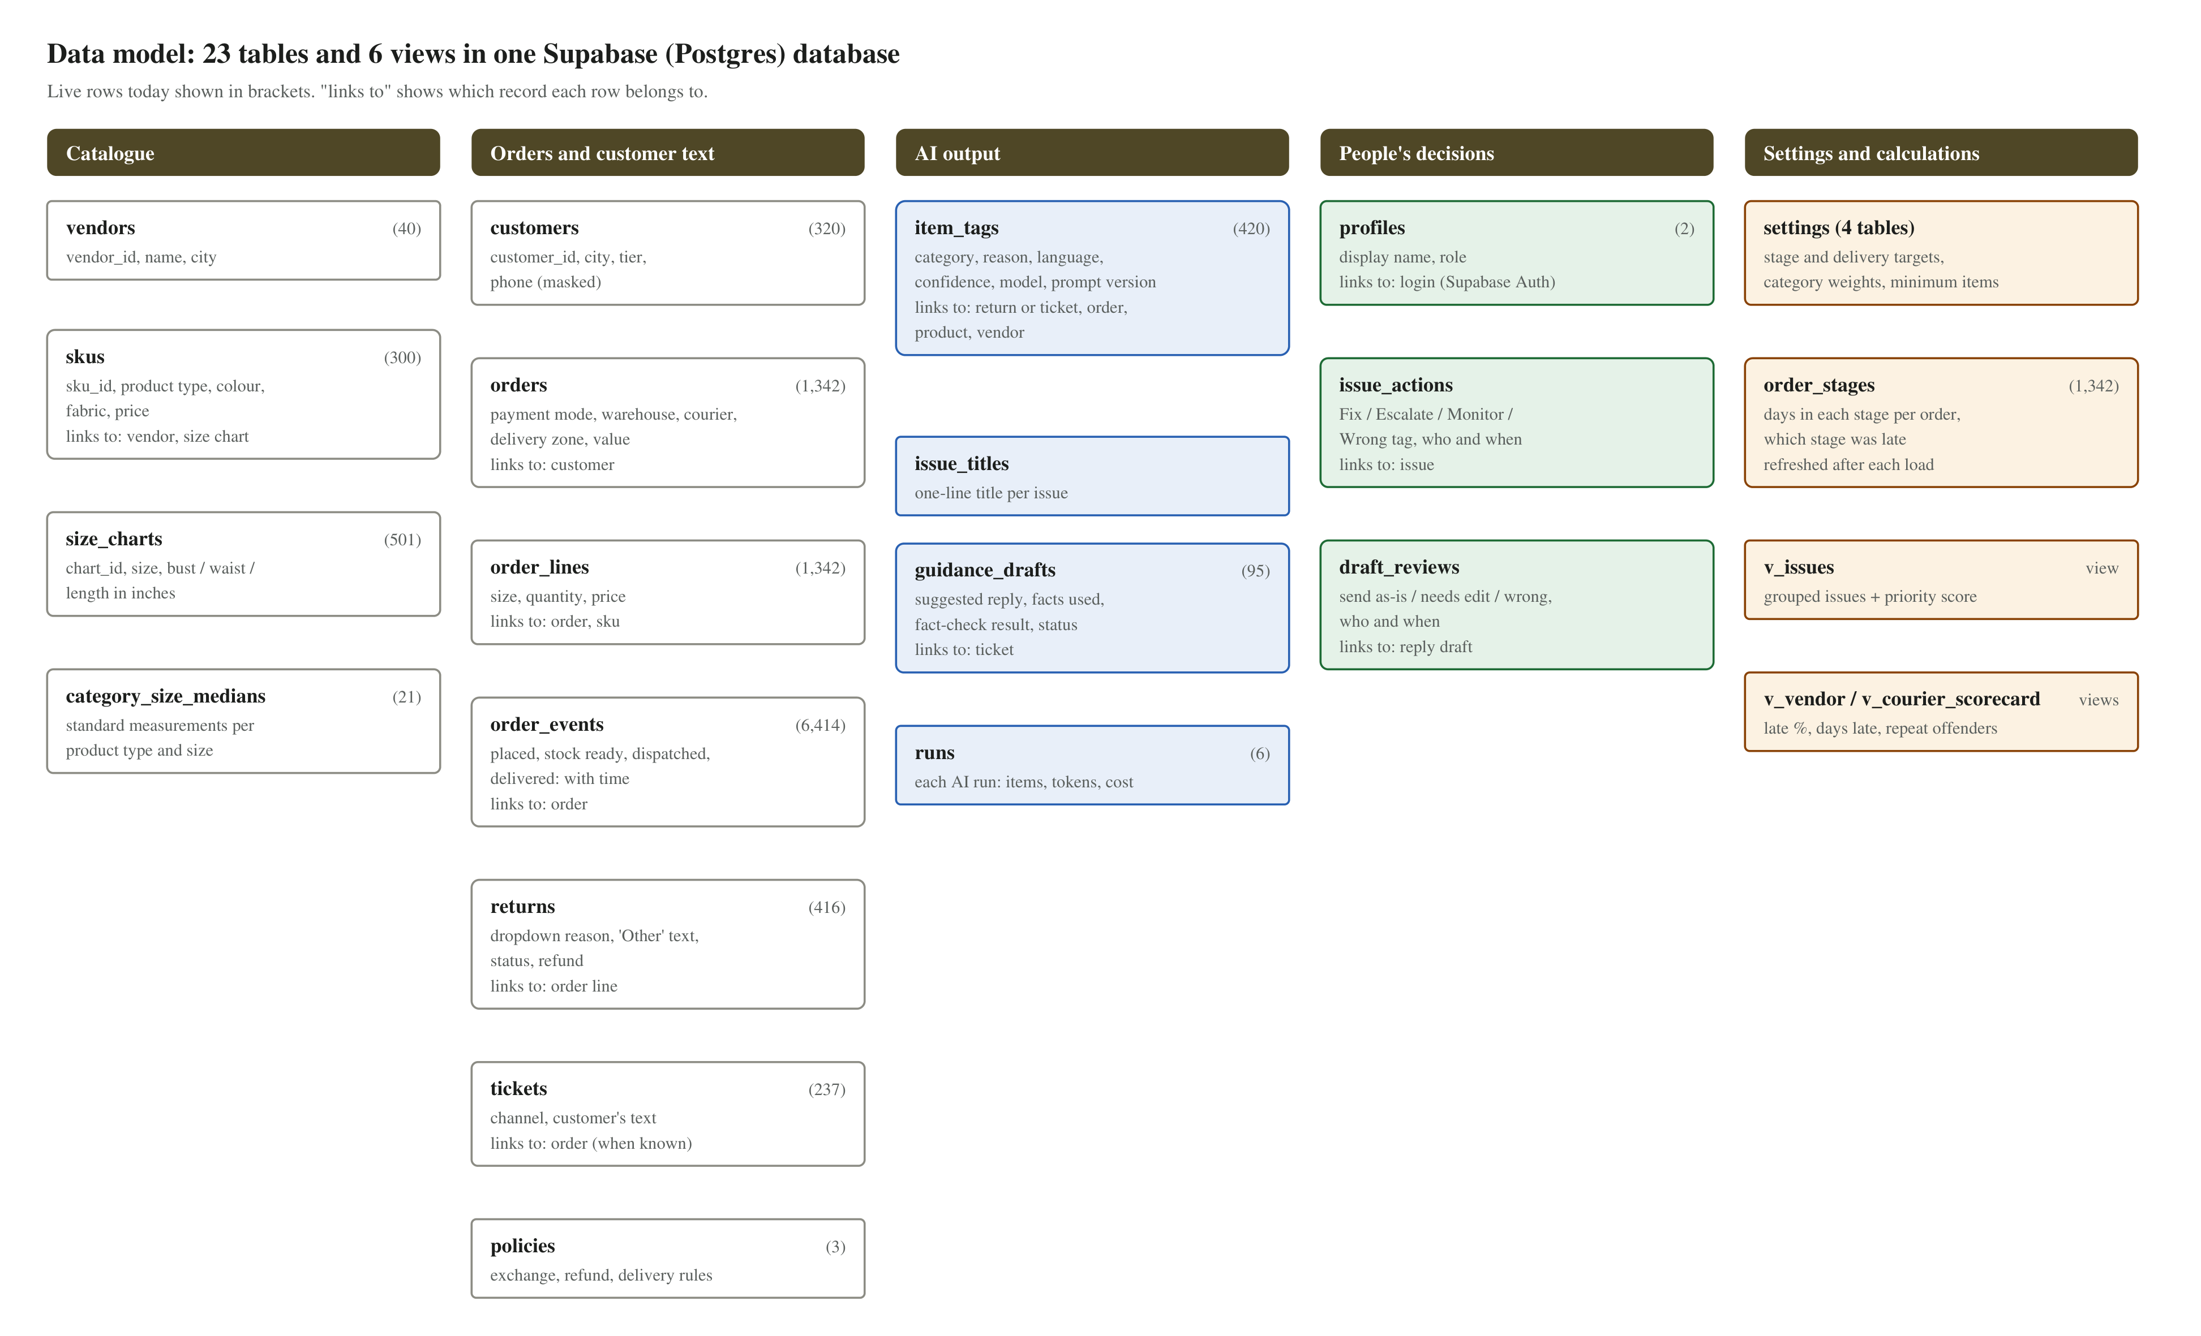
APPENDIX A4 · DATA
How the data is stored, and where it comes from
Live, not static
One Supabase (Postgres) database: 23 tables, 6 views. The app reads it live; clicks and ratings are saved as they happen.
Demo data is sample data
Made by a Python script with a fixed seed, shaped to the brief: 31% returns, 44% “Other”, 61% cash on delivery, Hinglish text.
Loaded once, then enriched
A setup script bulk-loads 1,342 orders, 416 returns and 237 tickets; the AI pipeline adds 420 tags and 95 reply drafts.
Pilot: real data
A nightly export from Dhaga's order database replaces the script. Screens, rules and AI steps stay the same.
Planted patterns for the demo, e.g. V-17's size chart 2 in tighter than standard. Code: scripts/sample_data.py, scripts/setup_db.py.
17
Notes:
If asked 'is this real data?': No, and we say so up front. It is realistic sample data that a Python script generates with a fixed seed, so it is the same every time. It is shaped to the numbers in the brief: 31% of orders returned, 44% of returns marked Other, 61% cash on delivery, Hinglish comments, 40 vendors in Tiruppur and Jaipur. Some patterns are planted on purpose so the demo has something to find, for example V-17 kurtas with a size chart 2 inches tighter than standard. If asked 'is it static?': No. It is loaded into a live Supabase database; the AI pipeline reads it and writes its tags and reply drafts back; every click and rating in the app is saved live. In the pilot the script is replaced by a nightly export of Dhaga's real orders, returns and tickets, and nothing else changes.

