Slide 1

FIFA 19 Analysis
By
Utkarsh Ujwal
Rahul Dhanasiri
Chakradhaar Viswatmula

Slide 2
Let’s talk Business!!
Year-to-date fiscal sales of FIFA 19 are approximately 20 million units making it the best selling console game in the calendar year of its release.
The dataset includes all the football players characteristics described by a set of statistics.
A team of 6000 volunteers help maintain and update the players database all year round.
There are multiple modes in the game but we have designed our analysis tailored for Manager mode.
BUT WHY????
As a manager you may need to replace a player or build a player given cost constraint at same time not compromising the skills, the classifier and cluster will aid to it.
All the big clubs have their own training academy which scout players based their competency at each position, therefore, this classifier will help with honing the skills for matching field position.
Using the cluster created by us, it outputs a range of players based on similar competency for the same playing position which may help with trade.

Slide 3
What do the models show??
Naive Bayes
Base model
Generative algorithm.
Assumes features are conditionally independent.
Accuracy 77.9%.
Logistic regression
Discriminative algorithm
Models p(Y|x) by learning input to output mapping, minimising error.
No conditional independence assumed.
Accuracy 93.42%.
SVM
Better scalability.
Dual form give sparse solution using kernel trick.
Doesn’t penalise examples for with correct decision are made.
Accuracy 94.43%.
 | GK | D | M | F
GK | 608 | 0 | 0 | 0
D | 0 | 776 | 239 | 4
M | 0 | 320 | 863 | 272
F | 0 | 2 | 17 | 780
 | GK | D | M | F
GK | 608 | 0 | 0 | 0
D | 0 | 930 | 87 | 2
M | 0 | 80 | 1335 | 40
F | 0 | 1 | 45 | 753
 | GK | D | M | F
GK | 608 | 0 | 0 | 0
D | 0 | 953 | 65 | 1
M | 0 | 83 | 1342 | 30
F | 0 | 4 | 33 | 763

Slide 4
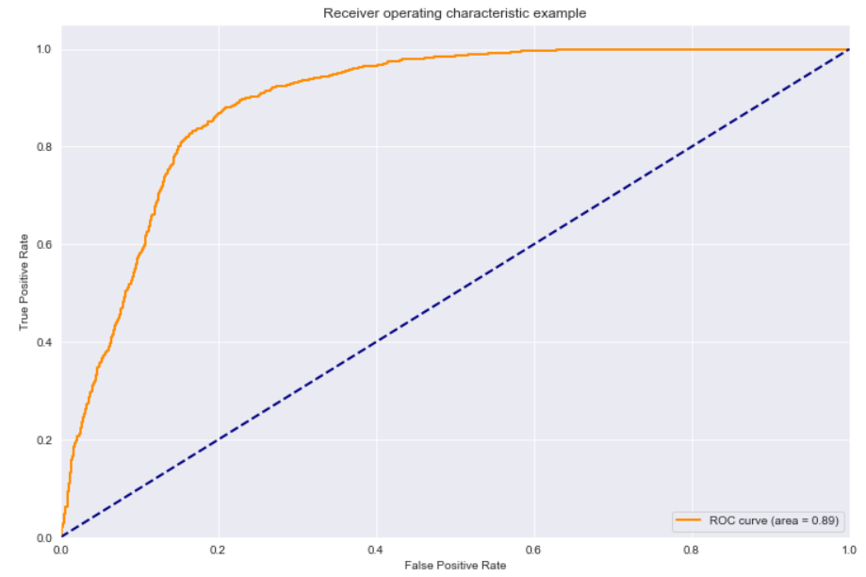
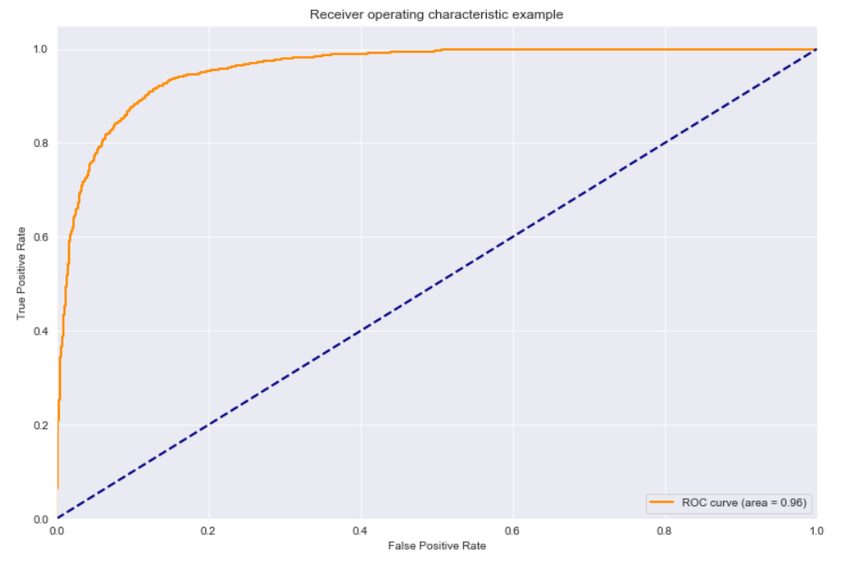
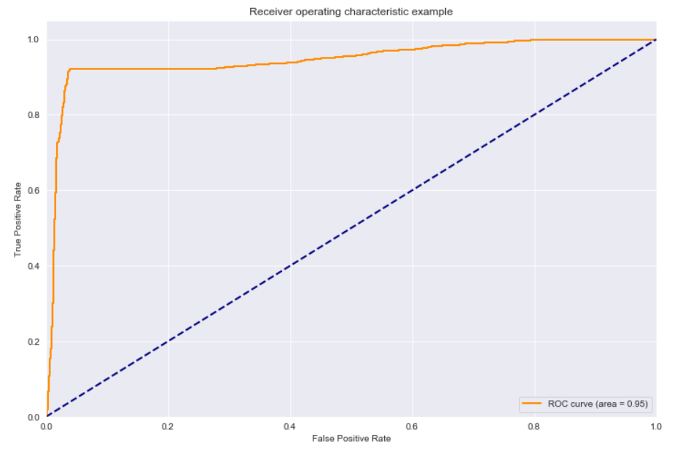
Let’s compare model performance now!
Naive Bayes
AUC = 0.89
Logistic regression
AUC = 0.95
SVM
AUC = 0.96

Slide 5
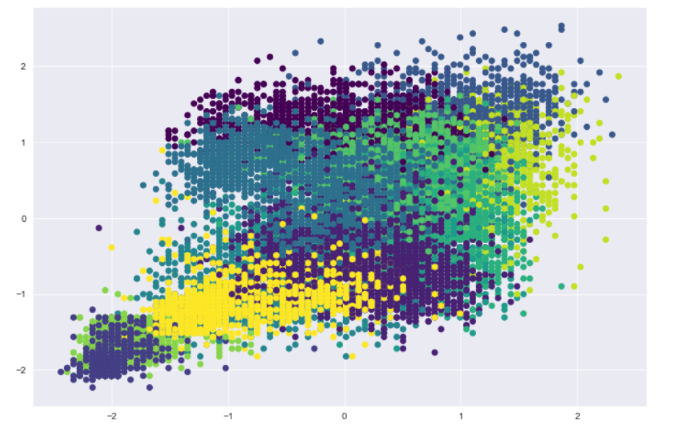
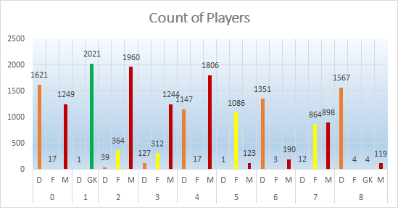
Diving into the Clusters..
Divided the data into 9 clusters as per “wss” plot.
It appears that the cluster 0 & 4 are representing the most defensive midfielders while cluster 7 represents attacking midfielders.
Cluster 3 represents midfielders while cluster 6 & 8 represents defenders.
Cluster 1 represents goalkeepers
Cluster 5 is for forwards.

Slide 6
It’s time to conclude!
We managed to classify a player’s position using his attributes like Crossing', 'Finishing', 'HeadingAccuracy', 'Short Passing', 'Volleys','Dribbling', 'Curve', 'Free Kick Accuracy', 'Long Passing', 'Ball Control' which would help a coach decide where to play an upcoming player to bring out the best of his potential.
We also developed a clustering-based model to group players with similarities in attributes and filtered out results to obtain like-for-like replacements for a specific player based on the fraction of the value of the current player being replaced.
This clustering model could help team managers make calculated decisions on finding the right like-for-like replacements for players in their team.

