Slide 1
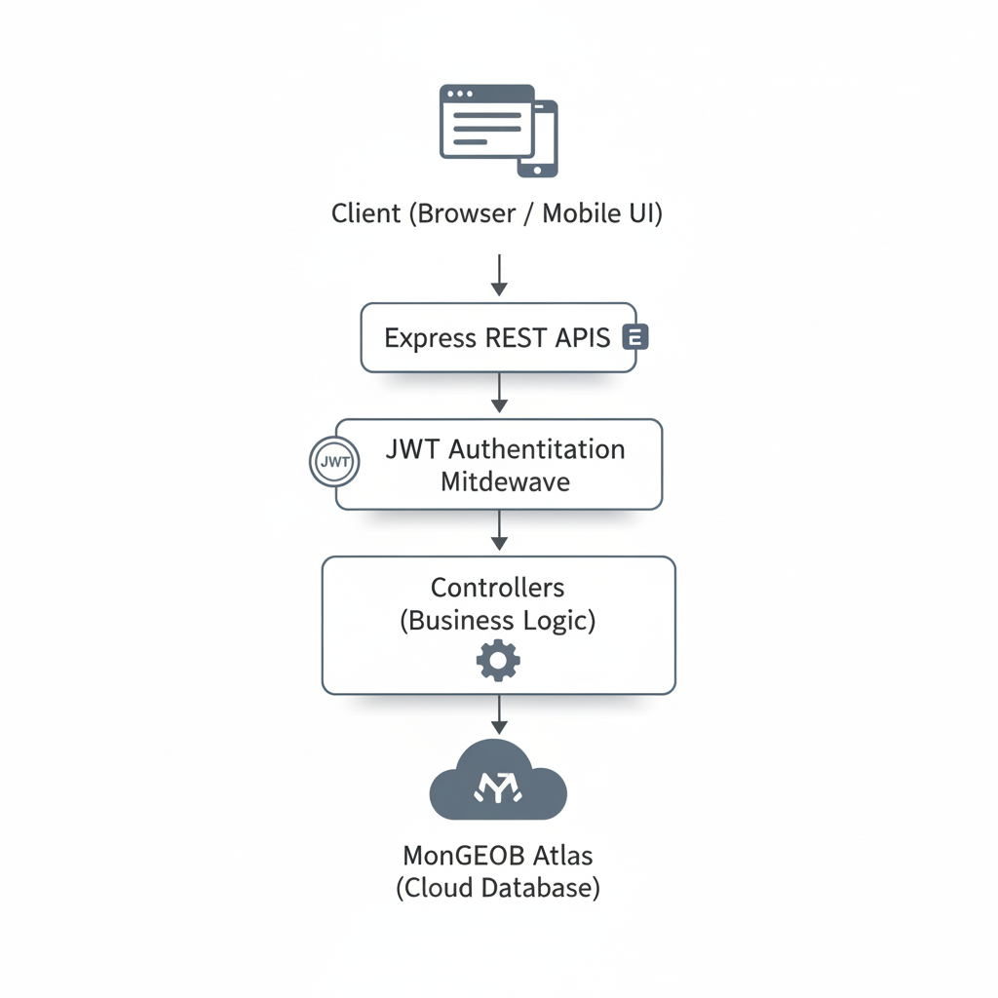
Habit Rabbit
Smart Habit Tracking for Consistent Growth
PROBLEM STATEMENT
Build a web or mobile application that allows users to create habits, mark daily completion, and view their progress over time using simple statistics, streak counters, and visual indicators.
TECH STACK SELECTION
• Frontend: React.js (Responsive and dynamic UI)
• Backend: Node.js + Express.js (API handling and business logic)
• Database: MongoDB Atlas (Cloud-based storage)
• Authentication: JWT (Secure login system)
• Development Tools: Thunder Client / Postman – For testing APIs, and
VS Code – For writing and managing code.
PROBLEM CONTEXT
Many students and professionals struggle to maintain daily habits due to lack of motivation and poor visibility of long-term progress.
BASIC ARCHITECTURE IDEA
SOLUTION IDEA
Habit Rabbit is a structured habit tracking platform that enables users to monitor consistency through streak tracking, historical data storage, and visual progress insights.
TARGET USERS
• College Students
• Competitive Exam Aspirants
• Working Professionals
• Fitness Enthusiasts
TARGET USERS
• College Students
• Competitive Exam Aspirants
• Working Professionals
• Fitness Enthusiasts

