Slide 1
HANGMAN
PYTHON

Slide 2
GROUP-12(O)
PARTICIPANTS:-
P.Durga Mahesh AP21110010911
J.Sai Dheeraj AP21110011244
M.Chakrapani AP2110010920
K.Akash AP2110010927

Slide 3
INDEX
1. INTRODUCTION …4
2. ABSTRACT …5
3. CODE …6-10
4. OUTPUT …11-13

Slide 4
INTRODUCTION
Hangman is a popular word guessing game where the player attempts to build a missing word by guessing one letter at a time. After a certain number of incorrect guesses, the game ends and the player loses. The game also ends if the player correctly identifies all the letters of the missing word.

Slide 5
ABSTRACT
Hangman is a guessing game player tries to guess it by suggesting letters within a certain number of guesses. Originally it is a Paper-and-pencil game, there are now electronic versions.

Slide 6
MODULUS
RANDOM
TIME
FUNCTIONS
Main()
Play_loop()
hangman()
choices()
getdetails()
checkdetails()

Slide 7
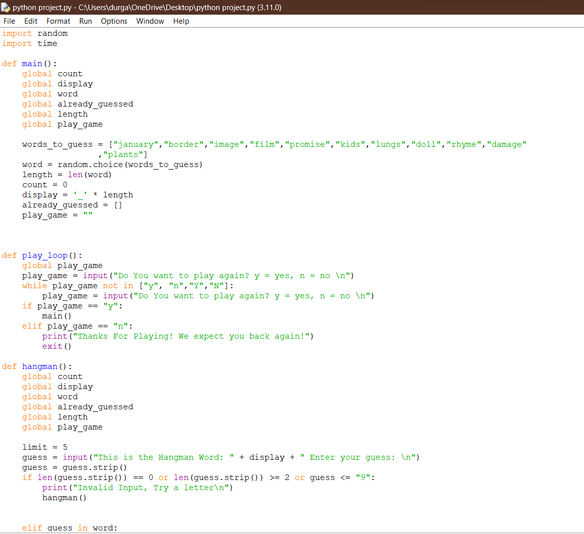
CODE

Slide 8
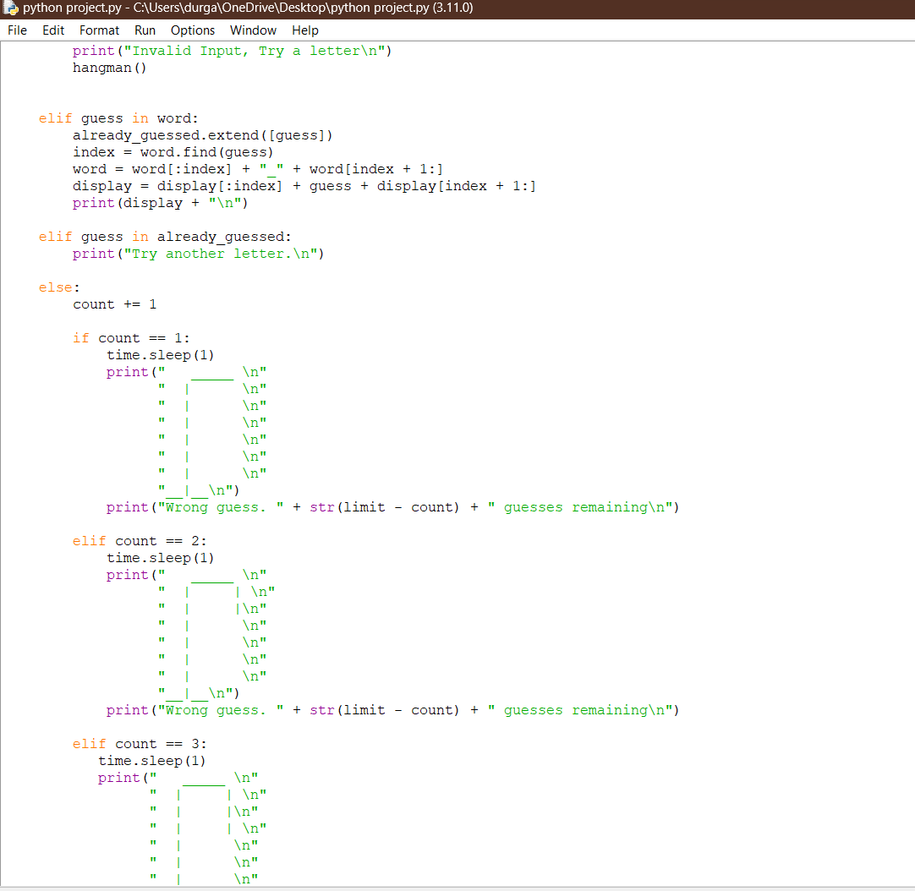

Slide 9
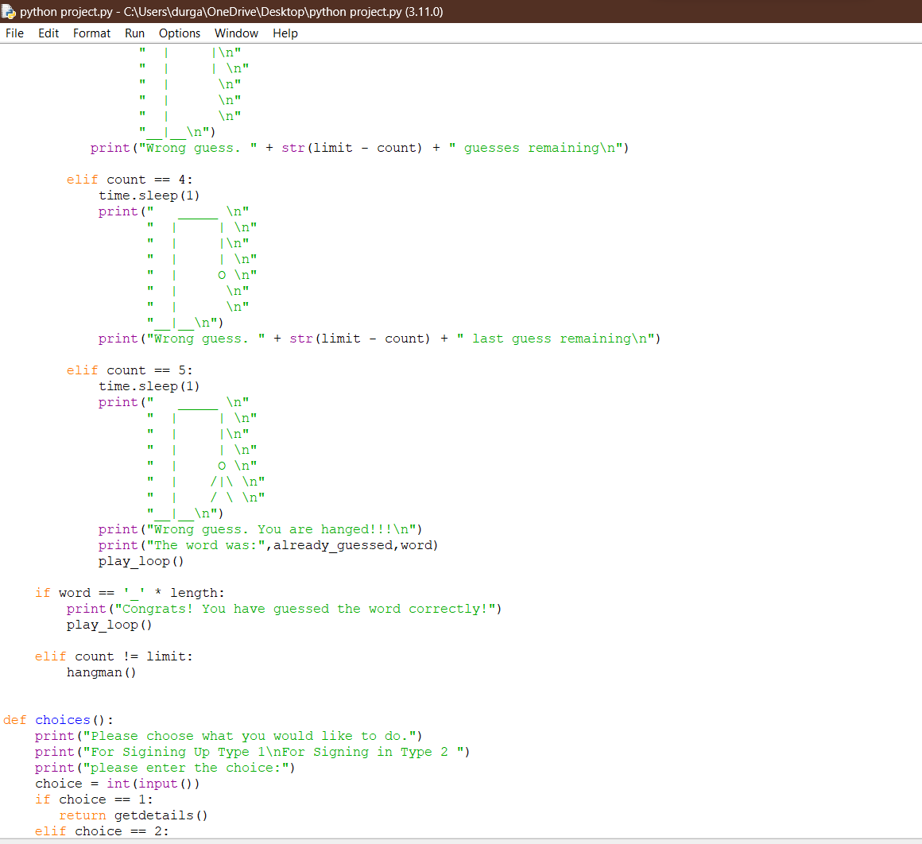

Slide 10
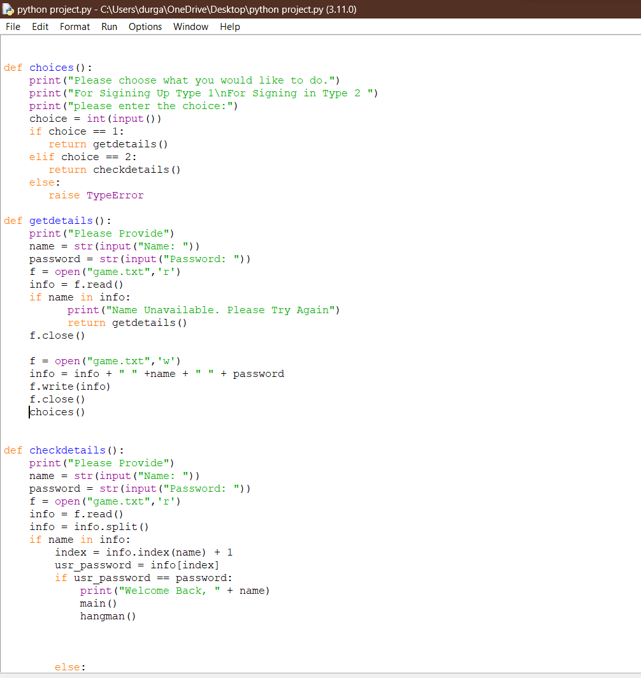

Slide 11
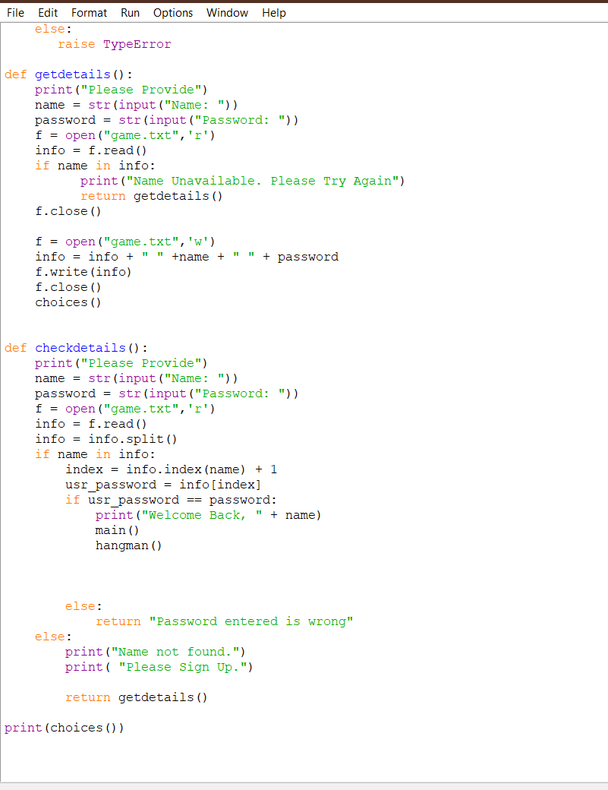

Slide 12
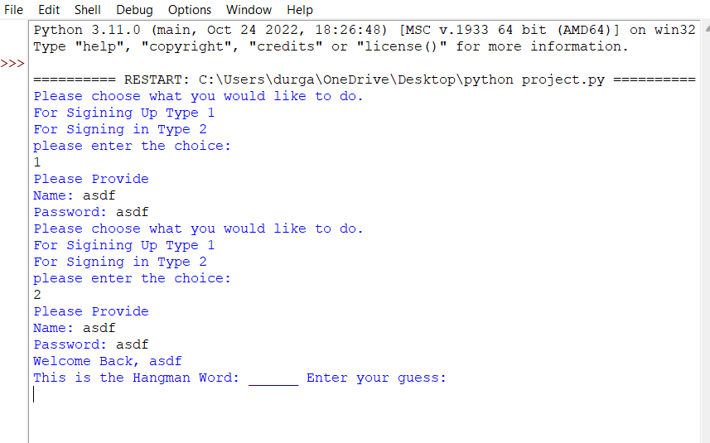
OUTPUT:

Slide 13
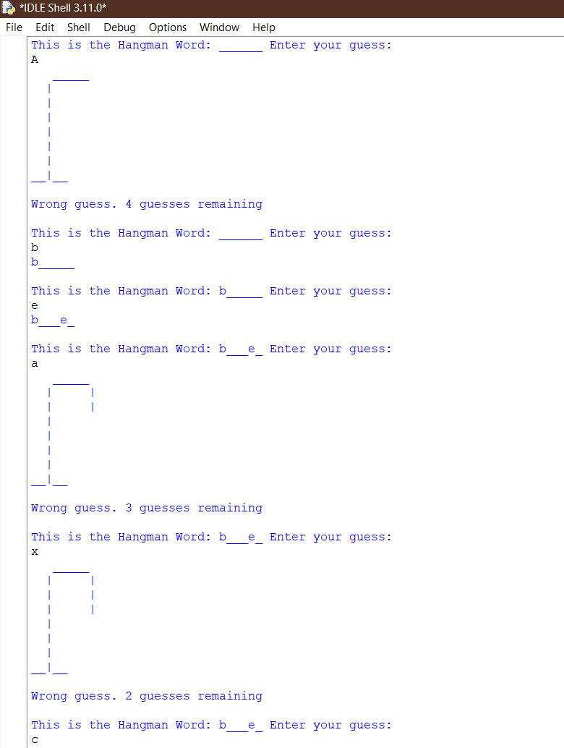

Slide 14
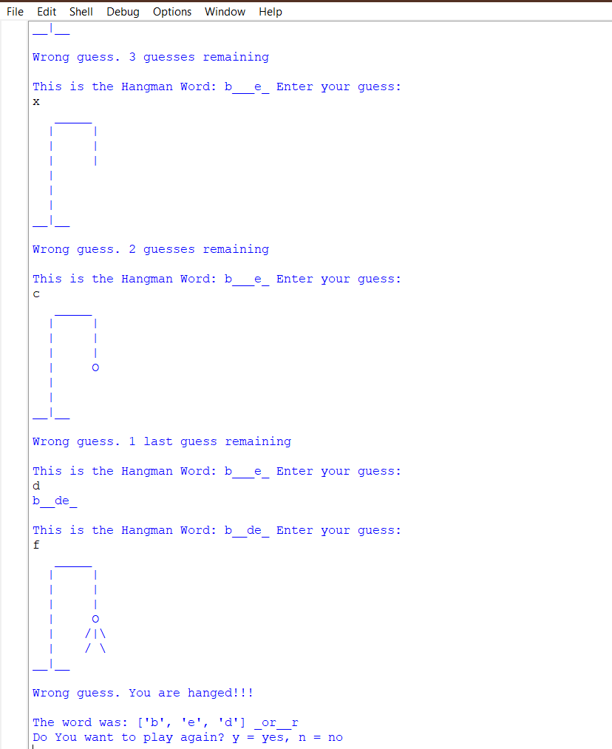

Slide 15
THANK YOU!

