Slide 1
MINI PROJECT
Title: An Enhanced Optimization Method For Predicting English Phrases During Sentence Formation Using Deep Learning
Team Members: Supervisor
P.Lakshmi Priya(20AG1A6646) Name: Dr.Kavitha soppari
M.pooja(20AG5A6606) Designation: Head of the Department
P.Chakradhat(20AG1A6647)

Slide 2



Contents:
Abstract
Introduction
Existing System
Proposed System
LSTM Architecture
Software and Hardware Requirements
Design-UML Diagrams
Code
Code Output
Conclusion
References

Slide 3
Abstract:
A ENHANCED OPTIMIZATION METHOD FOR PREDICTING ENGLISH PHRASES DURING SENTENCE FORMATION USING DEEP LEARNING represents a pivotal exploration into the task of predicting phrases within sentence contexts. Leveraging the capabilities of deep learning techniques, our study aims to enhance the precision of next-word prediction, a critical aspect in natural language processing applications such as text generation, machine translation, and dialogue systems. In pursuit of this objective, we delve into an investigation of various deep learning architectures, including recurrent neural networks (RNNs), long short-term memory networks (LSTMs), and transformer models. This exploration seeks to unravel the potential of these architectures in capturing intricate linguistic patterns and contextual dependencies. Additionally, we scrutinize preprocessing methods like tokenization and embeddings to augment the models' comprehension of input text. The outcomes of our experiments underscore the remarkable strides made by deep learning, showcasing its effectiveness in achieving enhanced optimization for predicting English phrases during sentence formation.

Slide 4
Introduction
In the realm of natural language processing (NLP), the accurate prediction of English phrases within the context of sentence formation stands as a pivotal challenge. Proficiently mastering this task holds the potential to revolutionize various NLP applications, from automated text summarization to machine translation. The advent of deep learning techniques has ushered in a new era of possibilities for enhancing the optimization methods employed in this endeavor.
In this project, we're taking a big step in teaching computers to understand and use English sentences effectively. Think of it as training a computer to talk and write in English like a pro.
We'll walk you through our approach, starting with gathering and preparing data, then using advanced computer techniques to make the computer really good at figuring out how to put sentences together.

Slide 5
Contd..
It can have wide-ranging applications, from making chatbots more conversational to improving translation tools. We'll also explain how we measure our computer's performance, how to use it in practical situations, and why ongoing improvements are vital.
The significance of this research extends beyond its immediate applications, as it represents a stride towards more human-like language understanding and generation. By enhancing the optimization method for predicting English phrases during sentence formation through the lens of deep learning, we embark on a journey that promises to reshape the way machines interact with and contribute to the realm of human language.

Slide 6
Existing Systems:
N-gram Model:
The N-gram model is a simple and widely used statistical language model for predicting the next word in a sequence of words. It's based on the assumption that the probability of a word depends only on the previous N-1 words
Draw Back of N- Gram Model: Limited contextual understanding, as these models consider only a fixed number of preceding words. They struggle with capturing long-range dependencies and understanding context beyond the local ngram.

Slide 7
Hidden Markov Models (HMM):
Hidden Markov Models (HMMs) are probabilistic models that assume the existence of underlying hidden states and observable outputs. In the context of next word prediction, we can represent a sequence of words as the observable output and the hidden states as the unobservable factors influencing the generation of those words
Draw Back of Hidden Markov : Model Similar to N-gram models, HMMs have limited context awareness and may not capture the semantic nuances in language well. They also assume independence between hidden states, which is a simplification.

Slide 8
Proposed System:
In the Model we want to work with and use Deep Learning Techniques a Long Short-Term Memory (LSTM) network is employed due to its ability to capture intricate sequence patterns. By utilizing Tensor Flow's high-level APIs, the model's implementation becomes more streamlined. We also explore techniques like hyper parameter optimization and teacher forcing for refinement LSTM networks were designed specifically to overcome the long-term dependency problem faced by recurrent neural networks RNNs (due to the vanishing gradient problem). LSTMs have feedback connections which make them different to more traditional feedforward neural networks.

Slide 9
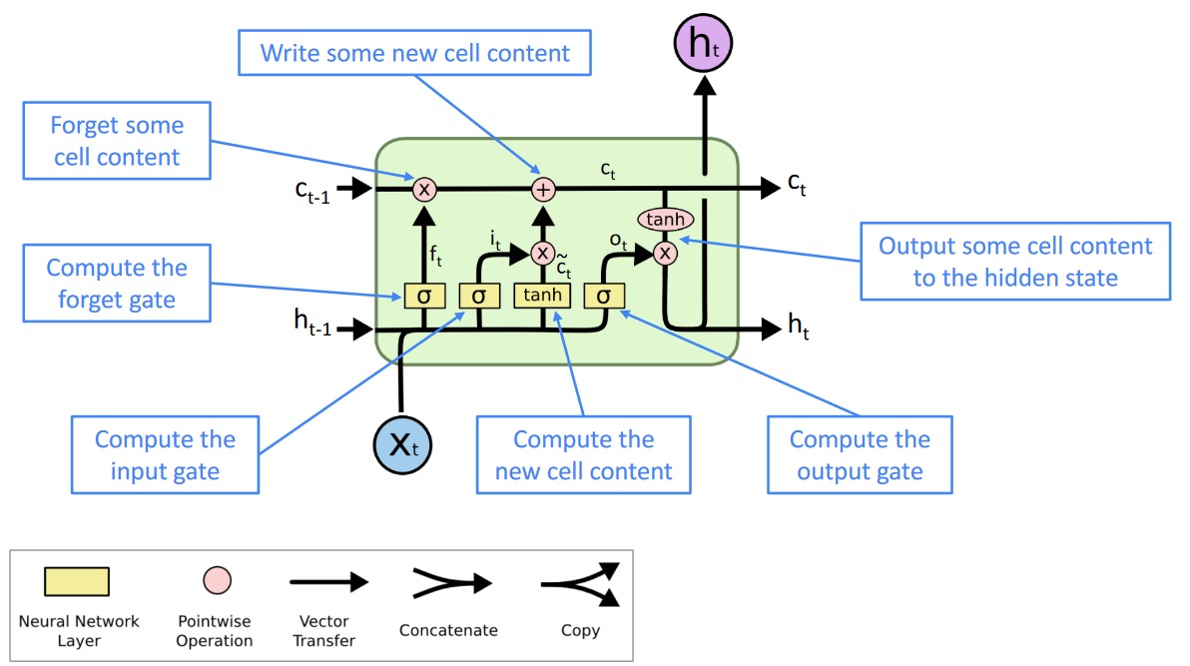
LSTM Architecture

Slide 10
LSTM Architecture:
Architectural model (in software) is a rich and rigorous diagram, created using available standards, in which the primary concern is to illustrate a specific set of tradeoffs inherent in the structure and design of a system or ecosystem. Software architects use architectural models to communicate with others and seek peer feedback. An architectural model is an expression of a viewpoint in software architecture.

Slide 11
Software and Hardware Requirements
Software Requirements:
Hardware Requirements:
TOOLS: Spyder and Google Colab or Jupyter
OPERATING SYSTEMS: Windows
LANGUAGE: Python
IDE: Anaconda
PACKAGE: numpy, Tensorflow, Keras, StreamLit.
CPU: Intel Core i5 or equivalent
OPERATING SYSTEM: windows
PROCESSOR: 1.7GHZ
RAM: 4GB minimum HARD DISK: 200GB

Slide 12
Design-UML Diagrams Use case:
Use case diagrams are used to gather the requirements of a system including internal and external influences. These requirements are mostly design requirements. So when a system is analyzed to gather its functionalities use cases are prepared and actors are identified. In brief, the purposes of use case diagrams can be as follows:
a. Used to gather requirements of a system.
b. Used to get an outside view of a system.
c. Identify external and internal factors influencing the system.

Slide 13
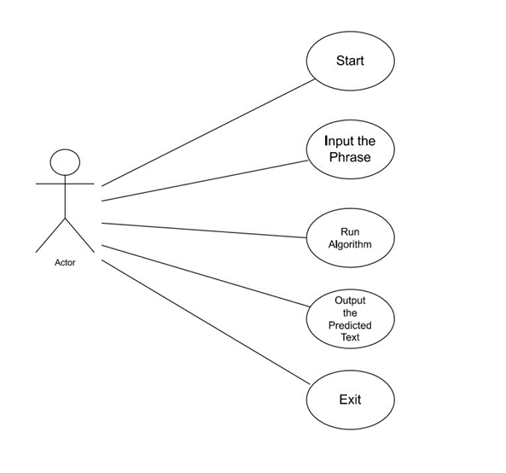
Use case diagram:

Slide 14
ACTIVITY DIAGRAM:
Activity diagram is another important diagram in UML to describe dynamic aspects ofthe system. Activity diagram is basically a flow chart to represent the flow form one activity to another activity. The activity can be described as an operation of the system. So the purposes can be described as:
• Draw the activity flow of a system.
• Describe the sequence from one activity to another.
• Describe the parallel, branched and concurrent flow of the system.

Slide 15
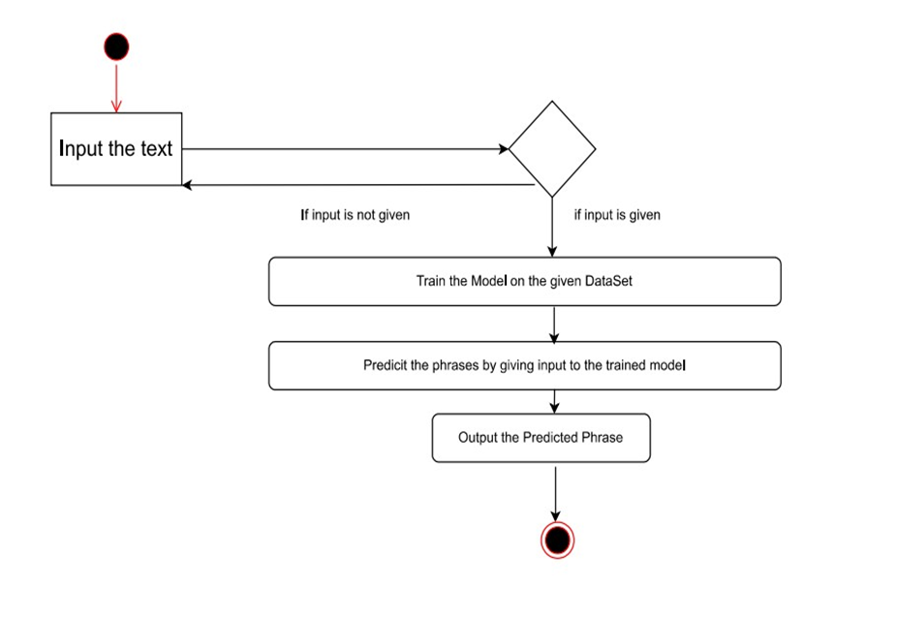
ACTIVITY DIAGRAM:

Slide 16
SEQUENCE DIAGRAM:
Sequence diagrams describe interactions among classes in terms of an exchange of messages over time. They're also called event diagrams. A sequence diagram is a good way to visualize and validate various runtime scenarios. These can help to predict how a system will behave and to discover responsibilities a class may need to have in the process of modelling a new system.

Slide 17
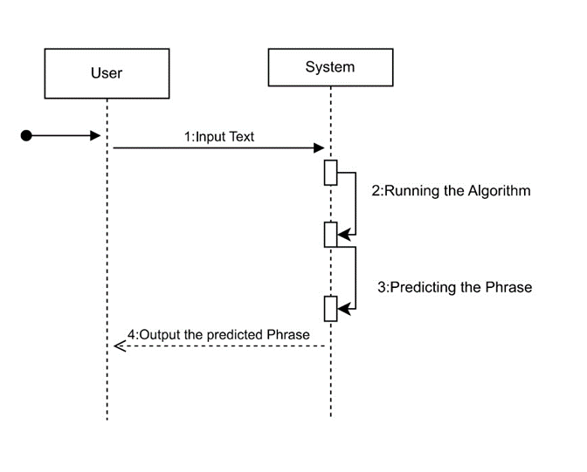
SEQUENCE DIAGRAM:

Slide 18
CLASS DIAGRAM:
The class diagram is the main building block of object-oriented modeling. It is used both for general conceptual modeling of the systematic of the application, and for detailed modelling translating the models into programming code.

Slide 19
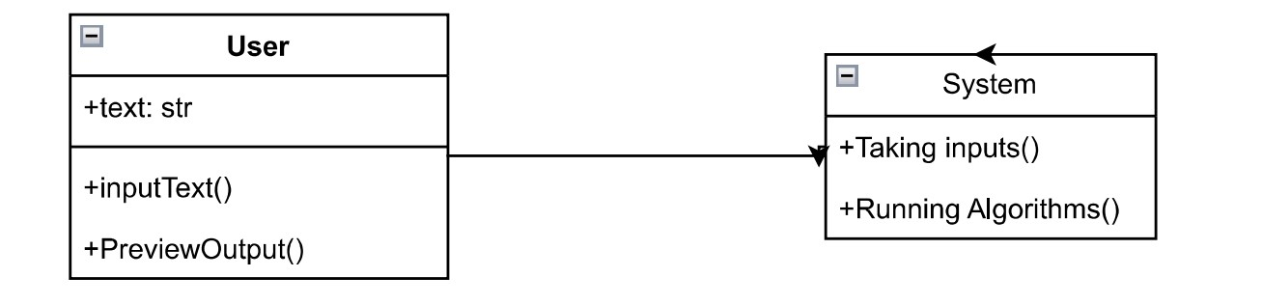
CLASS DIAGRAM:

Slide 20
COMPONENT DIAGRAM:
In the Unified Modeling Language, a component diagram depicts how components are wired together to form larger components and or software systems. They are used to illustrate the structure of arbitrarily complex systems

Slide 21
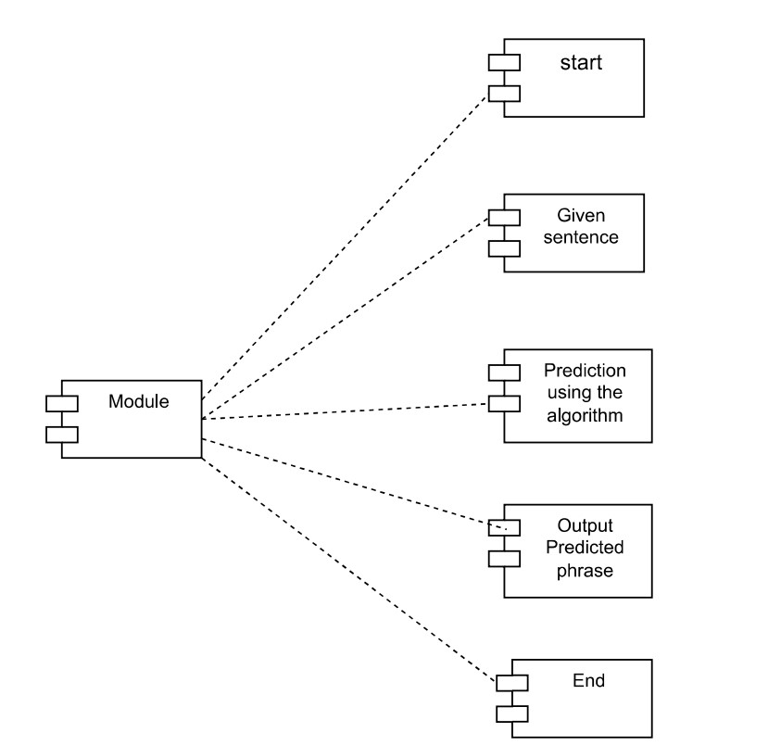
COMPONENT DIAGRAM:

Slide 22
CODE SAMPLE:
CODE TO TRAIN THE MODEL AND SAVE:
import numpy as np import tensorflow as tf from
tensorflow.keras.preprocessing.text import Tokenizer from
tensorflow.keras.preprocessing.sequence import pad_sequences from
tensorflow.keras.models import Sequential from
tensorflow.keras.layers import Embedding, LSTM, Dense
with open('sherlock-holm.es_stories_plain-text_advs.txt', 'r', encoding='utf-8') as file:
text = file.read()
tokenizer = Tokenizer() tokenizer.fit_on_texts([text]) total_words = len(tokenizer.word_index) + 1
input_sequences = [] for line in text.split('\n’):
token_list = tokenizer.texts_to_sequences([line])[0]
for i in range(1, len(token_list)):
n_gram_sequence = token_list[:i+1]
input_sequences.append(n_gram_sequence)
max_sequence_len = max([len(seq) for seq in input_sequences])
input_sequences = np.array(pad_sequences(input_sequences, maxlen=max_sequence_len, padding='pre'))

Slide 23
CODE SAMPLE:
X = input_sequences[:, :-1] y = input_sequences[:, -1]
y = np.array(tf.keras.utils.to_categorical(y, num_classes=total_words))
model = Sequential() model.add(Embedding(total_words, 100, input_length=max_sequence_len-1)) model.add(LSTM(150)) model.add(Dense(total_words, activation='softmax')) print(model.summary())
model.compile(loss='categorical_crossentropy', optimizer='adam', metrics=['accuracy']) model.fit(X, y, epochs=100, verbose=1)
seed_text = "i am happy" next_words =3
for _ in range(next_words):
token_list = tokenizer.texts_to_sequences([seed_text])[0]
token_list = pad_sequences([token_list], maxlen=max_sequence_len-1, padding='pre') predicted = np.argmax(model.predict(token_list), axis=-1) output_word = "" for word, index in tokenizer.word_index.items():
if index == predicted: output_word = word break
seed_text += " " + output_word
print(seed_text)

Slide 24
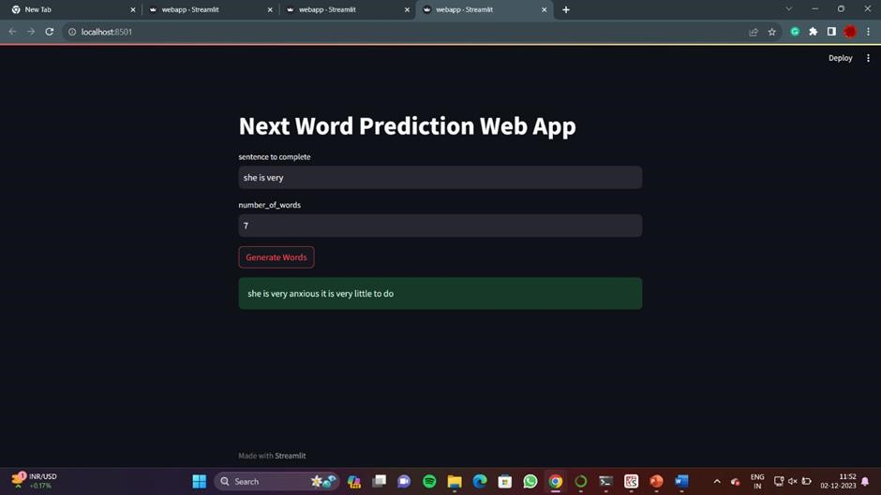
CODE OUTPUT:

Slide 25

CODE OUTPUT:

Slide 26
CONCLUSION:
In the ever-evolving landscape of natural language processing, our journey to enhance the optimization method for predicting English phrases during sentence formation using deep learning has been nothing short of a transformative odyssey. As we reach the culmination of this endeavor, we reflect on the milestones achieved and the promise it holds for the future of human-computer interaction and language understanding.
In the end, our journey continues, and it's an exciting time for computers that are getting really good at understanding and using language just like we do.

Slide 27
REFERENCES:
1. Word Embeddings with Word2Vec:
Mikolov, T., et al. "Efficient Estimation of Word Representations in Vector Space." (2013)
2. Long Short-Term Memory (LSTM) Networks:
Chung, J., et al. "Long Short-Term Memory." (2014)
3. Attention Mechanisms in NLP:
Bahdanau, D., et al. "Neural Machine Translation by Jointly Learning to Align and Translate." (2015)
4. Attention is All You Need:
Vaswani, A., et al. "Attention is All You Need." (2017)

Slide 28
REFERENCES:
5. Universal Language Model Fine-tuning for Text Classification:
Howard, J., & Ruder, S. "Universal Language Model Fine-tuning for Text Classification." (2018)
6. Hybrid Models and Ensemble Approaches:
A Hybrid Approach of Using Convolutional Neural Networks for Sentiment Analysis." (2018)

