Slide 1
Sentimental analysis of twitter comments

Slide 2
Team name: Mind Benders Our team : Saqlain Abbas Ali Khan kb sAi Naveen L.Chakravarthi MENTORS : NIDHI & revanth

Slide 3
objectives
Our goal is to analyse the sentiment of any user through their tweets from the twitter
Towards goal 1, we can build automated software tools that
(i) Analyse tweets from the twitter
(ii) Provide an negative or positive from the tweets of the twitter

Slide 4
What is sentiment analysis?
Sentiment Analysis is the process of ‘computationally’ determining whether a piece of writing is positive, negative or neutral. It’s also known as opinion mining, deriving the opinion or attitude of a speaker.

Slide 5
Why sentimental analysis?
Business: In marketing field companies use it to develop their strategies, to understand customers’ feelings towards products or brand, how people respond to their campaigns or product launches and why consumers don’t buy some products.
Politics: In political field, it is used to keep track of political view, to detect consistency and inconsistency between statements and actions at the government level. It can be used to predict election results as well!
Public Actions: Sentiment analysis also is used to monitor and analyse social phenomena, for the spotting of potentially dangerous situations and determining the general mood of the blogosphere.

Slide 6
modules
1.Keras:
1. It is a sub library of TensorFlow
2. We are using keras and underlying deep learning models to perform data cleaning, normalization and predictions
It offers a higher-level, more intuitive set of abstractions that make it easy to develop deep learning models regardless of the computational backend used

Slide 7
2.Tokenizer:
In Python tokenization basically refers to splitting up a larger body of text into smaller lines, words or even creating words for a non-English language.
3.pandas:
In computer programming, pandas is a software library written for the Python programming language for data manipulation and analysis. In particular, it offers data structures and operations for manipulating numerical tables and time series.
4.numpy:
NumPy is not another programming language but a Python extension module. It provides fast and efficient operations on arrays of homogeneous data. NumPy extends python into a high-level language for manipulating numerical data, similiar to MATLAB.

Slide 8
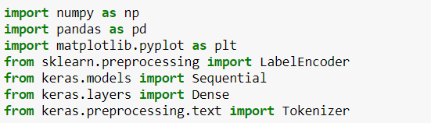
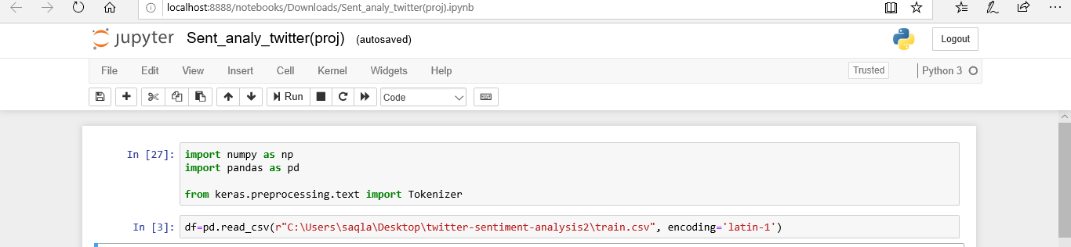
Code snippets:
1. Importing libraries :
2. Loading the datasets :
3.Handeling the missing values:
>> in this case we don’t have any missing values in our data set.

Slide 9
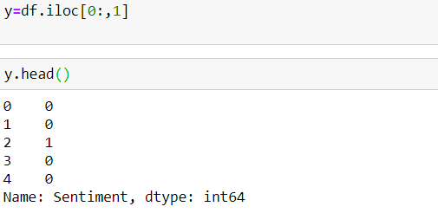
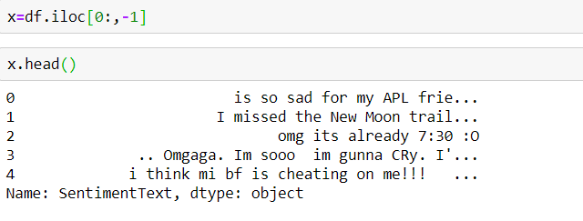
Code snippets :
4. split the dataset into dependent and independent variables:
> Dependent variable:
> Independent variable:

Slide 10
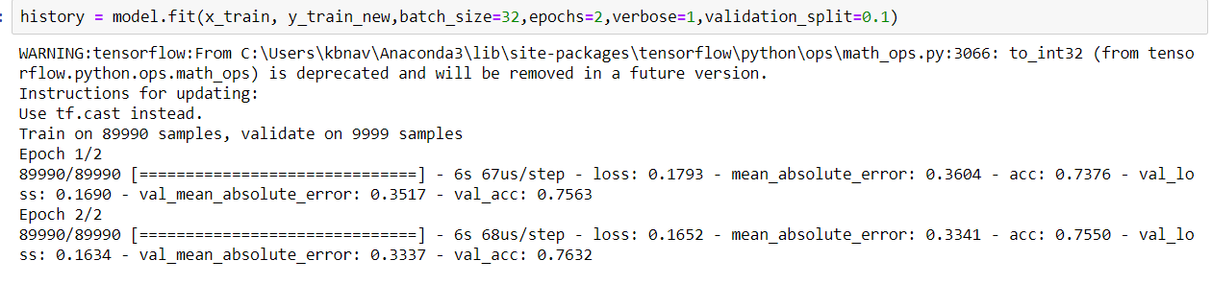
Code snippets:
4. Training the Algorithm:

Slide 11
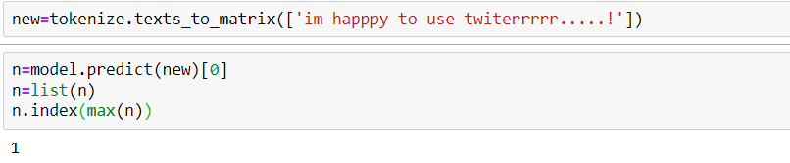
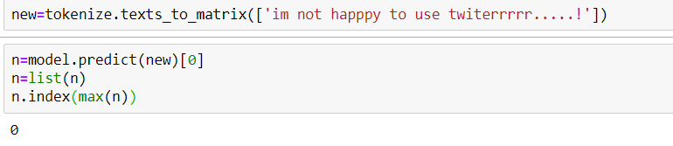
code snippets:
5. Testing the Algorithm :
[1]=positive
[0]=negative

Slide 12
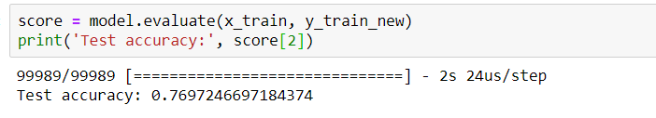
Code snippets :
6. Accuracy:

Slide 13
applications
Sentiment analysis has many applications and benefits to any business and organizations. It can be used to give a business valuable insights into how people feel about said product, brand or service.
When applied to social media channels, it can be used to identify spikes in sentiment, thereby allowing you to identify potential product advocates or social media influencers.
It can be used to identify when potential negative threads are emerging online a business, thereby allowing us to be proactive in dealing with it more quickly.
Sentiment analysis could also be applied to a corporate network, for example, by applying it to your email server, emails could be monitored for their general “tone”.

Slide 14
Conclusion
The age of getting meaningful insights from social media data has now arrived with the advance in technology. The twitter tweets case study gives you a glimpse of the power of Contextual Sentiment Analysis. It’s time for organizations to move beyond overall sentiment and count based metrics. Companies have been leveraging the power of data lately, but to get the deepest of the information, you have to leverage the power of AI, Deep learning and intelligent classifiers like Contextual Semantic Search and Sentiment Analysis

Slide 15
Thank you
Presented by
MIND BENDERS

