Slide 1
Linear & Logistic Regression
Artificial Intelligence
October 7, 2019

Slide 2
Plan
10/07/2019 | Machine Learning | Linear & Logistic Regression | Witten, Frank, Hall
10/09/2019 | Multiagent Systems | Quiz |  | Quiz 2 (Multiagent)
10/14/2019 | Machine Learning | Naive Bayes & Decision Trees | Witten, Frank, Hall
10/16/2019 | Machine Learning | SVM, KNN, KMeans | Witten, Frank, Hall | Assignment 2 (Multiagent)
10/21/2019 | Machine Learning | Validation Methods & Metrics | Witten, Frank, Hall
10/23/2019 | Neural Networks | Perceptrons
10/28/2019 | Machine Learning | Quiz |  | Quiz 3 (Machine Learning)

Slide 3
Quiz 2 (Multiagent systems)
Readings
Brooks (Subsumption)
Maes (Behavior Nets)
Corne, Reynolds, and Bonabeau (Swarm Intelligence)
Russell & Norvig (Genetic Algorithms)
Slides contain a lot of details on these topics
Format
Open-ended questions on concepts (e.g., decentralized control)
Encode problems so that multiagent systems can solve them
Perform simple operations (e.g. crossover)
Given partial execution of algorithm, choose next move

Slide 4
Quiz 2
Detailed understanding of main algorithms and how to apply them to solve problems [no need to memorize equations]
Particle swarm optimization
Ant colony optimization
Genetic Algorithms
High-level understanding of Subsumption architecture & Behavior nets
Conceptual understanding of theory of multiagent systems
Physical systems hypothesis
Society of mind
Decentralized control
and so on……..

Slide 5
On Canvas
Practice problems (non-graded) for Quiz 2
Power of Two Quiz format
Assignment 2 posted

Slide 7

Machine learning
Intro + Linear & Logistic Regression
Naïve Bayes & SVM
Decision Trees, KNN, & K-Means
Validation Methods & Metrics

Slide 8
Today
Intro to machine learning
Intro to supervised learning
Linear regression
In-class activity
Logistic regression
In-class activity

Slide 9
intro to machine learning

Slide 10
What is Learning?
Herbert Simon: “Learning is any process by which a system improves performance [on a task] from experience.”

Slide 11
Classification
Assign object/event to one of a given finite set of categories
Medical diagnosis
Credit card applications or transactions
Fraud detection in e-commerce
Worm detection in network packets
Spam filtering in email
Recommended articles in a newspaper
Recommended books, movies, music, or jokes
Financial investments
DNA sequences
Spoken words
Handwritten letters
Astronomical images

Slide 12
Problem Solving / Planning / Control
Performing actions in an environment in order to achieve a goal
Solving calculus problems
Playing checkers, chess, or backgammon
Balancing a pole
Driving a car or a jeep
Flying a plane, helicopter, or rocket
Controlling an elevator
Controlling a character in a video game
Controlling a mobile robot

Slide 13
Why Machine Learning?
Develop systems that are too difficult/expensive to construct manually because they require specific skills or knowledge tuned to a specific task (knowledge engineering bottleneck)
Develop systems that can automatically adapt and customize themselves to individual users (dynamic adaptation)
Personalized news or mail filter
Personalized tutoring
Discover new knowledge from large databases (data mining)
Market basket analysis
Medical text mining

Slide 14
Related Disciplines
Artificial Intelligence
Data Mining
Probability and Statistics
Information theory
Numerical optimization
Computational complexity theory
Control theory (adaptive)
Psychology (developmental, cognitive)
Neurobiology
Linguistics
Philosophy

Slide 15
At its core machine learning is….
The art of learning a program (rules) from data (experience)

Slide 16
The Learning Task: Improve on task, T, with respect to performance metric, P, based on experience, E
T: Playing checkers
P: Percentage of games won against an arbitrary opponent
E: Playing practice games against itself
T: Recognizing hand-written words
P: Percentage of words correctly classified
E: Database of human-labeled images of handwritten words
T: Driving on four-lane highways using vision sensors
P: Average distance traveled before a human-judged error
E: A sequence of images and steering commands recorded while
observing a human driver
T: Categorize email messages as spam or legitimate
P: Percentage of email messages correctly classified
E: Database of emails, some with human-given labels

Slide 17
Designing a Learning System
Choose the training experience
Choose exactly what is too be learned, i.e. the target function or model
Choose a learning algorithm to infer the target function from the experience
Validate the model with respect to simplicity, accuracy, generalizability, & fairness

Slide 18
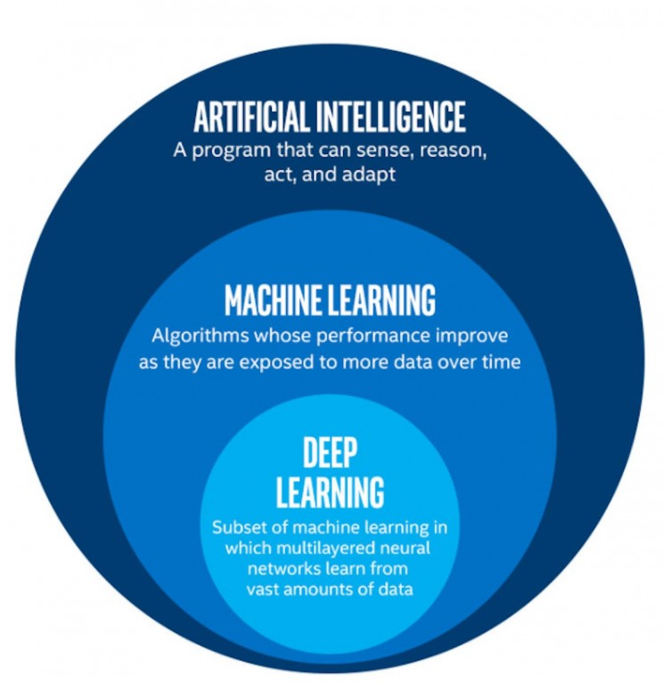

Slide 19
Machine Learning vs. Statistical Inference
Machine Learning
Focus on the prediction
Emphasis on generalizability
Model structure learned on the fly
Highly complex models
Inferential Statistics
Focus on model
Emphasis on explainability
Model structure fixed for hypothesis testing
Simpler models (some variant of linear/logistic regression)

Slide 20
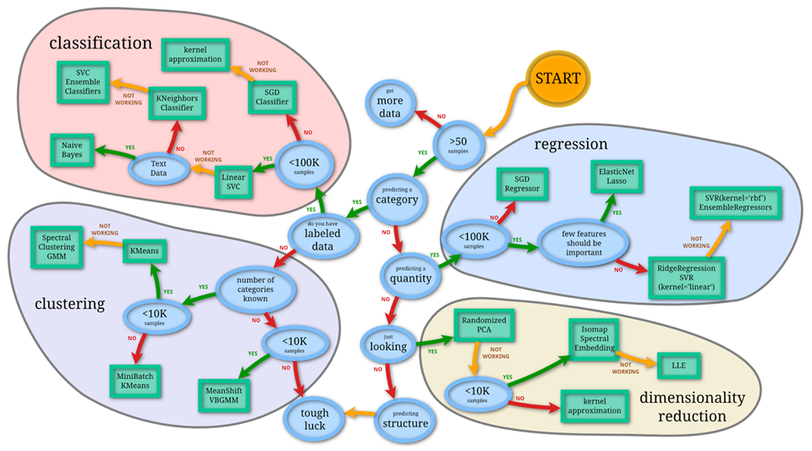
Choosing a learning method

Slide 21
supervised learning

Slide 22
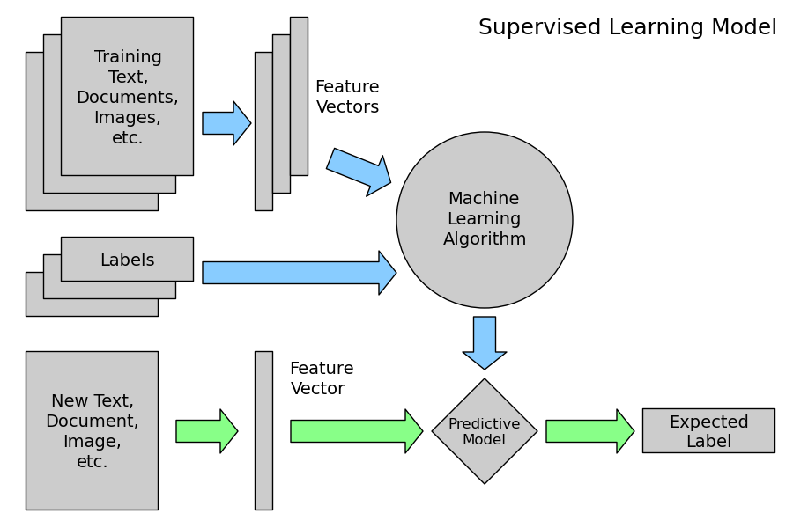

Slide 23
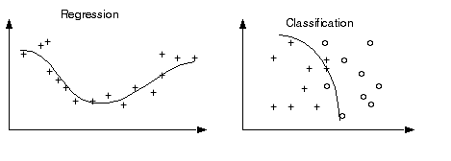
Classification vs. Regression
In classification, we predict categories (e.g., male vs. female).
In regression we predict numeric quantities (e.g., age)

Slide 24
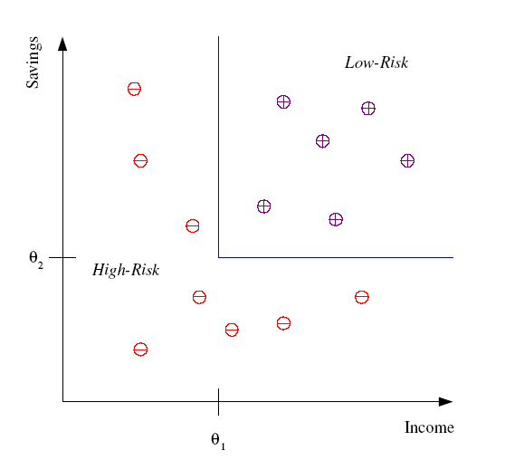
Classification
Example: Credit scoring
Differentiating between low-risk and high-risk customers from their income and savings
Discriminant: IF income > θ₁ AND savings > θ₂
THEN low-risk ELSE high-risk
(θ₁ and θ₂ are the learned parameters)
Model

Slide 25
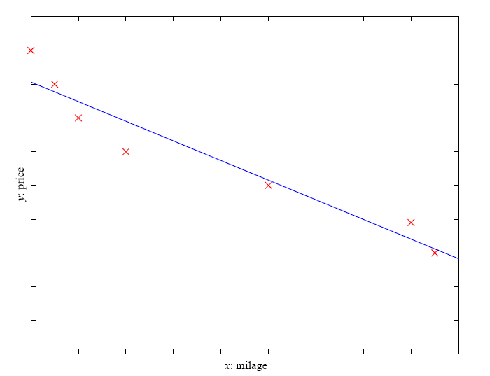
Prediction: Regression
Example: Price of a used car
x : car attributes
y : price
y = g (x | θ )
g ( ) model,
θ parameters
y = wx+w₀

Slide 26
Learning methods we will cover
Linear & Logistic Regression
Bayesian Classifiers
Decision Trees
Support Vector Machines
Instance-Based Learning
Unsupervised learning
KNN
Hierarchical clustering

Slide 27
linear regression

Slide 28
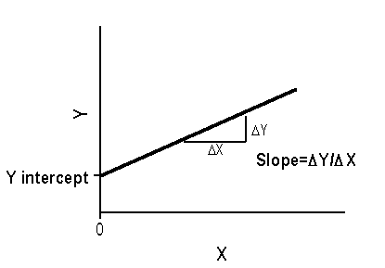
Model is a Line (y = b₁x + b₀)

Slide 29
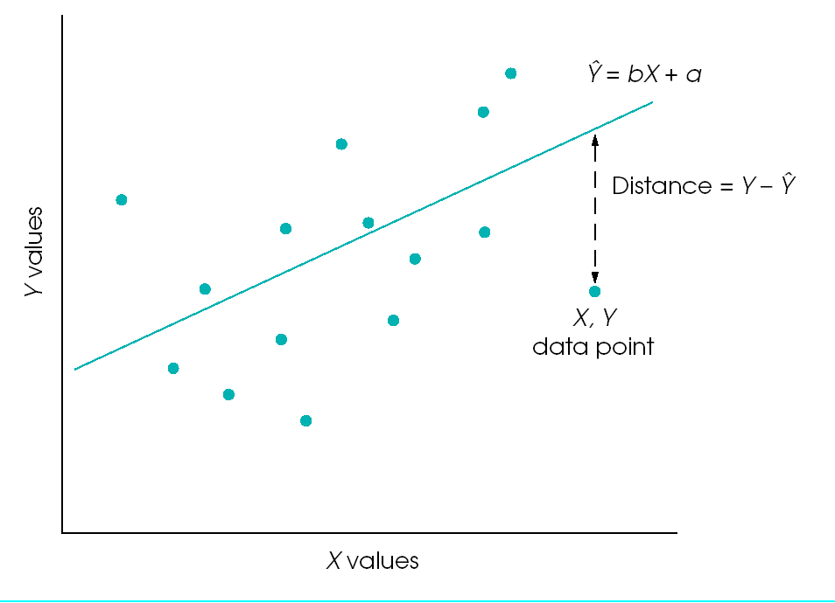
Linear Model & Error (Residual)

Slide 30
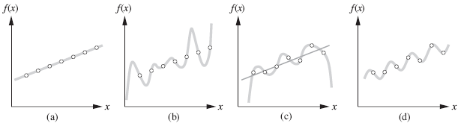
Which model is best?
We want simple models (few parameters) that generalize
to new unseen data – e.g., fig a or c

Slide 31
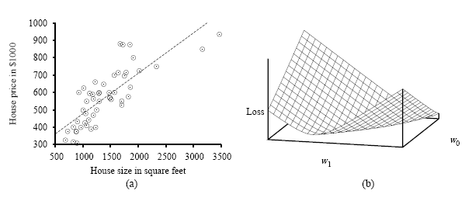
What is the line that minimizes the error?
How would we select the model parameters (w1 and w0)?

Slide 32


Direct Method: Ordinary Least Squares Estimation
Slope b₁ = Covariance(X,Y)/Variance(X)
Intercept b₀ = Ym – b₁Xm
(Ym and Xm are means; same as ybar and xbar)

Slide 33
See LinearRegression.xlsx for details
Slope is 0.373 and intercept is 867
A 1 unit increase in X increases Y by 0.373 (slope)
The value of Y when X is 0 is 867 (intercept)
How good is this model?

Slide 34
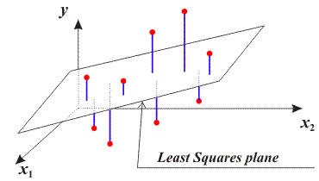
Multiple Regression
Y = b₀ + b₁*X₁ (simple linear regression)
Y = b₀ + b₁*X₁ + b₂*X₂ + ... + b_{p}*X_{p} (multiple regression)

Slide 35
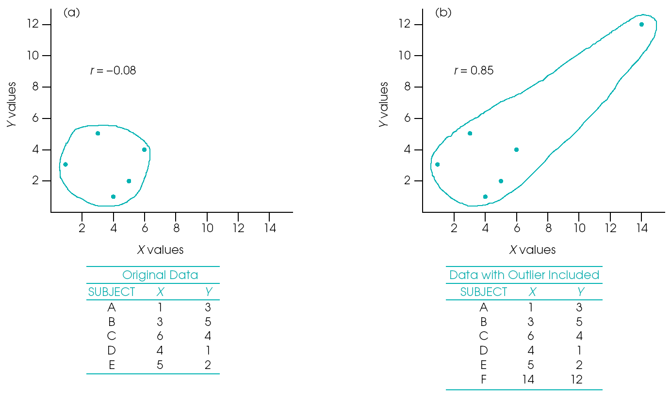
Issues with Regression (Outliers)

Slide 36
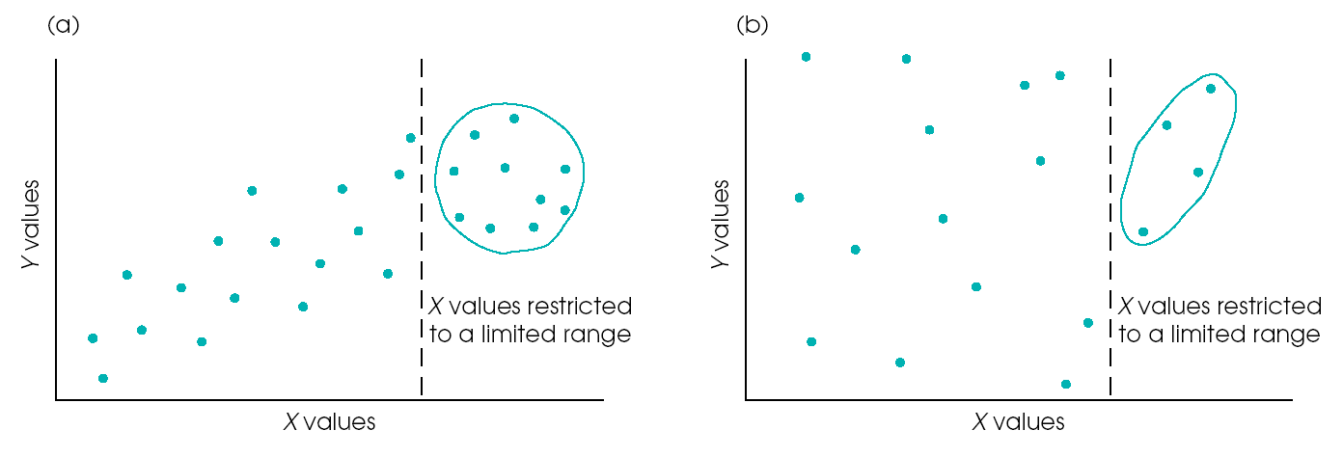
Issues with Regression (Restricted Range)

Slide 37
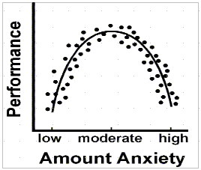
Issues with Regression (Non Linear Relationships)

Slide 38
in-class activity 1

Slide 39
logistic regression

Slide 40
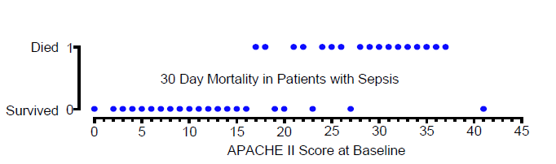
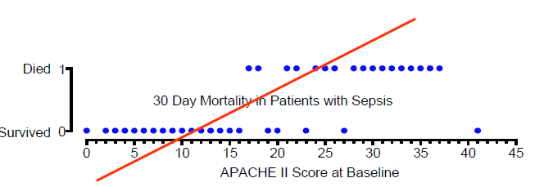
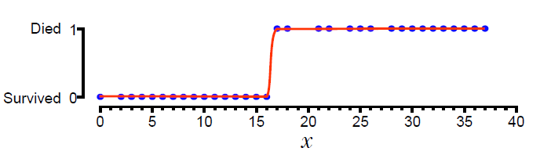
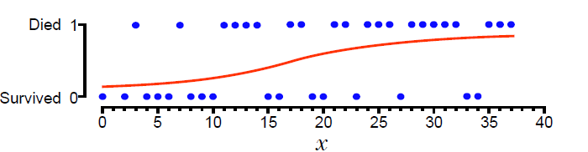
Binary outcomes
(0 or 1)
Linear model
unsuitable
Perfect model
(unrealistic)
Logistic model
(good enough)

Slide 41
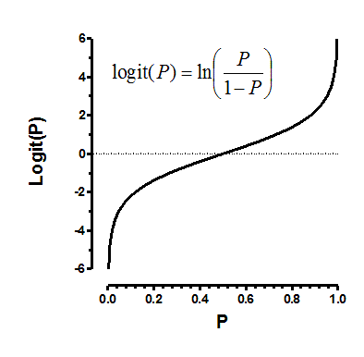

Slide 42


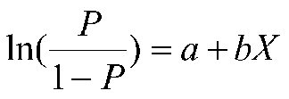
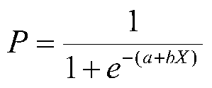

Slide 43
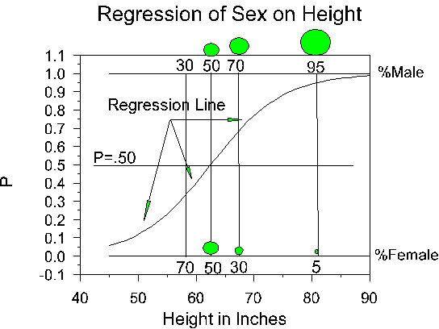
see http://faculty.cas.usf.edu/mbrannick/regression/Logistic.html
Notes:
The Y-axis is P, which indicates the proportion of 1s at any given value of height. (review graph)
The regression line is nonlinear. (review graph)
None of the observations --the raw data points-- actually fall on the regression line. They all fall on zero or one. (review graph)

Slide 44
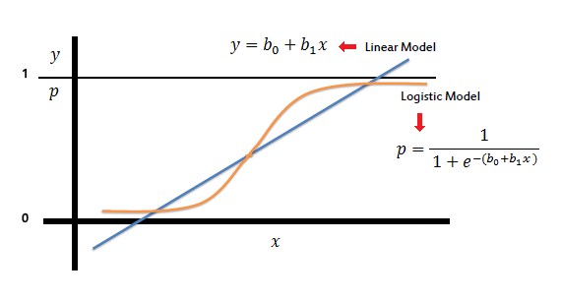
Linear vs. Logistic Regression

Slide 45
in-class activity

Slide 46
review

