Slide 1
Naïve Bayes & SVM
Artificial Intelligence
October 14, 2019

Slide 2
Plan
10/07/2019 | Machine Learning | Linear & Logistic Regression | Witten, Frank, Hall
10/09/2019 | Multiagent Systems | Quiz |  | Quiz 2 (Multiagent)
10/14/2019 | Machine Learning | Naive Bayes & SVM | Witten, Frank, Hall
10/16/2019 | Machine Learning | Decision Trees & Random Forest | Witten, Frank, Hall | Assignment 2 (Multiagent)
10/21/2019 | Machine Learning | Validation Methods & Metrics | Witten, Frank, Hall
10/23/2019 | Neural Networks | Perceptrons
10/28/2019 | Machine Learning | Quiz |  | Quiz 3 (Machine Learning)

Slide 3
Announcements
Assignment 2 due Wednesday
Quiz 2 grading in progress. Should be done by Wednesday
Overlap in content between AI and ML classes
What is the overlap?
Why there is overlap?
Why it should not be a problem?
What to do if you are concerned?
Stephen Hutt will teach the class on Wednesday

Slide 4

Machine learning
Intro + Linear & Logistic Regression
Naïve Bayes & SVM
Decision Trees & Random Forest
Validation Methods & Metrics

Slide 5
Today
Naïve Bayes Classifiers
In-class Activity
Conceptual overview of Support Vector Machines (SVM)

Slide 6
Review
What are the two key components of a good machine learning method?
What is the difference between classification vs. regression?
What is the main idea behind:
Linear regression
Logistic regression

Slide 7
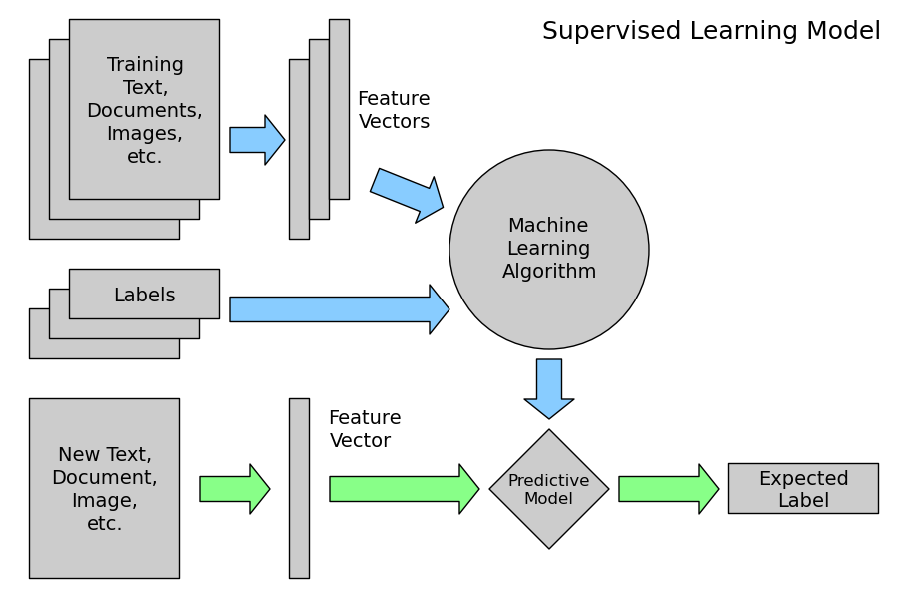

Slide 8
Naïve Bayesian Classifier

Slide 9
‘Play Tennis’ data
Should I play tennis if:
outlook is sunny, temp. is hot,
it is humid
it is not windy?
how about for <sunny, cool, humid = high, windy = true>)?

Slide 10
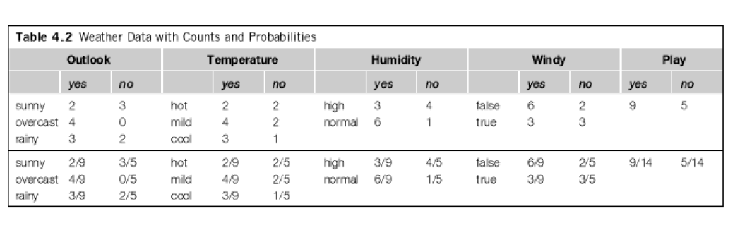
should I play for for <sunny, cool, humid = high, windy = true>)?
Likelihood(yes) = [P(sunny|yes) * P(cool|yes) * P(high|yes) * P(true|yes)] * P(yes)
Likelihood(yes) = [2/9*3/9*3*9*3/9] * 9/14 = 0.0053
Likelihood(no) = [P(sunny|no)*P(cool|no)*P(high|no)*P(true|no)] * P(no)
Likleihood(no) = [3/5*1/5*4/5*3/5] * (5/14) =0.0206
P(yes) = L(yes)/[L(yes) + L(no)]
P(yes) = 0.0053/(0.0053+0.0206) = 20.5%
P(no) = L(no)/[L(yes) + L(no)]
P(no) = .0206 / (0.0053+0.0206) = 79.5%
So decision is NO

Slide 11
Bayes Theorem
h = hypothesis (label)
E is evidence (features)

Slide 12


Independence Assumption

Slide 13
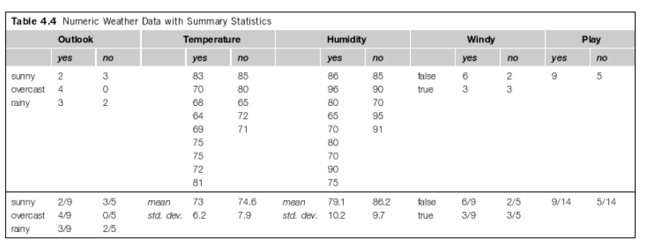
Numeric Attributes

Slide 14

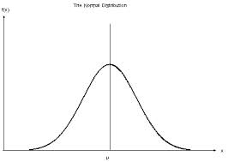
Gaussian (normal) Distribution

Slide 15

Numeric attributes

Slide 16
in class activity

Slide 17
Support Vector Machines (SVM)

Slide 18
Linear Separators
Binary classification is the task of separating classes in feature space (w^{T} is transpose of weight matrix):
w^{T}x + b = 0
w^{T}x + b > 0
w^{T}x + b < 0

Slide 19
Linear Separators
Which of the linear separators is optimal?

Slide 20
Classification Margin
Maximize the distance between positive and negative samples (use a plane rather than a line)
Examples closest to the hyperplane are support vectors.
Margin ρ of the separator is the distance between support vectors.
ρ
r

Slide 21
Maximum Margin Classification
Maximizing the margin is good according to intuition
Implies that only support vectors matter; other training examples are ignorable

Slide 22
Soft Margin Classification
What if the training set is not perfectly linearly separable?
Slack variables ξ_{i} can be added to allow misclassification of difficult or noisy examples, resulting margin called soft.
C is the regularization parameter that controls the trade-off between the misclassification penalty and margin width
ξ_{i}
ξ_{i}

Slide 23
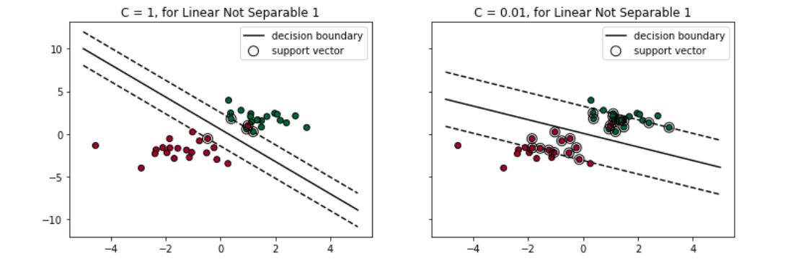
C parameter

Slide 24
Non-linear SVMs
Datasets that are linearly separable with some noise work out great:
But what are we going to do if the dataset is just too hard?
How about… mapping data to a higher-dimensional space:
0
x
0
x
x²
0
x

Slide 25
Non-linear SVMs: Feature spaces
General idea: the original feature space can be mapped to some higher-dimensional feature space where the training set is linearly separable:
Φ: x → φ(x)

Slide 26
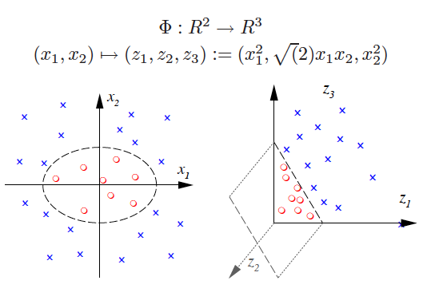
Kernel Trick: accomplished via kernel functions

Slide 27
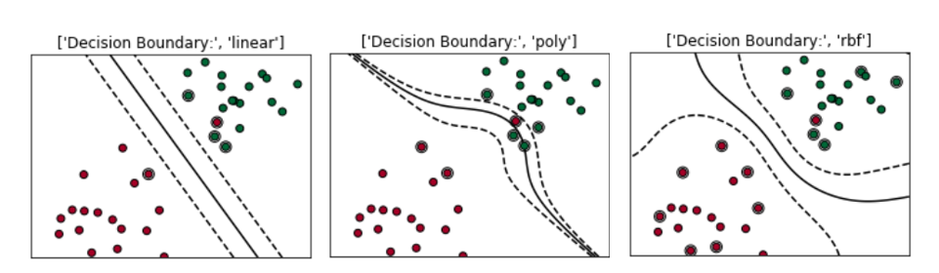
Types of Kernels (linear, polynomial, radial basis function)

Slide 28
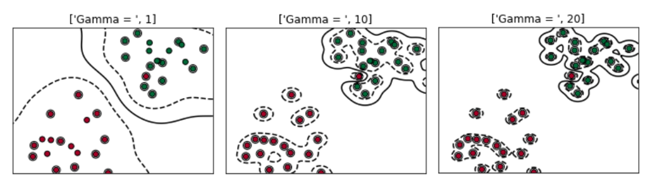
Gamma Parameter for RBF kernels (controls overfitting)

Slide 29
Demos
https://www.youtube.com/watch?v=3liCbRZPrZA
https://www.youtube.com/watch?v=9NrALgHFwTo
https://cs.stanford.edu/~karpathy/svmjs/demo/

Slide 30
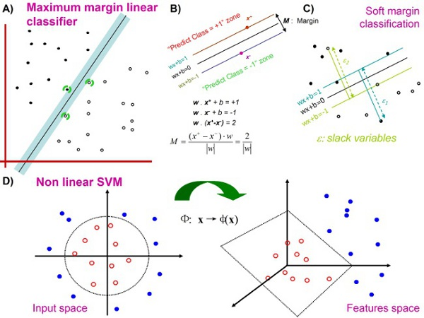
Summary: Linear classification problems, with A), B) hard or C) soft margins. D) Non linear classification.

Slide 31
review

Slide 32
Review: Naïve Bayes
What is the main idea behind Naïve Bayesian classification?
What to do with numeric attributes?
Why is it called Naïve?
What happens when independence assumptions are violated?
How to address this issue?
What to do with zero probabilities?

Slide 33
Review: Support Vector Machines
What is maximum margin classification?
What are support vectors?
What to do when data is not perfectly linearly separable?
What to do when data is completely nonlinear?
What is the kernel trick?
What are the two parameters of SVM?

