Slide 1
Validation
Artificial Intelligence
October 21, 2019

Slide 2
Our Plan
10/21/2019 | Machine Learning | Validation Methods & Metrics
10/23/2019 | Neural Networks | Intro to Neural Networks
10/28/2019 | Machine Learning | Quiz | Quiz 3 (Machine Learning)
10/30/2019 | Neural Networks | Feedforward Networks (Backprop)
11/04/2019 | Neural Networks | Self Organizing Maps | Assignment 3 (Machine Learning)
11/06/2019 | Neural Networks | Recurrent Networks (Hopfield)
11/11/2019 | Neural Networks | Quiz | Quiz 4 (Neural Networks)

Slide 3
Today
Basics of Validation
Validation Methods
Train/test splits, Cross validation, Bootstrapping
Validation Metrics
For classification, For regression
Assessing Fairness in Machine Learning

Slide 4

Machine learning
Intro + Linear & Logistic Regression
Naïve Bayes & SVM
Decision Trees & Random Forest
Validation Methods & Metrics

Slide 5
Intro to validation

Slide 6
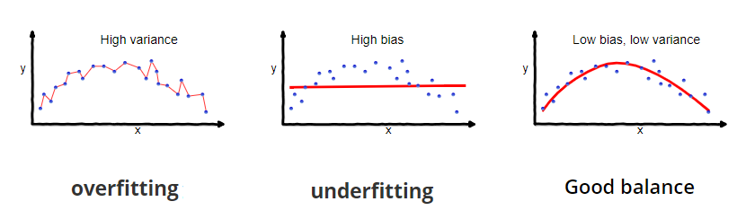
Bias and Variance
Bias: difference between the prediction of our model and the correct value which we are trying to predict
Variance: variability of a model prediction for a given data point. i.e., how much the predictions for a given point vary between different realizations of the model

Slide 7
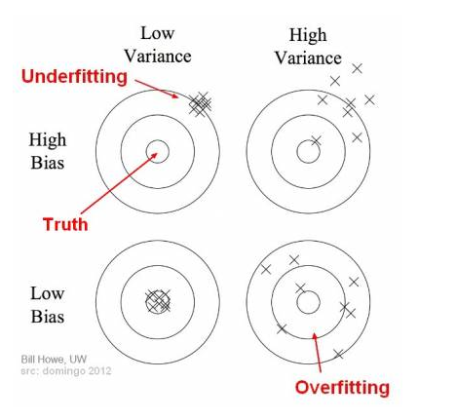
We want low variance and low bias (high accuracy)

Slide 8
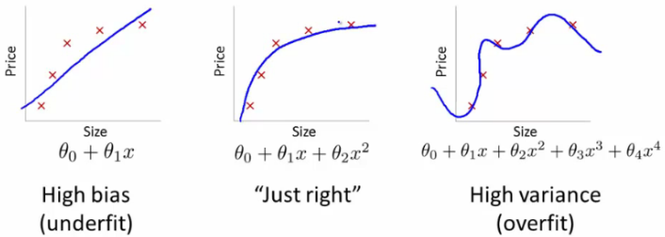
Underfitting and overfitting in regression

Slide 9
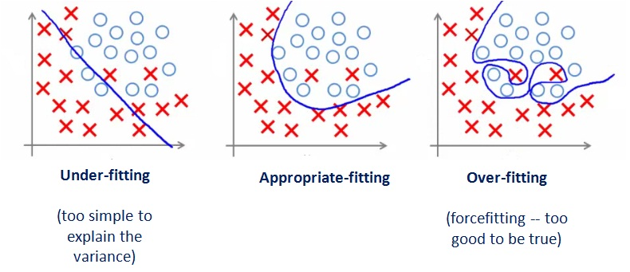
Underfitting and overfitting in classification

Slide 10
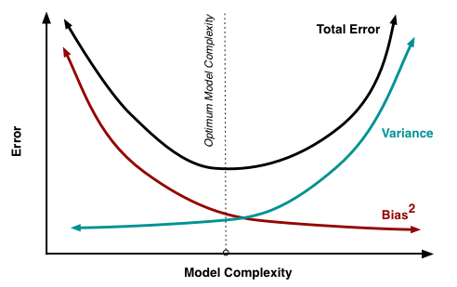
The Bias-Variance Tradeoff

Slide 11
validation methods

Slide 12
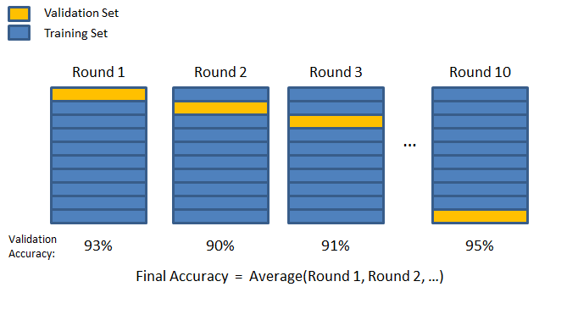
k-fold cross validation

Slide 13
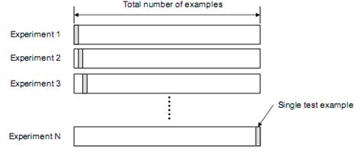
Leave-one-out cross validation (k = 1)

Slide 14
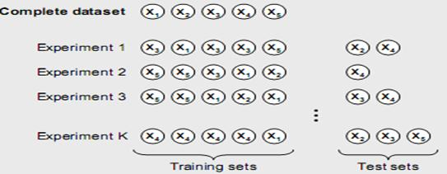
Bootstrapping

Slide 15
0.632 Bootstrap
Data set of n instances is sampled n times with replacement
36.8% chance of instance not being selected.

Slide 16
Summary of Validation Methods
When there is a ton of data
Percent split into training/testing
When there is a decent amount of data
K-fold cross-validation (Recommend not to use k = 1)
When there is little data
Bootstrapping
Most important thing is ensuring independence between training/testing sets and stratification (groups represented in training/testing)

Slide 17
validation metrics (classification)

Slide 18
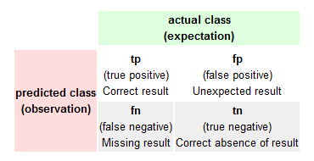

Confusion Matrix (Classification Table)

Slide 19
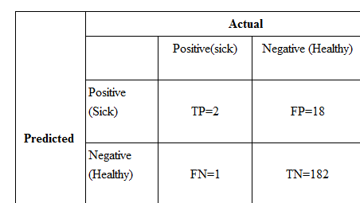
Confusion Matrix
Percent Correct = (2+182)/(1+182+18+1)=90.6%

Slide 20
The Problem with accuracy (% correct)
Have Cancer | Predicted Cancer | Correct
No | No | 1
No | No | 1
No | No | 1
No | No | 1
No | No | 1
Yes | No | 0
No | No | 1
No | No | 1
No | No | 1
No | No | 1
A model that just predicts the majority class every time will have
high accuracy (95% in this case)

Slide 21
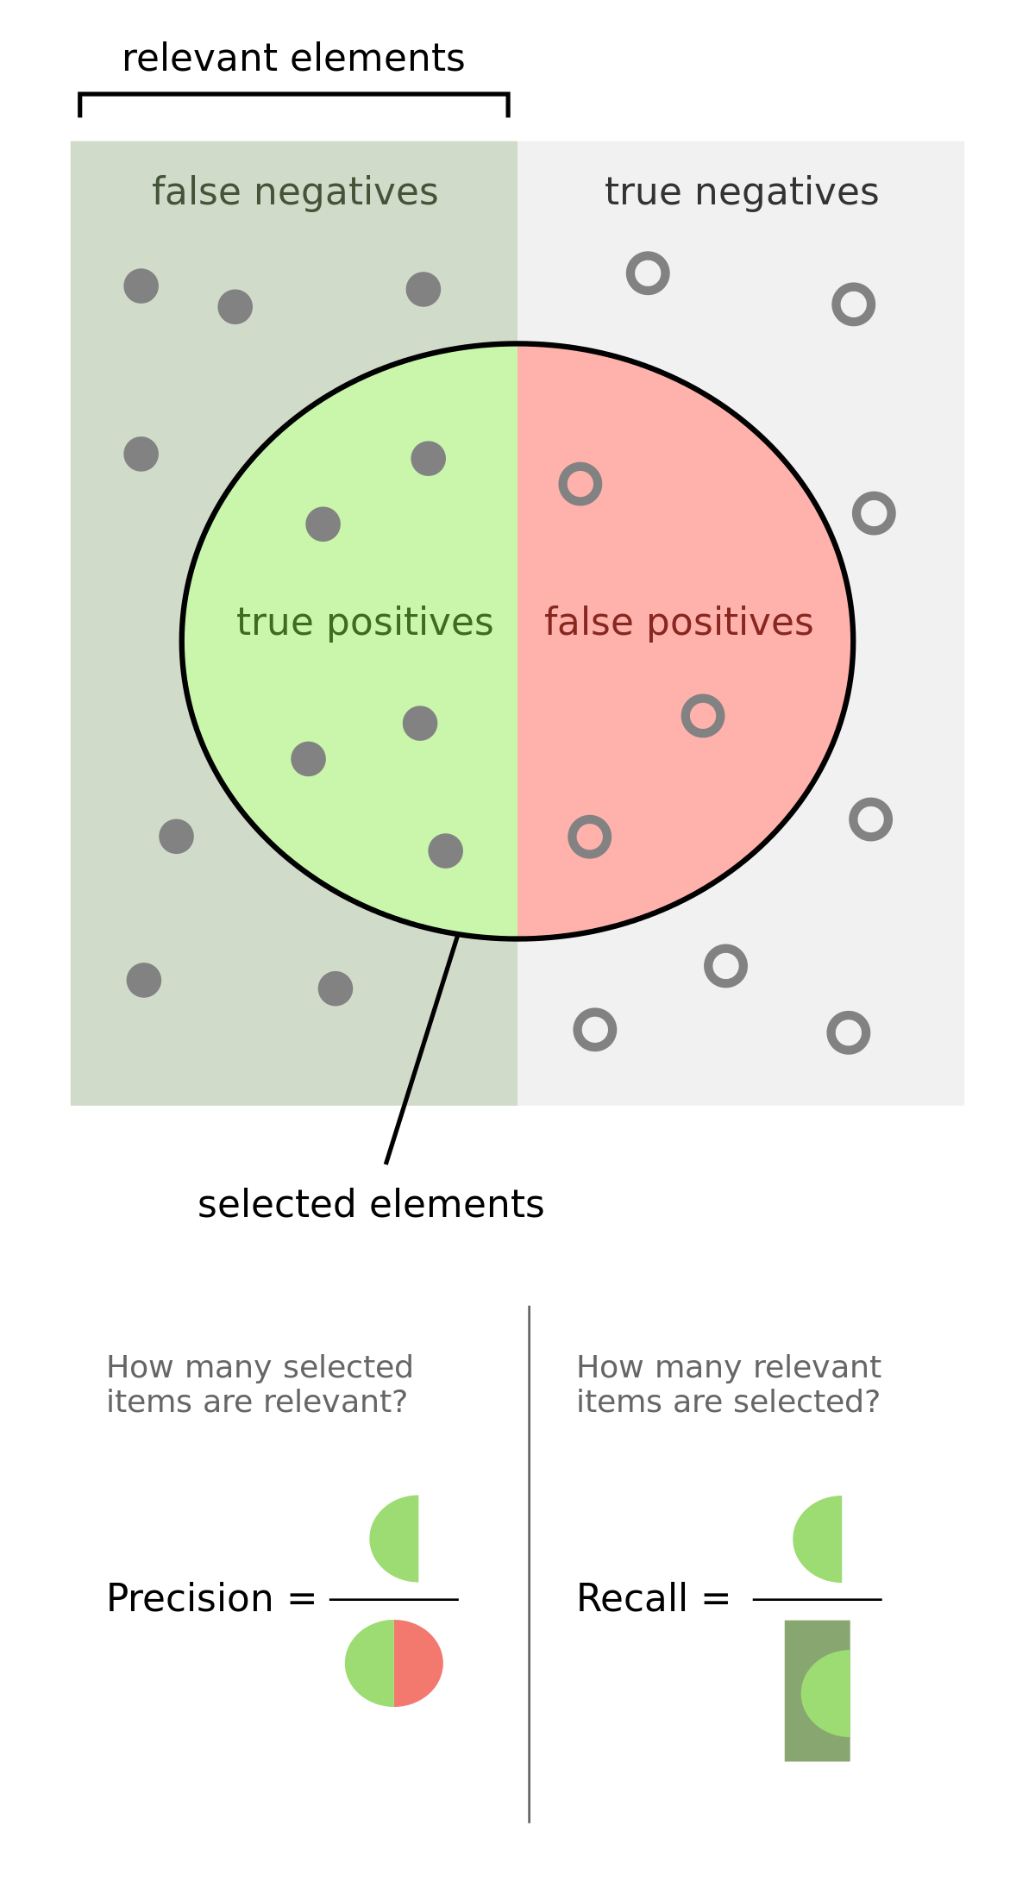
Precision and Recall
Class specific
Here we are predicting the green class
Precision – if I say it is green, is it really green?
Recall – of all the greens, how many do I accurately detect?

Slide 22




Slide 23
in class activity 1

Slide 24
AUROC
For many classifiers, we do not have binary predictions, but the probability of each class (e.g., logistic regression, naïve bayes, Random Forest)
AUROC = area under the receiver operating characteristics (ROC) curve
The ROC curve provides a more nuanced measure of model performance
It can be used to select an application-specific classification threshold as well

Slide 25
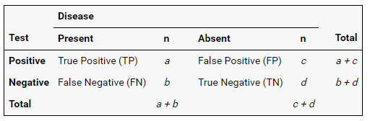

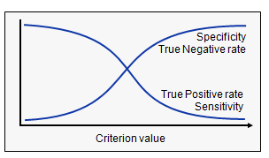
Key ideas: Sensitivity [Recall] & Specificity
Sensitivity - ability to correctly identify the signal
Specificity - ability to correctly identify the absence of the signal
False positive rate = 1- Specificity

Slide 26
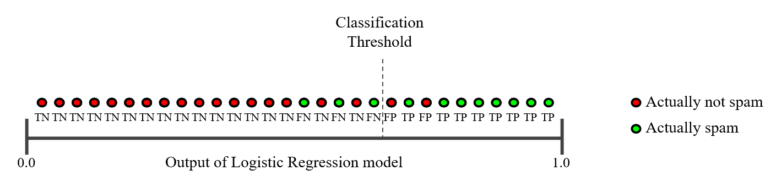
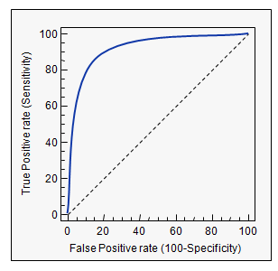
AUC or area under ROC curve: Plot sensitivity vs. (1- specificity) at various decision thresholds

Slide 27
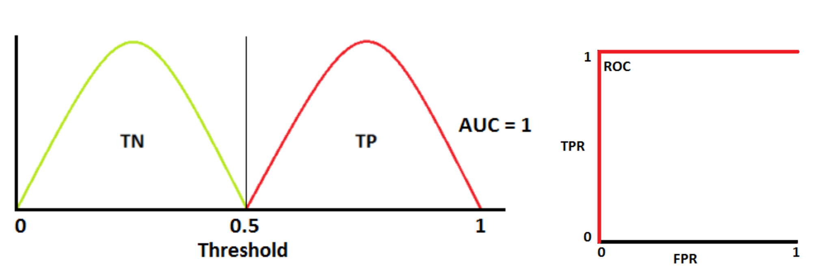
AUC of 1 – perfect performance

Slide 28
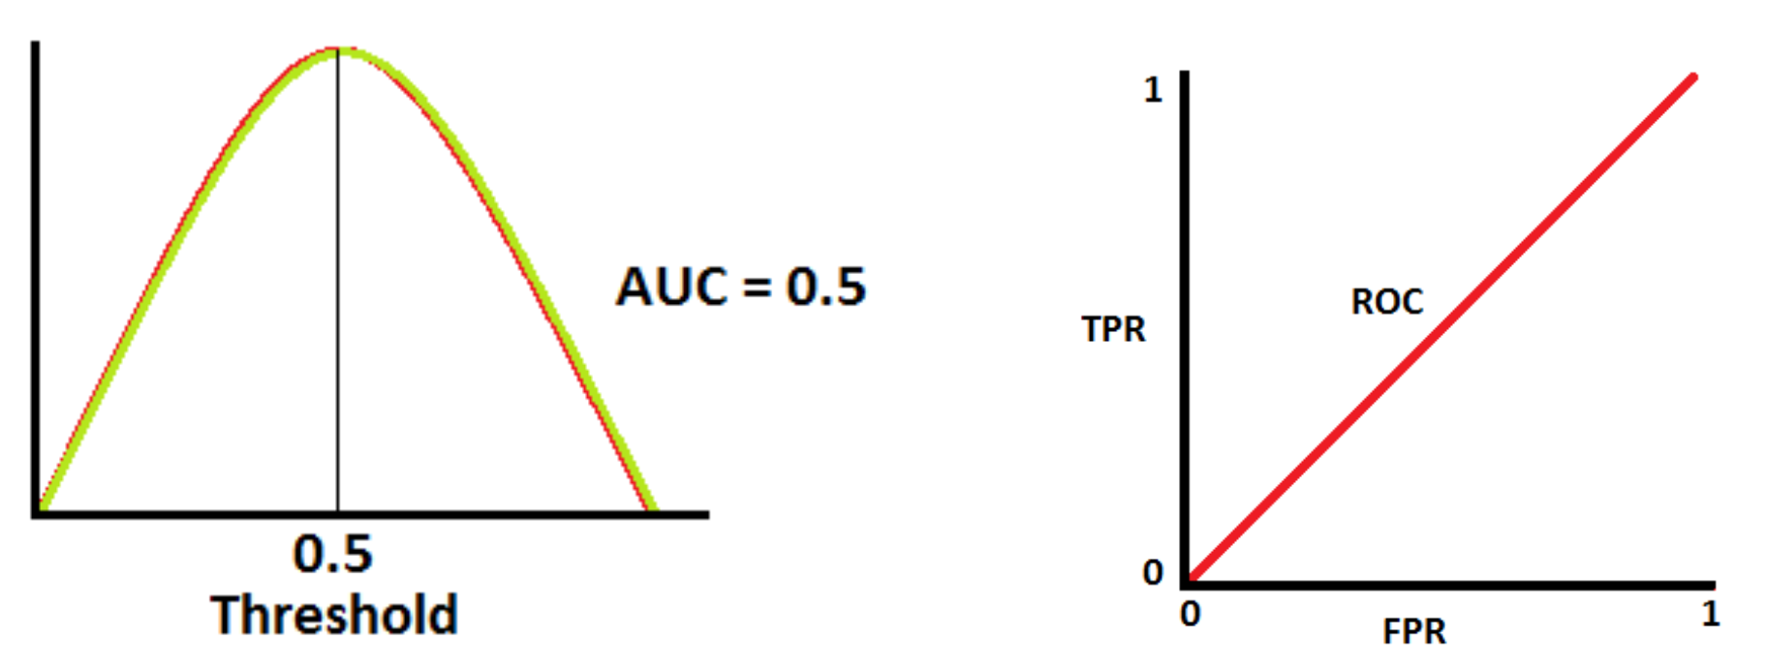
AUC of 0.5 – chance performance

Slide 29
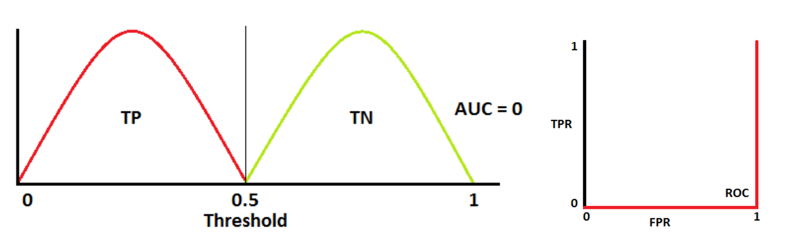
AUC of 1 –performance below chance

Slide 30
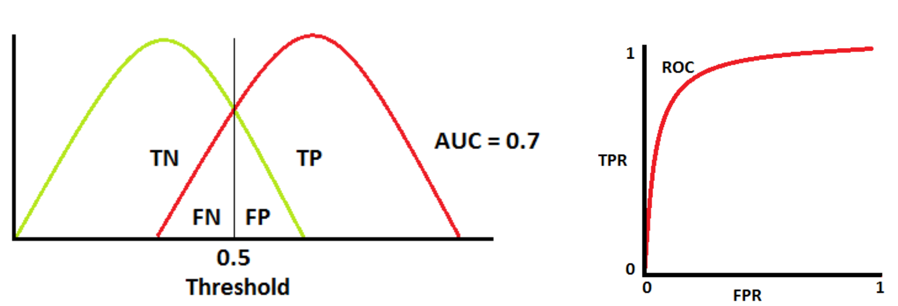
Typical AUCs lie between 0.5 to 1

Slide 31
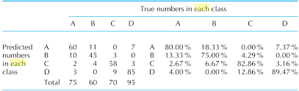
Multiclass Problems
Compute precision, recall, F1 for each class, then combine using unweighted or weighted F1 (weighted by base rates – e.g., class D would have a higher weight than A)
Consider a one vs. other problem (A vs. [B, C, D]; B vs. [A, C, D]) and compute AUROCs

Slide 32
in class activity 2

Slide 33
validation metrics (regression)

Slide 34
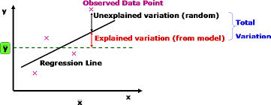
RSq (Coefficient of Determination)
Intuition – how much better does the model do then simply predicting the mean.

Slide 35



Regression (Proportion of variance explained or RSq)
y_{i} = dependent variable (outcome)
x_{i}= independent dependent variable (feature)
f_{i} = predicted values by regression model
SS = sum of squares (measure of variance)
tot = total; res = residual (error variance)
RSq. lies between 0 [chance] and 1 [perfect] performance

Slide 36
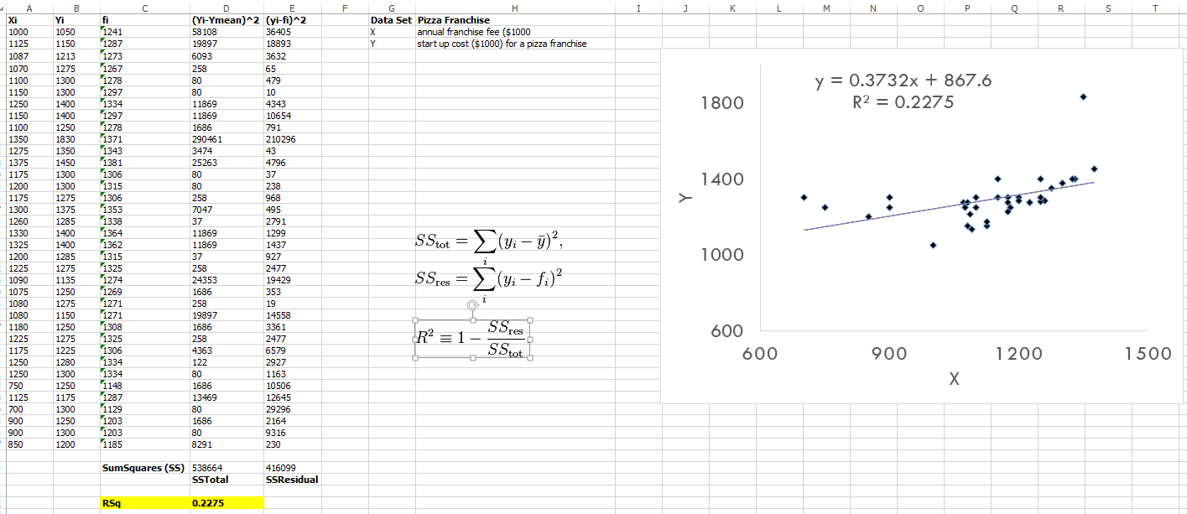
See worked example (RSqWorksheet.xlsx)

Slide 37
assessing fairness in machine learning

Slide 38
What is fairness
Lets borrow from, “Civil Rights Act. Civil Rights Act of 1964, Title VII, Equal Employment Opportunities, 1964.”
Sensitive attribute – gender, race, disability, etc
Disparate treatment - decisions are (partly) based on a person’s sensitive attribute – e.g., using race in a model predicting loan approval.
Disparate impact outcomes disproportionately hurt (or benefit) people with sensitive attributes – e.g., a model predicting GPA is less accurate for economically disadvantaged youth.

Slide 39
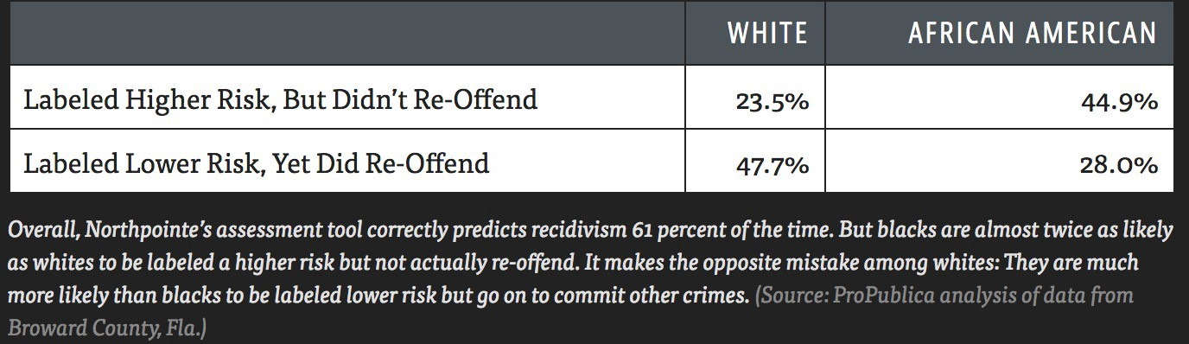
Assessing Fairness of Machine Learning
Central question – is the model generating equally accurate predictions for subgroups in the data (Disparate impact)
We ignore (for now) questions on why models are biased (unfair) and how to make them fair (Disparate treatment)
recidivism means the likelihood that a convicted person will reoffend

Slide 40
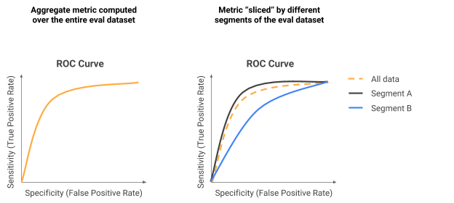
Slicing Analysis
Basic idea is to examine performance by subgroups (slices)
Simple difference among AURROC for A vs. B.

Slide 41
Absolute Between-ROC Area (ABROCA)
Basic idea is to compute differences between ROC curves
Different from simply subtracting two AUC values (which can be 0 if the curves cross)

Slide 42
review

Slide 43
Grading Update
Quiz 2 graded and released
Individual Score: mean = 5.54/7.5
Group Score: mean = 5.44/6
Combined Score = 5.91/7.5
View on gradescope; Solutions posted on Canvas
In-class activity scoring posted on Piazza and canvas
12 currently done (median 11 submitted); 11 remaining
allowances for 4 missed ICAs
Score (out of 7.5%) computed as [#submitted/19 * 7.5]

