Slide 1
Behavior-based AI
Artificial Intelligence
September 25, 2019

Slide 2
Assignment 1
Due Monday 9/30 by 2:00 pm
Keep the late submission policy in mind
10% deduction if less than 24 hours late
25% deduction if greater than 24 hours but less than 48 hours late
50% deduction if greater than 48 hours but less than 72 hours late
Submissions will not be accepted beyond 72 hours (3-days past the deadline)
Any questions?

Slide 3
Agenda
W | 09/25/2019 | Multiagent Systems | Behavior-based AI | Brooke, Maes
M | 09/30/2019 | Multiagent Systems | Swarm Intelligence |  | Assignment 1 (Search)
W | 10/02/2019 | Multiagent Systems | Genetic Algorithms
M | 10/07/2019 | Multiagent Systems | Quiz |  | Quiz 2 (Multiagent)

Slide 4
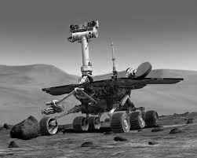
Topic 3: Multi-agent systems for planning and problem solving
Behavior-based AI & Behavior Nets
Swarm intelligence
Generic algorithms

Slide 5
Behavior-based AI
Slides adapted from presentation by Prof. Sharkey

Slide 6
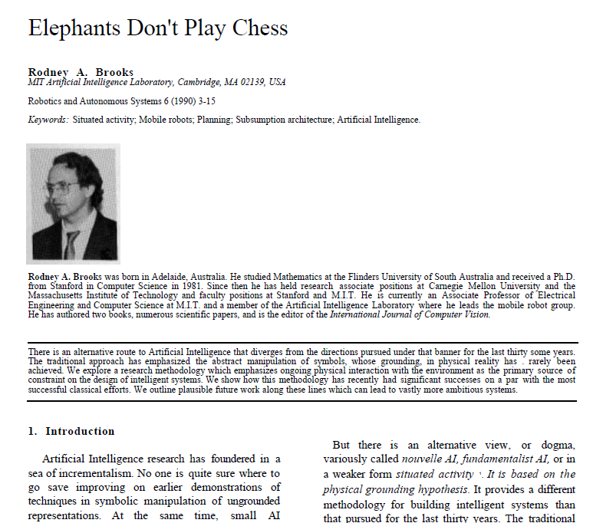

Slide 7
Topics
Introduction to behavior-based AI
Subsumption architecture
Principles of behavior-based AI
In-class activity
Behavior networks

Slide 8
Intro to BEHAVIOR-BASED ai

Slide 9
Introduction
What is intelligence?
Is a house fly intelligent?
Is a house fly more intelligent than Deep Blue?

Slide 10
Introduction
It is unlikely that a house fly:
Forms 3D surface representations of objects
Reasons about the threat of a human with a fly swatter, in particular about the human’s beliefs, goals, or plans
Makes analogies concerning the suitability for egg laying from one situation to another
Constructs naïve physics theories of how to land on the ceiling
Stores knowledge about past encounters as episodes

Slide 11
Introduction
It is much more likely that a house fly:
Has close connection of sensors to actuators
Has pre-wired patterns of behavior
Has simple navigation techniques
Functions almost as a deterministic machine
And yet a house fly is much more successful in the real world than our attempts at AI!

Slide 12
Three approaches to AI
Symbolic AI or Traditional AI or GOFAI (Good Old Fashioned AI)
Connectionism or Neural Networks or Parallel Distributed Processing (PDP)
New AI, (nouvelle AI), Behavior-Based AI, or Embodied AI

Slide 13
Changing emphasis
GOFAI- emphasis on human intelligence, and cognitive reasoning.
Emphasis on centralized control, representing, and reasoning with knowledge.
Key idea is the use of heuristics to manage search

Slide 14

Turn of the millennium – interest in wider range of biological intelligence with decentralized control.
New emphasis on interaction between
Brain
Body
World

Slide 15
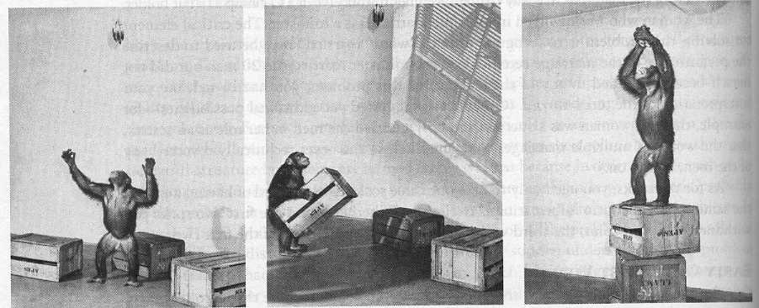
Consider the classic monkey and banana problem

Slide 16
Symbolic AI needs symbolic representation
Concentrates on aspects of problem that can be solved symbolically.
on(monkey, floor),
on(box, floor),
at(monkey, a),
at(box, b),
at(bananas, c),
status(bananas, hanging).
Assumes perception and recognition has already occurred – this is the fatal flaw

Slide 17
Key idea of behavior-based AI
Robots operate in world, using “highly reactive architectures, with no reasoning systems, no manipulable representations, no symbols, and totally decentralised computation” (Brooks, 1991).
The world is its own best model – it contains every detail – “the trick is to sense it appropriately and often enough”

Slide 18
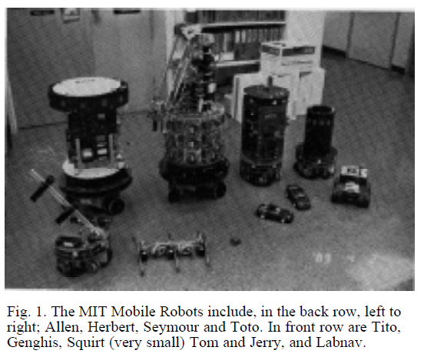
Simple robots as proof of concepts
Early robots developed by Brooks et. al at MIT
Allen
Herbert
Seymour
Tom & Jerry
Genghis
Squirt
Tito
Labnav

Slide 19
subsumption architecture

Slide 20
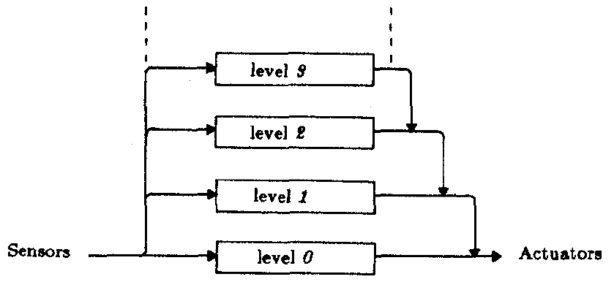
Subsumption Architecture
A parallel and distributed method for connecting sensors and actuators in robots
Simple modules connected in layers
Starting from lowest level: e.g. obstacle avoidance
Next level e.g. goal finding

Slide 21
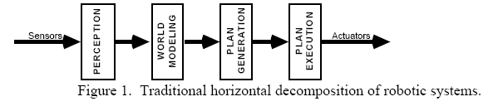
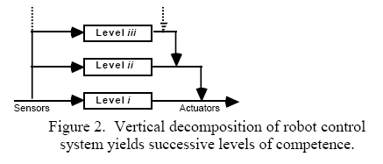

Slide 22
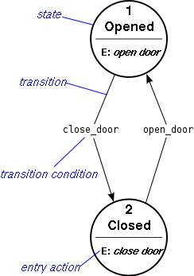
Finite State Machine
Input alphabet
Finite set of states
Output alphabet
Transition function

Slide 23
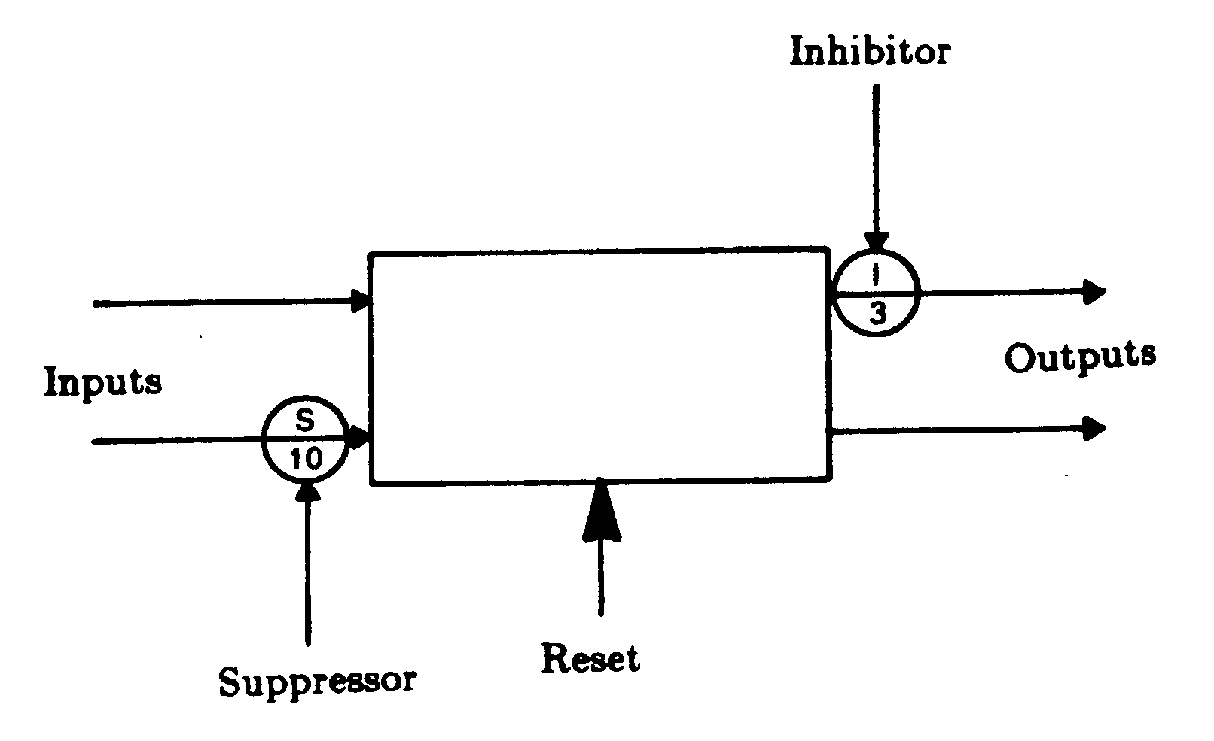
The Subsumption Architecture
Each layer is made up of connected, simple processors: Augmented Finite State Machines (AFSMs)

Slide 24
The Subsumption Architecture
The most important aspect of these AFSMs
Outputs are simple functions of inputs and local variables
Inputs can be suppressed and outputs can be inhibited
This function allows higher levels to subsume the function of lower levels
Lower levels, therefore, still function as they would without the higher levels
No shared state. One AFSM cannot look inside another

Slide 25

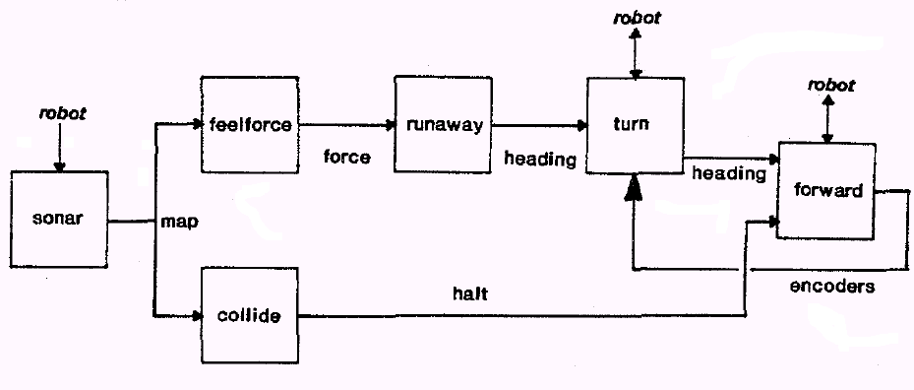
An Example: Allen
Level 0: Stays still, runs away if approached, avoids collisions

Slide 26
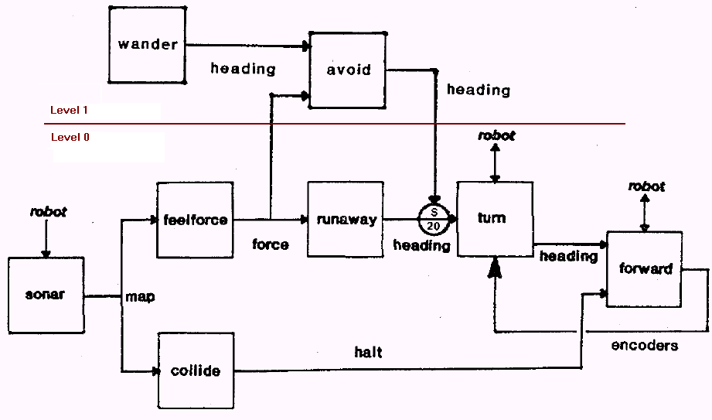
An Example: Allen
Level : Adds random wandering

Slide 27
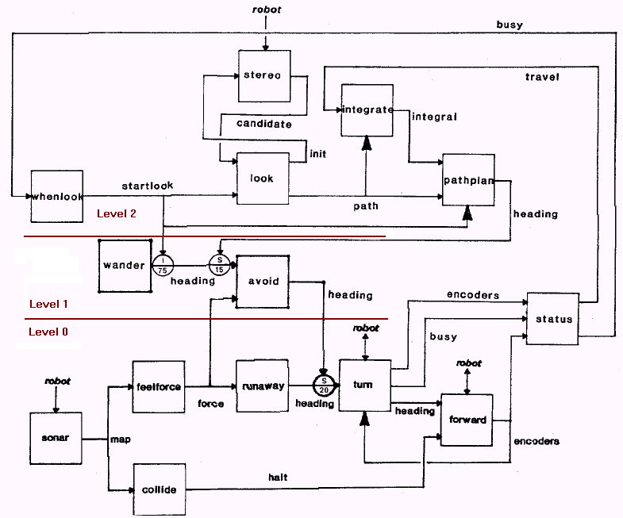
An Example: Allen
Level 2: Moves to distant places

Slide 28
Videos
General video
https://www.youtube.com/watch?v=9u0CIQ8P_qk
Herbert - https://www.youtube.com/watch?v=YtNKuwiVYm0
Genghis - https://www.youtube.com/watch?v=BUxFfv9JimU

Slide 29
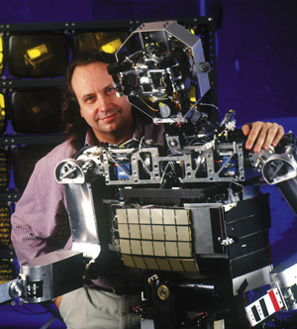
Cog
https://www.youtube.com/watch?v=CbZ9_rUZZMA

Slide 30
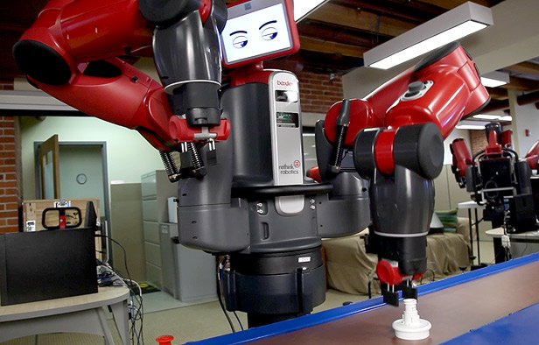
Baxter
https://www.youtube.com/watch?v=gXOkWuSCkRI

Slide 31
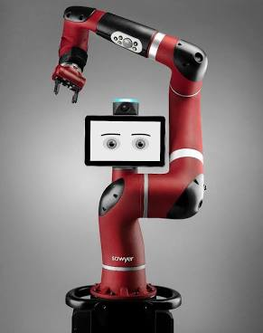
Sawyer
https://www.youtube.com/watch?v=S4mULTknb2I

Slide 32
conceptual issues

Slide 33
Key topics of Embodied AI
Embodiment
Situatedness
Intelligence
Emergence

Slide 34
Embodiment
Only an embodied agent is validated as one that can deal with the real world.
Only through a physical grounding can any internal symbolic system be given meaning.

Slide 35
Situatedness
Traditional AI – working in symbolic abstracted domain. No real connection to external world.
Situated agent – getting information from its sensors, and responding in timely fashion.
“the world is its own best model”

Slide 36
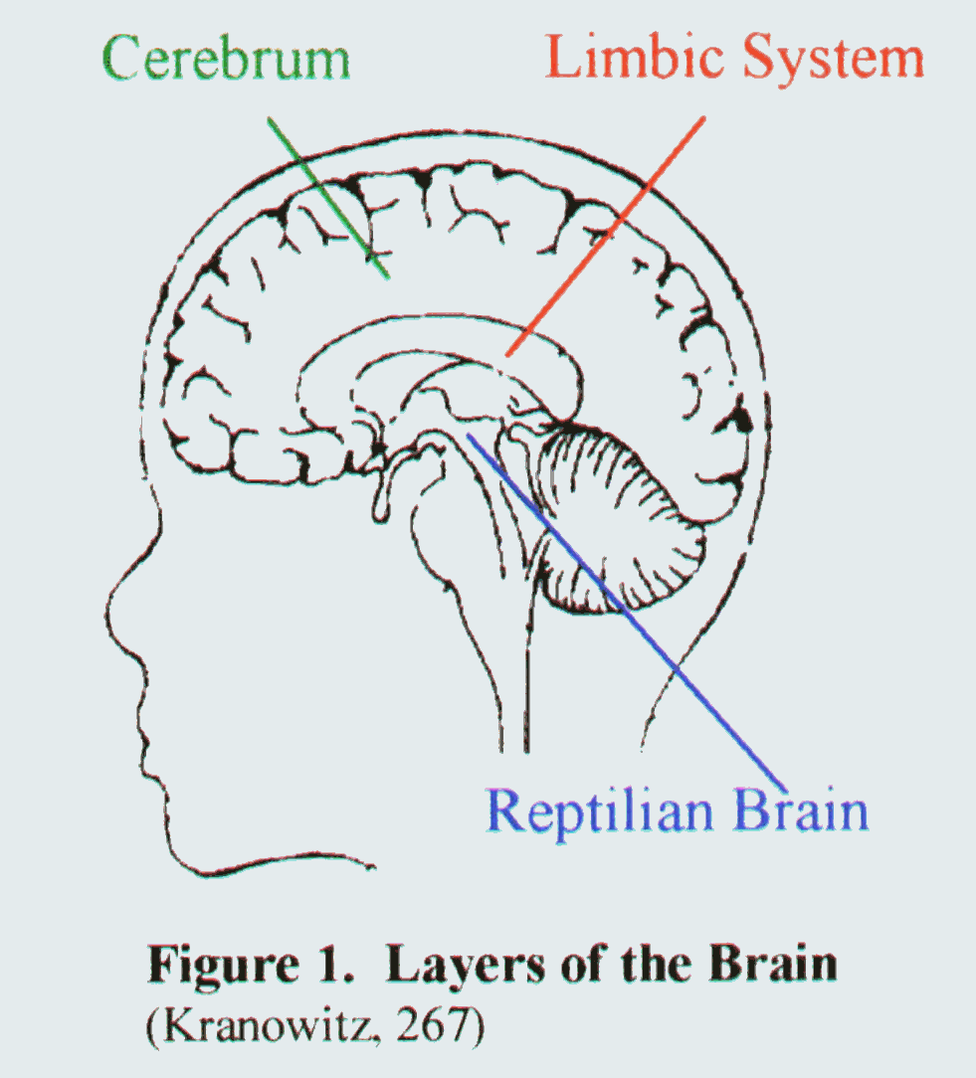
Intelligence
“intelligence is determined by the dynamics of interaction with the world”
Our reasoning, and language abilities are comparatively recent developments
Simple behaviours, perception and mobility, took much longer to evolve

Slide 37
Emergence
“intelligence is in the eye of the observer”
intelligence emerges from interaction of simple modules
E.g. obstacle avoidance, goal finding, wall following modules.
Individual components simple, but resulting combined behaviour appears intelligent.

Slide 38
in-class activity

Slide 39

“What magical trick makes us intelligent? The trick is that there is no trick. The power of intelligence stems from our vast diversity, not from any single, perfect principle.” -Marvin Minsky, The Society of Mind, p. 308

Slide 40
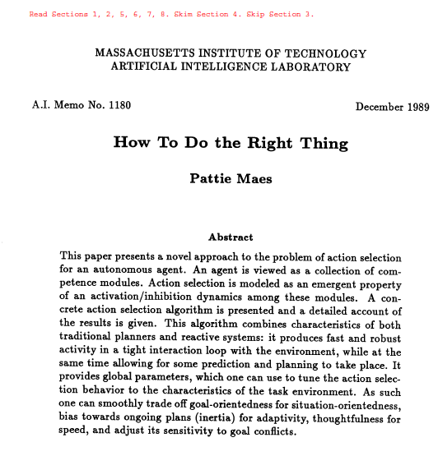

Slide 41
Behavior nets

Slide 42
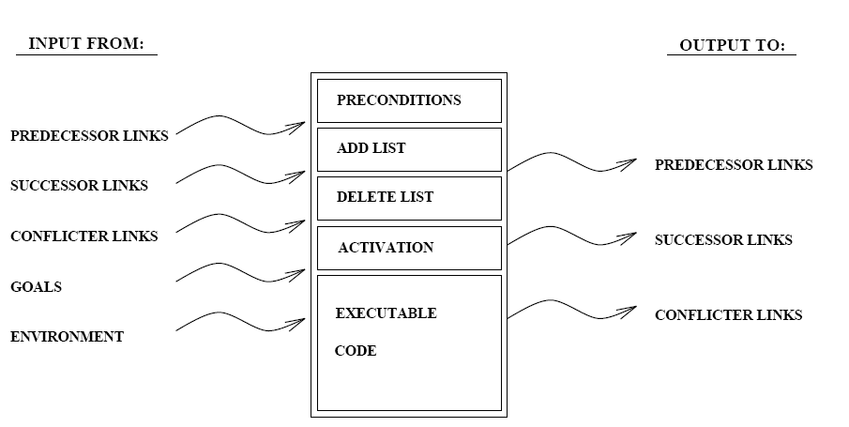
A behavior (or competency module)

Slide 43
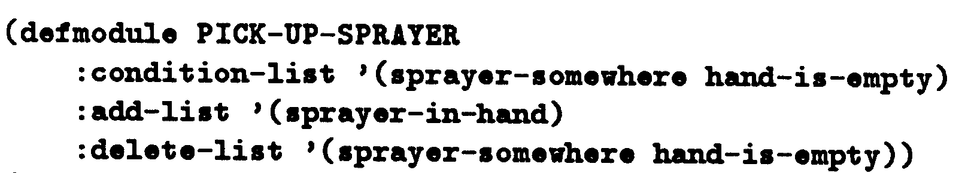
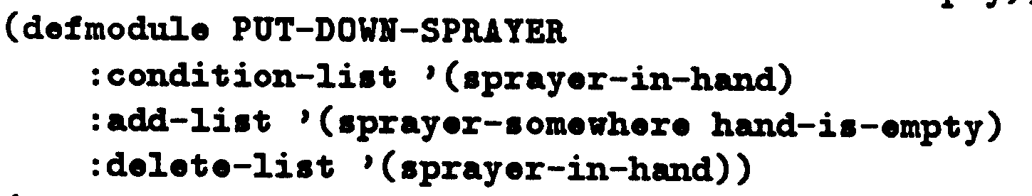

Slide 44
Connect behaviors

Slide 45
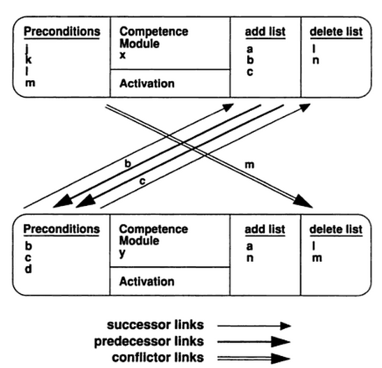

Slide 46
Activation Spreading Links
Internal Sources
Successor links – X has Y as successor for every p that is on X’s add list and Y’s precondition list
Predecessor links – Y has X as predecessor for every successor link from X to Y
Conflictor links – A conflicts with B for every p that is on the delete list of B and on the precondition list of A
External Sources
Environment E or state S activates X for every p in X’s preconditions that are true
Goal G activates p in X’s add list if p satisfies G
Protected goal PG inhibits p in X’s delete list if p is a component of G

Slide 47
Repeat forever
Get activation from state (environment) and goals
Receive activation from state (environment)
Receive activation from goals
Lose activation from protected goals
Spread activation to other behaviors
Send activation to predecessors
Receive action from successors
Inhibit weaker conflictors
Lose activation from stronger conflictors
Decay all activations so that thresholds are bounded
Activate module X if:
X is executable – all preconditions are satisfied
X’s activation is above a threshold
X has the highest activation compared to others with (1) and (2)
If X is selected then set its activation to 0
If none are selected, then reduce threshold by 10%

Slide 48
Industrial Robot
Robot with two arms
Needs to sand a board and spray paint itself
Must coordinate use of hands or use an existing vise in parallel
Must do sanding before painting because is not operational once it has painted itself
Initial state is hand-is-empty, hand-is-empty, sander-somewhere, sprayer-somewhere, operational, board-somewhere

Slide 49
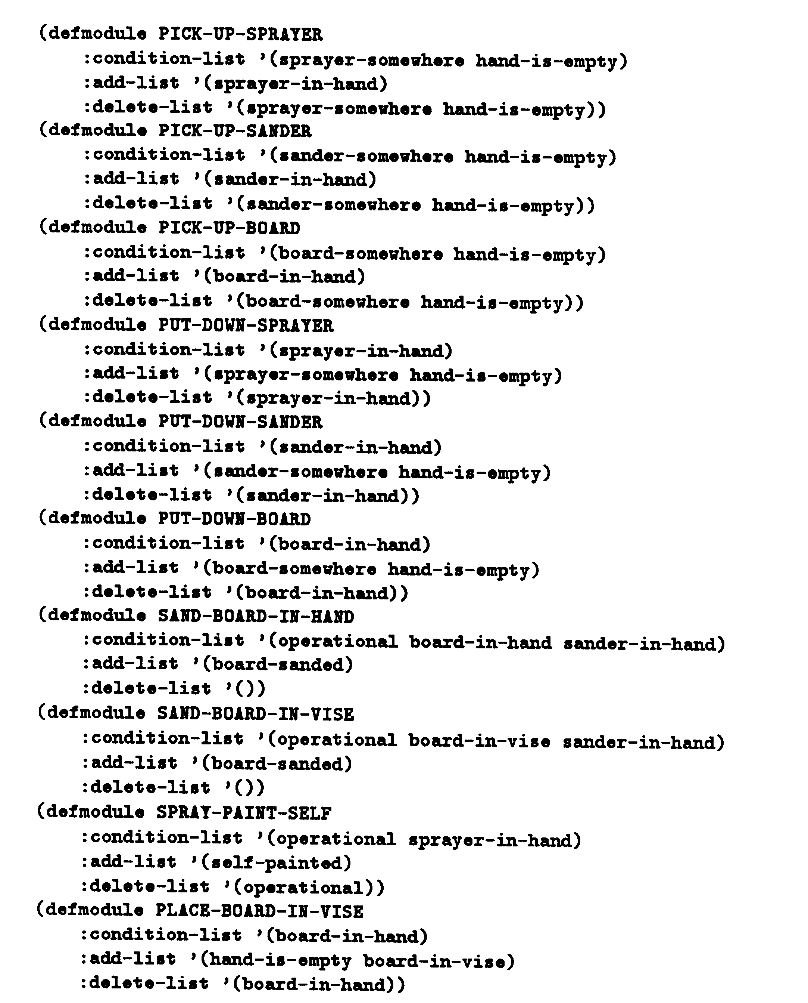

Slide 50
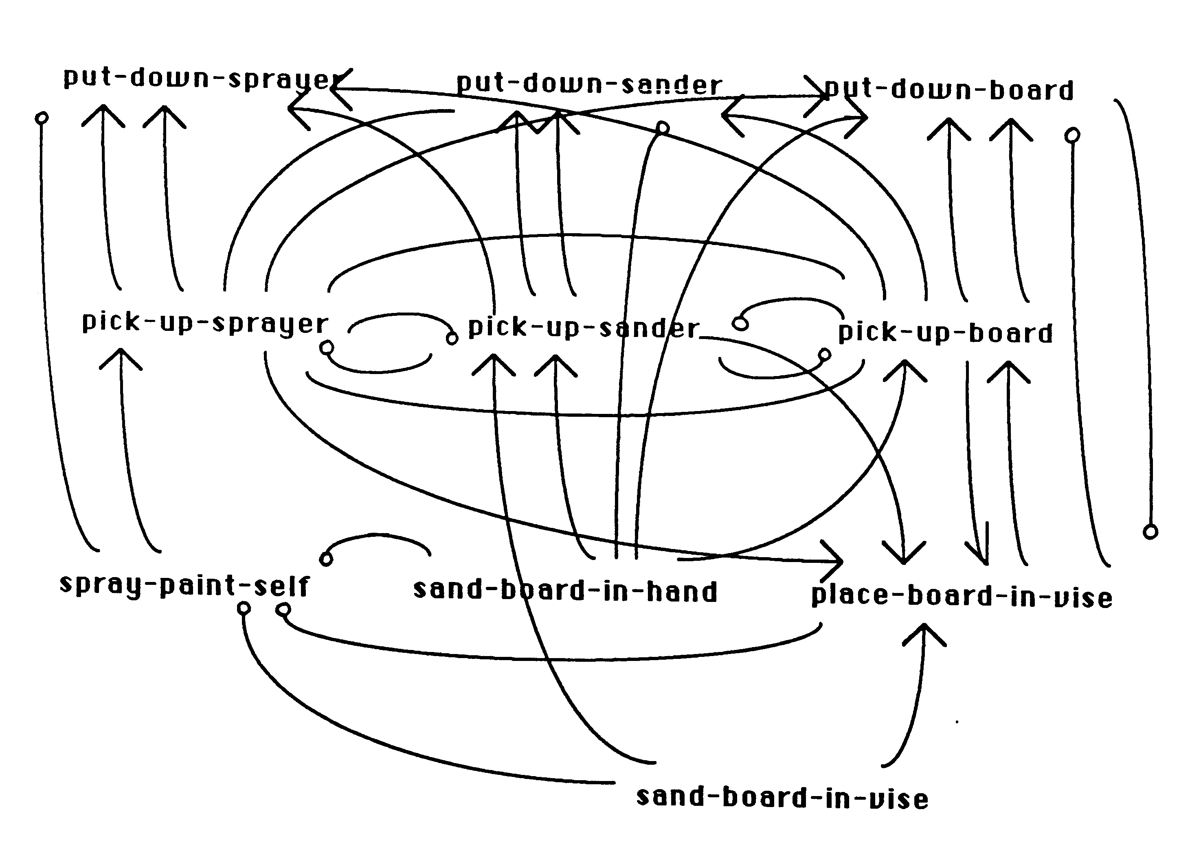

Slide 51
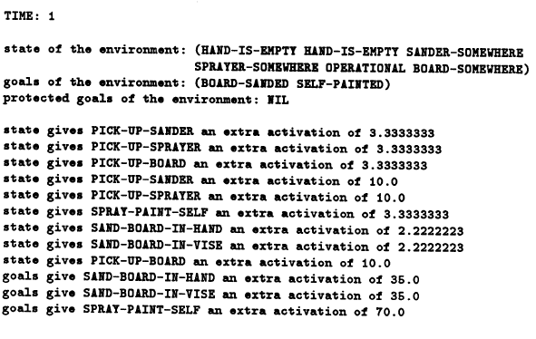

Slide 52
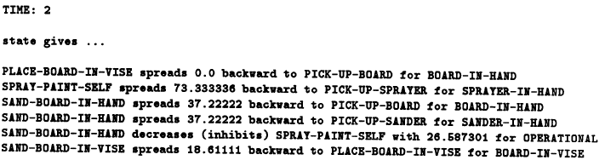
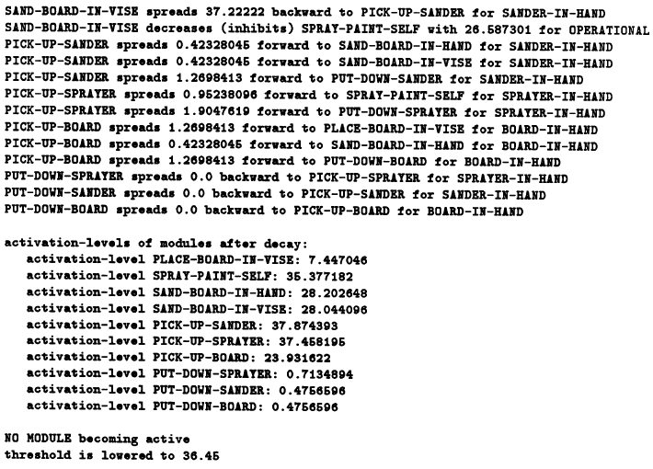

Slide 53
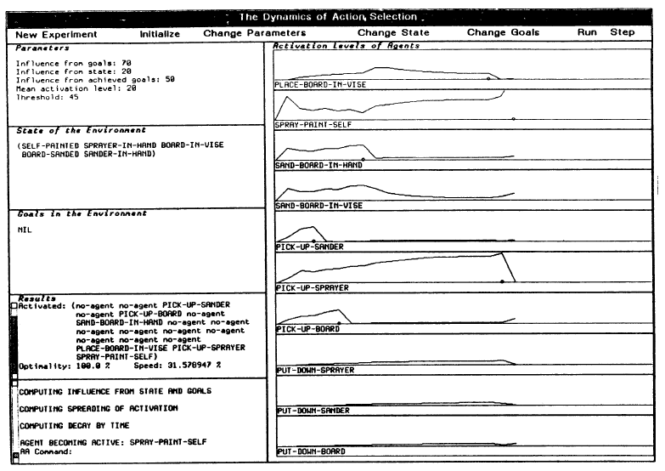

Slide 54
The Plan
2 PICK-UP-SANDER 0.440
4 PICK-UP-BOARD 0.419
5 SAND-BOARD-IN-HAND 0.460
15 PLACE-BOARD-IN-VISE 0.184
16 PICK-UP-SPRAYER 0.934
17 SPRAY-PAINT-SELF 1.518

Slide 55
Good Enough Decisions
What are good-enough decisions?
They are goal oriented
They are opportunistic and adaptable
They stick to a particular goal unless absolutely necessary
They handle interacting and a conflicting goals
They are robust, reactive, and fast
All good decisions involve tradeoffs
Being goal oriented vs. opportunistic
Being thoughtful vs. fast
Being forward-looking vs. learning from the past

Slide 56
Global Parameters control behavior
Global parameters
phi (amount state activates module)
gamma (amount unachieved goal activates module)
delta (amount protected goal deactivates module)
mu (mean activation – for decay)
theta – threshold for execution
How do we make decisions ?
more goal-oriented?
impulsive?
more reactive?
persistent?

Slide 57
Main ideas of Behaviour-based AI
No central model of world
No central locus of control
No separation into perceptual system, central system, and actuation system
Layers or behaviours run in parallel
Behavioural competence built up by adding behavioural modules

Slide 58
review

