Slide 1
Genetic Algorithms
Artificial Intelligence
October 2, 2019

Slide 2
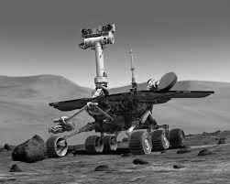
Topic 3: Multi-agent systems for planning and problem solving
Behavior-based AI & Behavior Nets
Swarm intelligence
Generic algorithms

Slide 3
So what is a genetic algorithm?
Genetic algorithms are a randomized heuristic search strategy.
Simulate natural selection, where the population is composed of candidate solutions (genes)
Focus is on evolving a population from which strong and diverse candidates can emerge via mating (sexual reproduction)

Slide 4
Basic Idea of Genetic algorithms
Inspired by genetic inheritance
Start with a population of genes that encodes problem (candidate representation)
Evaluate genes using fitness (same as objective function)
Evolve the population with selection, crossover, and mutation so that fittest genes stay and are modified
Stop when time runs out or good enough solution is found

Slide 5
Candidate representation
We want to encode candidates in a way that makes mutation and crossover easy.
The typical candidate representation is a binary string (genetic code)
Other representations are possible, but they make crossover and mutation harder.

Slide 6
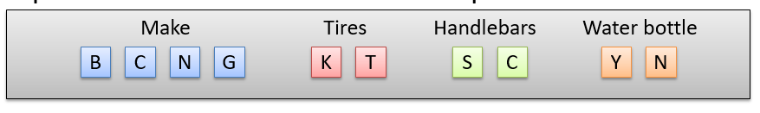
Candidate representation example
Let’s say we want to encode bikes based on these attributes:
Make (Bridgestone, Cannondale, Nishiki, or Gary Fisher)
Tire type (knobby, treads)
Handlebar type (straight, curved)
Water bottle holder (Boolean)
We can encode the gene as a binary string, where each bit represents whether a value is accepted.

Slide 7
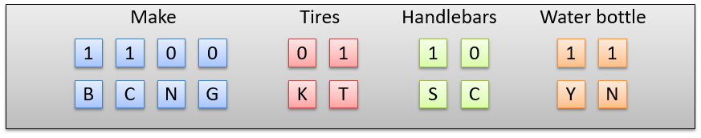
Candidate representation example
The candidate will be a bit string of length 10, because we have 10 possible attribute values.
Let’s say we want a rule that will match any bike that is made by Bridgestone or Cannondale, has treaded tires, and has straight handlebars.
This rule could be represented as 1100011011

Slide 8
Genetic Algorithm Operation: Selection
Fitness Proportionate Selection
Every individual can become a parent with a probability which is proportional to its fitness.
Idea is for the fittest individuals in a population to mate and reproduce
Selection Methods (Positive fitness values only)
Roulette Wheel Selection
Stochastic Universal Sampling
Selection Methods (Positive/Negative fitness values)
Tournament selection

Slide 9
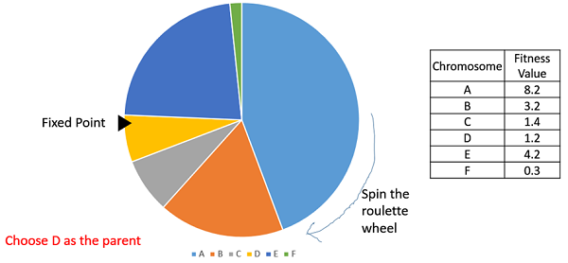
Roulette Wheel Selection
A fitter individual has a greater area on the wheel and therefore a greater chance of being selected
Selection occurs sequentially (wheel is rotated multiple times)

Slide 10
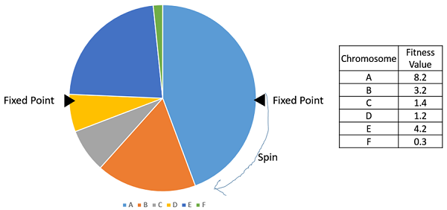
Stochastic Universal Sampling
Same idea as roulette wheel selection except
Selection occurs in parallel (wheel is rotated once)

Slide 11
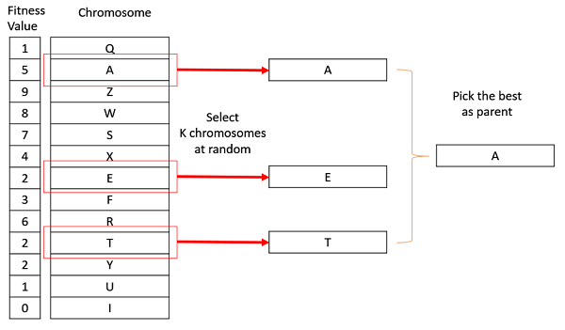
Tournament Selection
Select a random k-individuals from the population
Choose the best (fittest) among them

Slide 12
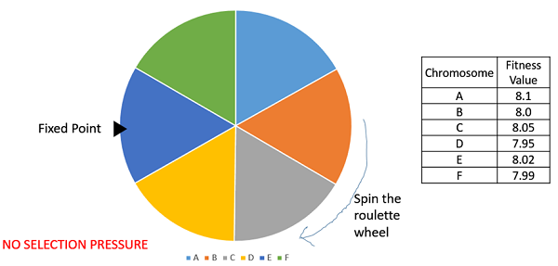
Ranked Selection
Fitness proportionate selection fails when finesses are similar
Forgo fitness, and choose based on fitness rankings instead
In fitness proportional selection, A is almost as likely as F
In rank selection, A (rank 1) is 6 times more likely to be chosen than F (rank 6)

Slide 13
Genetic Algorithm Operators: Crossover and Mutation
Parent 1
1 0 1 0 1 1 1
Parent 2
1 1 0 0 0 1 1
Child 1
1 0 1 0 0 1 1
Child 2
1 1 0 0 1 1 0
Mutation
0
Crossover and mutation points, generally chosen randomly

Slide 14
High-level GA Algorithm
Encode problem as genes (candidate representations)
Randomly generate an initial population
Evaluate the fitness of the population
Select parents and “reproduce” the next generation via crossover and mutation
Replace the old generation with the new generation
Repeat step 2 though 4 till iteration N or good enough solution found
Notes:
T is predefined by the user.

Slide 15
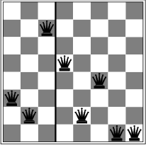
Apply GA to 8-queens

Slide 16
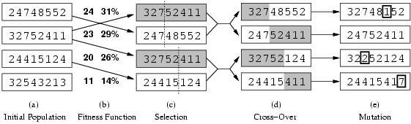
production of next generation
random mutation
Fitness function: number of non-attacking pairs of queens (min = 0, max = (8 × 7)/2 = 28
→ the higher the better)
24/(24+23+20+11) = 31%
crossover point randomly generated
probability of a given pair selection
proportional to the fitness (b)

Slide 17
GA Demos
https://www.youtube.com/watch?v=rGt3iMAJVT8
https://www.youtube.com/watch?v=uxourrlPlf8

Slide 18
Analysis of GAs
How and why do they work?
They work remarkably well
Why do they work?
Uphill tendency – selection operation
Exchange of information along parallel search threads – crossover
Random exploration – mutation and randomness everywhere

Slide 19
Game of life
https://www.youtube.com/watch?v=C2vgICfQawE&t=1s

