Slide 1
Swarm Intelligence
Artificial Intelligence
September 30, 2019

Slide 2
Plan
W | 09/25/2019 | Multiagent Systems | Behavior-based AI
M | 09/30/2019 | Multiagent Systems | Swarm Intelligence | Assignment 1 (Search)
W | 10/02/2019 | Multiagent Systems | Genetic Algorithms
M | 10/07/2019 | Machine Learning | Naive Bayes & Bayes Nets
W | 10/09/2019 | Multiagent Systems | Quiz | Quiz 2 (Multiagent)
M | 10/14/2019 | Machine Learning | Decision Trees & Random Forest
W | 10/16/2019 | Machine Learning | Other Methods (SVM, KNN, etc) | Assignment 2 (Multiagent)

Slide 3
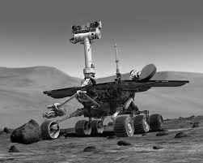
Topic 3: Multi-agent systems for planning and problem solving
Behavior-based AI & Behavior Nets
Swarm intelligence
Generic algorithms

Slide 5
Agenda
Introduction to swarm intelligence (SI)
Ant Colony Optimization (ACO)
In-class activity
Quiz 1 Scoring
Particle Swarm Optimization (PSO)

Slide 6
Introduction to swarm intelligence (si)

Slide 7

“What magical trick makes us intelligent? The trick is that there is no trick. The power of intelligence stems from our vast diversity, not from any single, perfect principle.” -Marvin Minsky, The Society of Mind, p. 308

Slide 8
Swarming
What is swarming?
collective behavior obtained by the aggregation of animals of the same size
Examples?
Termites swarm to build colonies
Birds swarm to find food
Bees swarm to reproduce
Why?
To forage better
To migrate
As a defense against predators

Slide 9
“the whole is greater than the sum of its parts”

Slide 10
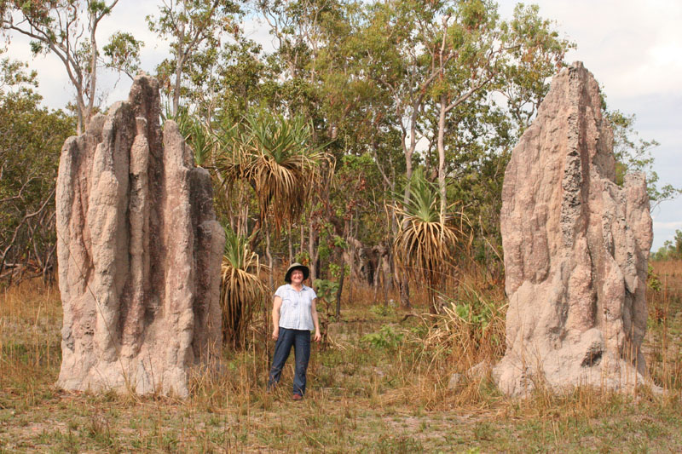
Swarms can achieve things that an individual cannot

Slide 11
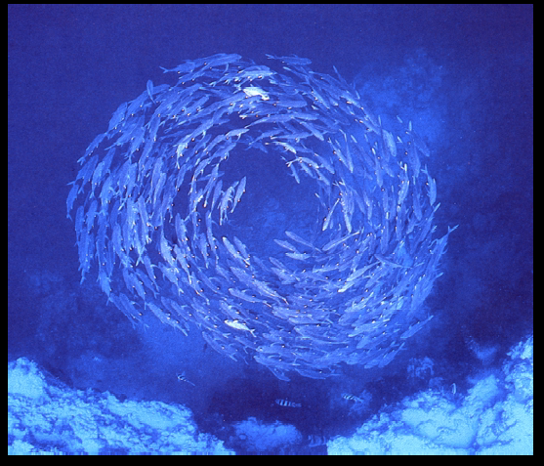
http://www.scs.carleton.ca/~arpwhite/courses/95590Y/notes/SI%20Lecture%203.pdf

Slide 12
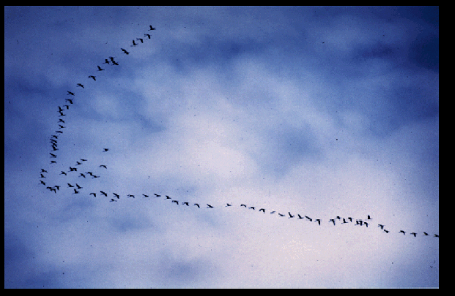
http://www.scs.carleton.ca/~arpwhite/courses/95590Y/notes/SI%20Lecture%203.pdf

Slide 13
Swarming – Example
Bird Flocking
“Boids” model was proposed by Reynolds
Boids = Bird-oids (bird like)
Only three simple rules

Slide 14
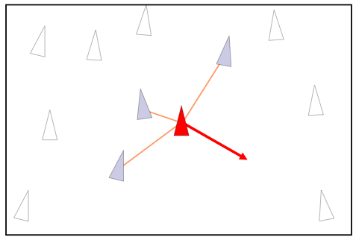
Collision Avoidance
Rule 1: Avoid Collision with neighboring birds

Slide 15
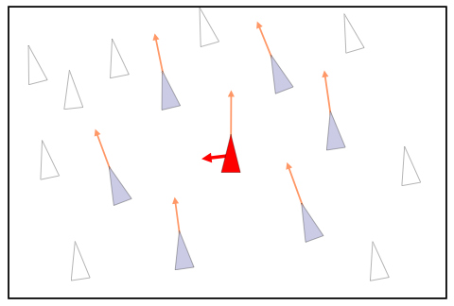
Velocity Matching
Rule 2: Match the velocity of neighboring birds

Slide 16
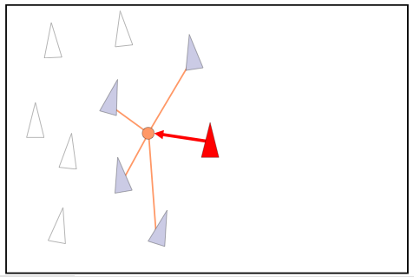
Flock Centering
Rule 3: Stay near neighboring birds

Slide 17
Video of Boids
https://www.youtube.com/watch?v=GUkjC-69vaw
https://www.youtube.com/watch?v=WUnSmvNYjIM

Slide 18
Smarm Intelligence (SI)
Collective emergent behavior of decentralized self-organized systems
Why?
Computer Systems are getting complicated
Hard to have a master control
Attempt to learn from nature
Swarm intelligence systems are:
Robust
Relatively simple
Decentralized

Slide 19
Applications
Movie effects
Lord of the Rings
Network Routing
ACO Routing
Swarm Robotics
Swarm bots
All sorts of optimization problems (like our local search algorithms)

Slide 20
Two main SI algorithms
Ant Colony Optimization (ACO)
Particle Swarm Optimization (PSO)

Slide 21
Ant Colony Optimization (ASO)

Slide 22
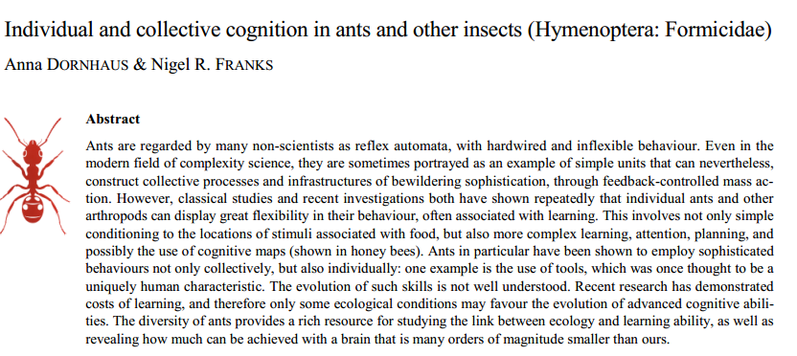

Slide 23
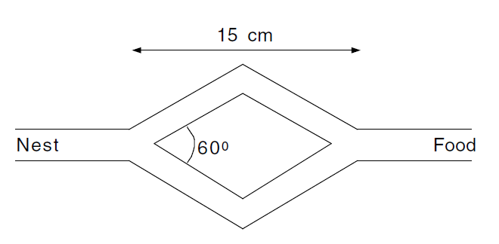
Denebourg’s double bridge experiments (same length)
Ants choose each branch

Slide 24
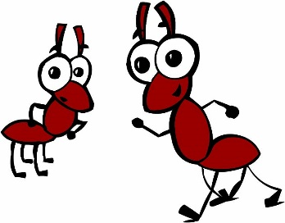
Double bridge experiments: different lengths

Slide 25
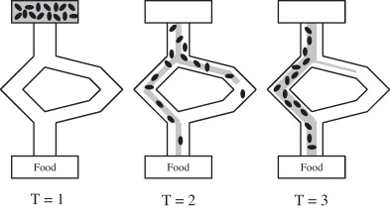
Double bridge experiments
The majority of ants follow the short path
How?

Slide 26
Key concept is Stigmergy
Stigmergy – indirect communication between individuals (ants) driven by environment modifications
Done with pheromone trails in ants
Pheromone is a semiochemical (chemical secreted for the purpose of communication)

Slide 27
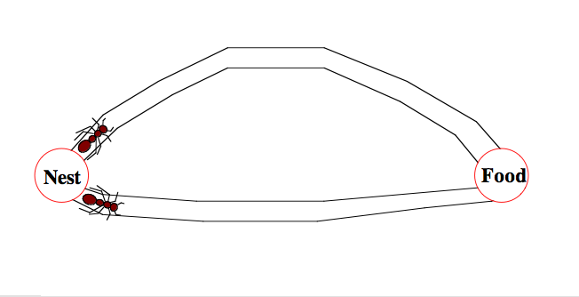
Foraging behavior of Ants
Two ants start with equal probability of going on either path.

Slide 28
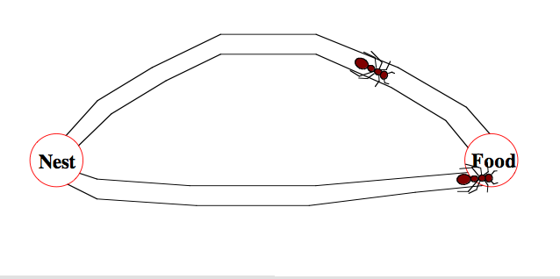
Foraging behavior of Ants
The ant on shorter path has a shorter to-and-fro time from it’s nest to the food.

Slide 29
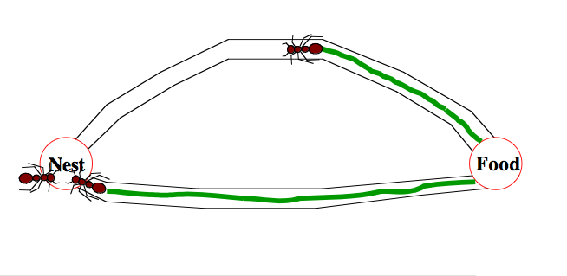
Foraging behavior of Ants
Ants deposit pheromone along the way
The density of pheromone on the shorter path is higher because of 2 passes by the ant (as compared to 1.5 by the other).

Slide 30
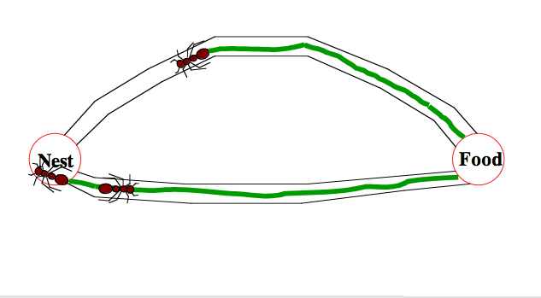
Foraging behavior of Ants
The next ant takes the shorter route.

Slide 31
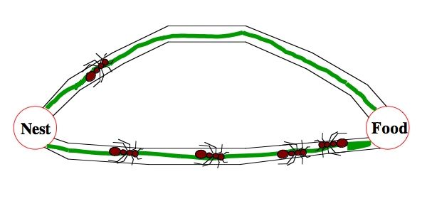
Foraging behavior of Ants
Over many iterations, more ants begin using the path with higher pheromone, thereby further reinforcing it.

Slide 32
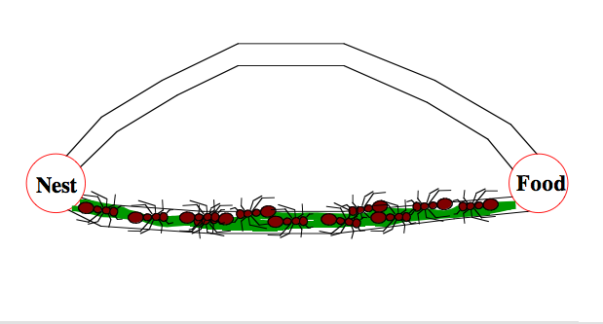
Foraging behavior of Ants
After some time, the shorter path is almost exclusively used.

Slide 33
Ant Colony Optimization
A combinatorial optimization problem reduced to a (problem-specific) construction graph.
Artificial ants build solutions to an optimization problem in each iteration
Ants deposit pheromone on each vertex represent quality of solutions after each iteration
This informs search for next wave of ants (learning from previous iteration)

Slide 34
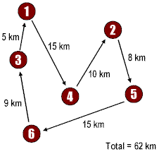
The Traveling Salesperson Problem (TSP)
A Salesperson wishes to travel around a given set of cities, and return to the beginning, covering the smallest total distance
Easy to State
Difficult to Solve for large number of cities

Slide 35
Ant Colony Optimization (ACO) for TSP
Graph (N,E): where N = cities(nodes), E = edges
= the tour cost from city i to city j (edge weight)
Ants move from one city i to the next j with some transition probability.
B
A
D
C

Slide 36
Ant Colony Optimization (ACO) for TSP
Each edge is associated a static value based on the edge-cost η(i,j) = 1/d_{i,j}. this is the heuristic component
Each edge of the graph is augmented with a pheromone trace τ(i,j) deposited by ants. Initially, 0 (or some constant).
Trace is dynamic and it is learned at run-time
Each ant tries to produce a complete tour, using the probability depending on η(i,j) and τ(i,j) to choose the next city.

Slide 37
ACO Algorithm for TSP
Initialize
Place each ant in a randomly chosen city
For Each Ant
Choose NextCity(For Each Ant)
yes
more cities
to visit
No
Return to the initial cities
Update trace level using the tour cost for each ant
No
Stopping
criteria
yes
Print Best tour

Slide 38

A simple TSP example
[]
1
[]
A
B
2
[]
C
3
[]
4
D
E
[]
d_{AB} =100;d_{BC} = 60…;d_{DE} =150
5

Slide 39
Iteration 1
[A]
[B]
1
A
2
B
[C]
3
C
[D]
[E]
D
5
4
E

Slide 40
How to choose next city?
[A]
1
A
B
[A]
1
[A]
C
1
[A,D]
[A]
1
1
D
E

Slide 41
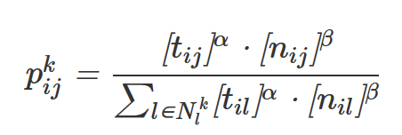
Probability of choosing next city
To compute probability of next city by ant k,
α and β are both parameters used to control the importance of the pheromone trail (tau or t) and heuristic information (static edge cost, n).
The denominator is a normalization factor.

Slide 42
Iteration 2
[E,A]
[C,B]
5
A
3
B
[B,C]
2
C
[A,D]
[D,E]
1
D
4
E

Slide 43
Iteration 3
[D,E,A]
[E,A,B]
4
5
A
B
[A,D,C]
1
C
[B,C,D]
[C,B,E]
2
D
3
E

Slide 44
Iteration 4
[B,C,D,A]
[D,E,A,B]
2
A
4
B
[E,A,B,C]
5
C
[C,B,E,D]
[A,DCE]
D
3
1
E

Slide 45
Iteration 5
[C,B,E,D,A]
[A,D,C,E,B]
3
1
A
B
[D,E,A,B,C]
4
C
[E,A,B,C,D]
[B,C,D,A,E]
D
5
E
2

Slide 46
Path and Trace Update
[A,D,C,E,B]
C₁ =300
1
[B,C,D,A,E]
C₂ =450
2
[C,B,E,D,A]
C₃ =260
3
[D,E,A,B,C]
C₄ =280
4
[E,A,B,C,D]
C₅ =420
5

Slide 47
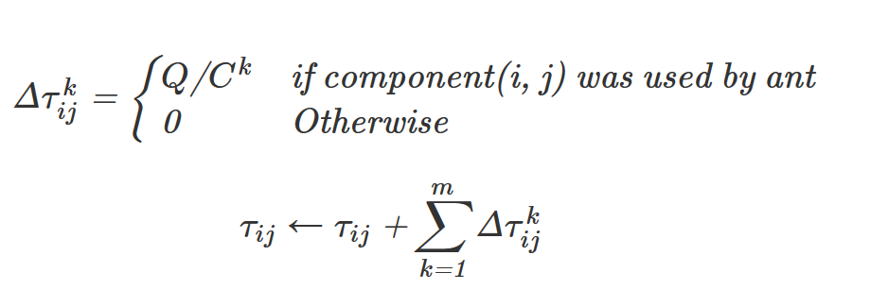
Local Pheromone Update
Q is a constant (typically 1)
C is the cost of a solution
Sum Q/C for every tour using i, j
Use that to update the pheromone value on i, j

Slide 48

Global Pheromone Update
rho is an evaporation constant used to decay pheromone trace

Slide 49
ACO Review 1
Each edge is associated a static edge-cost η(i,j) = 1/d_{i,j}.
Each edge is augmented with a pheromone trace τ(i,j) deposited by ants. Initially, 0 or some constant.
Each ant produces a complete tour, using the probability depending on η(i,j) and τ(i,j) to choose the next city.
α and β are both parameters used to control the importance of the pheromone trail and edge cost (heuristic)

Slide 50
ACO Review 2
Local pheromone update
Global pheromone update

Slide 51
Read More
http://www.theprojectspot.com/tutorial-post/ant-colony-optimization-for-hackers/10
Also includes simulation

Slide 52
In-Class Activity 8
https://tinyurl.com/AIF19-ICA8

Slide 53
quiz 1 scoring

Slide 54
Quiz 1
Look for Piazza post with details on how to access your individual and group scores (Canvas for summary/Gradescope for details)
Individual scores: Mean = 5.4/7.5 or 72%
Group scores: Mean = 5.8/7.5 or 77%
Overall scores: Mean = 5.54/7.5 or 73%
Added a 0.5 point bonus (for this quiz only), resulting in mean overall scores of 6.0/7.5 or 80%

