Slide 1
Swarm Intelligence
Artificial Intelligence
October 2, 2019

Slide 2
Plan
W | 09/25/2019 | Multiagent Systems | Behavior-based AI
M | 09/30/2019 | Multiagent Systems | Swarm Intelligence | Assignment 1 (Search)
W | 10/02/2019 | Multiagent Systems | Genetic Algorithms
M | 10/07/2019 | Machine Learning | Naive Bayes & Bayes Nets
W | 10/09/2019 | Multiagent Systems | Quiz | Quiz 2 (Multiagent)
M | 10/14/2019 | Machine Learning | Decision Trees & Random Forest
W | 10/16/2019 | Machine Learning | Other Methods (SVM, KNN, etc) | Assignment 2 (Multiagent)

Slide 3
Quiz 2 (Multiagent systems)
Readings
Brooks (Subsumption)
Maes (Behavior Nets)
Corne, Reynolds, and Bonabeau (Swarm Intelligence)
Russell & Norvig (Genetic Algorithms)
Slides contain a lot of details on these topics
Format
Open-ended questions on concepts (e.g., decentralized control)
Encode problems so that multiagent systems can solve them
Perform simple operations (e.g. crossover)
Given partial execution of algorithm, choose next move

Slide 4
Quiz 2
Detailed understanding of main algorithms and how to apply them to solve problems [no need to memorize equations]
Particle swarm optimization
Ant colony optimization
Genetic Algorithms
High-level understanding of Subsumption architecture & Behavior nets
Conceptual understanding of theory of multiagent systems
Physical systems hypothesis
Society of mind
Decentralized control
and so on……..

Slide 5
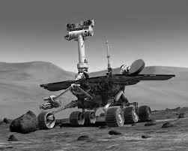
Topic 3: Multi-agent systems for planning and problem solving
Behavior-based AI & Behavior Nets
Swarm intelligence
Generic algorithms

Slide 7
Agenda
Review of Ant Colony Optimization
Particle Swarm Optimization (PSO)
In-class activity
Genetic Algorithms
Review of Principles of Swarm Intelligence

Slide 8
review of ant colony optimization

Slide 9
Review
What is the motivation of ant colony optimization?
What are the main components of the ACO algorithm?
Heuristic value
Pheromone trail
Local pheromone update
Global pheromone update
What are the steps in using ACO to solve the TSP?

Slide 10
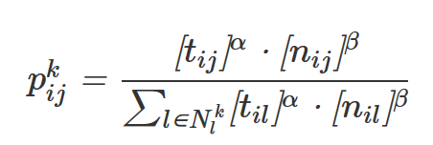
ACO Review 1
Each edge is associated a static edge-cost η(i,j) = 1/d_{i,j}.
Each edge is augmented with a pheromone trace τ(i,j) deposited by ants. Initially, 0 or some constant.
Each ant produces a complete tour city by city based on the probability (computed from η(i,j) and τ(i,j)) of choosing the next city.
α and β are parameters used to control the importance of the pheromone trail and edge cost (heuristic)

Slide 11
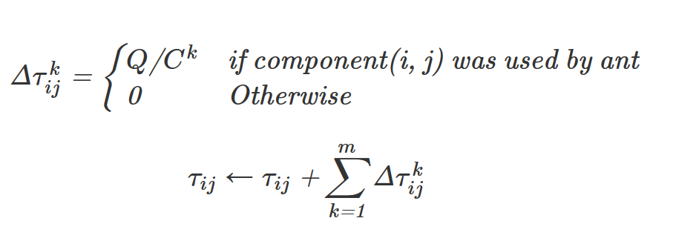

ACO Review 2
Local pheromone update done after a complete tour
Computed edge by edge depending on solution costs of tours produced by ants using each edge
Global pheromone based on rho (evaporation parameter)

Slide 12
Read More
http://www.theprojectspot.com/tutorial-post/ant-colony-optimization-for-hackers/10
Also includes simulation

Slide 13
Particle Swarm Optimization (PSO)

Slide 14
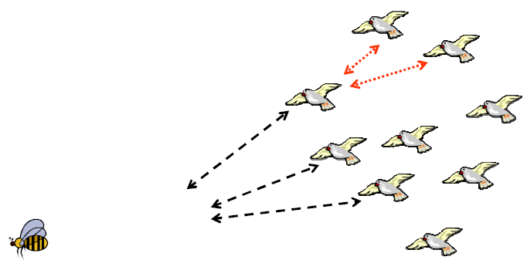
Particle swarm optimization imitates human or insects social behavior.
Bird flocking is one of the best examples of PSO in nature
Applications include any optimization problem (like local search)

Slide 15
PSO: the basic idea
Each particle (or agent) is searching for the optimum (like local search)
A particle has:
a current position
a velocity (it is moving)
Each particle remembers the position associated with its best result (personal best or pbest)
But this would not be much good on its own; particles need help in figuring out where to search.

Slide 16
PSO: the basic idea
The particles in the swarm cooperate. They exchange information about what they’ve discovered.
A particle has a neighborhood associated with it.
A particle knows the best position within its neighborhood (called global best or gbest)

Slide 17
What a particle does
In each timestep, a particle has to move to a new position. It does this by adjusting its velocity as:
The current velocity +
A weighted random portion in the direction of its pbest +
A weighted random portion in the direction of the gbest
Its new position is simply its old position plus the new velocity.

Slide 18
Details

Slide 19
Algorithm

Slide 20
Inertia Weight

Slide 21
Visualizing PSO

Slide 22
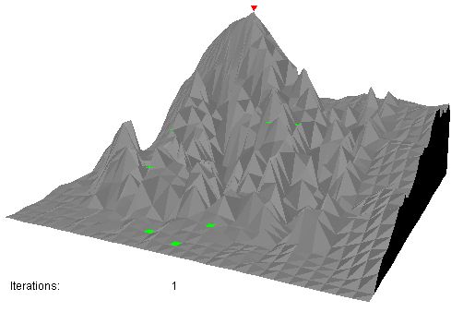

Slide 23
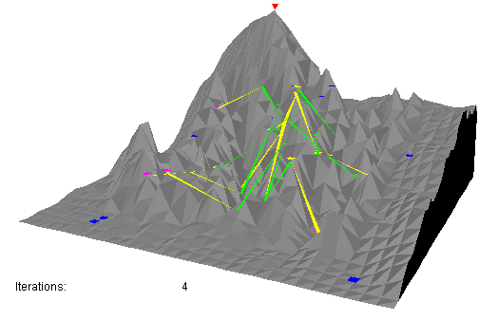

Slide 24
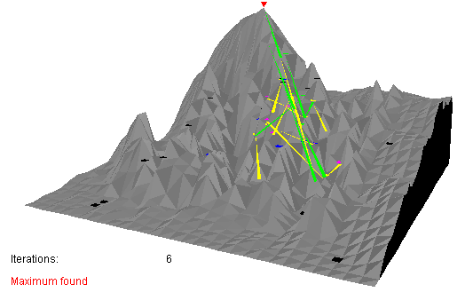

Slide 25
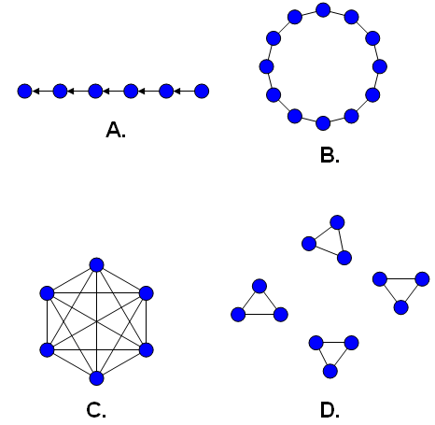
Neighborhood topologies
Single-sighted, - individuals only compare themselves to the next best.
Ring - each individual compares only to those to the left and right.
Fully connected, - everyone is compared together.
Isolated - individuals only compare to those within specified groups.

Slide 26
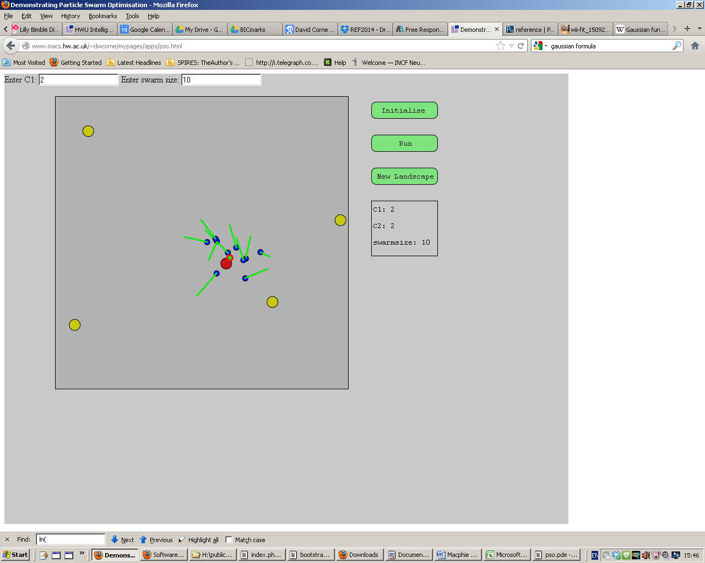
Explore PSO and its parameters with this app
http://www.macs.hw.ac.uk/~dwcorne/mypages/apps/pso.html

Slide 27
Movies using swarm intelligence
https://www.youtube.com/watch?v=TWqx57CR69c

