Slide 1
Adversarial Search
Artificial Intelligence
September 16, 2019

Slide 2
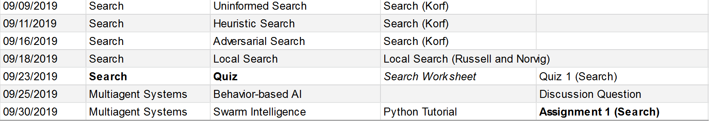
Plan

Slide 3
Quiz 1 (9/23)
Search Basics
How to formulate problems as search problems
How to evaluate search algorithms
Uninformed search
How to perform searches given a state space
Main advantageous/disadvantageous of each search
Heuristic search
Understanding heuristics and their properties
How to perform pure heuristic search and A*
Basic idea of iterative-deepening A*

Slide 4
Quiz 1
Local Search
Understand basic concepts of four main local search algorithms and their variants
Adversarial Search
Understand the idea of look-ahead search
Perform a minmax search on a problem
Perform alpha-beta pruning
General
Have a good conceptual understanding of search and know the main terms and concepts (see end of Korf reading)

Slide 5
Announcements
Take-home practice for Quiz 1 will be posted tonight/tomorrow
Assignment 1 will be posted by class Wednesday (due 9/30)
Office hours
Look at updated office hours
Document with suggestions for alternate hours (see Piazza)
Virtual office hours possible in some circumstances
Gradescope is not for debugging

Slide 6
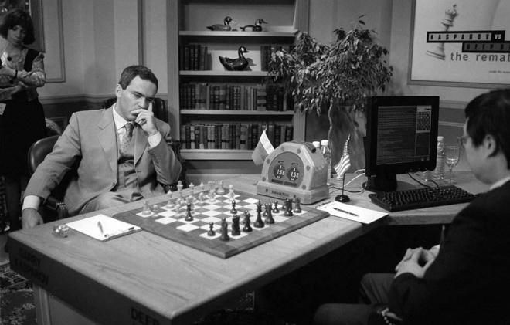
Topic 2: Search
Uninformed search
Heuristic search
Adversarial search
Local search

Slide 7
Materials for Adversarial Search
Required
Korf
Optional Reading
Adversarial Search (Russell & Norvig)
Slides contain a lot of information for this topic

Slide 8
Adversarial Search
Intro to adversarial search
Look-ahead search
Minimax or Minmax
α-β pruning
In-class activity
Analysis of α-β pruning

Slide 9
Intro to adversarial search

Slide 10
Key Problem
We have experience in search where we assume that we are the only intelligent being and we have explicit control over the “world”
Does not hold true in games
Time is limited (cannot search entire space)
We do not have control over the world (have to contend with opponent)

Slide 11
Game Formulation
Initial state (in some suitable representation):
e.g. board and player moving next
Successor state function:
e.g. legal moves for each player and the resulting states
Terminal test:
indicates when the game is over
corresponding states are called terminal states
Utility function or heuristic function:
evaluates the terminal states/outcome of a game (win, loss or draw): e.g. +1, -1, 0

Slide 12
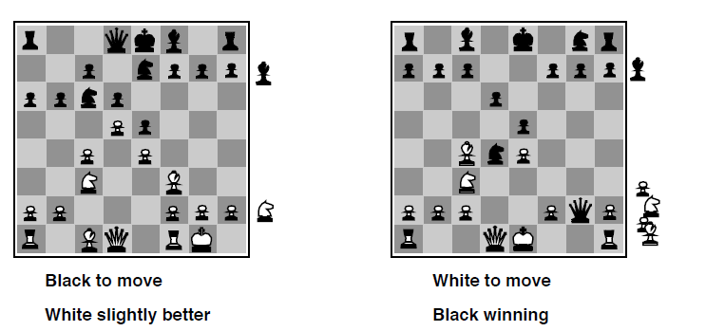
Evaluation functions or Utilities
For chess, typically linear weighted sum of features
Eval(s) = w₁ f₁(s) + w₂ f₂(s) + … + w_{n} f_{n}(s)
e.g., w₁ = 9 with
f₁(s) = (number of white queens) – (number of black queens), etc.

Slide 13
Look ahead search

Slide 14
Key Idea: Look Ahead
3x3 Tic-Tac-Toe
optimal play
We start with 3 moves per player
X’s turn
O’s turn
X

Slide 15
Look-ahead based Tic-Tac-Toe
X’s turn
O’s turn
X
Tie
Tie
Tie
Tie

Slide 16
Look-ahead based Tic-Tac-Toe
X’s turn
O’s turn
Win for O
Win for O
Tie
Tie
Tie
Tie

Slide 17
Look-ahead based Tic-Tac-Toe
X’s turn
O’s turn
Win for O
Win for O
Tie
Tie
Tie
Tie

Slide 18
Look-ahead based Tic-Tac-Toe
X’s turn
Win for O
Tie
Win for O
O’s turn
Win for O
Tie
Tie
Tie
Tie
Win for O

Slide 19
Look-ahead based Tic-Tac-Toe
X’s turn
Win for O
Tie
Win for O
Look-ahead moves till bottom tree. Label bottom-most boards
Then label boards one level up, according result of best possible move.
…and so on
Implemented as depth-first search

Slide 20
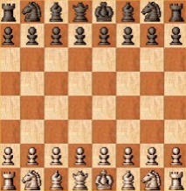
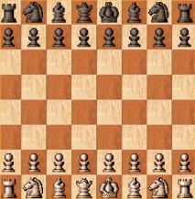
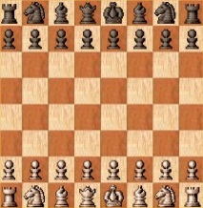
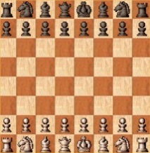
Look-ahead based Chess
But there’s a catch…
X’s turn
White’s turn
Black’s turn
O’s turn
X

Slide 21
How big is this tree?
~35 moves per position
~80 levels deep
Over 10^40 to 10^50 nodes
Not just another large number (number of atoms in universe is 10^80)

Slide 22
Key solution -
Depth-limited look-ahead strategy
Search upto N levels based on time
Compute utility of each node based on heuristic
Pick node based on computed utility

Slide 23
minmax

Slide 24
Formal definition of a game:
Initial state
Successor function: returns list of (move, state) pairs
Terminal states: states where game ends
Terminal test: determines when game over
Utility function (objective function or payoff function): gives numeric value for terminal states
An action by one player is called a ply, two ply (an action and a counter action) is called a move.
We will consider games with 2 players (Max and Min)
Max moves first

Slide 25
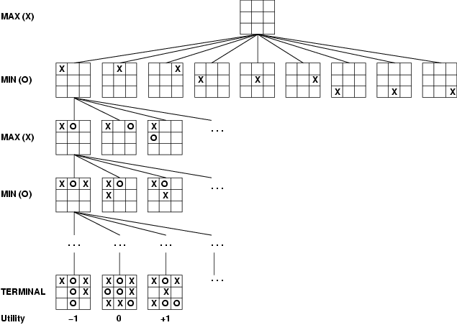
Game Tree Example: Tic-Tac-Toe
Tree from
Max’s
perspective
Notes:
Crosses and noughts

Slide 26
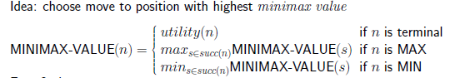
Minimax
Perfect play for deterministic, 2-player game
Max tries to maximize its score
Min tries to minimize Max’s score (Min)
Goal: Max to move to position with highest minimax value
Identify best achievable payoff against best play (and subpar play)

Slide 27
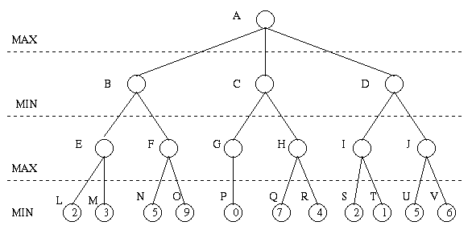
Minimax Algorithm
Payoff for Max

Slide 28
Minimax Algorithm (cont’d)
3
9
0
7
2
6
Payoff for Max

Slide 29
Minimax Algorithm (cont’d)
3
0
2
3
9
0
7
2
6
Payoff for Max

Slide 30
Minimax Algorithm (cont’d)
3
3
0
2
3
9
0
7
2
6
Payoff for Max

Slide 31
The Minimax Algorithm
Generate the game tree down to the terminal nodes
Apply the utility function to the terminal nodes
For a S set of sibling nodes, pass up to the parent…
the lowest value in S if the siblings are min
the largest value in S if the siblings are max
Recursively do the above, until the backed-up values reach the initial state.

Slide 32
What is Max’s best move?
max
A1
A2
A3
min
A11
A12
A13
A21
A22
A23
A31
A32
A33
3
12
8
2
4
6
14
5
2

Slide 33
3
A1
A2
A3
3
2
2
A11
A12
A13
A21
A22
A23
A31
A32
A33
3
12
8
2
4
6
14
5
2
In this game Max’s best move is A1, because Max is guaranteed a score of at least 3.

Slide 34
Properties of minimax algorithm
Complete?
Yes (if tree is finite)
Optimal?
Yes
Time complexity?
O(b^{m})
Space complexity?
O(bm) (depth first)
For chess
b ≈ 35, m ≈ 80 for "reasonable" games
exact solution completely infeasible

Slide 35
alpha beta pruning

Slide 36
α-β Pruning
Can we improve search by reducing the size of the game tree to be examined?
If a move is determined worse than another move already examined, then no need to further examine the node
Allows us to search almost twice as deep
Really is what makes game tree search practically feasible
Deep Blue 14 plies using alpha-beta pruning
Otherwise only 7 or 8 (weak chess player)
ply = half move / one player

Slide 37
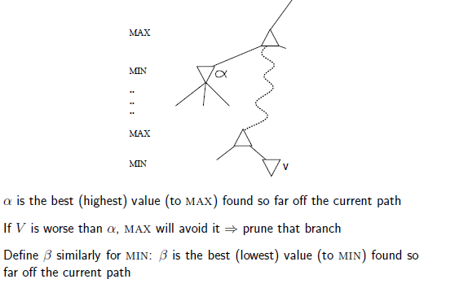
General Strategy

Slide 38
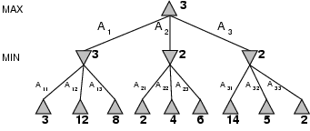
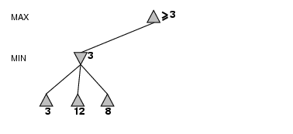
α-β pruning example
MAX knows that it can at least
get “3” by playing this branch
MIN will choose “3”, because it minimizes the
utility (which is good for MIN)

Slide 39
α-β pruning example

Slide 40
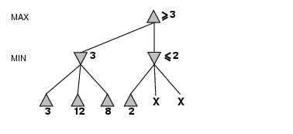
α-β pruning example
MAX knows that the new branch
will never be better than 2 for him.
He can ignore it.
MIN can certainly do as good as
2, but maybe better (= smaller)

Slide 41
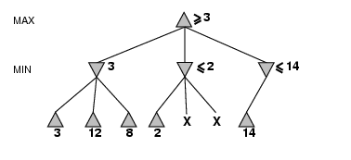
α-β pruning example
MIN will do at least as good as 14 in this branch
(which is very good for MAX!) so MAX will want
to explore this branch more.

Slide 42
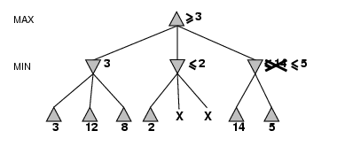
α-β pruning example
MIN will do at least as good as 5 in this branch
(which is still good for MAX) so MAX will want
to explore this branch more.

Slide 43
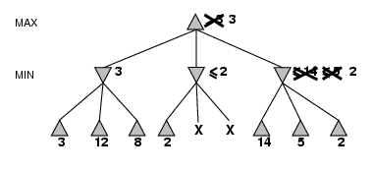
α-β pruning example
Bummer (for MAX): MIN will be able
to play this last branch and get 2. This
is worse than 3, so MAX will play 3.

Slide 44
Example from Korf reading (detailed explanation in reading)

Slide 45
In-CLASS ACTIVITY

Slide 46
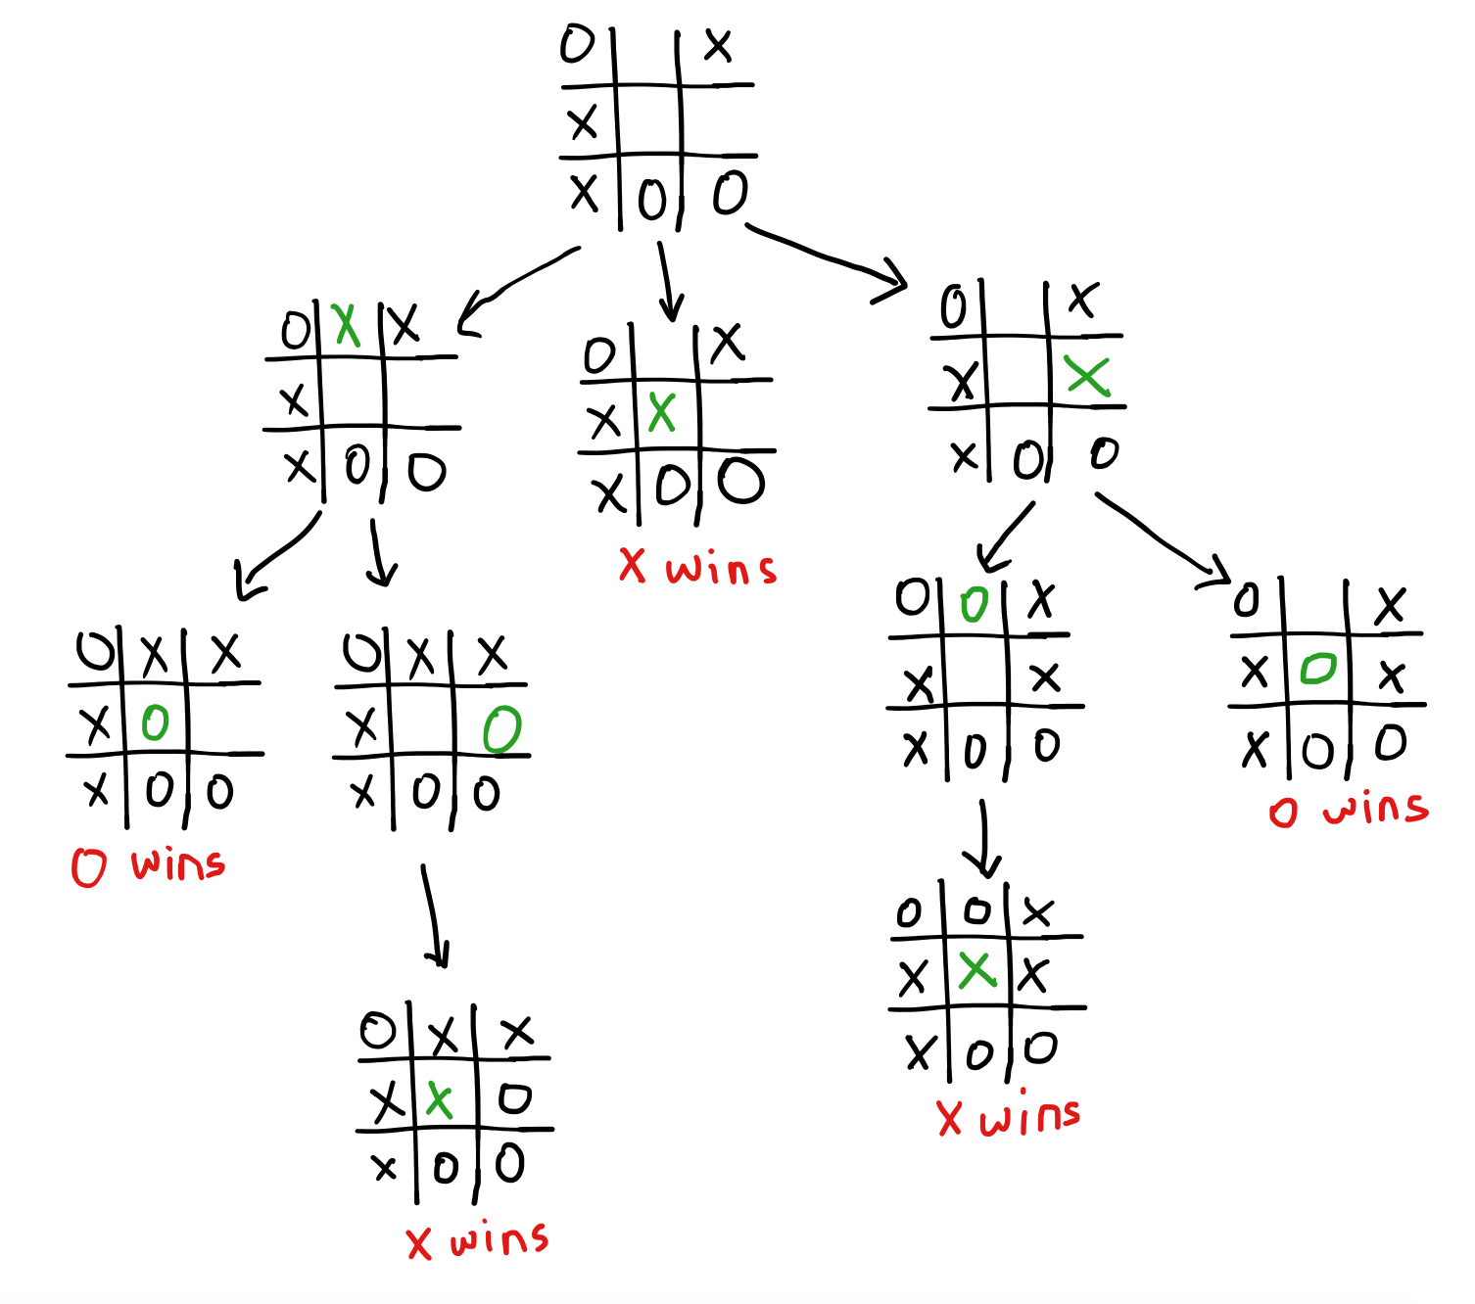
Best move from root is to place X at the center position on the second row

Slide 47
See ICA5-Alpha-beta pruning example in Files/Tutorials for steps
https://canvas.colorado.edu/files/7532247/download?download_frd=1

Slide 48
analysis of alpha-beta pruning

Slide 49
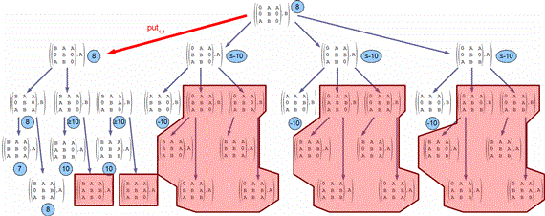
Illustration: Alpha-beta pruning for tic-tac-toe (shaded areas are pruned)

Slide 50
Alpha-Beta Pruning Details
α is the best (highest) found so far along the path for Max
β is the best (lowest) found so far along the path for Min
Search below a MIN node may be alpha-pruned if its β ≤ α of some MAX ancestor
Search below a MAX node may be beta-pruned if the
α ≥ β of some MIN ancestor.

Slide 51
Properties of α-β
Pruning does not affect final result (it is exact)
Good move ordering improves effectiveness of pruning
For min, sort in increasing order
For max, sort in decreasing order
Worst case means that no nodes are pruned, so time complexity same as DFS
With "perfect ordering," time complexity = O(b^{m/2})
doubles depth of search
See Korf reading for more details on this

Slide 52
How Deep Blue did it?
Look-ahead search with alpha-beta pruning
customized hardware
30 billion positions per move searched
sometimes reached a depth of 40 plies
sophisticated evaluation function with 8000 features
knowledge
opening book with 4000 positions
70000 grandmaster games to be consulted
large end-game database

Slide 53
Review
Game-play
Look-ahead search
Look N-levels ahead search
Minmax search
Alpha-beta pruning
Properties of alpha-beta pruning

