Slide 1
Heuristic Search
Artificial Intelligence
September 11, 2019

Slide 2
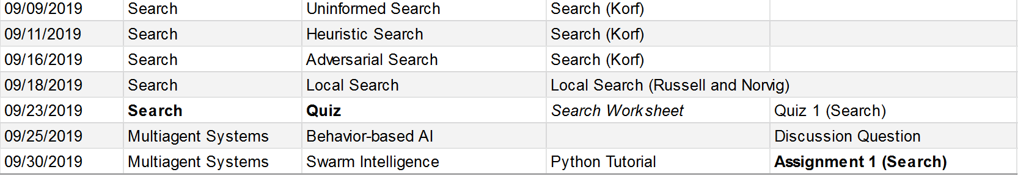
Plan

Slide 3
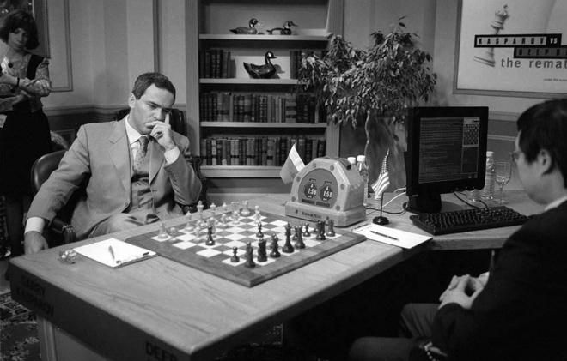
Topic 2: Search
Uninformed search
Heuristic (Informed) search
Adversarial search
Local search

Slide 4
Today
Review of search + uniform cost search
Intro to heuristic search
Heuristic searches
Pure-heuristic search
A*
IDA*

Slide 5
Review of Uninformed Search

Slide 6
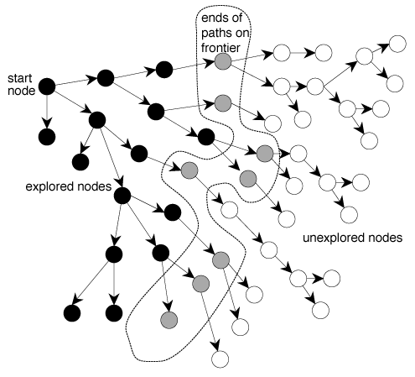
General Problem Space

Slide 7
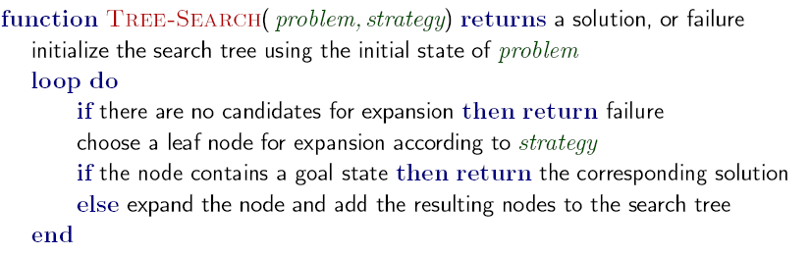
Basic AI Search Algorithm

Slide 8
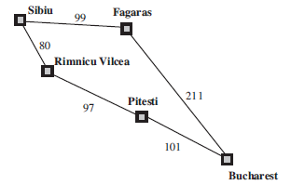
Uniform Cost Search

Slide 9
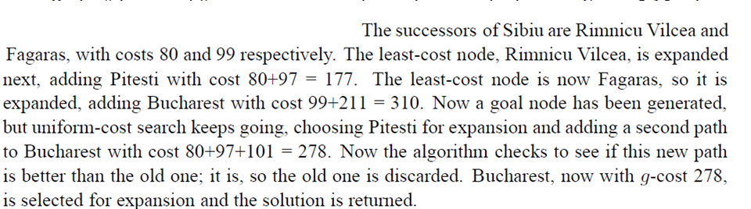
UCS

Slide 10
Demo of searches
https://www.youtube.com/watch?v=Gm1f6ojwuAc

Slide 11
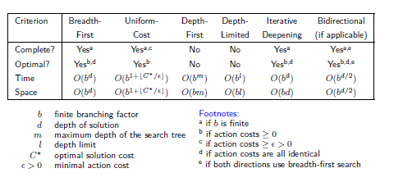
Comparing Uninformed Search Strategies (tree search; finite spaces)

Slide 12
Heuristic Search

Slide 13
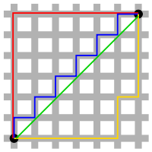
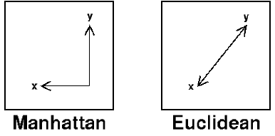
Manhattan Distance

Slide 14
Heuristics for 8-puzzle
3
2
8
3
3
Current State
2 spaces
4
5
6
7
1
The Manhattan Distance - The number of misplaced tiles (not including the blank)
8
1
2
3
Goal State
3 spaces
4
5
6
8
7
8
1
In this case, only the “3”, “8” and “1” tiles are misplaced, by 2, 3, and 3 squares respectively, so the heuristic function evaluates to 8.
In other words, the heuristic is telling us, that it thinks a solution is available in just 8 more moves.
3 spaces
1
Total 8
Notation: h(n) h(current state) = 8

Slide 15
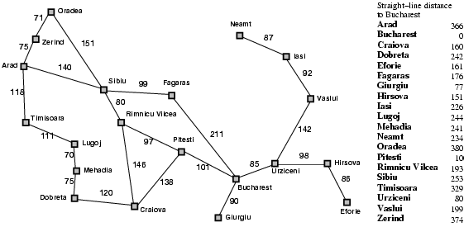
Find path from A to B using h(n)

Slide 16
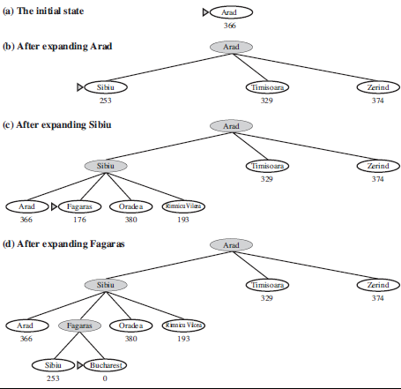
Pure Heuristic Search

Slide 17
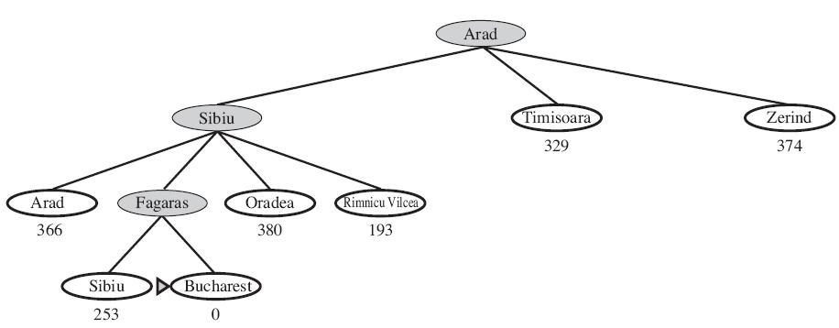
Pure Heuristic Search (Solution)

Slide 18
We found A-S-F-B at a cost of 450, but A-S-R-P-B costs 418

Slide 19
Complete? Consider going from Isai to Fagaras

Slide 20
Family of best-first-searches
Breadth-first – expand based on min depth
Uniform-cost – expand based on distance from start : g(n)
Pure heuristic – expand based on distance to goal: h(n)

Slide 21
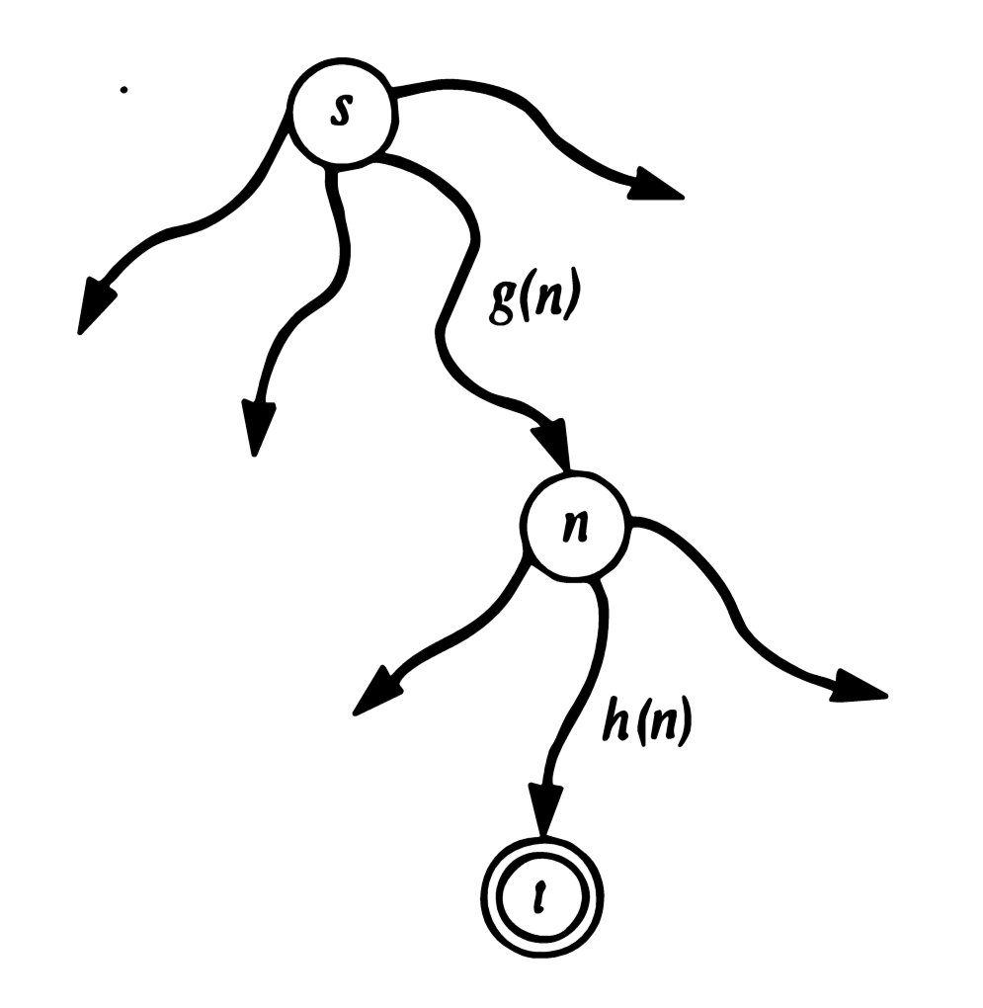
A* search
Evaluation function f(n) = g(n) + h(n)
n is the node being considered for expansion
g(n) = cost so far to reach n (uniform cost)
h(n) = estimated cost from n to goal (pure heuristic)
f(n) = estimated total cost of path through n to goal (A*)

Slide 22
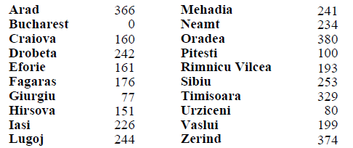
Straight line distance to Bucharest

Slide 23
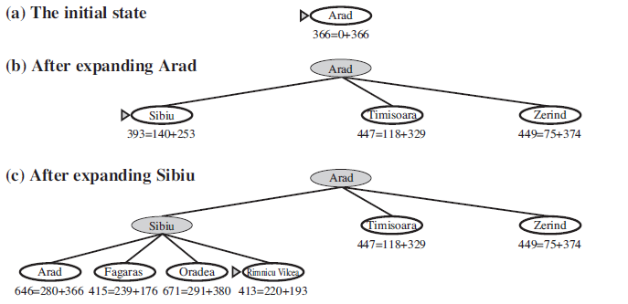
A* from A to B (Part 1)

Slide 24
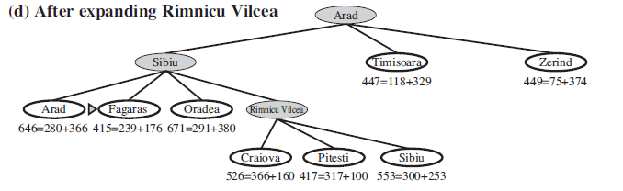
A* from A to B (Part 2)

Slide 25
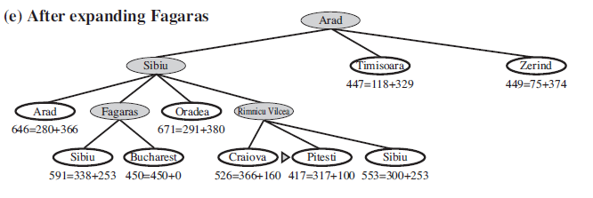
A* from A to B (Part 3)

Slide 26
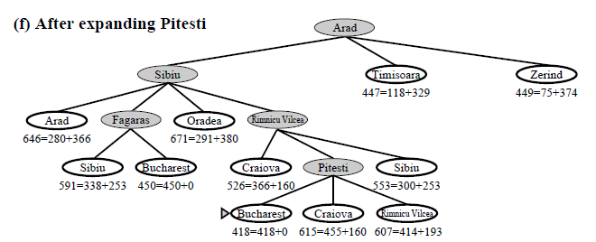
A* from A to B (Part 4)

Slide 27
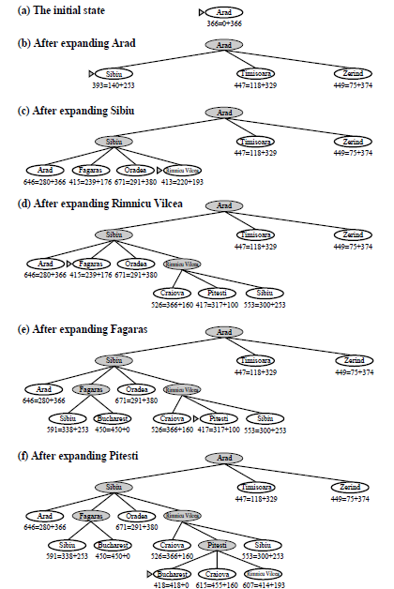

Slide 28
In-Class Activity

Slide 29
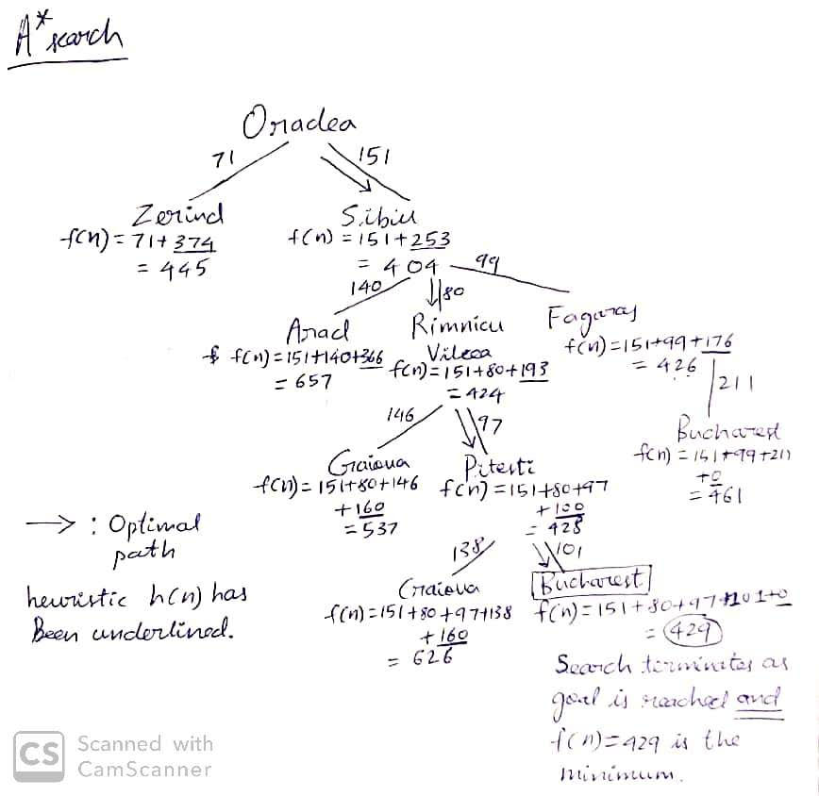
Notes:
In class activity solution

Slide 30
Animations
https://qiao.github.io/PathFinding.js/visual/

Slide 31
How A* searches

Slide 32
A* finding optimal path from Washington DC to LA on the freight network (from CTA data)
http://upload.wikimedia.org/wikipedia/commons/6/60/A%2A_Search_Example_on_North_American_Freight_Train_Network.gif

Slide 33
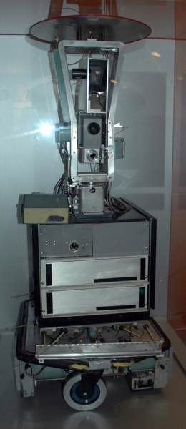
Why A*?
Pathfinding problem for Shakey the Robot
Nilson proposed heuristic A1 algorithm in 1968 (faster than Dijkstra’s)
Raphael improved A1 and called it A2
Hart proved that A2 was best possible algorithm
Nilson, Raphael, Hart jointly worked on proof using Kleen Star syntax
Called it A* to include all possible versions of A

Slide 34
Iterative Deepening A*
Start
f0
f1
f2
f3
IDA*: Repeat depth-first within f-limit increasing:
f0, f1, f2, f3, ...

Slide 35
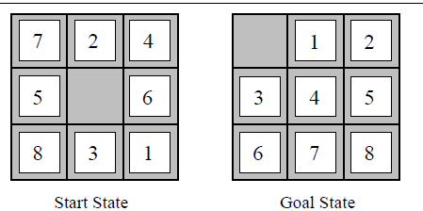
Two Heuristics for 8-puzzle
H1 = number of misplaced tiles = 8
H2 = sum of distance of tiles to goal = 18

Slide 36
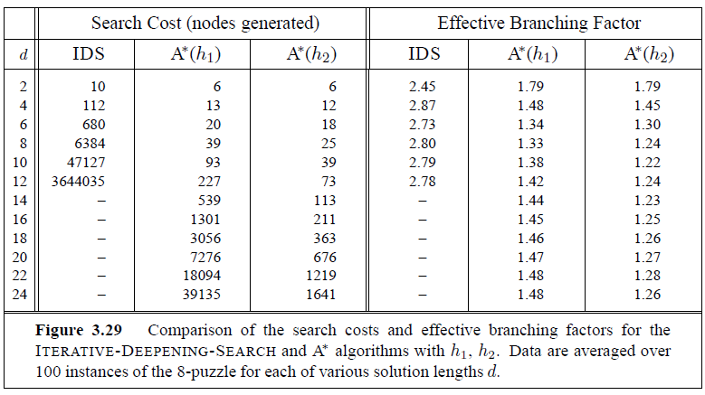
Performance (Comparing heuristics)

Slide 37
Review

