Slide 1
Study of Intelligence – Foundation and Issues by Pfeifer and Scheier
Artificial Intelligence
August 28, 2019

Slide 2
Announcements
Monday (9/02)
No class (Labor Day)
Wednesday (9/04)
History, Motivation, Core Themes of AI (Franklin)
Submit discussion question by 12 pm Tuesday (9/03)
Python tutorial will be posted online
Office-hours will focus on tutorial

Slide 3
Today
Discussion of the reading
In-class activity
Some additional thoughts on intelligence
Your questions on reading
Debriefing for new students

Slide 4
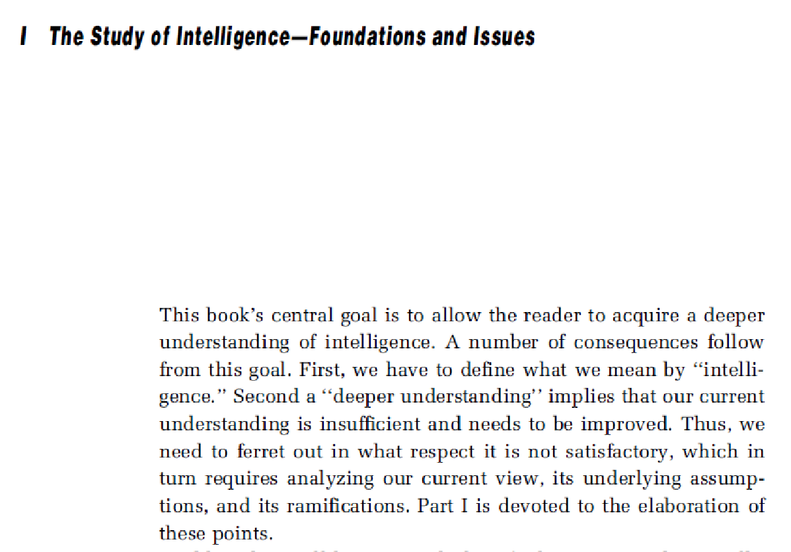

Slide 5
Any Clarification Questions on the Reading?

Slide 6
Overview of the Reading

Slide 7
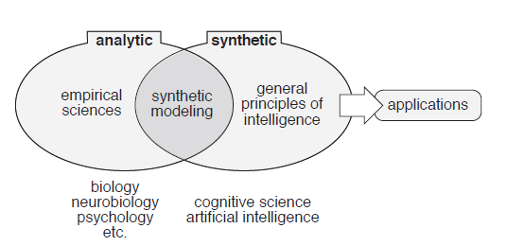
Approaches to studying intelligence

Slide 8
Definitions of Intelligence
The ability to carry on abstract thinking
Having learned or the ability to learn to adjust oneself to the environment
The ability to adapt oneself adequately to relatively new situations in life
A biological mechanism by which the effects of a complexity of stimuli are brought together and given a somewhat unified effect in behavior
The capacity to acquire capacity
The capacity to learn or to profit by experience
write down which definition you think is best

Slide 9
Fluid vs. Crystallized intelligence
Fluid intelligence
Crystallized intelligence
reasoning and thinking
measured by how well you solve puzzles
knowledge accumulated over a lifetime
measured through vocabulary and general knowledge
Assign a percentage to the value of fluid vs. crystallized intelligence - e.g., (50% fluid; 50% crystallized) [write down]

Slide 10
Facets of Intelligence
Thinking and problem solving
Learning and memory
Language
Intuition and creativity
Consciousness
Emotions
Surviving in a complex world
Perceptual and motor activities
Pick three facets of intelligence you think are the most important and rank order them [write down]

Slide 11
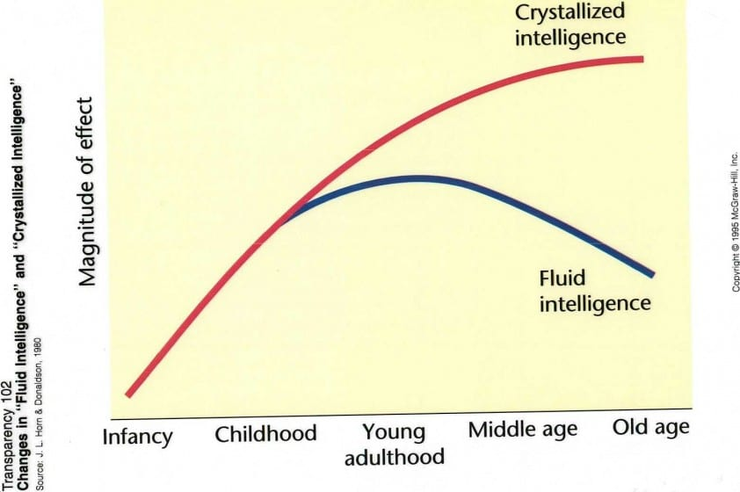
Does intelligence increase, stay the same, or decrease as people age?

Slide 12
Facets of Intelligence
Thinking and problem solving
Learning and memory
Language
Intuition and creativity
Consciousness
Emotions
Surviving in a complex world
Perceptual and motor activities

Slide 13
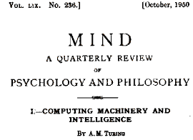
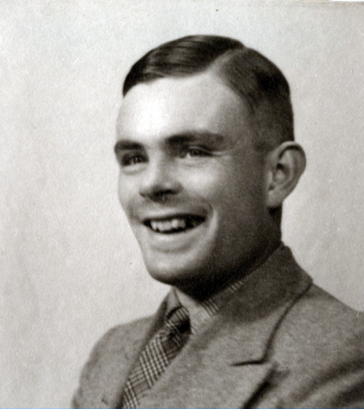
Alan Turing

Slide 14
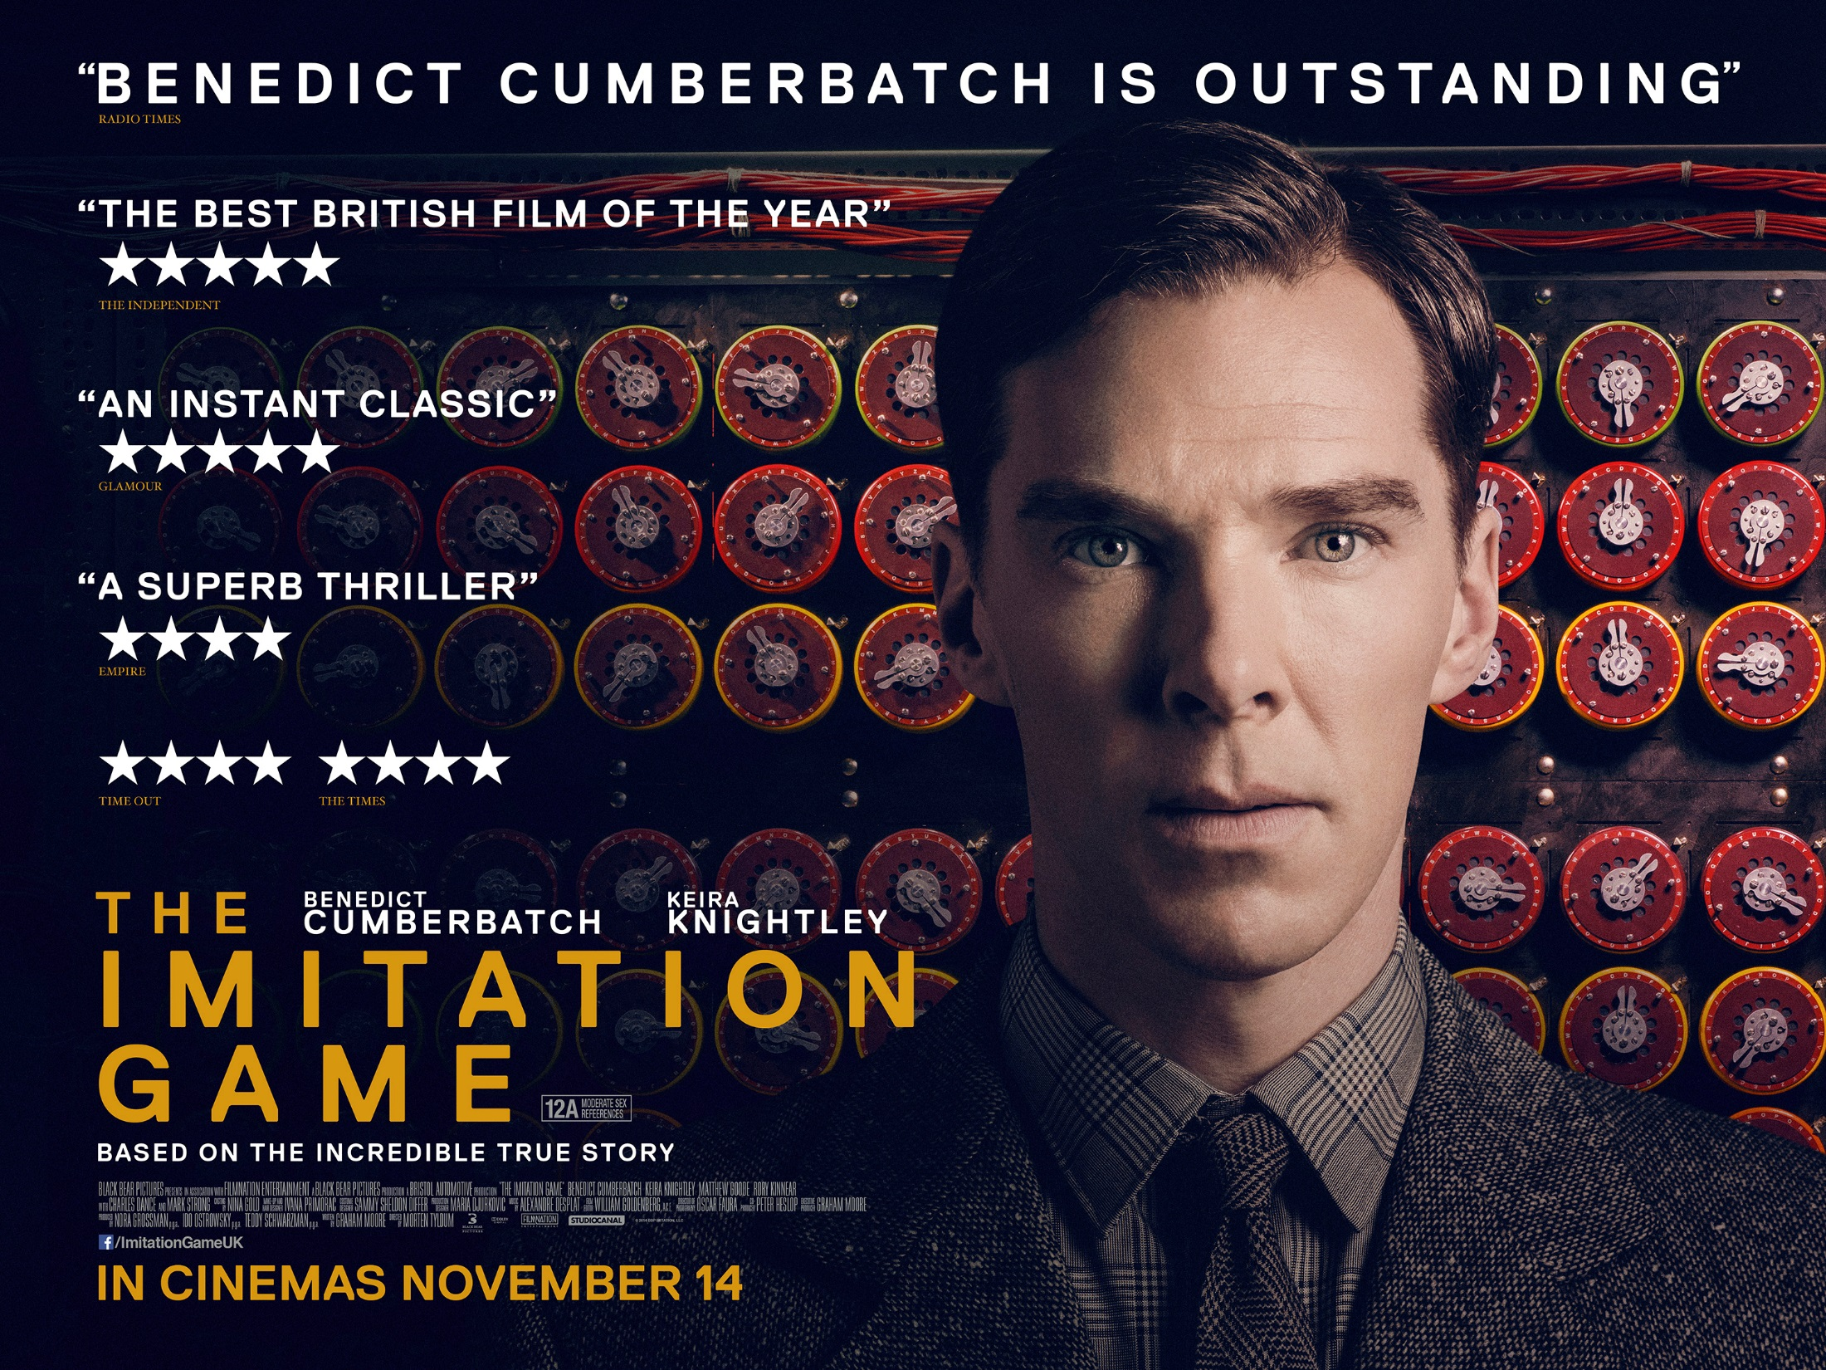

Slide 15
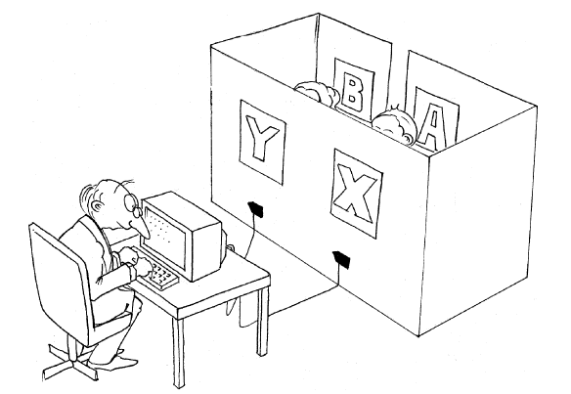
Turing Test

Slide 16
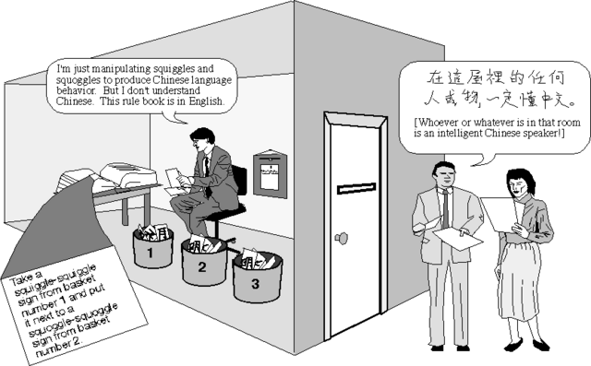
Chinese Room

Slide 17
Turing test vs. Chinese room
Turning Test
Chinese Room
a computer program that demonstrates intelligent behavior is intelligent
cannot tell if a computer program is intelligent based on its behavior along
Is intelligent behavior a sufficient criterion of intelligence? [write down]

Slide 18
In-class activity - graded
Go over your notes for the following four questions:
Which definition of intelligence do you like best
Rank order top three facets of intelligence
Percent value for fluid vs. crystallized intelligence
Is intelligent behavior a sufficient criterion of intelligence?
Work with your partner to come up with unified responses to the questions and enter them at https://tinyurl.com/AIF19-ICA1
You have 10 mins for this activity

Slide 19
Your (Excellent) Questions

Slide 20
Strategies for Intelligence
Sage Garrett. The writer describes the chess program's strategy of checking for many alternatives as "completely unintelligent". Isn't the computer taking advantage of the fact that it can check these alternatives quickly? Isn't using its strengths against the human an intelligent strategy?
James Mcdonald. Does Garry Kasparov's brain do this same kind of processing but in a different way? What is the essence of Gary's ability to predict the outcome of any given game state given his input of what I can only assume is an absurdly large amount of chess matches played in one lifetime?

Slide 21
Imitation as intelligence
Stacy Hayes. Can an agent who only acts based on observed and then consequently imitated behaviors be considered intelligent? Would an agent that mixed two observed behaviors to form one that hasn't been observed qualify as intelligent?

Slide 22
Emotions and Consciousness
Gerritt Luoma. Given one was to produce two fully cognitive AI with creativity, consciousness, problem solving ability, and the capability of complete conversation, what do you believe would be key differences in their behaviors if one possessed emotions while the other didn't.
Melissa Pollich. How can we create and/or measure the intelligence of "artificially intelligent machines" if we are using human properties such as consciousness and emotion as parameters for defining 'artificial intelligence', when these properties are not (and have never been) well understood or explained by humans?

Slide 23
Is aiming for intelligence and intractable problem?
Kaelan Patel. How relevant is modern "unintelligent" AI research to the goal of creating a general intelligence? If something sophisticated like a modern neural net-trained program (e.g. AlphaGo) is not considered intelligent in the way a human is, can we be sure that continuing along this line will yield "real" intelligence later on?
Braden Holmes. How could we ever determine if an AI is truly intelligent and thinking as opposed to mimicking the results we would expect from such a machine?

Slide 24
Emergence of Intelligence
Graham Harper. If autonomous agents are not programmed to help each other, where would that ability come from? How does an original concept like collaboration emerge in a machine that has not been told about it?

Slide 25
Consciousness
Zach Morrissey. In the section called Consciousness, the author states that conscious thought is a very small part of one’s mental state. Could unconscious processes be the main cause of varying levels of intelligence in humans?
Calvin Zikakis. What decides the lacking of consciousness and emotions in artificial intelligence? If humans can make a machine learn as if it was a human by replicating our brains; can we replicate how emotions and consciousness work in humans within our AI?

Slide 26
How to validate models?
Mattias Leino. When researchers use synthetic modelling to study intelligence, what kind of tests can they perform to validate their models? And in the cases where the intelligence of an animal or a human is being modeled do you separately test to validate that the model is good at modelling the animal / human vs how many of those findings extrapolate to more general principles of intelligence?

Slide 27
Is there really a difference?
Tyler Valentine. Is there actually any difference between human intelligence and artificial intelligence? I think that intelligence as a concept reserved for living beings doesn’t seem to have any innate qualities which would distinguish it from some sort of ‘perfectly’ programmed AI.

Slide 28
For next class (9/04)
Please read History, Motivation, Core Themes of AI (Franklin)
Submit one “good” discussion question by 12 pm (noon) Tuesday (9/03) under PCA2 (pre-class activity) on canvas
A "good" question usually starts with a "why", "what", or "how" and is authentic in that it does not have a prescripted response. In other words, the person asking the question genuinely wants to know something they do not know.
Also re-opening PC1 for new students to submit - deadline Friday 8am 8/30

