Slide 1
Introduction to Artificial Intelligence
Artificial Intelligence
August 26, 2019

Slide 2
Agenda
Overview of course and syllabus
Learning & pedagogical philosophy
What is AI & topics we will cover

Slide 3
Overview and Syllabus

Slide 4
A little background
Preparation
B.S. in Electrical Engineering 2002
M.S. in Mathematical Sciences 2004
PhD in Computer Science 2009
Appointments
Postdoc in Cognitive Science 2010
Research Assistant Professor 2010-2012
Assistant/Associate Prof. in Computer Science & Psychology at University of Notre Dame in 2012-2017
Associate Professor in Computer Science and Institute of Cognitive Science at CU Boulder from 2017 to present

Slide 5
A little background
Teaching
(Computer Science) Data structures
(Psychology) Psychological Statistics, Psychology for Programmers
(Both) Artificial Intelligence (x 5), Human-Computer Interaction (x 4), Mind-Reading Machines,

Slide 6
AI and me
Intelligent Distribution Agent 2002
Intelligent Environments 2003
Cognitive Architectures 2004
Intelligent Kiosk 2005
Emotion Detection 2006
Large-scale Semantic Spaces 2007
Intelligent Tutoring Systems (ITS) 2008
Speech-enabled ITSs 2009
Affect-sensitive ITSs 2010
Robust Automated Knowledge Capture 2011
Confusion Tutor 2012
Eyetracking and Mind Wandering 2013
Classroom Discourse Analysis 2014
Attention-aware Computing 2015
Multi-sensor, multi-modal modeling 2016
Multimodal collaborative problem solving 2017

Slide 7
Current Projects in our Lab
Multimodal Modeling of Socio-Emotional-Cognitive Processes during Collaboration by Humans and Agents
Intelligent Interfaces for Learning & Collaboration
Next-Generation STEM Learning Games
Multimodal Sensing in the Wild to Enhance Work Performance of Individuals and Teams
Speech and Language Processing to Analyze Written and Spoken Discourse
Modeling Brain & Behavior during Reading

Slide 9
Resources
Canvas as main learning management system
No textbook, will upload materials to Canvas
Google sheet for Schedule
Google Calendar for Office Hours
Piazza for Discussion
Gradescope for Assignments

Slide 10
Getting Help
Please use Piazza as your first point of communication so you can get the quickest response
It allows private and public messages
Feel free to email me if your questions are not answered and if you have something private to discuss

Slide 11
Learning Goals
(General Goal) Demonstrate a broad overview of the field of AI including its history, goals, accomplishments, challenges, future directions. Develop a general appreciation for the science of intelligence, both natural and synthetic.
(LO1) Demonstrate a conceptual understanding of the core AI topics listed above.
(LO2) Apply conceptual knowledge of core AI concepts by implementing AI algorithms, analyzing intelligent systems, and using existing AI tools to solve problems.
(LO3) Learn about exciting trends, paradigms, and major advances of AI, while considering its philosophical roots, ethical, and societal implications.

Slide 12
Content – Seven core topics
The foundations of intelligence (x2)
Solving problems by search (x4)
Multi-agent systems for planning and problem solving (x3)
Machine learning (x4)
Artificial neural networks (x4)
Deep neural learning (x4)
Ethical and social considerations of AI in everyday life (x2)

Slide 13
Assessments
Quizzes (37.5%)
Goal is to test conceptual knowledge
5 quizzes for 7.5% each
Highest quiz weighted 1.5, lowest 0.5, others 1.0
Quizzes are a learning opportunity
Assignments (50%)
Goal is to test application of knowledge
5 individual assignments for 10% each
Will involve a programming component in Python
Pre-class Preparation & In-Class Activities (12.5%)

Slide 14
Pre-class Preparation & In-Class Activities
Pre-class Preparation (5%)
Read material and submit a thought or discussion question
Do background research to prepare for a debate
etc
In-Class Activities (7.5%)
Discuss a topic and submit a response or vote as a group
Solve a problem as a group and submit response
Solve a problem individually and present to the class
etc

Slide 15
Late/Missed Submissions
Quizzes
Can be rescheduled for extenuating circumstances with documentation – ideally before the quiz date
Will likely be a different version of the quiz
Pre-class preparation & In-class activities
No late submissions allowed for pre-class prep
Will make allowances for a few in-class activities
Assignments
10% deduction if less than 24 hours late
25% deduction if greater than 24 hours but less than 48 hours late
50% deduction if greater than 48 hours but less than 72 hours late
Not be accepted beyond 72 hours (3-days past the deadline)

Slide 16
Policies
Submission Difficulties
Attendance
Workload
Plagiarism and collaboration policy
See syllabus for details on Accommodations, Religious Observances, Classroom Behavior, Discrimination and Harassment, & Honor Code

Slide 17
Schedule
https://tinyurl.com/AIF19Schedule

Slide 18
Questions?

Slide 19
Learning and pedagogical philosophy

Slide 20


Cognitive Science of Learning

Slide 21
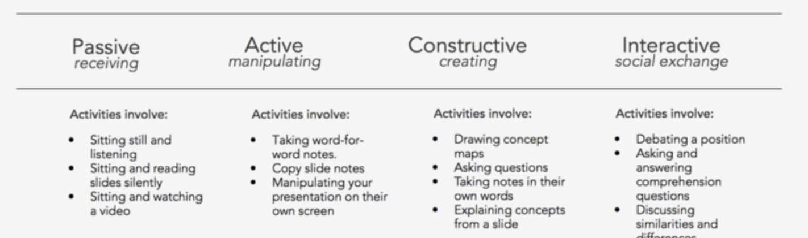
Principle 1: People learn by telling and doing
Interactive > Constructive > Active > Passive Learning

Slide 22
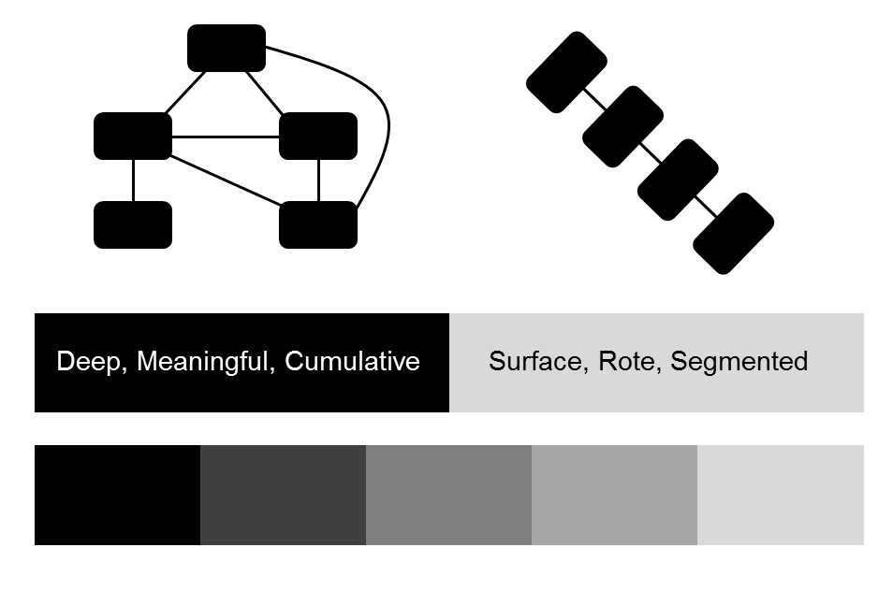
Principle 2: Deep learning involves productive struggle
Distinguish deep (conceptual) from shallow (rote) learning
Deep learning involves conceptual change
Conceptual change occurs when there is cognitive disequilibrium [conflict, impasses, confusion]
Confusion provides an opportunity for learning
Should distinguish productive from hopeless confusion

Slide 23
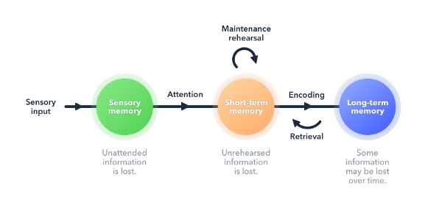
Principle 3: Retrieval practice is one of the most effective learning strategies
Retrieving a memory modifies and strengthens it
Retrieval (not recollection) create new retrieval cues/pathways
Searching memory involves retrieving related info, resulting in stronger encodings and more efficient organization
Failure to retrieve provides valuable cues – judgments of learning

Slide 24
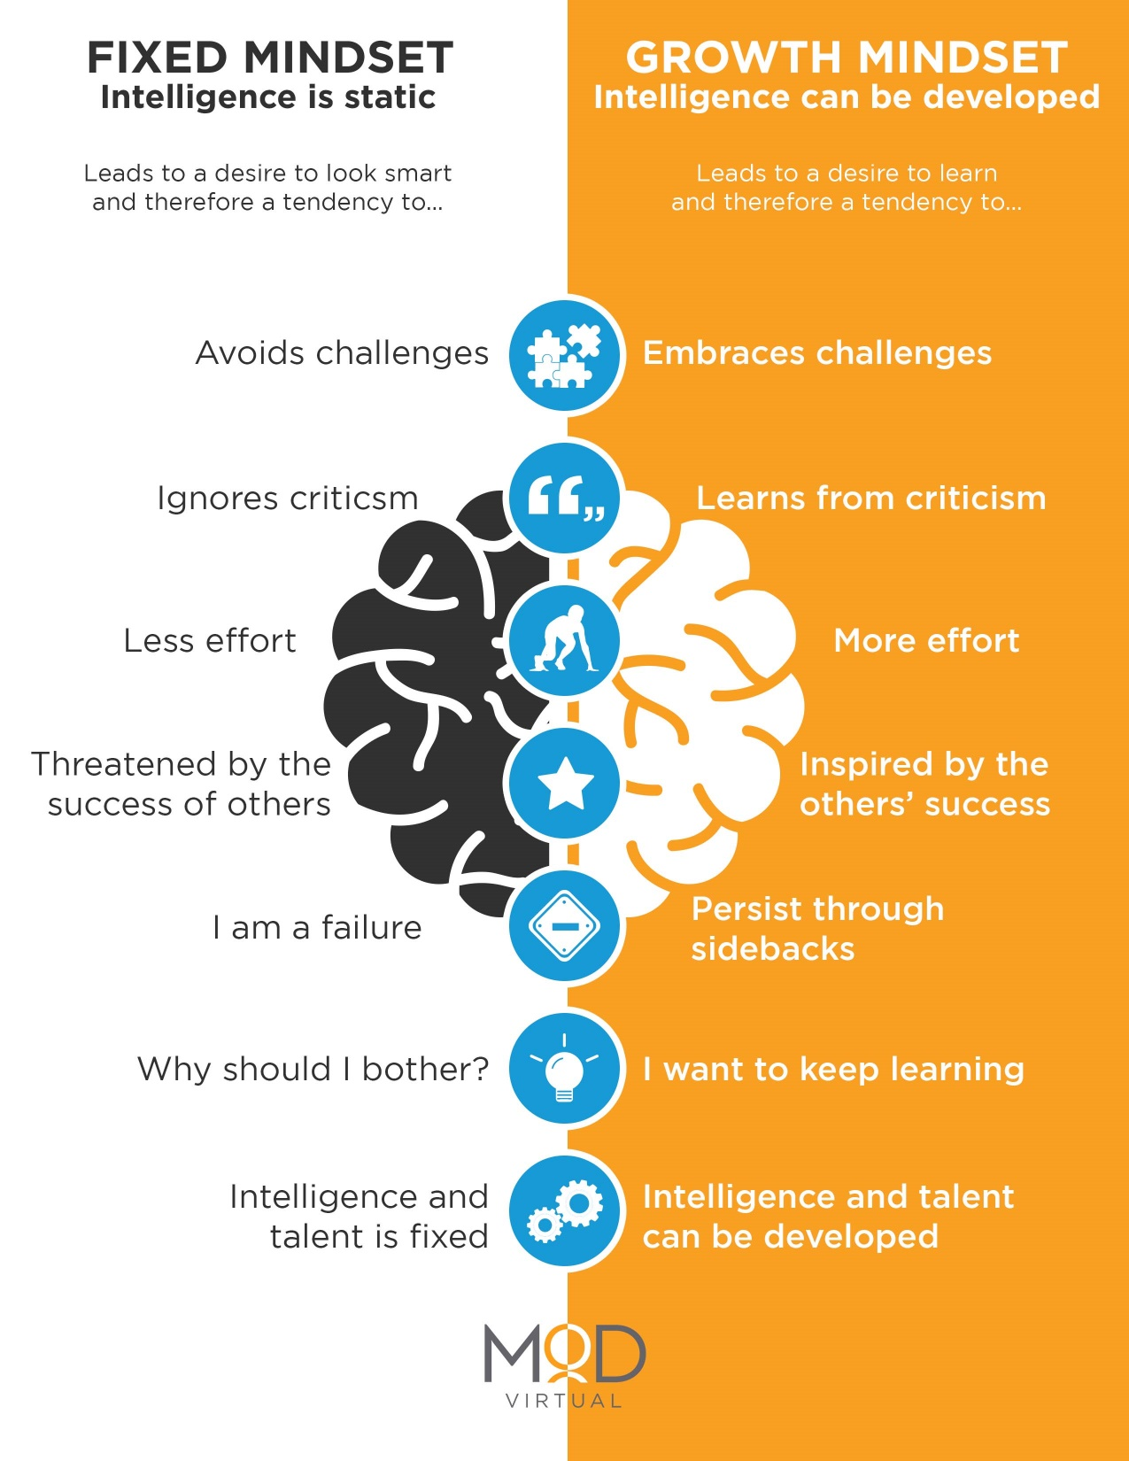
Principle 4: Intelligence is not fixed but malleable It just takes hard work and a supportive culture of learning

Slide 25
Implications for how course is designed
People learn by telling and doing and when learning is interactive/constructive
Very little passive learning via lecturing;
Opportunities for discussion, creation, & collaborations
Deep learning involves productive struggle
No detailed slides or notes; Must create your own representations by engaging with materials
Assignments designed to be challenging but solvable with effort

Slide 26
Implications for how course is designed
Retrieval practice is one of the most effective learning strategies
Engage in self-explanations whenever possible
Low-stakes in-class activities to afford memory retrieval
Immediate and discriminating feedback
Quizzes are designed to be learning opportunities
Intelligence is not fixed but malleable
Adopt a growth mindset by embracing challenge
Create a supportive culture where failure is to be embraced as a learning opportunity

Slide 27
Things to Note
This is not a class where you do not show up, read over lectures/materials at home, and take an exam.
This is a class where you attend each day, prepare before class (when required), share your ideas with the class, and engage in the in-class activities and at-home assignments.
This is not a programming class. AI is an exciting topic that delves into the essence of the mind and goes far beyond algorithms and programming.
My goal is to help you learn. The ideal outcome is that everyone learns deeply and everyone gets an A

Slide 28
Questions?

Slide 29
What is AI and topics we will cover?

Slide 30
What is AI?

Slide 31
“the study and design of intelligent agents” (theory) “the study or design of intelligent agents” (practice)

Slide 32
Key Fields involved in AI
 |  | Build Smart Systems (Engineering)
 |  | No | Yes
Study Smart Systems (Science) | No | X | Computer Science
 | Yes | Cognitive Psychology/ Neuroscience | Cognitive Science

Slide 33
Topic | Why?
Foundations of intelligence and overview of AI | Grounding, big issues, recognition of limitations and opportunities
Solving problems with search | Bread and butter of “classical AI” or “thought-based AI”
Multiagent systems for planning and problem solving | Different way of thinking “behavior-based AI”
Machine learning | Learning programs from data – “data-driven AI”
Artificial neural networks | Modeling the brain and solving “ill-defined AI” problems
Deep neural learning | State of the art in machine learning & AI
Ethical and Societal Implications | To become a good AI citizen

Slide 34
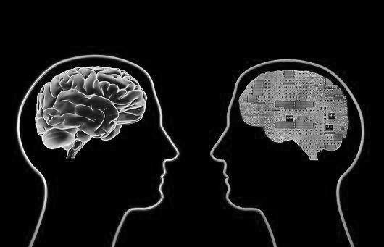
Foundations of Intelligence and AI
Intelligence and its study
History and core themes of AI

Slide 35
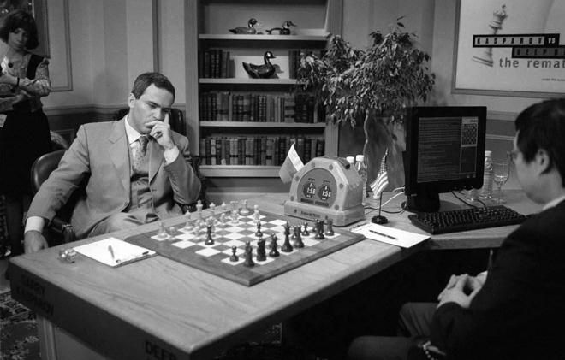
Solving problems with search
Uninformed search
Heuristic search
Adversarial search
Local search

Slide 36
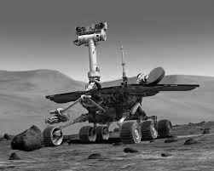
Multi-agent systems for planning and problem solving
Behavior-based AI
Swarm intelligence
Genetic algorithms

Slide 37

Machine learning
Naive Bayes & Bayes Nets
Decision Trees & Random Forest
Other Methods (SVM, KNN, etc)
Validation Methods & Metrics

Slide 38
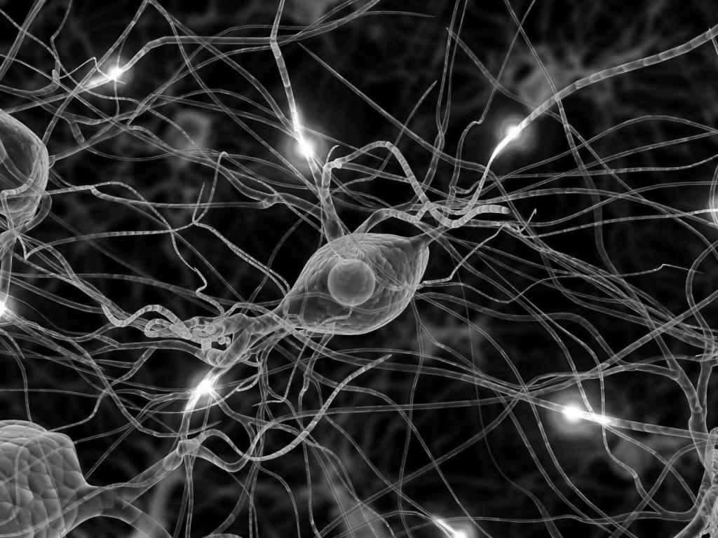
Artificial Neural Networks
Perceptrons
Recurrent Networks (Hopfield)
Feedforward Networks (Backprop)
Self-organizing maps

Slide 39

Deep Neural Learning
Deep Sequence Learning
Convolutional Neural Networks
Representational Learning
Deep Learning in Practice

Slide 40
Ethical and Societal Implications
Fairness and generalizability
Privacy and security
etc

Slide 41
Questions?

Slide 42
For next class (8/28)
Please Read the Study of Intelligence – Foundation and Issues by Pfeifer and Scheier
Submit one “good” discussion question by 8am Wednesday (8/28) under PCA1 (pre-class activity) on canvas
A "good" question usually starts with a "why", "what", or "how" and is authentic in that it does not have a prescripted response. In other words, the person asking the question genuinely wants to know something they do not know.

