Slide 1
Local Search
Artificial Intelligence
September 18, 2019

Slide 2
Quiz 1 (9/23)
Search Basics
How to formulate problems as search problems
How to evaluate search algorithms
Uninformed search
How to perform searches given a state space
Main advantageous/disadvantageous of each search
Heuristic search
Understanding heuristics and their properties
How to perform pure heuristic search and A*
Basic idea of iterative-deepening A*

Slide 3
Quiz 1
Local Search
Understand basic concepts of four main local search algorithms and their variants
Adversarial Search
Understand the idea of look-ahead search
Perform a minmax search on a problem
Perform alpha-beta pruning
General
Have a good conceptual understanding of search and know the main terms and concepts (see end of Korf reading)

Slide 4
Power of Two Quiz
Goal is to use the quiz as an opportunity for learning and to improve your scores
Individual & Team Components
30 minutes to complete the quiz alone & submit
5 min break + 25 minutes to complete the quiz as pairs & submit
Weighted score
Score = team_weight * team_score + (1- team_weight) * individual score
team_weight can range from from 0 to 0.3 (your choice)
Discussion
Discussion of selected items in class (time permitting)

Slide 5
Announcements
Reorganized canvas, everything in Files->Search folder
Quiz 1 practice problems posted on Canvas
Assignment 1 posted (due 2pm 9/30)

Slide 6
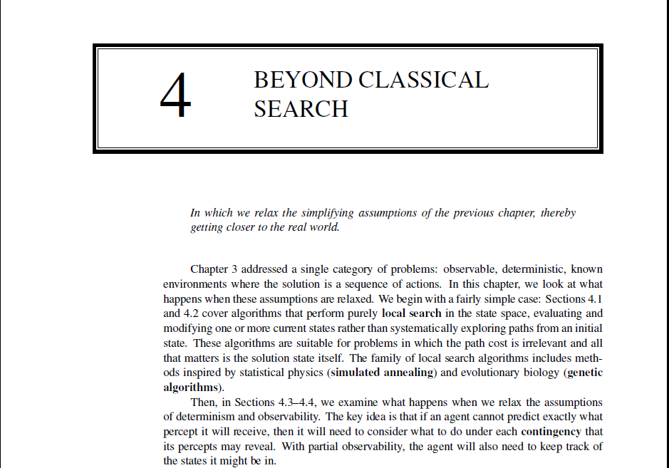

Slide 7
Agenda
Review & Analysis of Alpha-Beta Pruning
Basic Concepts of Local Search and Optimization
Hill Climbing Search and its variants
Simulated Annealing
Local Beam Search

Slide 8
analysis of alpha-beta pruning

Slide 9
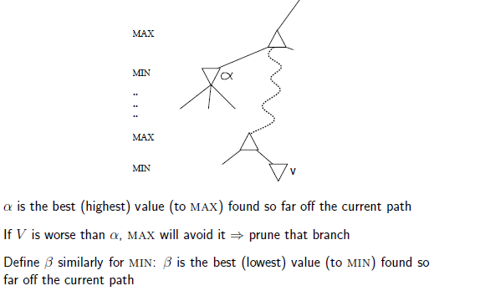
General Strategy of Alpha-Beta Pruning

Slide 10
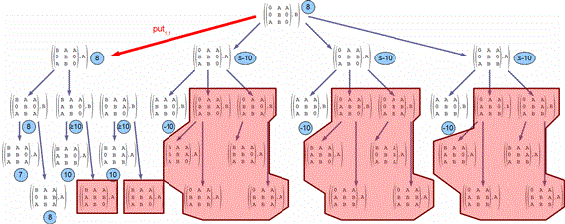
Illustration: Alpha-beta pruning for tic-tac-toe (shaded areas are pruned)

Slide 11
Properties of α-β
Pruning does not affect final result (it is exact)
Good move ordering improves effectiveness of pruning
How should we sort [3, 4, 1, 2, 8] for min vs. max?
For min, sort in increasing order [1, 2, 3, 4, 8]
For max, sort in decreasing order [8, 4, 3, 2, 1]
Worst case means that no nodes are pruned, so time complexity same as DFS
With "perfect ordering," time complexity = O(b^{m/2})
doubles depth of search
Real world complexity is between these two extremes (see reading)

Slide 12
How Deep Blue did it?
Look-ahead search with alpha-beta pruning
Customized hardware
30 billion positions per move searched
sometimes reached a depth of 40 plies
Sophisticated evaluation function with 8000 features
Knowledge
opening book with 4000 positions
70000 grandmaster games to be consulted
large end-game database

Slide 13
Intro to local search

Slide 14
Requirements for Local Search
Can navigate very large search spaces
Does operations very quickly
Find solutions to search spaces where other approaches are completely infeasible
Uses very little memory
Do not save path (don’t care)

Slide 15
Key Idea
The Objective function (sometimes heuristic or fitness)
Select (random) initial state (initial guess at solution)
Make local modification to improve current state
Repeat Step 2 until goal state found (or out of time)

Slide 16
Hill climbing

Slide 17
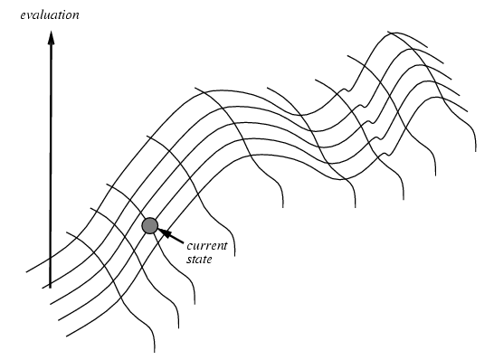
Hill Climbing Search (Steepest Ascent vs. Steepest Descent)

Slide 18
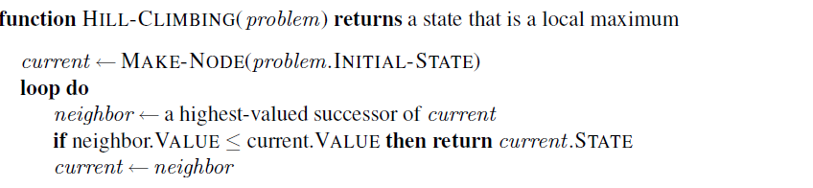
Hill Climbing (for maximization)

Slide 19
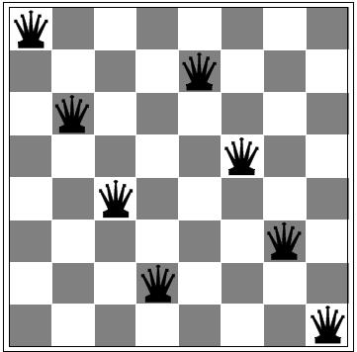
8-queen problem

Slide 20
Local search with min-conflict heuristic (only column moves allowed)
1
2
2
0
3
2
3
2
2
2
2
2
3
2
Pick initial complete assignment (at random)
Repeat
Pick a conflicted variable var (at random)
Set the new value of var to minimize the number of conflicts
If the new assignment is not conflicting then return it

Slide 21
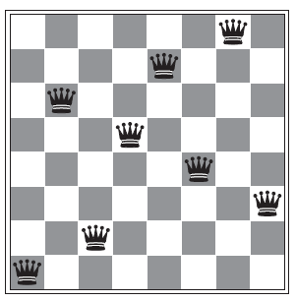
Getting stuck in local minima
This state has h = 1 but every successor has a higher cost

Slide 22
Why does this happen?

Slide 23
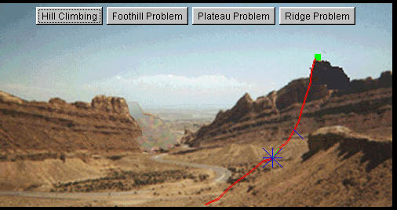
http://wwwic.ndsu.edu/juell/vp/cs724s00/hill_climbing/

Slide 24
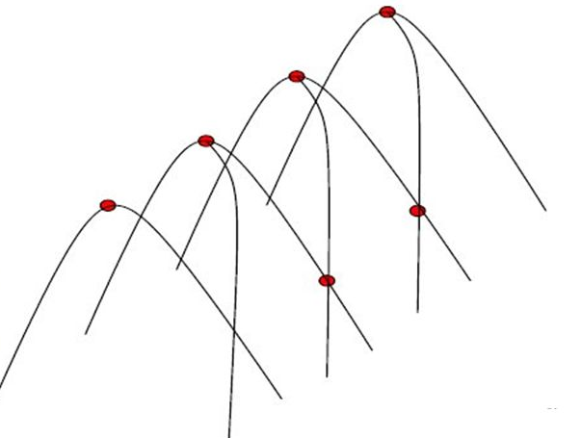
Ridge

Slide 25
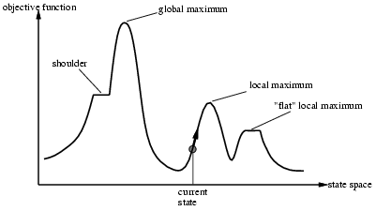
Problems with Hill Climbing (the State Space Landscape)

Slide 26
Greedy hill climbing resembles trying to find the top of Mount Everest in a thick fog while suffering from amnesia

Slide 27
Problems with Hill Climbing (the State Space Landscape)

Slide 28
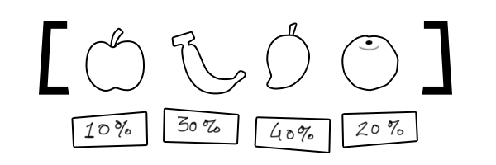
Weighted Random Selection

Slide 29
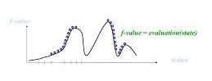
Random Restart Hill Climbing

Slide 30
Hill climbing variants
Greedy or steepest ascent/descent (basic algorithm)
Hill-climbing with sideways moves
Hill-climbing with limited number of sideways moves
Stochastic hill climbing
First-choice hill climbing
Random-restart hill climbing

Slide 31
in-class activity A

Slide 32
SIMULATED ANNEALING

Slide 33
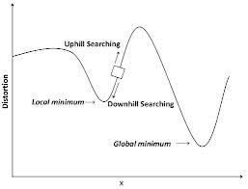
Uphill moves are bad for a minimization problem

Slide 34
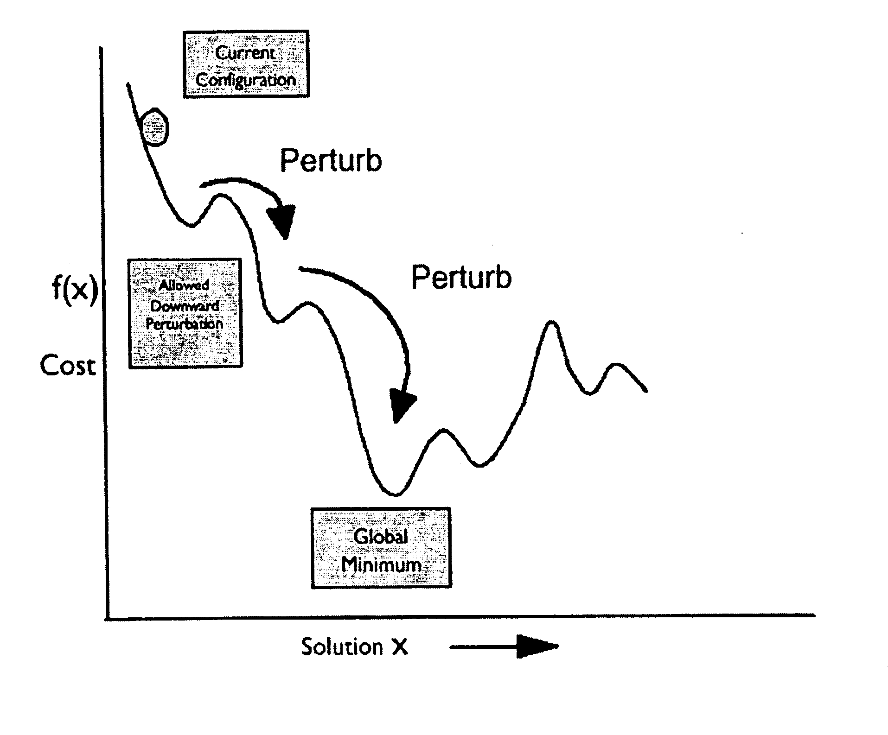
Ping-Pong analogy
for simulated annealing

Slide 35
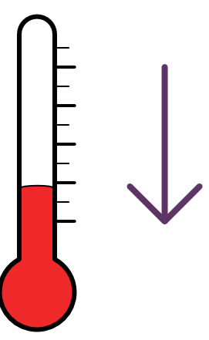
Simulated Annealing Algorithm
Similar to greedy hill-climbing BUT
Pick random move m instead of best move
If m improves situation accept it with probability p = 1
Else accept it with p < 1
p decrease as a function of move badness (exponentially)
p also decrease as a function of temperature T
T starts very high and is gradually reduced (analogous to heating and gradually cooling metals)

Slide 36
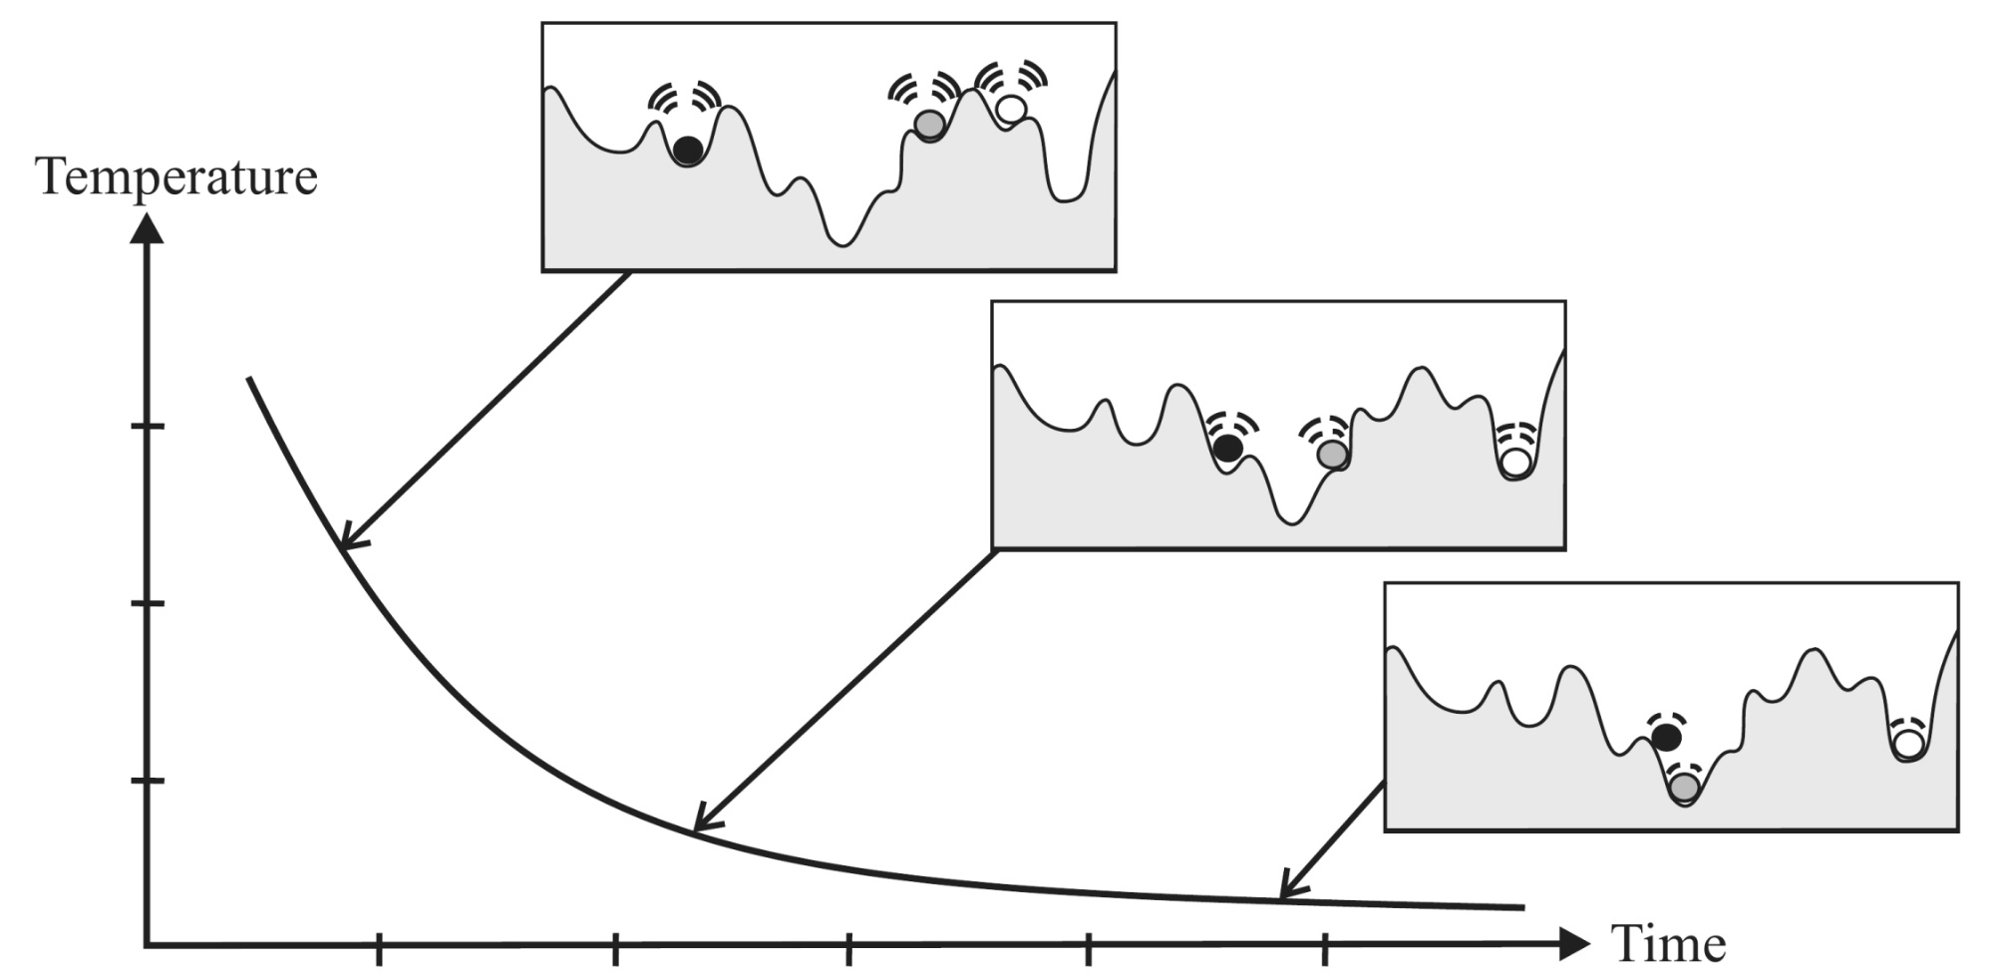
Effect of Temperature
Notes:
The following figure presents the value of the objective function. The temperature makes it possible to « jump » to a less « good » zones to exit a « valley ». The balls and signals in the following figure show up to what height the balls can « jump », that is to say the tolerance of negative variation of the objective function in obtaining a new solution.

Slide 37
Technical Details (from reading)

Slide 38
Simulated annealing demo
https://www.youtube.com/watch?v=KQYfaitQn7g

Slide 39
in-class activity B

Slide 40
Random Restart Hill Climbing
What value will the algorithm return as the final result?
4.9 – the optimum found
Is the returned value more likely to be a local or global optimum?
local, because it converged too quickly and there was too much variability among results

Slide 41
Simulated Annealing
What can you say about the effect of temperature on the probability of choosing successor b?
Will be more likely to select the successor despite it being a suboptimal move at higher temperatures
What is the highest temperature that would decrease the likelihood of choosing successor b?
Objective Function of Current State (a) | Objective Function at Successor State (b) | Temperatures (c) | Probability of Selecting Successor
17 | 15 | 50 | 0.96
17 | 15 | 10 | 0.82
17 | 15 | 5 | 0.67
17 | 15 | 1 | 0.14
17 | 15 | 4 | 0.61
17 | 15 | 3 | 0.51
17 | 15 | 2.85 | 0.50

Slide 42
Simulated Annealing
What is the highest temperature that would decrease the likelihood of choosing successor b? – 2.85
Objective Function of Current State (a) | Objective Function at Successor State (b) | Temperatures (c) | Probability of Selecting Successor
17 | 15 | 50 | 0.96
17 | 15 | 10 | 0.82
17 | 15 | 5 | 0.67
17 | 15 | 1 | 0.14
17 | 15 | 4 | 0.61
17 | 15 | 3 | 0.51
17 | 15 | 2.85 | 0.50

Slide 43
BEAM SEARCH

Slide 44
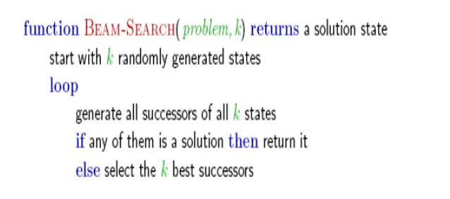

Slide 45
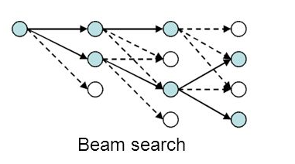
Local Beam Search

Slide 46
Summary
Local search algorithms
Key idea of local search
State space landscape
Hill-climbing search and its variants
Simulated annealing
Local Beam Search

Slide 47
Review

Slide 48
Quiz 2 (2/13)
Uninformed search
How to formulate problems as search problems
How to perform all six searches given a state space
Main advantageous/disadvantageous of each search (technical details not needed)
Heuristic search
How to perform pure heuristic search and A* (emphasis on A*)
Basic idea of iterative-deepening A*

Slide 49
Quiz 2
Local Search
Understand basic concepts of four main local search algorithms and their variants
Encode problems as genes and perform simple operations on Genetic Algorithms
Adversarial Search
Understand the idea of look-ahead search
Perform a minmax search on a problem
Perform alpha-beta pruning
General
Have a good conceptual understanding of search and know the main terms and concepts (see end of Korf reading)

Slide 50
Presentation responses
Sakai -> AI-S17 Resources / Presentations -> Response Submission
https://tinyurl.com/AI-S17-Responses

