Slide 1
Project Presentation of Industry Oriented Hands on Experience (22CS422)
On
PetCare Chakshu Chaudhary
221198131
Supervised By
Swati Goel
Department of Computer Science and Engineering,
Chitkara University, Punjab

Slide 2

Introduction
Urban pet parents in cities like Mumbai and Delhi struggle to find trustworthy daycare. Meanwhile, millions of stray animals face hunger, traffic, and disease — with no unified platform to report, feed, or rehome them. So our project is a
A full-stack MERN web application bridging pet owners, creches, and stray animal welfare — all in one place.
2

Slide 3
The Problem
Fragmented Services:Bookings, adoptions, and reporting scattered across unreliable apps
Stray Crisis:Millions of street animals overlooked due to disconnected communities
Legal Hurdles:Adoption paperwork is complex; supply of homes doesn't meet demand
3

Slide 4
Objective
Bridge Creches & Owners-Easy search, comparison, and booking of pet daycare
Community Hub:A vibrant space for pet lovers to connect, share stories, and tips
Drive Adoptions:Interactive stray posts with comments to promote rehoming
Boost Bookings:Target a 30–50% increase in creche utilization
4

Slide 5
Proposed Solution
Unified full-stack web app:— part booking platform, part community hub for stray welfare.
Authentication:Secure JWT login with user profiles and pet details
Stray Postings:Upload photos, add health/location info, enable community comments
Creche Booking:Browse filtered listings, check availability, and book directly
5

Slide 6
Proposed Solution
Frontend:React.js with hooks (useState, useEffect, useContext) and Vite for fast builds
Backend:Express.js & Node.js with scalable RESTful APIs and JWT security
Media & Storage:Cloudinary for image uploads; JSON files (fs module) for lightweight data
6

Slide 7
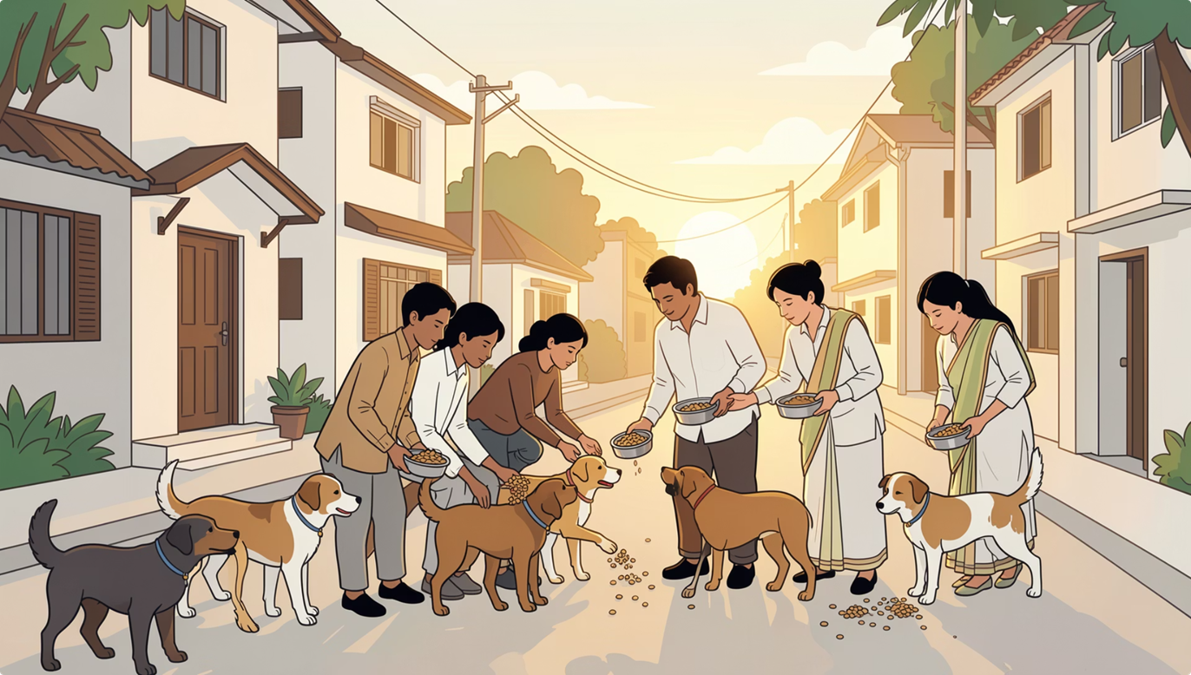
Community & Welfare Benefits
Owner Stress Reduction:Seamless bookings eliminate fragmented app hunting and reliability worries
Enhanced Pet Welfare:Real-time stray reporting connects communities with feeders and vets faster
Economic Uplift:More creche revenue supports local businesses and job creation
7

Slide 8
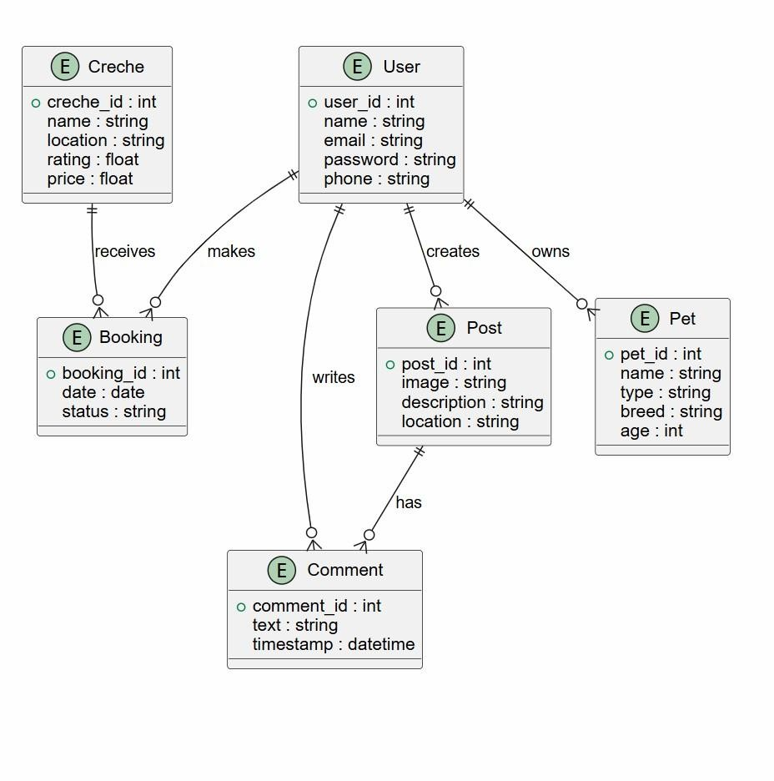
Class Diagram

Slide 9
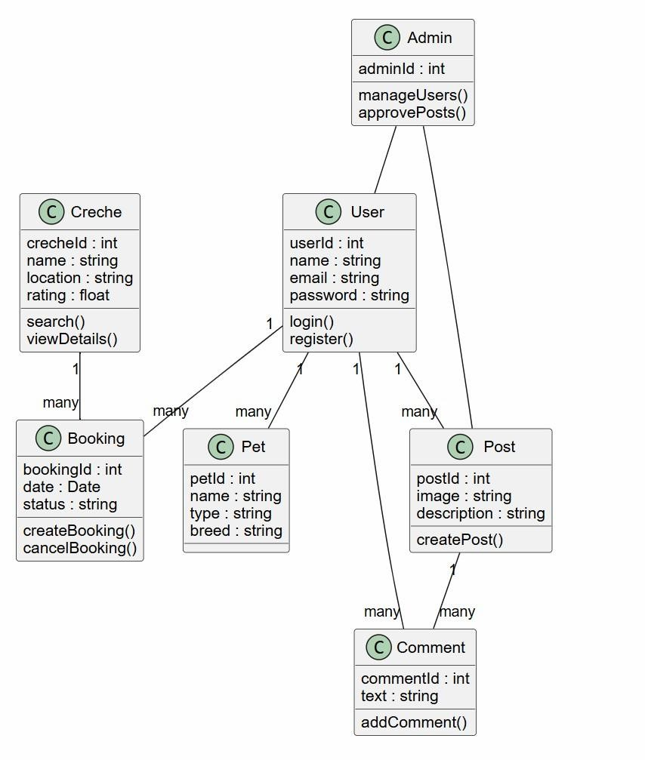
ER Diagram

Slide 10
Conclusion
To conclude, PetCare combines technology, convenience, and social responsibility in one platform. By helping users manage their pets and enabling the community to report stray sightings, the project creates a meaningful step toward better pet care and safer support for stray animals
10

Slide 11
Thank You
11

