Slide 1
Simple RPC Framework
Sridhar Chakravarthy

Slide 2
Agenda
Requirements
Architecture
CODE Walk thru/REVIEW
Questions (Async, any time)

Slide 3
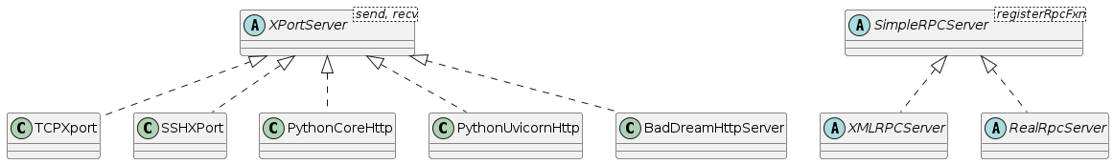
Problem Overview
App Client
App Server
RPC Client
RPC Server
Xport Client
Xport Server
Notes:
The software stack looks stable.
But Xport is not only of different types * (like tcp/http) Multiple Implementation of http
Need to integrate with 3rd party like XML RPC Server
Software Architecture to easily integrate different Xport providers and even different RPC Servers

Slide 4
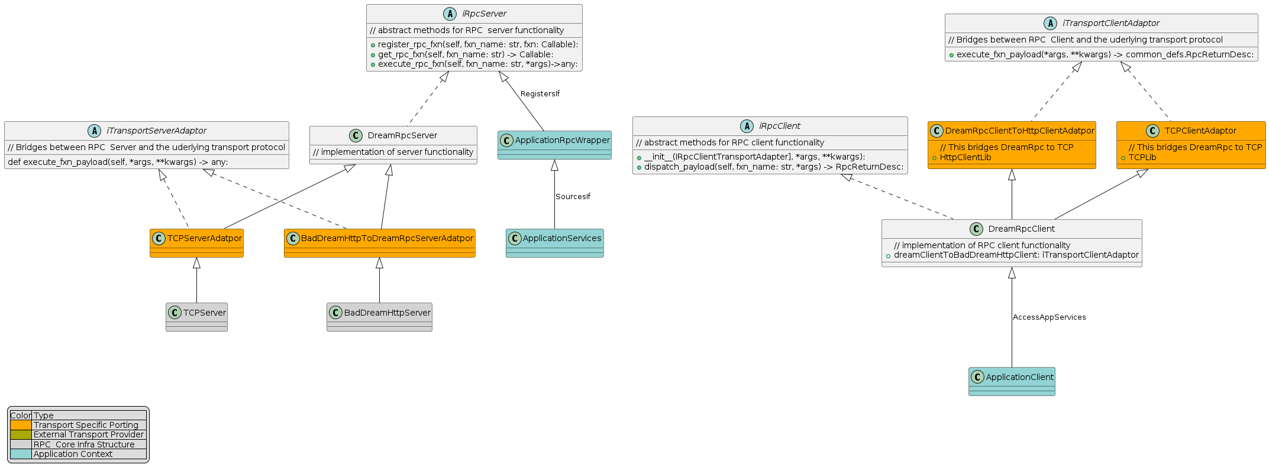
Solution Architecture
Notes:
Transport Adoption: Standardize RPC Interface definition
Decouple transport and RPC through Adaptor Implements Adaptors for different Transport
CustomRPC Adoption: implements another iRPCServer (CustomRpcWrapper) Cannot use Default DreamRPCServer

Slide 5
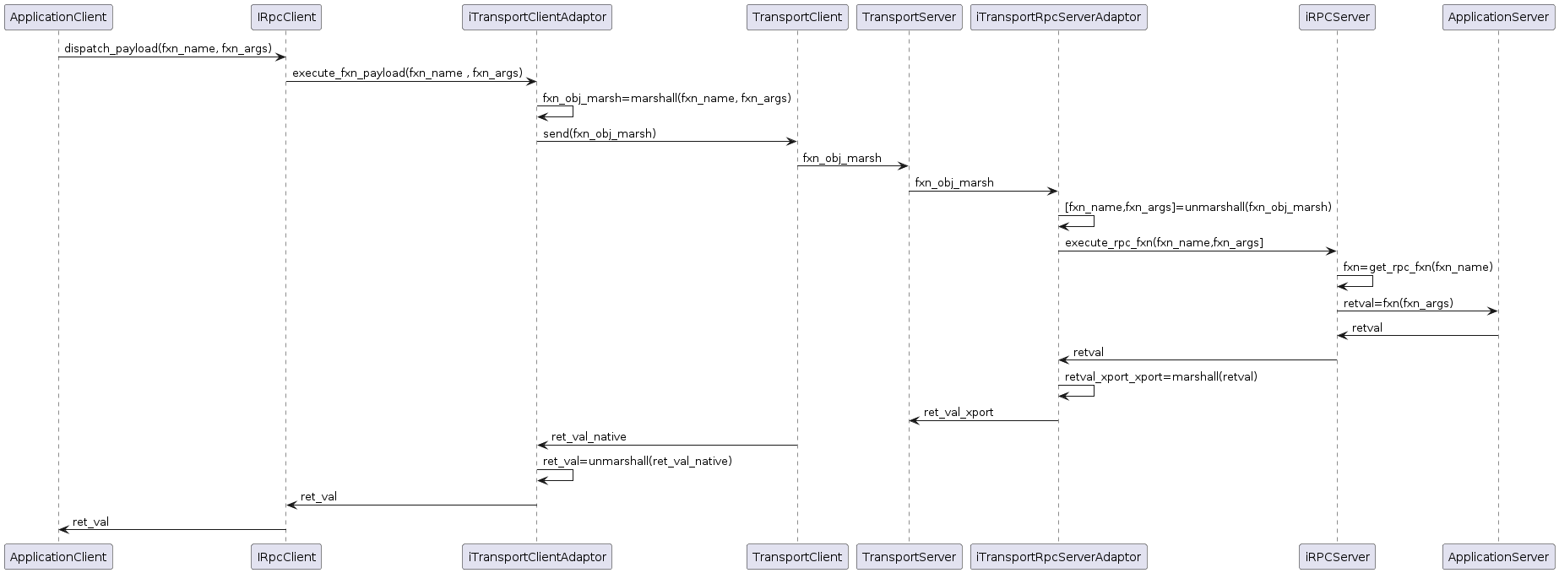
RPC Call: Sequence diagram

Slide 6

Code Review

