Slide 1
Dine in UM
Awesome Project

Slide 2
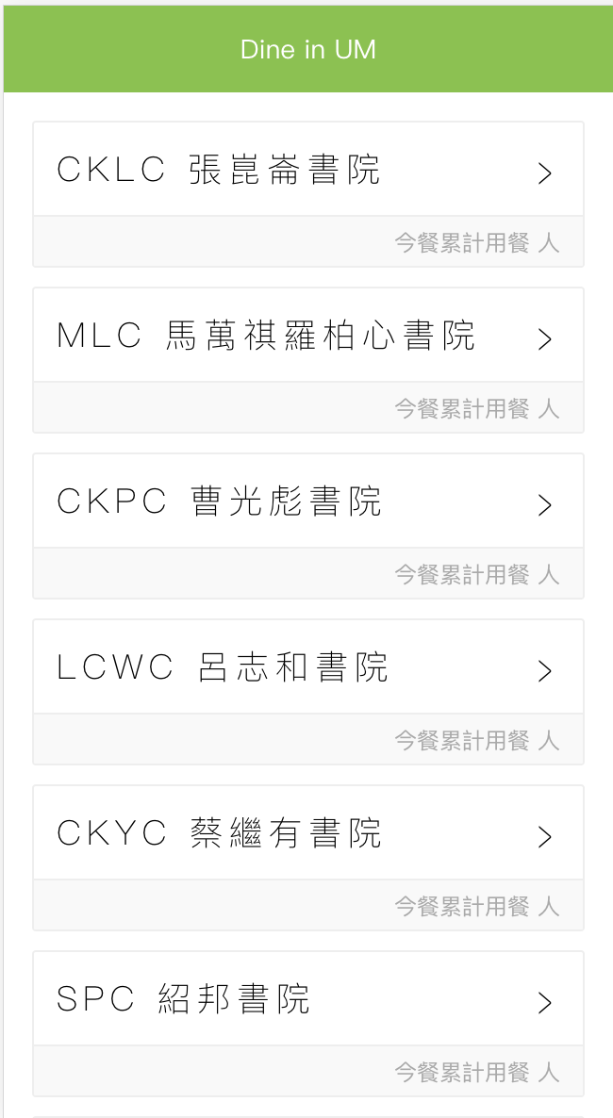
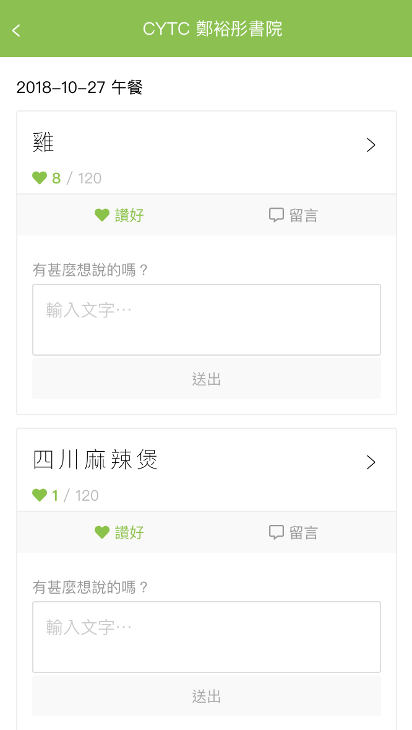
Introduction

Slide 3

Prediction
Big Data Used the data from 2014/08/23 to 2015/11/27. (365 recoards)
Machine Learning Train our model.

Slide 4
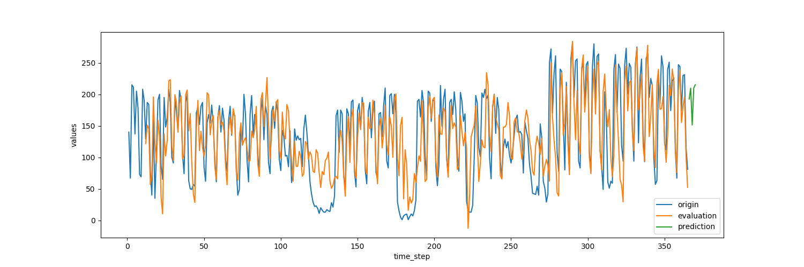
Prediction Result

Slide 5
Prediction Result
Used the data from 2014/08/23 to 2015/11/22 to train.
Predict the data from 2015/11/23 to 2015/11/27.
Date | Acutal | Prediction | Difference
2015/11/23 | 217 | 194 | 23
2015/11/24 | 248 | 215 | 33
2015/11/25 | 155 | 144 | 11
2015/11/26 | 234 | 198 | 36
2015/11/27 | 229 | 218 | 11

Slide 6
Demonstration

Slide 7
Thank you!

