Slide 1


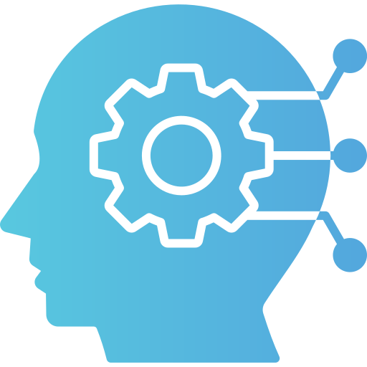
Class-Wide Data Collection & Deep Learning Model

Slide 2

Project Group Members
Yashwanth Chiluka
yashwanthchiluka@my.unt.edu
Gayaetiri Chalasani
gayaetirichalasani@my.unt.edu
Chandra Prakash Reddy Kalwakolu
chandraprakashkalwakolu@my.unt.edu
Rich Lao
richie.lao.le@gmail.com
We did receive and greatly appreciate the substantial amount of voluntary participation for our data collection from the class; and from the professor and teaching assistant for incentivizing it.

Slide 3

Abstract
Gestures, whether they be whole body or minute, can help serve as an early indicator for several neural disorders such as Parkinson’s disease, cerebral palsy or strokes. To simplify and to streamline early detection, developing a machine learning and deep learning model can allow for easier and more consistent gesture recognition. To do this, data was collected from the accelerometer and gyroscope sensor functions off a phone application and used to identify the given gestures of a user to apply as data for a simple model.

Slide 4
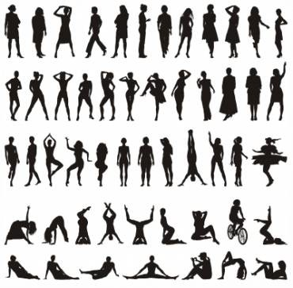
Project Design
Using the phone application, Sensor Logger, accelerometer and gyroscope data was collected from a user for the following gestures:
Walking,
Running,
Waving,
Stretching,
Squatting,
Jumping and
Dancing
All data was collected while in the user’s pocket and again, while around their arm.
Note: a combination of simple and more involved gestures are recommended. As well as maybe specifying what kind of motion you are trying to track (e.g. a certain stretch or dance).

Slide 5
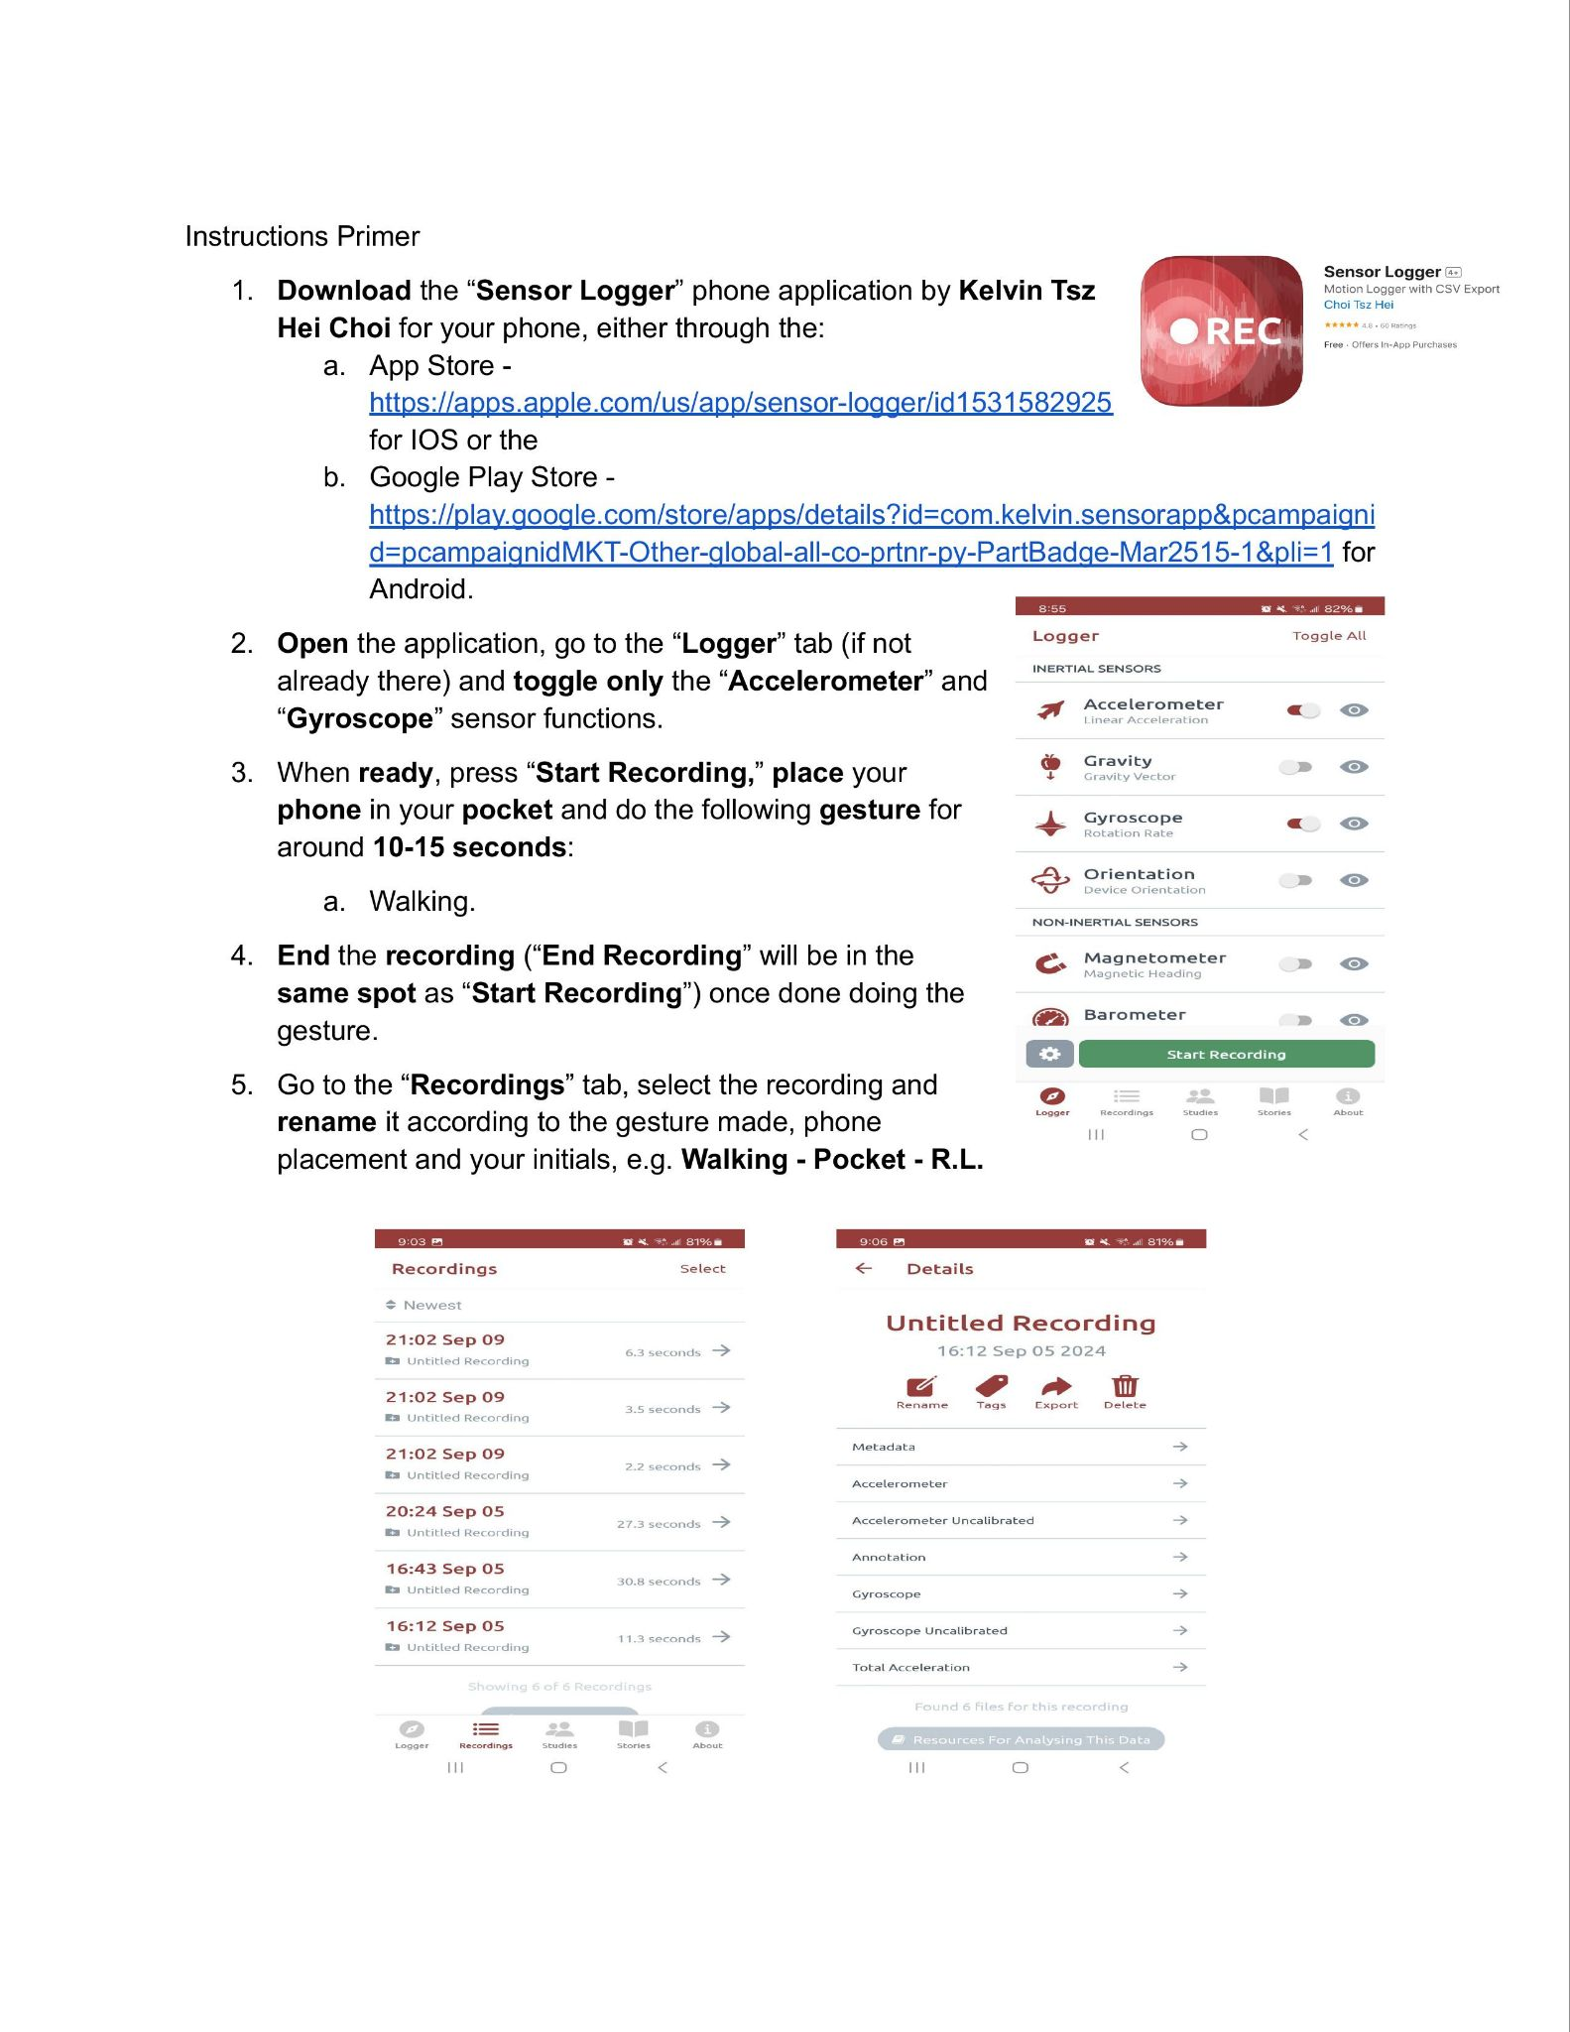
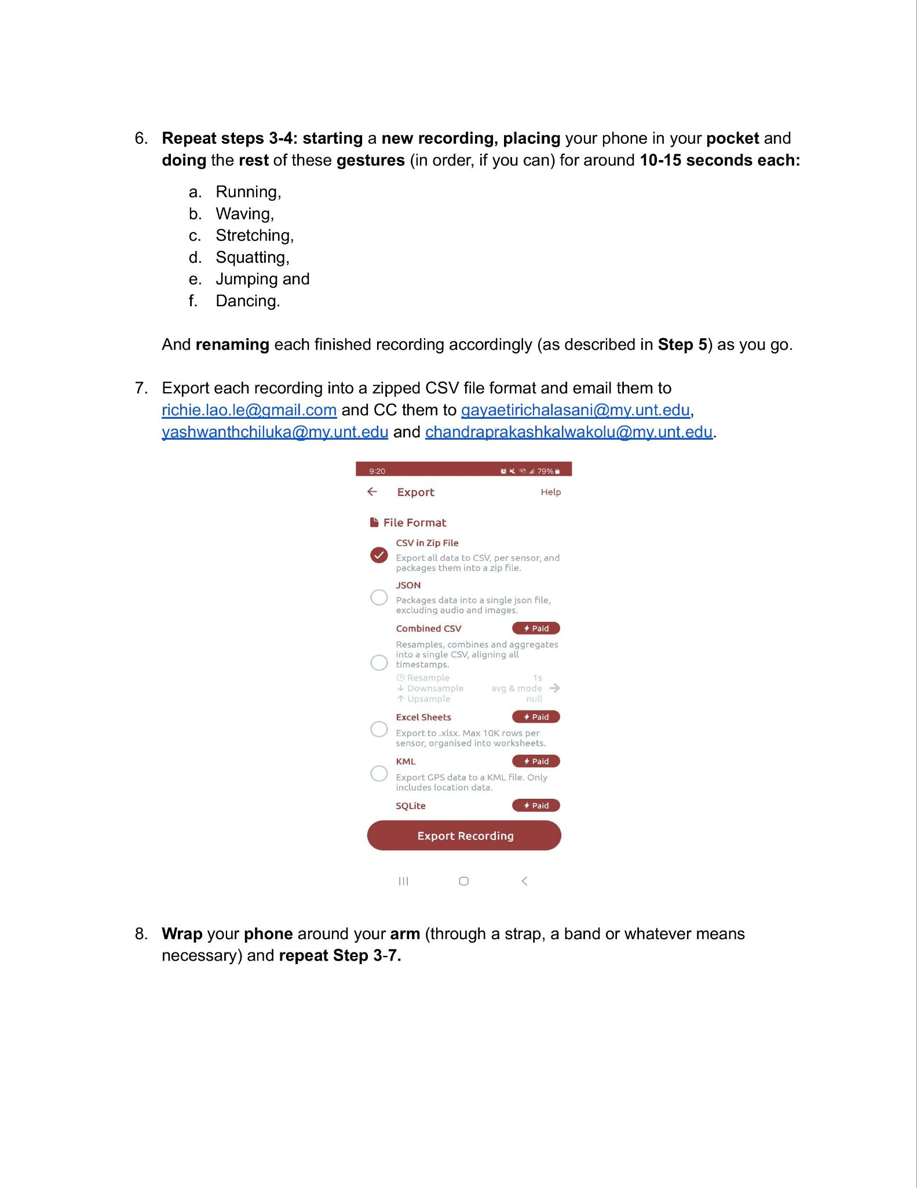
Project Design - Instructional Write-Out
A step-by-step guide of the instructions was drafted and written out, detailing the steps needed to:
Locate and download the application on a user’s phone.
Use it to track the accelerometer and gyroscope data of the given gestures.
Rename the data appropriately, format and export it to the group.

Slide 6
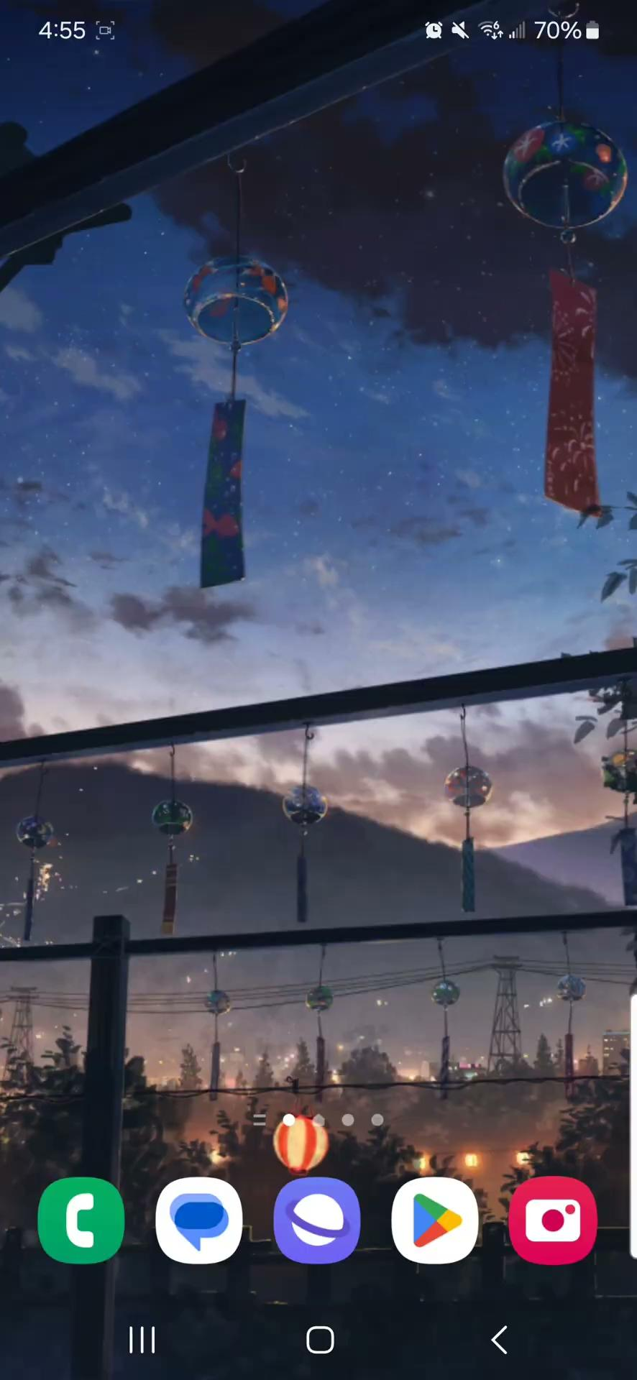
Project Design - Instructional Video
A short instructional video was made and recorded, visualizing the steps as in the instructional write-out.
Note: the write-out and accompanying video were tested on individuals outside the class to determine viability and were adjusted accordingly.

Slide 7
Project Design - Data Collection
An initial set of data was recorded and collected from the group first, to use as a training set for the first version of the simple model.
Following the instructions made, accelerometer and gyroscope data were collected from the given gestures
Note: specifically, the vector data given on a XYZ plane, will be used.
Stored in a shared Google Drive folder. All present and future data will also be categorized and kept here as well.
Then any and all further datasets gathered from the class will be implemented as a Train, validation and test set for the final versions of the model.

Slide 8
Project Design - Framework
The accelerometer and gyroscope data will be recorded for the user’s movement, speed and angle for each gesture. Particularly, the accelerometer will track the direction and speed over time along a XYZ axis while the gyroscope will track the rotation over a XYZ plane.
The data will be labeled accordingly to the gesture made, the placement of the user’s phone and the user’s name or initials.
The data will be collected and formatted into a CSV file format.
The collected data will be pre-processed due to possible noise, outlying and null values that may come from some outside components.

Slide 9
Project Design - Framework cont.
Data visualization will be performed to obtain a greater understanding of data trends and patterns.
The data sets will contain a time stamp, gesture label and accelerometer and gyroscope data.
The LSTM model is designed to identify different given gestures using the collected data.
The phone will be placed in the user’s pocket and then, on their arm to obtain accurate data with respect to the gesture from two separate and related points of motion.

Slide 10




Project Design - Toolbox
Our main project library consisted of the following:
TensorFlow,
Pandas,
NumPy,
Matplotlib and
Sklearn.
We primarily used the following tools:
Google CoLab and
Sensor Logger.

Slide 11
Project Design - Toolbox cont.
Sensor Logger
will be our primary way of collecting data from the class. It is a phone application available for both Android and IOS operating systems and can be used to track both accelerometer and gyroscope data from a user. The data can then be formatted and exported into a CSV file format.
Google CoLab
is a service that provides easy access to computing resources needed to complete this project, including GPUs and TPUs.
TensorFlow
is a free and open-source library full of resources on machine learning and artificial intelligence. It has a wide array applications, ranging from tasks, and more specifically, its focus on training and inference of deep neural networks.

Slide 12
Project Design - Toolbox cont.
Deep gesture: a deep learning-based gesture recognition model that uses motion sensors data.
Recurrent Neural Networks (RNN) were used to identify gestures based on sequential data from motion sensors. A model of RNN- LSTMs because they are faster, have less parameters and memory and has a simpler infrastructure to work with. Using a LSTM-based model will allow for faster learning while still accurate.
LSTM(Long-short term memory model):
The LSTM model has the 4 layers:
Input Layer
LSTM layer
Dense Layer
Output Layer

Slide 13
Input Layer: The input layer receives the sequences of sensor readings.
LSTM Layer:One or more LSTM layers learn the temporal patterns in the data. You can adjust the number of units in the LSTM layer(s) based on your dataset size and complexity.
Dense Layer: A fully connected layer (dense layer) follows the LSTM layers, which combines features learned by the LSTM layers.
Output Layer: The final layer is typically a softmax layer with a number of neurons equal to the number of gesture classes, producing a probability distribution across the classes.
Loss Function: We have used categorical cross-entropy as the loss function for multi-class classification problems.
Batch size and epochs: We have used the batch size of 32 and 50 epochs to train the model on the given data

Slide 14
Evaluation metrics: we have used Accuracy, confusion matrix , precision, recall and f1 score.
Accuracy: we got 92.7 percent accuracy on 34000 data points, we used Lstm model with softmax activation.
Confusion matrix: A table that compares actual and predicted classifications that visualizes how well the model performs . This helps to identify which gestures are often confused with each other.
Precision: measures the accuracy of the positive predictions.
Recall: measures the ability to find all positive instances.
F1-score: The harmonic mean of precision and recall .

Slide 15
Project Milestones
Write-out a set of instructions and record a video of said instructions. They will be passed around and followed by the class to collect data.
1.
If necessary, run a set of blind trial tests using the initial write-up and video of the instructions and modify accordingly to the feedback.
2.
Collect a training set of data from the group to use as a base for the working simple model.
3.
Code and develop the model accordingly to the training data collected.
4.
Collect a validation and test set of data from the class to use for further model testing.
5.
Validate and test the model.
6.
Draw results and conclusions from the final tests.

Slide 16
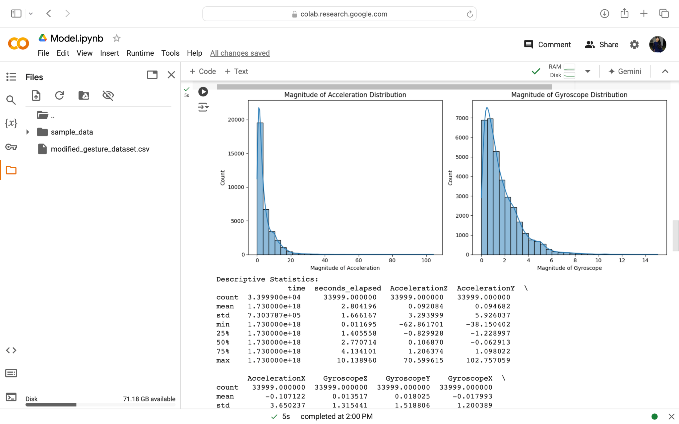
Visualization graphs
Bar graphs:The adjacent bar graphs
shows the magnitude of acceleration
And gyroscope distribution i.e;descriptive
Statistics across the data points that we
Have used along the x, y and z axis .

Slide 17
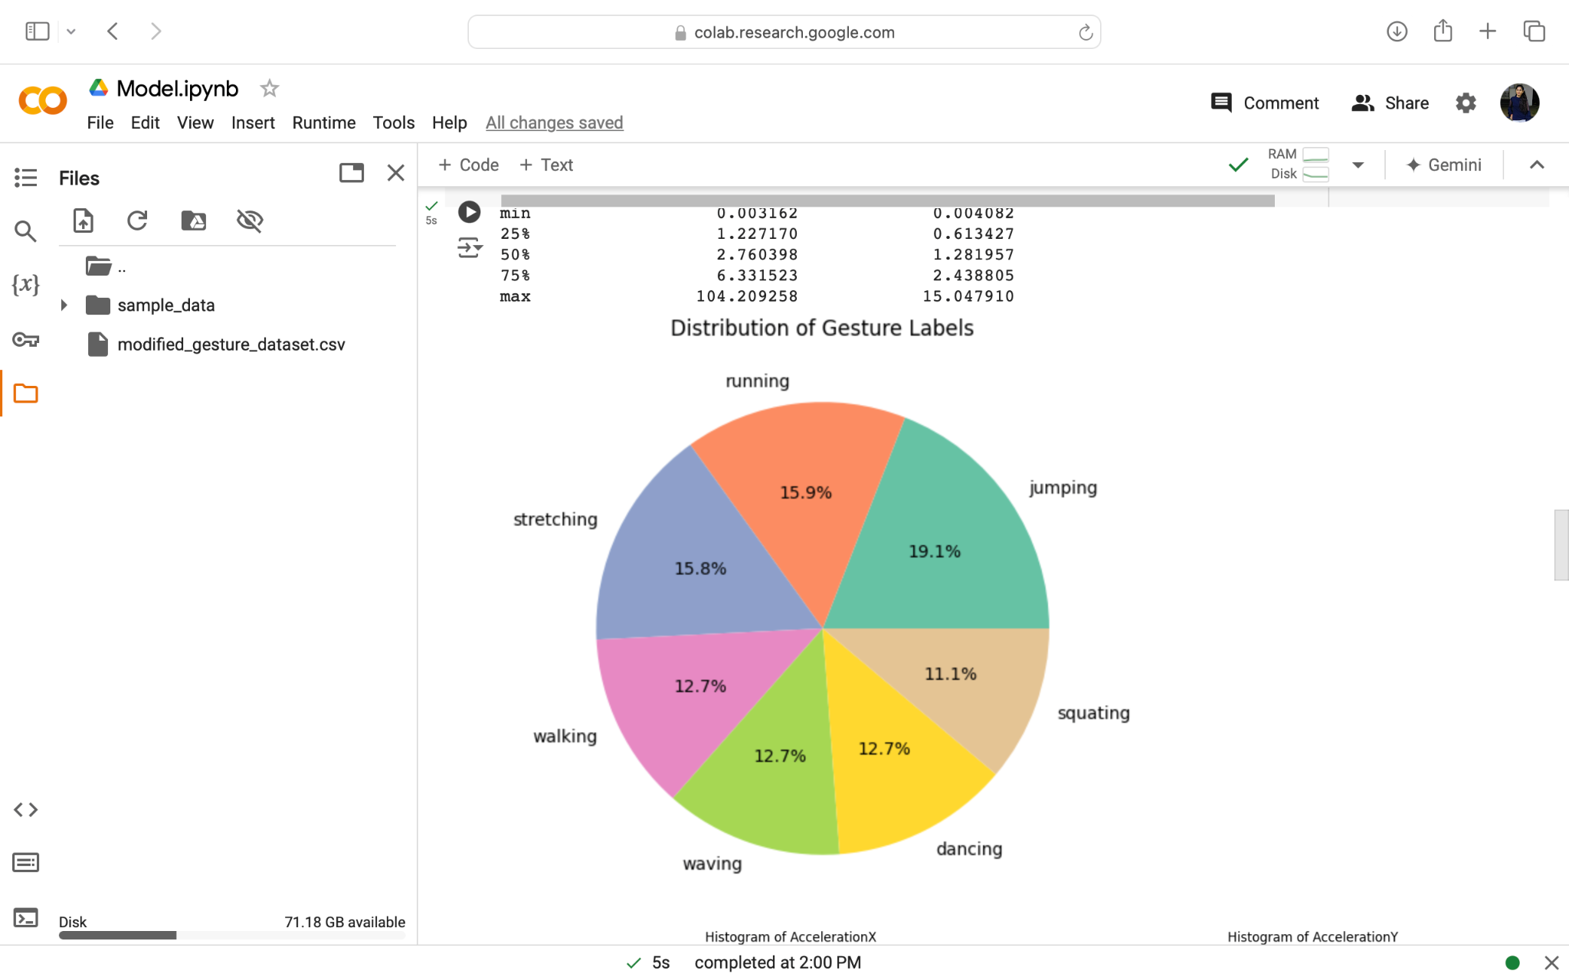
Pie chart: The adjacent pie chart shows
The percentage of data distributed for
Each gesture with the different color
Marks.

Slide 18
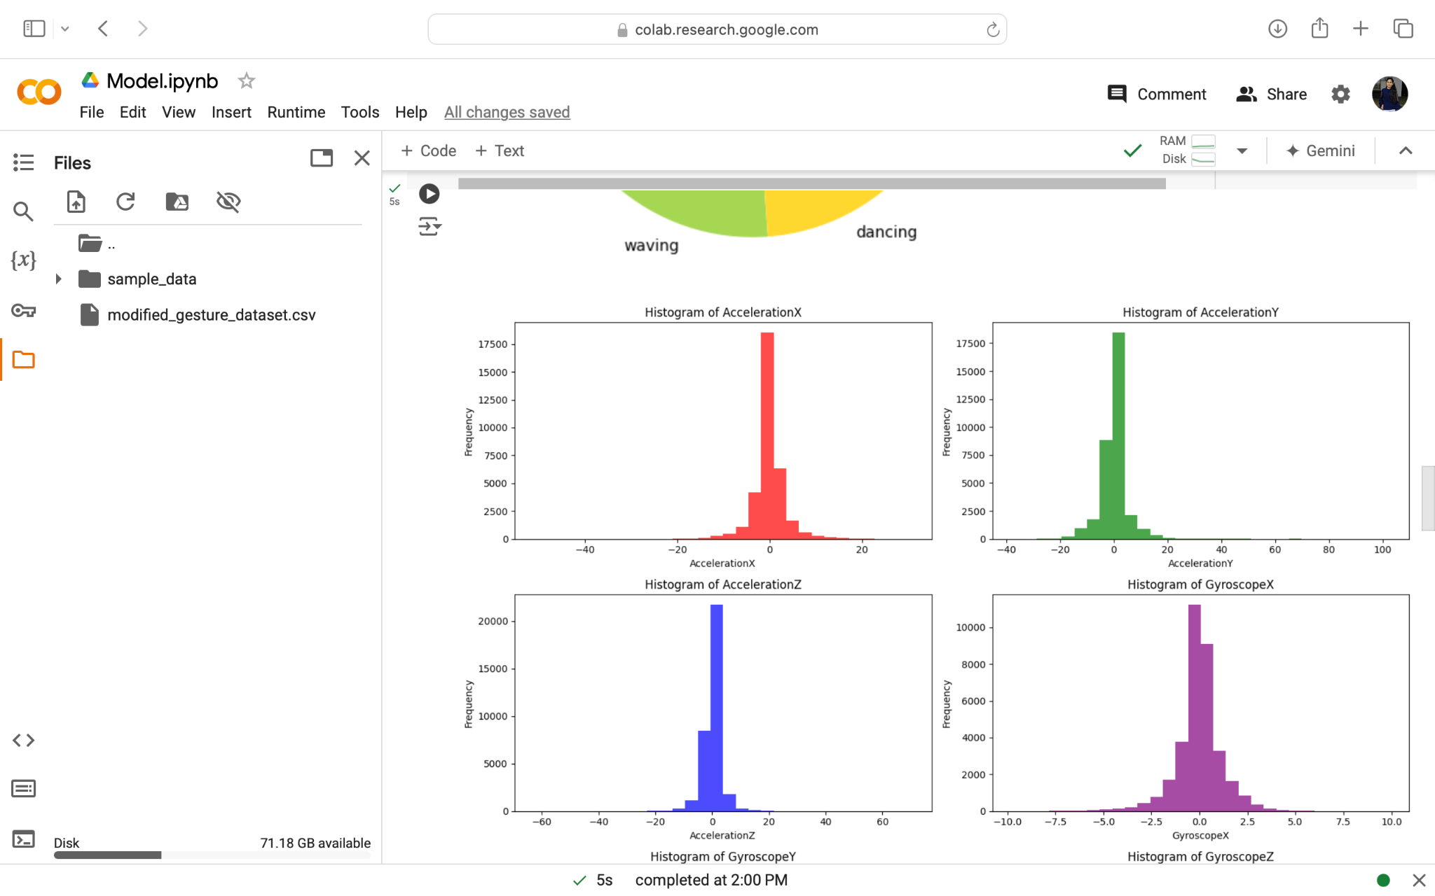
Histograms:The adjacent hist-
Ogram images shows the
Acceleration and gyroscope
Data across the x, y and z axis
By taking frequency on y axis.

Slide 19
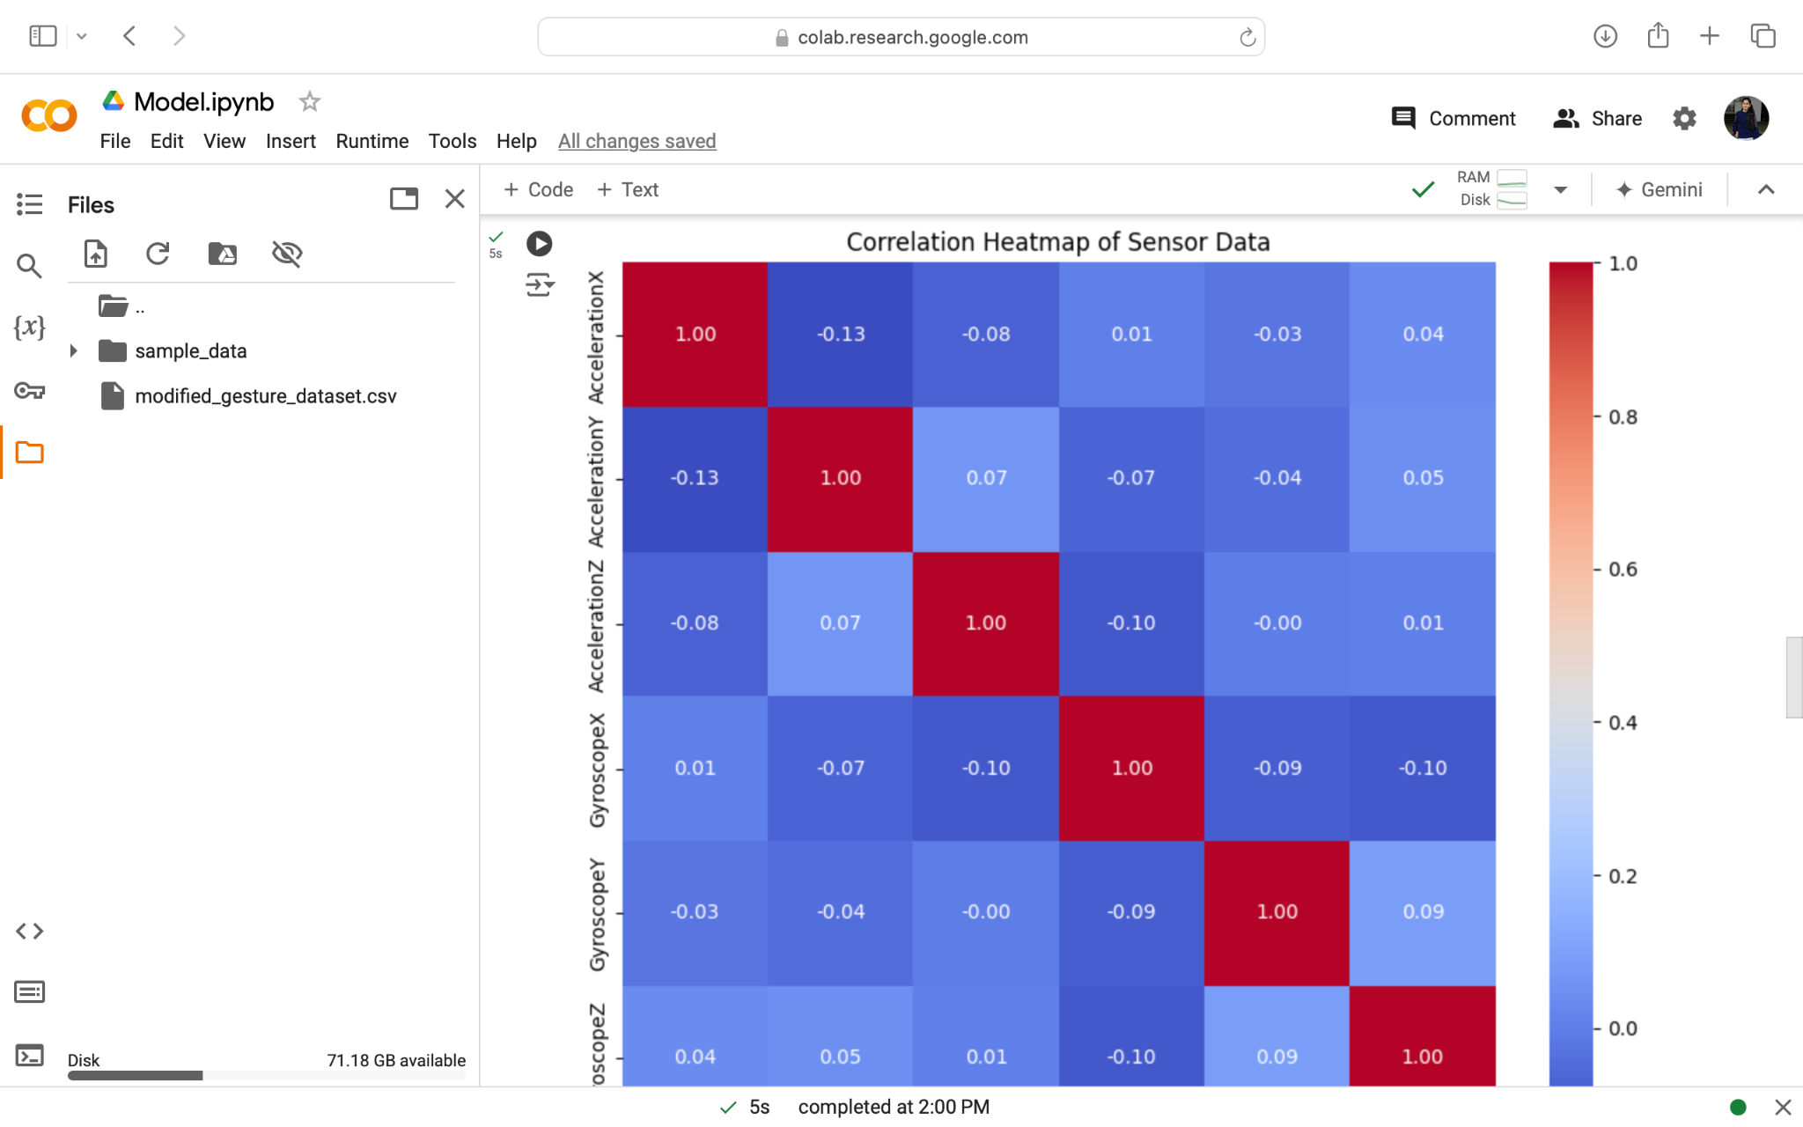
HeatMap:The correlation heatmap of sensor data visually Illustrate the sensor
readings i.e;Acceleration and gyroscope
data,Related to each other. Positive
Correlations close to 1 between
The acceleration X and gyroscope
Y may respond similar during
Specific gesture recognition.

Slide 20
Data Specification
Dataset Size: 33,999 entries
Columns:
time: Unix timestamp representing the time of each data recording.
seconds_elapsed: Time elapsed during the gesture (in seconds).
Acceleration (X, Y, Z): Accelerometer readings capturing the acceleration along the X, Y, and Z axes.
Gyroscope (X, Y, Z): Gyroscope readings capturing the rotation along the X, Y, and Z axes.
Label: Gesture classification (e.g., walking, jumping, running, etc.).
Data Characteristics:
Collected using mobile phone accelerometers and gyroscopes.
Sensor data represents both simple and complex gestures, tracked across different axes (XYZ).
Data is recorded at regular intervals to capture the motion in real-time.
Data Format: CSV file with labeled sensor readings for gestures.

Slide 21
Code
Data Preparation:
The dataset is first loaded from a CSV file that includes gesture data recorded through accelerometers and gyroscopes from mobile devices. Important steps include:
Handling Missing Values: The dataset is checked for missing values and any found are removed.
Feature Engineering: The magnitudes of the accelerometer and gyroscope readings are calculated using their respective X, Y, and Z components. This helps summarize the overall movement in one value per timestamp for each sensor.
Data Preprocessing:
The labels (gestures) are encoded using LabelEncoder to transform them into numerical values required for model training. The feature matrix includes sensor readings, and the labels are the target values.

Slide 22
Code
Sequence Creation:
Since we are working with time series data (gesture sequences), the code slices the dataset into sequences of 10 time steps. Each sequence is associated with a corresponding label to use in training the LSTM model.
Model Architecture:
LSTM Layers: The model is built using two LSTM (Long Short-Term Memory) layers, which are well-suited for time series data.
Dropout Layers: Dropout is used to prevent overfitting by randomly setting a fraction of input units to 0 during training.
Dense Layer: The final dense layer uses a softmax activation to output probabilities for each gesture class.

Slide 23
Code
Model Training:
The model is trained for 50 epochs using sparse_categorical_crossentropy as the loss function, which is appropriate for multi-class classification problems. Accuracy is monitored for both training and validation sets.
Evaluation Metrics:
After training, predictions are made on the test set, and a confusion matrix is computed to evaluate the model's performance visually.

Slide 24
Confusion Matrix:
The confusion matrix is a powerful tool to visualize the performance of our gesture classification model. It allows us to see at a glance how many gestures were correctly classified and where the model made errors.
True Positives (Diagonal Values): The diagonal values of the matrix represent correct predictions. For example, we predicted "jumping" correctly 94% of the time, and "dancing" 90% of the time. These high diagonal values are a strong indicator that the model is very accurate in identifying most gestures.
Off-Diagonal Values (Misclassifications): Any non-diagonal values represent misclassifications. For instance, the model sometimes confused "squating" with "stretching." While these misclassifications are minimal, they highlight specific areas where the model could potentially be improved. This might suggest these two movements have similar sensor data patterns.
Key Insights from the Confusion Matrix:
Strong Classifications: Gestures like "running" and "jumping" were correctly identified with over 94% accuracy. This shows that the model is highly reliable for these categories.
Areas for Improvement: Gestures such as "squating" and "stretching" show a slight drop in accuracy. The confusion between these could be due to their similarity in motion, and refining the dataset or increasing training data for these categories could improve the results.

Slide 25
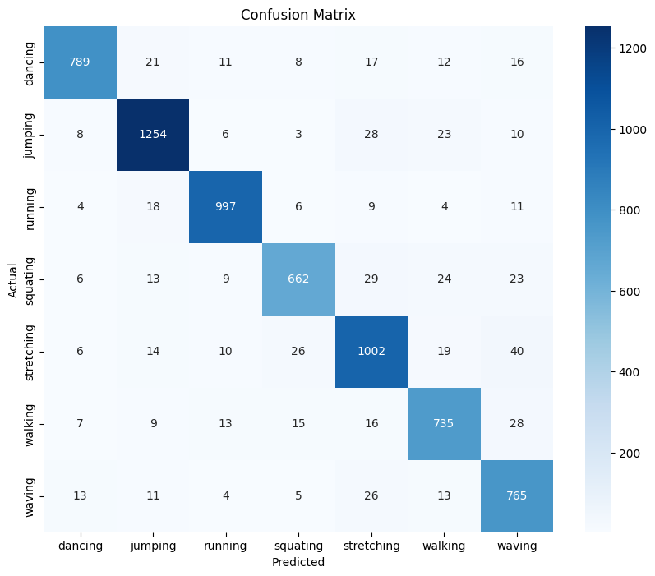
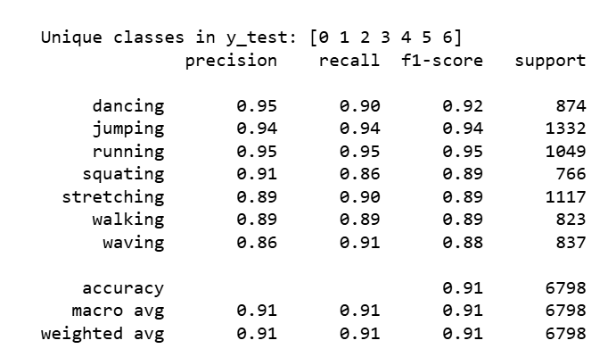
Results
Image

Slide 26
Results
Final Results:
The model achieved an accuracy of 91%, which is a strong performance for gesture classification.
The confusion matrix and classification report highlight that while some gestures were more challenging to classify (e.g., squating and stretching), the overall precision, recall, and F1-scores were consistent across all classes.

Slide 27
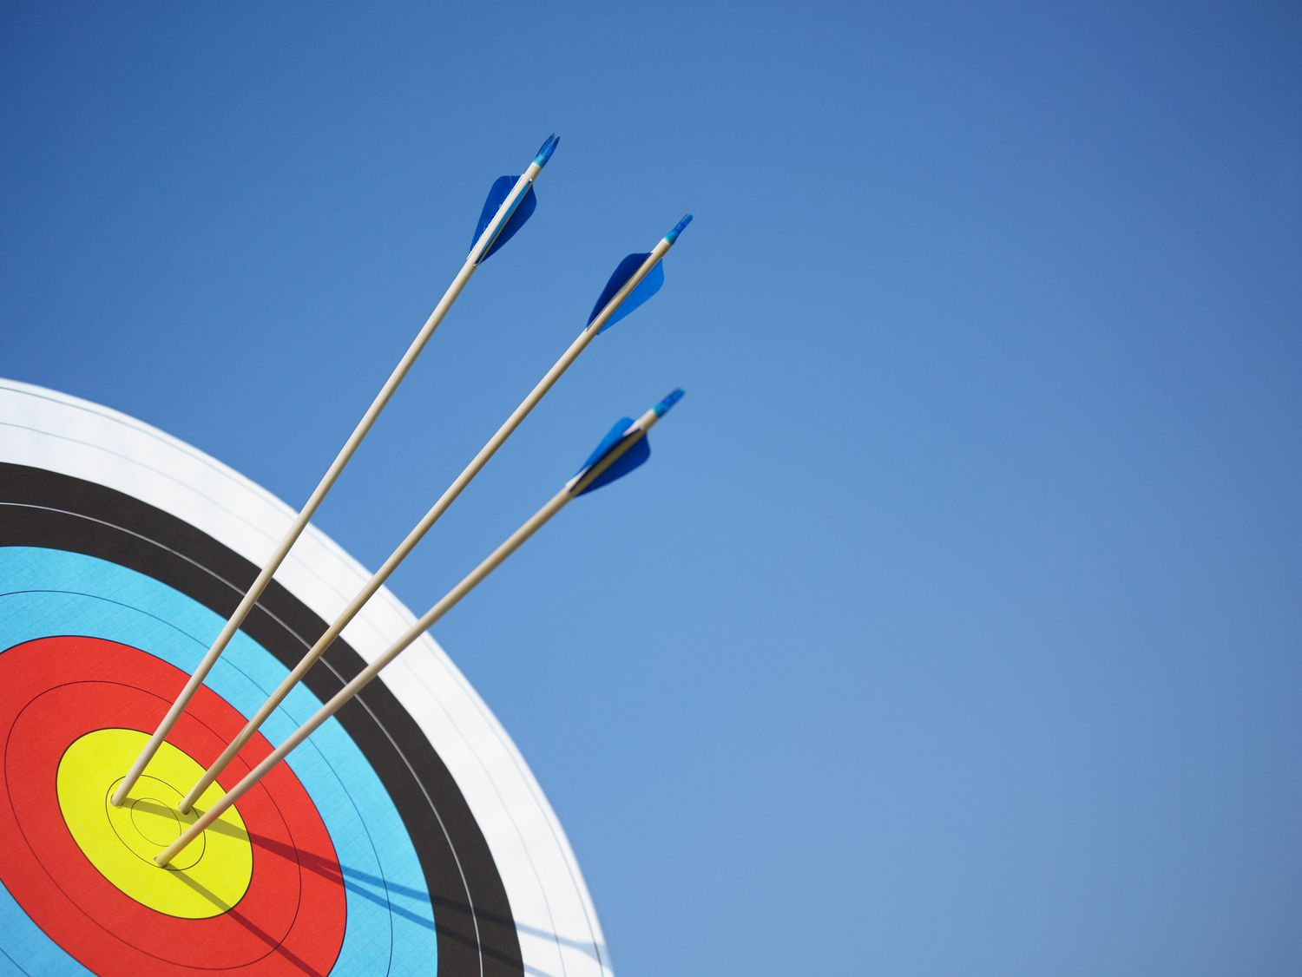
Project Goals
It is to be expected that the final version of the working simple model will have an accuracy of around 99 percent. Given that the data is of quality and pre-processed to remove any outliers, null or misinterpreted values.
Furthermore, this version of the model, along with all of the data collected, can be used a foundation for further iterations that can be implemented for a future Kaggle competition.

Slide 28
Future Project Goals
Post-Surgical Recovery Monitoring:
Goal: Create a gesture-based system to monitor the mobility of post-surgery patients, ensuring they follow recovery guidelines (e.g., avoiding certain movements) and tracking their progress over time.
Outcome: Improve post-operative care with continuous, non-invasive monitoring of movement, reducing the risk of complications.
Hand Gesture Detection for Motor Skill Therapy:
Goal: Develop a gesture recognition system focused on hand movements to assist in motor skill therapy for stroke or traumatic brain injury patients, providing real-time feedback during therapy exercises.
Outcome: Enhance rehabilitation efforts by accurately tracking small motor skills and providing personalized feedback to therapists and patients.

Slide 29
Repository & Archive
The code used for the project’s simple model will be stored in the following GitHub repository link:
https://github.com/Yashwanth0402/Gesture-Recognition-using-RNN/
All of the data collected will be categorized and kept in the following Google Drive folder:
https://drive.google.com/drive/folders/1cd_e9l_NQ50kgcMeqplgEtn9p2T-UGrz?usp=drive_link
All of the relevant project documents will be shared in this Google Drive folder; if needed, here is the link:
https://drive.google.com/drive/folders/1jY_TZQ_0MUQxwfOJhXGbKo7Ig7w9_mEi?usp=drive_link

