Slide 1
Stop Changing the Trigger Criteria!
Mike Chale
Senior Developer
@Trifecta
@mike_chale

Slide 2
Who is Trifecta?
Deliver consistent customer experiences across web, mobile, and eCommerce platforms that are fully integrated into your business systems.
20+ Years developing enterprise solutions, primarily focused on commerce
100+ Salesforce Certifications, including a Salesforce MVP
Trifecta Commerce – Available on the AppExchange
Native app, streamlines order entry supporting B2B and B2B2C commerce.
Top Industries Served:
Manufacturing/Distribution
CPG/Retail
Life Sciences
Hospitality and Entertainment
Visit our booth – #2021 Moscone North

Slide 3
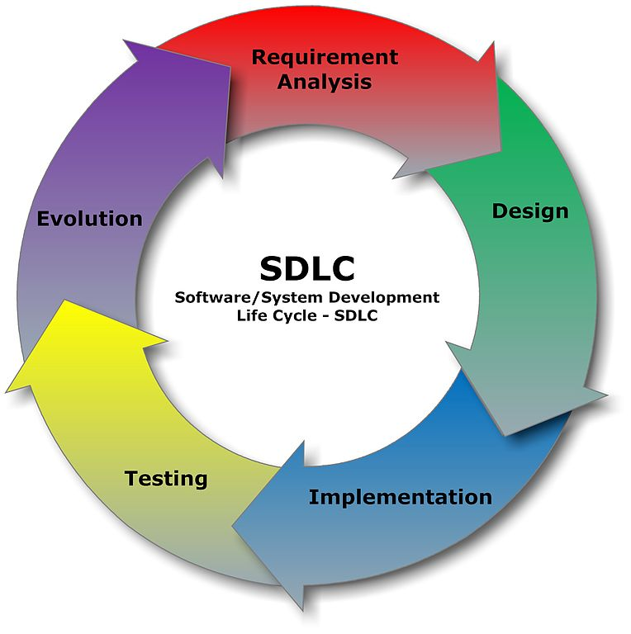
The Theory
How the software development life cycle *should* look
Source: https://commons.wikimedia.org/wiki/File:SDLC_-_Software_Development_Life_Cycle.jpg

Slide 4
The Reality
Business requirements change. Often.
Constantly updating trigger requirements is slow
Let admins focus on “when” and developers on “how”

Slide 5

The Reality
What software development is really like
Source: https://twitter.com/shinypb/status/585160800559439872

Slide 6
What options do we have?
Custom settings
Process Builder & Flow
Formula fields

Slide 7
Scenario #1
Sales wants to selectively add Account Team Members
Currently, Team A is added to Hospitality Accounts
Team A is switching to Entertainment

Slide 8
Demo

Slide 9
Scenario #2
Management wants Contracts created for Opportunities
Currently, Contracts are created for Closed/Won Opportunities
Management needs more granular control

Slide 10
Demo

Slide 11
Scenario #3
Employees need to submit time logs for approval
Management wants submission to be automatic
Management wants to control who can approve

Slide 12
Demo

Slide 13
Recap
Apex can be invoked by Process Builder and Flow
Formula fields can hold criteria for WHICH records
Formula fields can hold criteria to determine actions
Presentation - https://github.com/chalemic/StopChangingTheTriggerCriteria

