Slide 1
Unit Testing: Not Just for Apex
Testing the Declarative Side of the Salesforce1 Platform
Mike Chale
Senior Developer
@Trifecta
@mike_chale

Slide 2
Who is Trifecta?
Deliver consistent customer experiences across web, mobile, and eCommerce platforms that are fully integrated into your business systems.
20+ Years developing enterprise solutions, primarily focused on commerce
100+ Salesforce Certifications, including a Salesforce MVP
Trifecta Commerce – Available on the AppExchange
Native app, streamlines order entry supporting B2B and B2B2C commerce.
Top Industries Served:
Manufacturing/Distribution
CPG/Retail
Life Sciences
Hospitality and Entertainment
Visit our booth – #2021 Moscone North

Slide 3
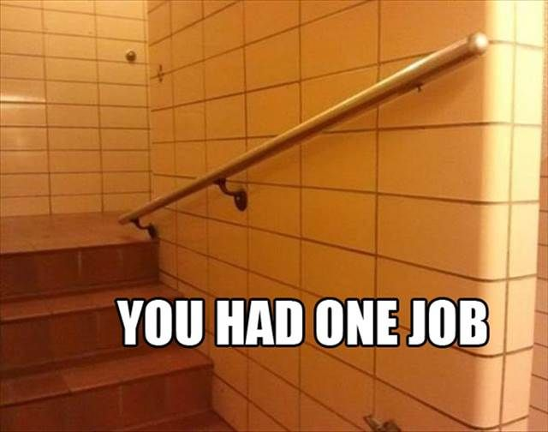
Unit testing has one job . . .
Source: https://www.pinterest.com/pin/460141286900183385/

Slide 4
Why Unit Test?
Ensure customizations work as expected
Verify edge cases
Make changes confidently
Preserve knowledge

Slide 5
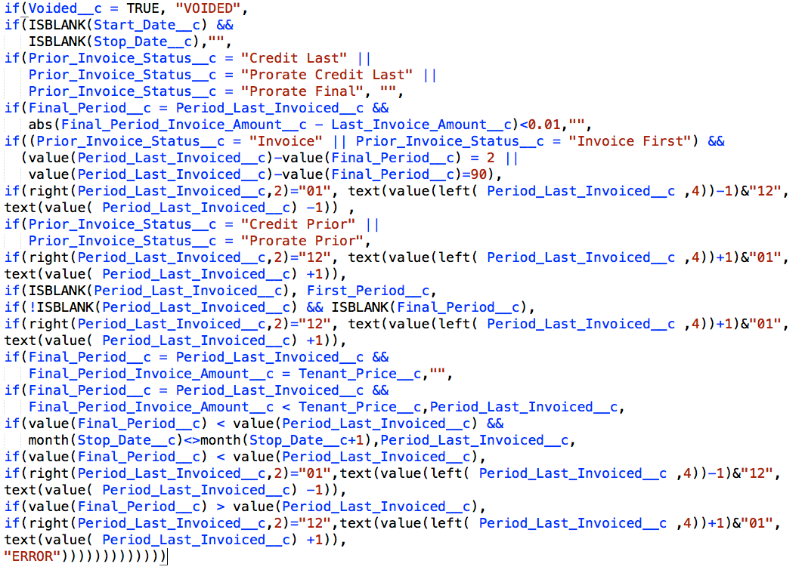
When I saw the light. . .
. . . this was step 1 of a 3 step field update process

Slide 6
Why Unit Test Metadata?
Change Management
Declarative features replacing code
Save time

Slide 7
Unit Testing Metadata
Verify sObject rules
Required fields
Lookup filters
Validation rules

Slide 8
Sample Request #1
Leads are converted without contact information!
Need company size on Lead for classification
Accounts have their Key Contact outside of the company

Slide 9
Demo

Slide 10
Unit Testing Metadata
Verify sObject rules
Verify critical processes

Slide 11
Verifying Approval Processes
Are the entry criteria working as expected?
Is it going to the correct person/people?
Check all branches

Slide 12
Sample Request #2
All “big deals” need to be approved
Deals worth at least $50,000 go to manager
Deals over $100,000 require secondary approval

Slide 13
Demo

Slide 14
Unit Testing Metadata
Verify sObject rules
Verify critical processes
Verify complex Process Builder
Post to Chatter
Auto-submit Approval

Slide 15
Testing Process Builder
Processes can have multiple branches
Each branch can perform multiple steps
Post to Chatter
Update self / related records
Submit for Approval
Invoke Apex and Flows

Slide 16
Sample Request #3
Approval Process is great!
Can the Opportunity be submitted automatically?
And @mention the manager

Slide 17
Demo

Slide 18
Unit Testing Metadata
Verify sObject rules
Verify critical processes
Verify complex Process Builder
Post to Chatter
Auto-submit Approval
Update and create records

Slide 19
Sample Request #4
Need reminders!
Can we automatically convert an Opportunity to an Order?
And create the Contract?

Slide 20
Demo

Slide 21
Recap
Complex orgs have many interactions
Workflows and Process Builder can be complex
Save time with regression testing

Slide 22
Resources
Presentation and sample code - https://github.com/chalemic/UnitTestingMoreThanApex
How to Write Good Unit Tests - https://developer.salesforce.com/page/How_to_Write_Good_Unit_Tests
Testing Best Practices - https://developer.salesforce.com/docs/atlas.en-us.apexcode.meta/apexcode/apex_testing_best_practices.htm
Apex Approval Processing Example - https://developer.salesforce.com/docs/atlas.en-us.apexcode.meta/apexcode/apex_process_example.htm
Apex Lead Convert Class - https://developer.salesforce.com/docs/atlas.en-us.apexcode.meta/apexcode/apex_dml_convertLead.htm

