Slide 1
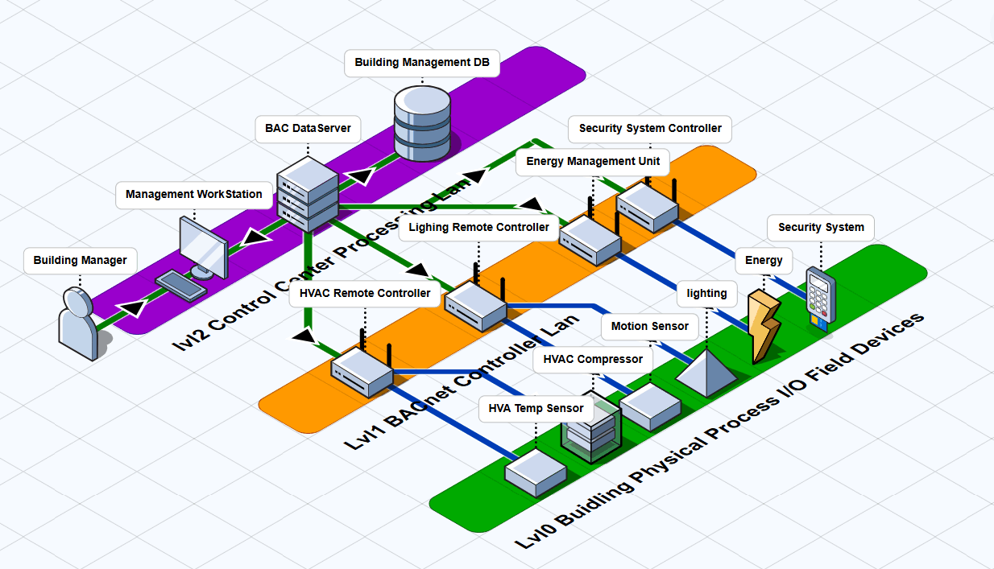
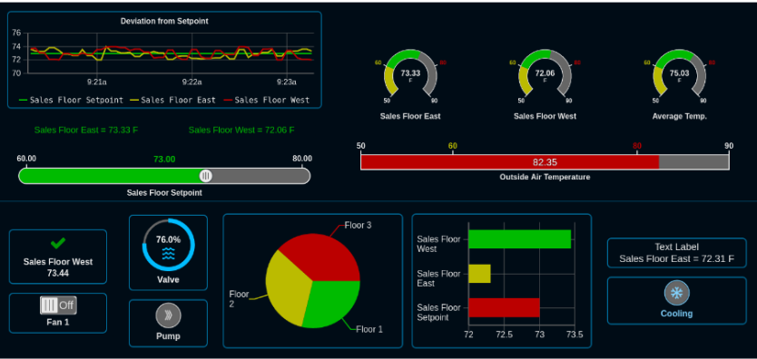
Building Management Dashboard
Provide the BACnet client Communication interface for user to build their own HMI and Operation management Zone data base.
Provide the RTU simulation program with BACnet server for user to build different Level1 OT field controller
Provide connection interface lib for controller to link to the virtual or physical level0 OT device such as the temperature sensor, security door locker
Simulated Electrical Signal
BACnet Communication Bus

Slide 2
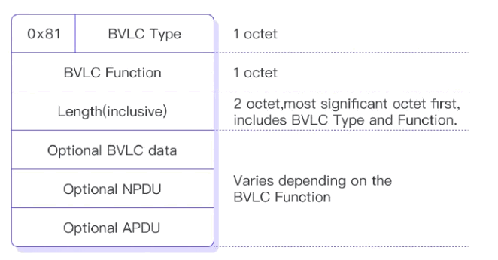
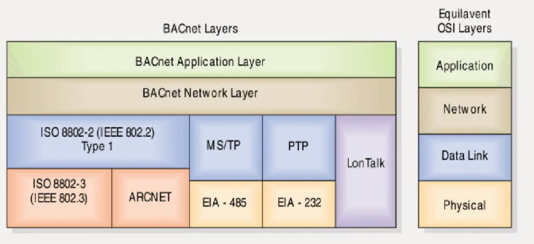

Slide 3
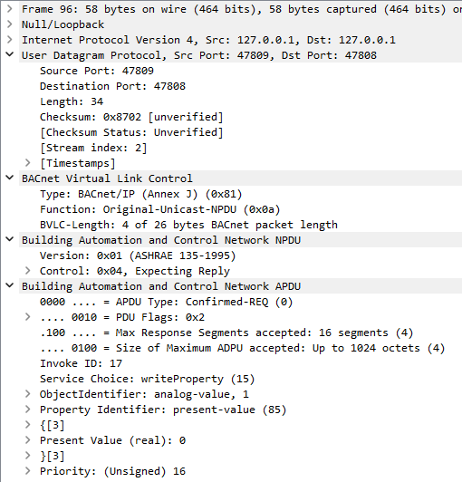
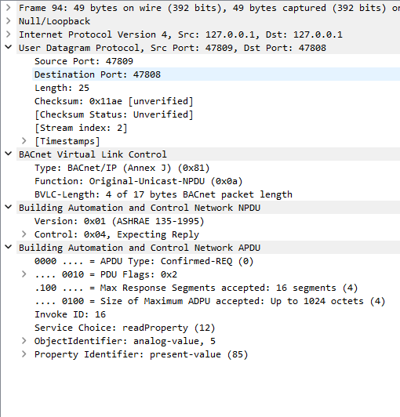
Write Analog Value Property Request
Read Analog Value Property Request

Slide 4
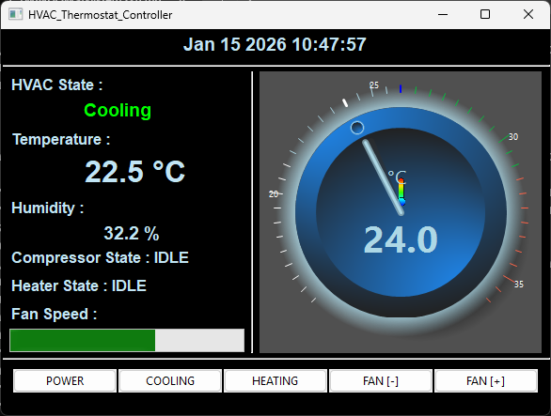












Level0 OT Physical Field I/O Devices
Level1 OT Controller Devices
BACnet Bus
Level2 OT Control Console/HMI/
Center HVAC Physical Components Simulation Modules
BACnet HVAC RTU Simulation Framework
BACnet HVAC Wall Remote Thermostat Controller/App
System OP
Sensors
BACnet Server
Room Temp Sensor
Room Humidity Sensor
RTU input variables
BAC Input Objects [R]
UDP Simulated Electrical Signal RTU Input
BAC Analog Objects [R]
Compressor
Air Conditioner
Fan
HVA Auto
Control
Logic
BACnet Client
RTU output variables
UDP Simulated Electrical Signal RTU Output
BAC Output Objects [W]
Building Management Dashboard
BAC Analog Objects [W]
BACnet Client
Cooling pump
Heater
Power Unit
Other Building Device
BACnet Server
People Detection and Count Radar

Slide 5
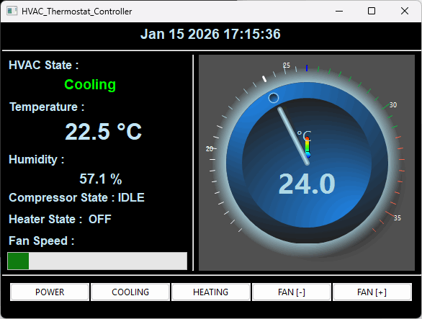
Current Air Conditioner State:
Cooling/Heating/Power OFF
Temperature control rotate knob
Current Room Temperature Sensor Reading (C)
HVAC Basic Function Control Buttons
Power On/Off
Cooling Pump On/Off
Heater On/Off
Fan Speed Decrease
Fan Speed Increase
Current Room Humidity Sensor Reading (%)
Current compressor and heater State from OPS sensor
Current Room Fan Speed Sensor Guage

Slide 6
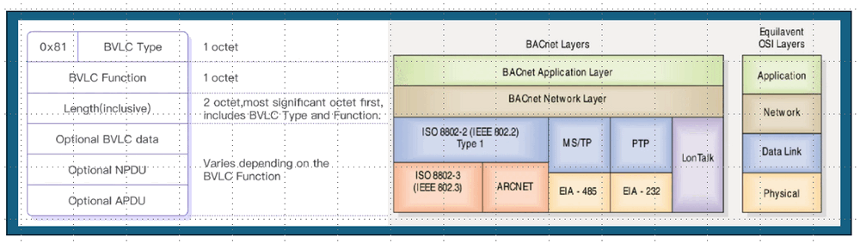
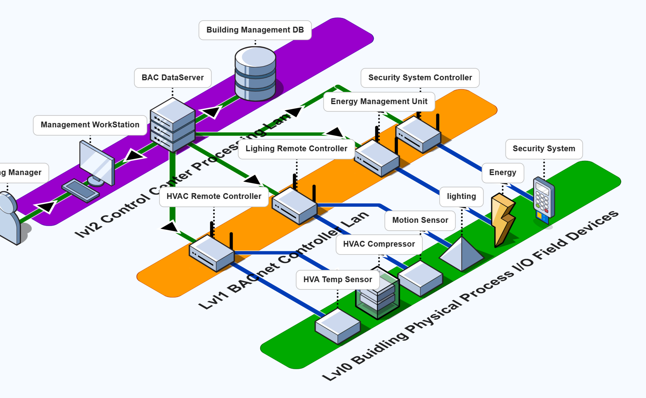
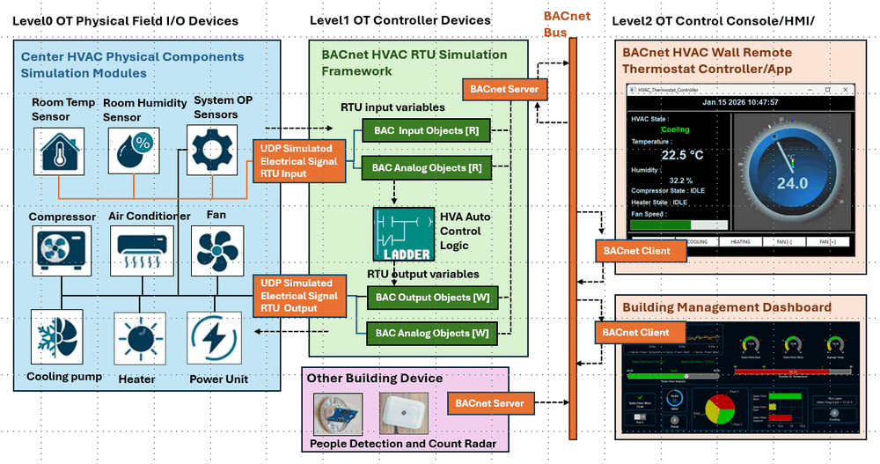
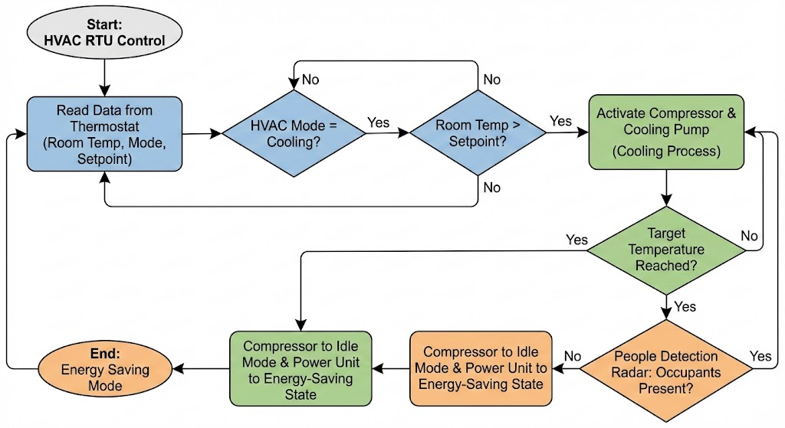
Python Visual Building Controller (RTU) with ISO 16484-5 BACnet to Simulate the Building HVAC System
Building Environment

