Slide 1
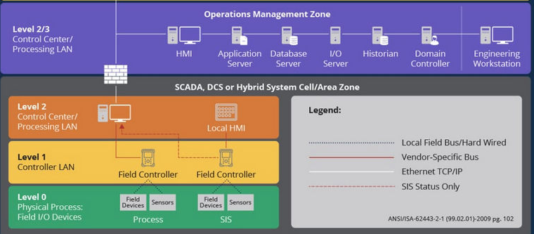
Different OT levels OPC-UA data follow with related OPC-UA-TCP server and client configuration
Provide the OPC-UA-TCP client Communication interface for user to build their own HMI and Operation management Zone data base.
OPC-UA Client
OPC-UA Client
Provide the PLC, IED and RTU simulation program with OPC-UA-TCP server for user to build different Level1 OT field controller
OPC-UA Server
OPC-UA Client
OPC-UA Client
Electrical Signal Simulation Link Clients
PLC
OPC-UA Server
RTU
OPC-UA Server
Provide connection interface lib for user to connect to the virtual or physical level0 OT device
Electrical Signal Simulation Link Server

Slide 2
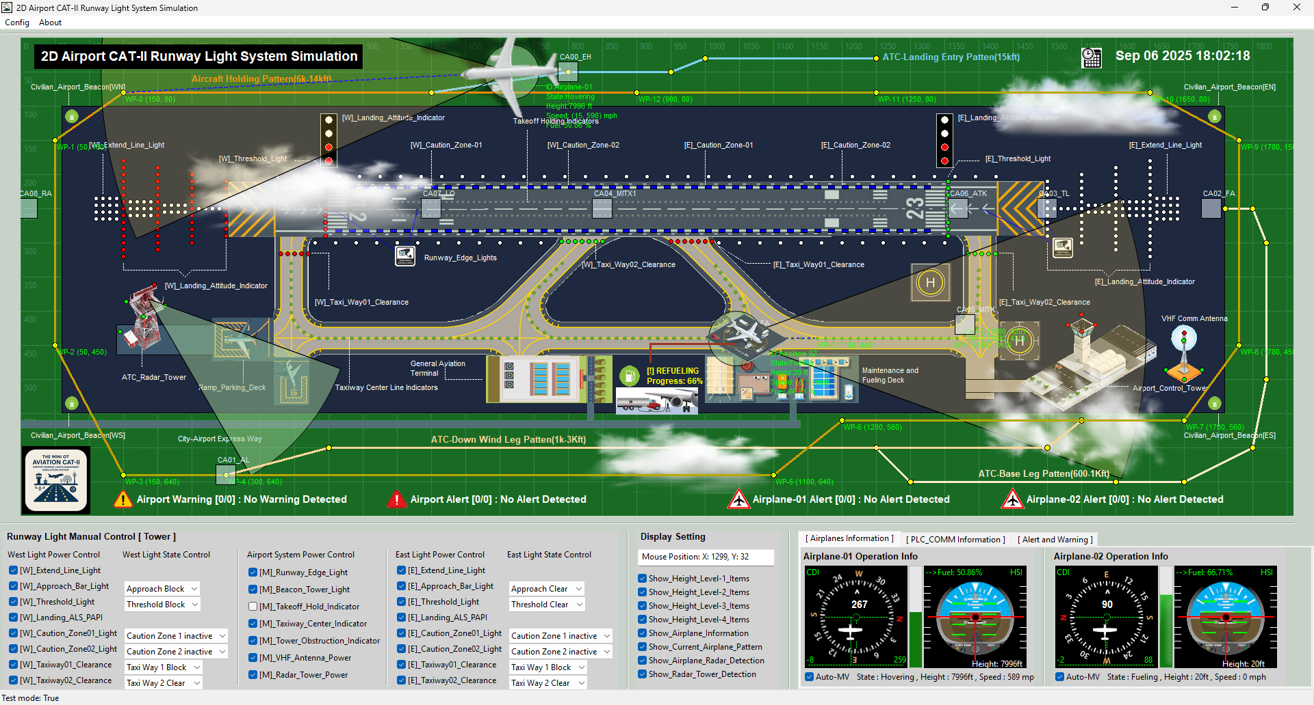
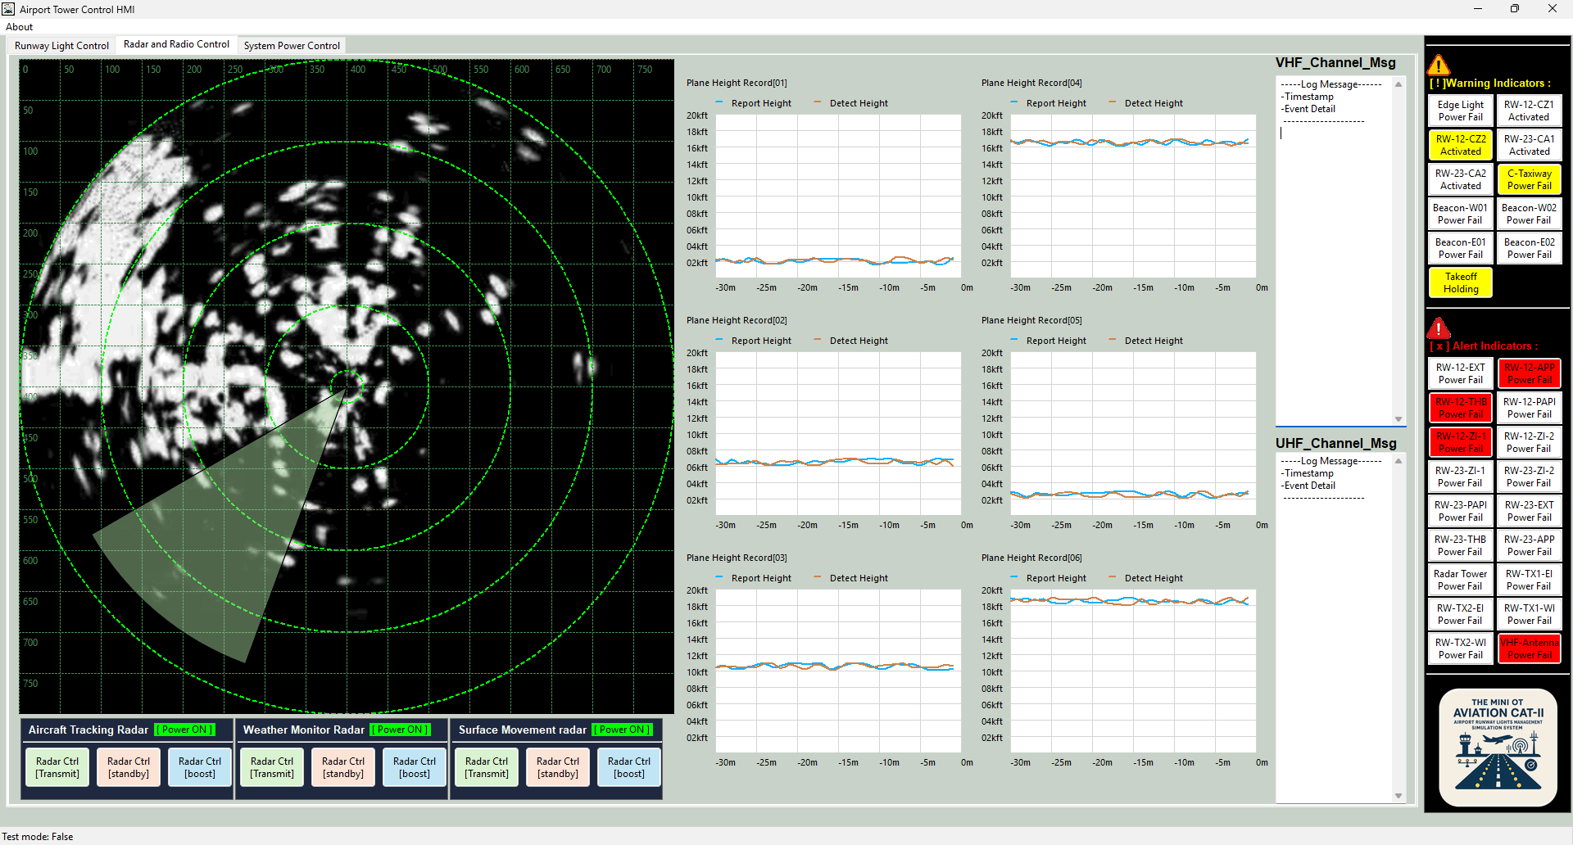

Python Virtual PLC Simulator with IEC 62541 OPC-UA-TCP Communication Protocol
Level0 OT Physical Field I/O Devices
Level1 OT Controller Devices
Level2 OT Control Center (HQ)
Runway Light Physical World Simulator
OPC-UA PLC Simulation Framework
SCADA HMI/Console Program
Periodic message
PLC input variables
OPC-UA Server
OPC-UA Client
ADS-B Data Management Module
Var_Int16
UA Data Structure
ADS-B Monitor HMI
Var_Float
UA-Name Space
Var_Str
UA-Object
Tower ADS-B
Plane ADS-B
Var_Bool
Input OW MD Flag
UA-bool
output OW MD Flag
Airport Traffic Tracker
UDP Simulated ACARS Channel to PLC input
UA-bool
UA-int16
OPC-UA Server
Weather Info Sensor
Ladder Logic
Level3 OT Data Center
Var_Str
UA-float
OPC-UA Client
I/O Raw DB
Historian DB
Airspace info Tracker
UDP Simulated ACARS Channel to PLC output
UA-str
ADS-B Data Management Module
Var_Float
Grand Station ADS-B Antenna
PLC output variables
UA-bool

Slide 3

Weather Sensor
UA data structure variable
1
PLC input hash table variables
3
Tower HMI
Weather Radar
2
7
8
Ladder Logic calculation module
OPC UA Server
OPC UA Client
Plane
7
9
6
PLC input hash table variables
4
Raw Data Base
ADS-B antenna
5
UA data structure variable
Temperature_var1
IF Temp1 > Temp2 :
OUT = True
ELSE
OUT = False
END IF
compare_bool_var
Temperature_var2
combine_message

