Slide 1
Database Silsilah Keluarga
PAS-03
Akbar Abdirahman (1906381672)
Chandra Halim Nuruddin (1906381584)

Slide 2
Latar Belakang
Di masyarakat, ada keluarga yang mencatat garis keturunannya dan ada juga yang tidak. Pencatatan garis keturunan pada umumnya dilakukan secara manual di media buku. Hal ini dikarenakan pencatatan digital membutuhkan kemampuan penggunaan komputer yang jarang dikuasai orang tua kebanyakan. Akibatnya, ketika generasi muda menanyakan relasi dengan kerabat tak sedikit orang tua yang kebingungan menjelaskan silsilah keluarganya. Oleh karena itu, kami berencana membuat suatu inovasi berupa database silsilah keluarga untuk memudahkan pencatatan data keluarga dan penelusuran relasi antar dua anggota keluarga.

Slide 3
Binary Tree Design
struct BinaryNode {
char *name;
int level;
struct BinaryNode* child;
struct BinaryNode *sibling;
}
typedef struct BinaryNode BinaryTree;
typedef BinaryTree* BinaryTreePtr;
FIRST
CHILD
ROOT
NULL
FIRST
CHILD
DATA
NEXT SIBLING
NULL
DATA
NULL
NULL
DATA
NULL

Slide 4
Linked List Design
struct ListNode {
char *name;
char *parent;
int age;
int gender;
struct ListNode* next;
}
typedef struct ListNode LinkedList;
typedef LinkedList* LinkedListPtr;
DATA
NEXT
DATA
NEXT
DATA
NEXT

Slide 5
Algoritma Reading DataPeople.csv
1. Function read_people ( )
2. begin
3. LinkedListPtr People;
4. open file “DataPeople.csv” in read mode
5. string line = read per line from “DataPeople.csv
6. parse line into data parent, name, gender, age
7. insert_list ( People, parent, name, gender, age )
8. close file “DataPeople.csv”
9. return People
10. end.

Slide 6
Algoritma Inserting Linked List People
1. Procedure insert_list ( People, parent, name, gender, age )
2. begin
3. LinkedListPtr new, prev, curr
4. simpan data personal (parent, name, gender, age) di new
5. next of new = NULL
6. next of prev = NULL
7. curr = People
8. find position to insert by comparing parent and age
9. insert from beginning in People if People is empty or parent is lowest in lexicographically
10. otherwise insert between prev and curr in People
11. end.

Slide 7
Algoritma Writing DataPeople.csv
1. Procedure write_people ( People )
2. begin
3. open file “DataPeople.csv” in overwrite mode
4. print table header to the first line of “DataPeople.csv”
5. while People exist begin
6. file print data of People with “;” as delimit
7. People = next of People
8. endwhile
9.. close file “DataPeople.csv”
10. end.

Slide 8
Algoritma Converting Linked List to Binary Tree
1. Function convert_family ( )
2. begin
3. LinkedListPtr People = read_people()
4. string root = name of first People
5. BinaryTreePtr Family = create_tree ( People, root, 0 )
6. return Family
7. end.

Slide 9
Algoritma Creating Binary Tree
1. Function create_tree ( People, name, level )
2. begin
3. BinaryTreePtr Parent = NULL
4. data of Parent are parent and level
5. find child of parent in People
6. if exist then add create_tree ( People, child, level+1 ) as down child of Parent
7. find sibling of parent in People
8. if exist then add create_tree ( People, sibling, level ) as right child of Parent
9. return Parent
10. end.

Slide 10
Algoritma Writing DataFamily.csv
1. Procedure write_family ( People, Family )
2. begin
3. open file “DataFamily.csv” in overwrite mode
4. print table header to the first line of “DataFamily.csv”
5. StackPtr stack
6. push data Family to stack
7. while stack is not empty begin
8. BinaryTreePtr node = pop stack
9. if ( node has sibling ) then push to stack
10. if ( node has child ) then push to stack
11. file print data of node with “;” as delimit
12. endwhile
13. close file “DataFamily.csv”
14. end.

Slide 11
Algoritma What is Relation between two person
1. Procedure what_relation ( person1, person2 )
2. begin
3. level1 = scan_family ( name of person1 )
4. level2 = scan_family ( name of person2 )
5. switch ( level1 - level2 ) begin
6. // based on data person1 and person2
7. case 0 : person1 (sibling or cousin) person2
8. case 1 : person1 (son/daughter or nephew/niece) person2
9. case -1 : person1 (father/mother or uncle/aunty) person2
10. case 2 : person1 (grand son/daughter) person2
11. case -2 : person1 (grand father/mother) person2
12. default : too far relationship
13. endswitch
14. end.

Slide 12
Algoritma Scanning DataFamily.csv
1. Function scan_family ( who )
2. begin
3. open file “DataFamily.csv” in read mode
4. string line = read per line from “DataFamily.csv
5. for every line parse line into data name, child’s name, sibling’s name, level
6. if ( name same as who ) then return level
7. close file “DataFamily.csv”
8. return -1
9. end.

Slide 13
Algoritma Scanning LinkedList People
1. Function scan_people ( who )
2. begin
3. open file “DataPeople.csv”
4. looping search who in DataPeople.csv until found or end of file
5. if found then return data of who
6. else return NULL
7. end.

Slide 14
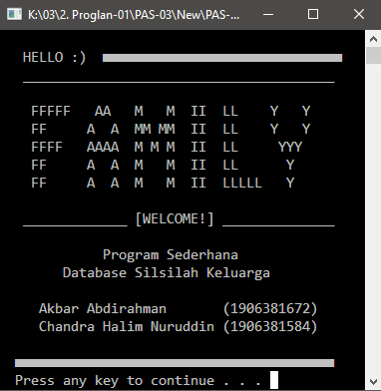
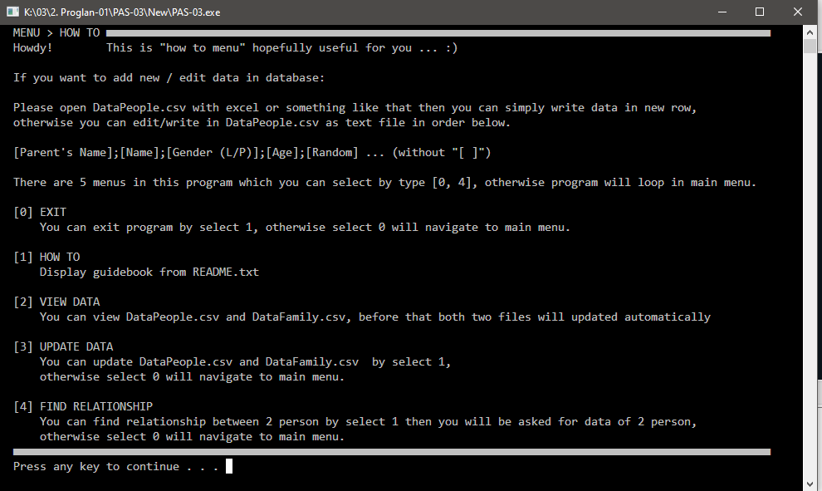
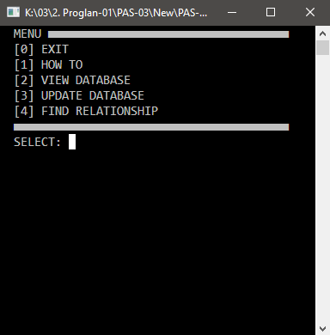

Slide 15
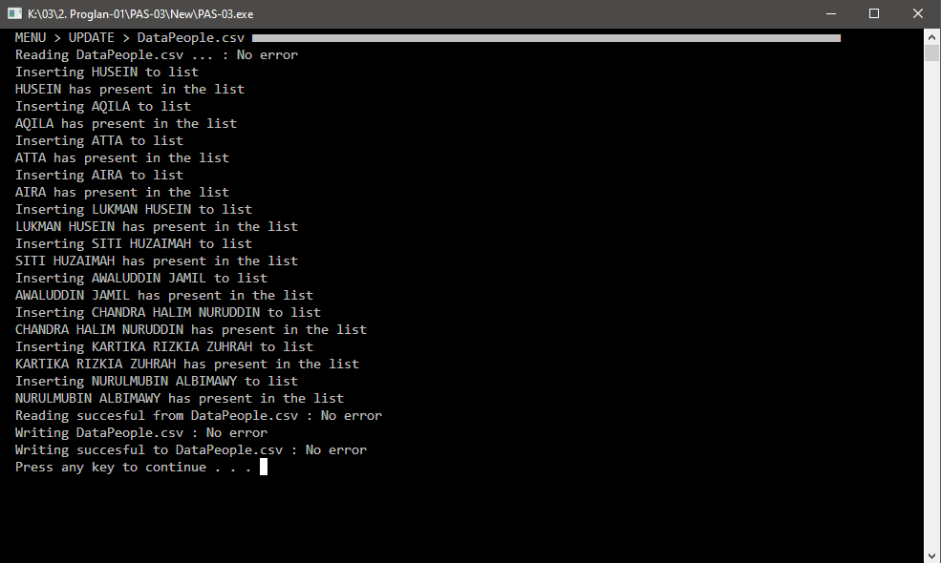
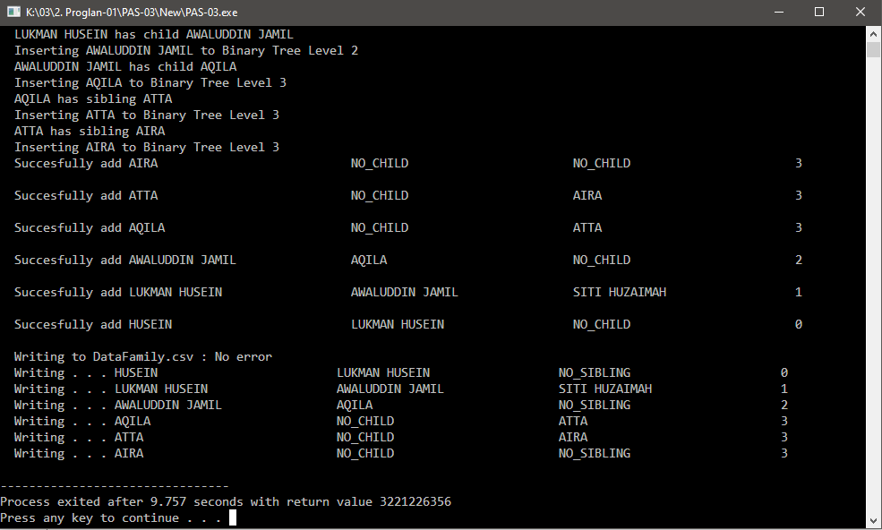
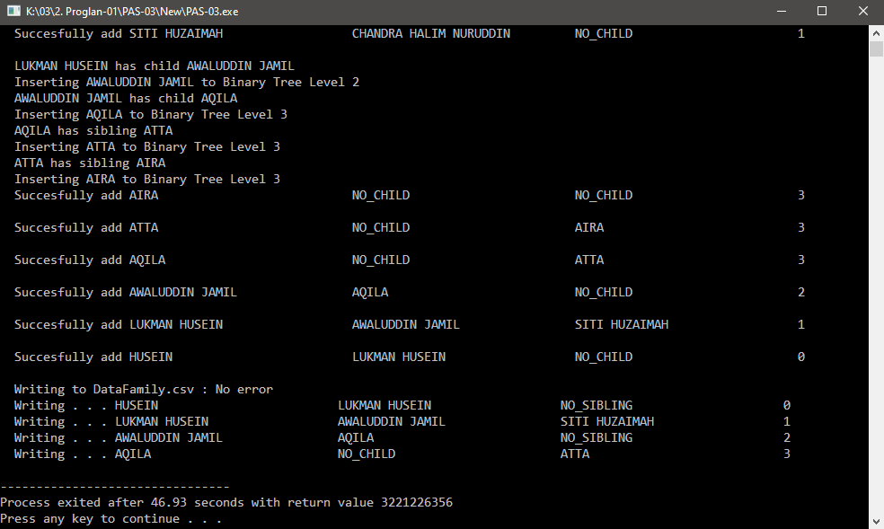
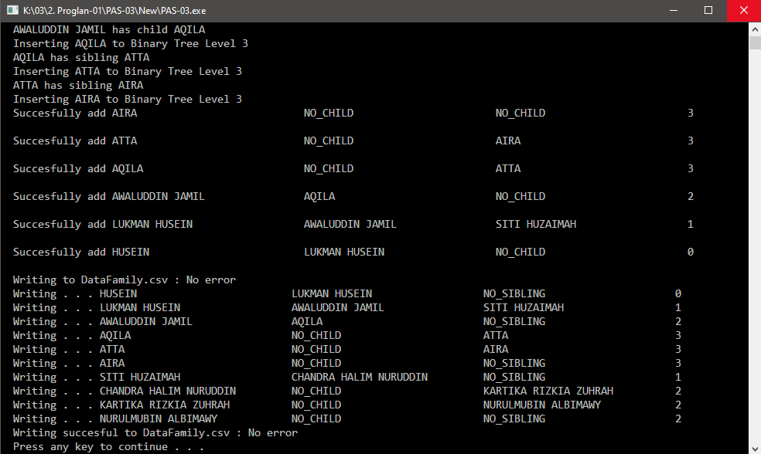

Slide 16
