Slide 1
POKHARA UNIVERSITY · BE MECHANICAL · COURSE CODE: MEC 232
Fundamentals of Measurement Systems
Methods · Analog vs. Digital · DAQ Pipeline · Calibration · Uncertainty · Intrusive Sensing · Electrical Safety
Instructor:
Er. Saroj Chalise
BE Mechanical (IOE Pulchowk, 2014) · ME Mechanical (IOE Pulchowk, 2019)
10+ Years in Hydropower Machinery, Automotive Testing & Engineering Pedagogy
Course Specification:
MEC 232 (3-1-1) · 3 Credits · 45 Hours · Full Marks: 100 · Pass Marks: 45
Nature: Theory & Practical · Level: Bachelor · Program: BE Mechanical
Notes:
Good morning students. Welcome to Unit I: Fundamentals of Measurement Systems. Today we begin our journey into how engineers measure the physical world—from temperatures inside a motorcycle engine to electrical signals in factory robots. Everything in modern industry depends on trustworthy measurements.
[CORE TAKEAWAY]: Before you can control or improve an engineering system, you must be able to measure it accurately.

Slide 2
Lecture Roadmap
Unit I Lecture Roadmap
• 1.1 Methods of Measurements: Direct, Deflection & Null-Balance
• 1.2 Analog vs. Digital Instruments: Resolution, Quantization & Sampling
• 1.3 Data Acquisition Pipeline (DAQ): From Sensor to Computer Display
• 1.4 Static Calibration: Sensitivity, Drift, Linearity & Hysteresis
• 1.5 Measurement Errors & Uncertainty: Gross, Systematic, Random & ISO GUM
• 1.6 Intrusive vs. Non-Intrusive Sensing: Circuit & Flow Loading Effects
• 1.7 Electrical Safety: Ground Loops, Galvanic Isolation & IEC CAT Ratings
Unit I · MEC 232 · Er. Saroj Chalise | Slide 2 of 94
Notes:
Here is our road map for Unit I. We will take each topic one step at a time. We will never rush into tough math before first understanding the real machine or physical situation in plain words.
[CORE TAKEAWAY]: Every section covers one vital link in the engineering measurement chain.

Slide 3
Learning Objectives
What You Will Learn in Unit I
Key Competencies & Practical Skills
• Choose between direct, deflection, and null-balance measurement tools for any workshop job.
• Explain the difference between continuous analog dials and digital LCD readouts.
• Calculate the digital voltage resolution of an Analog-to-Digital Converter (ADC).
• Trace how a physical quantity travels through an entire Data Acquisition (DAQ) system.
• Read and interpret a calibration curve, including sensitivity slope and hysteresis lag.
Key Takeaway: Our goal is practical engineering understanding: knowing how instruments work, how they fail, and how to get correct readings.
Unit I · MEC 232 · Er. Saroj Chalise | Slide 3 of 94
Notes:
These objectives match our engineering syllabus. Notice that everything here connects directly to equipment you will see in real industrial workshops and test labs.
[CORE TAKEAWAY]: Our goal is practical engineering understanding: knowing how instruments work, how they fail, and how to get correct readings.

Slide 4
Real-World Context
Why Measurement Matters in Everyday Life
Every Engineering Decision Relies on Good Data
• A motorcycle speedometer tells you if you are traveling safely within the speed limit.
• A hospital patient monitor measures pulse rate and body temperature to alert doctors instantly.
• A petrol pump meter measures the exact volume of fuel going into your vehicle tank.
• If any of these measuring devices give the wrong number, bad decisions follow—engines fail, drivers get fined, or patients are put in danger.
Key Takeaway: In engineering, an incorrect measurement is often worse than no measurement at all.
Unit I · MEC 232 · Er. Saroj Chalise | Slide 4 of 94
Notes:
Ask students: "Have you ever weighed yourself on a bathroom scale that read 2 kg even when no one was standing on it?" That is a measurement error. In engineering, lives and expensive machines depend on correct readings.
[CORE TAKEAWAY]: In engineering, an incorrect measurement is often worse than no measurement at all.

Slide 5
The Big Picture
The Measurement Chain: Physical World to Decision
How Physical Action Becomes Useful Information
• Step 1: Physical Reality — Something exists in nature: heat in a boiler, pressure in a pipe, or weight on a crane.
• Step 2: Sensing — An instrument touches or senses that physical change.
• Step 3: Conversion — The instrument turns the physical change into a pointer movement or an electrical voltage.
• Step 4: Display & Decision — A human reads the dial or a computer activates an emergency shut-off valve.
Key Takeaway: An unbroken chain connects the physical event, the sensor, the electrical signal, and the final engineering decision.
Unit I · MEC 232 · Er. Saroj Chalise | Slide 5 of 94
Notes:
Emphasize that a sensor is just a translator. It translates physical energy into something humans or computers can interpret.
[CORE TAKEAWAY]: An unbroken chain connects the physical event, the sensor, the electrical signal, and the final engineering decision.

Slide 6
1.1 Methods
1.1 Methods of Measurements
Section 1.1 · Direct Comparison · Deflection · Null-Balance
Core Pedagogical Objective:
All measurements compare an unknown quantity against a known standard.
Unit I · MEC 232 · Er. Saroj Chalise | Slide 6 of 94
Notes:
Now let us enter Section 1.1: Methods of Measurements. How do we physically make a measurement? There are three fundamental methods: direct comparison, deflection, and null-balance.
[CORE TAKEAWAY]: All measurements compare an unknown quantity against a known standard.

Slide 7
1.1 Methods
What Does "Measuring" Actually Mean?
Comparing an Unknown Against a Known Standard
• Imagine you want to buy 2 meters of electric wire from a hardware shop.
• The shopkeeper pulls wire from a bundle and aligns it against a marked metal stick (a 1-meter ruler).
• The length of the wire is the "unknown quantity" (we call this the measurand).
• The metal stick is the "known standard".
• Measurement is simply the act of comparing an unknown physical quantity with a predefined reference standard.
Key Takeaway: Measurand = The physical quantity you want to find out.
Unit I · MEC 232 · Er. Saroj Chalise | Slide 7 of 94
Notes:
Keep it very simple. Define the word "measurand" in plain language: it just means the unknown thing you want to measure.
[CORE TAKEAWAY]: Measurand = The physical quantity you want to find out.

Slide 8
1.1 Methods
Method 1: Direct Comparison
Side-by-Side Comparison with Zero Energy Transduction
• In direct comparison, you place the unknown quantity directly against a standard of the exact same kind.
• Measuring the width of a steel plate with a steel rule is direct comparison: length is compared directly with length.
• Measuring a sack of potatoes with an equal-arm balance by adding 1 kg iron weights to the other pan is direct comparison: mass is compared directly with mass.
• No motors, no batteries, and no complex electrical circuits are involved.
Key Takeaway: Direct comparison compares like with like: length against length, mass against mass.
Unit I · MEC 232 · Er. Saroj Chalise | Slide 8 of 94
Notes:
Direct comparison is the oldest and simplest method known to humanity. It requires zero electrical power.
[CORE TAKEAWAY]: Direct comparison compares like with like: length against length, mass against mass.

Slide 9
1.1 Methods
Workshop Tools for Direct Comparison
Everyday Mechanical Standards
• Steel Rule & Measuring Tape: Marks stamped at exact millimetre intervals.
• Vernier Caliper & Micrometer: Sliding vernier scales for measuring cylinder diameters down to 0.02 mm.
• Gauge Blocks (Slip Gauges): Blocks of hardened steel ground to exact thicknesses (e.g., exactly 10.000 mm).
• Equal-Arm Beam Balance: Two hanging pans comparing an unknown object against certified brass weights.
Key Takeaway: Direct tools provide high physical reliability because they rely on solid physical standards.
Unit I · MEC 232 · Er. Saroj Chalise | Slide 9 of 94
Notes:
Show students that these are tools they already use in the workshop. They are all direct comparison tools.
[CORE TAKEAWAY]: Direct tools provide high physical reliability because they rely on solid physical standards.

Slide 10
1.1 Methods
Limitations of Direct Comparison
Why Can We Not Use Direct Comparison for Everything?
• 1. Eye Fatigue & Parallax Error: The human eye must read tiny lines. Looking from an angle gives the wrong number.
• 2. Cannot Measure Fast Moving Parts: You cannot hold a ruler against a spinning turbine shaft!
• 3. Cannot Measure Invisible Quantities: You cannot hold a ruler against a magnetic field or electric voltage.
• 4. Manual and Slow: Requires a human operator for every single reading; impossible for computer automation.
Key Takeaway: Direct comparison is great for static mechanical parts, but useless for automated, fast, or electrical systems.
Unit I · MEC 232 · Er. Saroj Chalise | Slide 10 of 94
Notes:
This slide motivates why engineers invented deflection and electronic instruments: we need instruments that can measure fast, invisible, and automated signals.
[CORE TAKEAWAY]: Direct comparison is great for static mechanical parts, but useless for automated, fast, or electrical systems.

Slide 11
1.1 Methods
Method 2: Deflection Method
The Unknown Quantity Pushes a Pointer Against a Spring
• Think of the needle on a motorcycle speedometer or a bathroom spring scale.
• When you step onto a bathroom scale, your body weight compresses an internal steel spring.
• As the spring compresses, it turns a gear that swings a pointer across a printed dial.
• When the pushing force of your weight matches the resisting force of the compressed spring, the needle stops.
• The position of the needle shows your weight.
Key Takeaway: In deflection instruments, the unknown quantity produces a mechanical movement opposing a calibrated spring.
Unit I · MEC 232 · Er. Saroj Chalise | Slide 11 of 94
Notes:
Walk through the bathroom scale. Emphasize that the needle only moves because an input force pushes against a calibrated spring.
[CORE TAKEAWAY]: In deflection instruments, the unknown quantity produces a mechanical movement opposing a calibrated spring.

Slide 12
1.1 Methods
How a Deflection Instrument Balances Forces
Opposing Forces in Perfect Equilibrium
• Two opposing forces meet inside the meter:
• 1. Deflecting Force: Created by the unknown input (your weight, water pressure, or electric current). It pushes the needle forward.
• 2. Controlling (Restoring) Force: Created by an internal spring. The farther the needle moves, the harder the spring pushes back.
• When the two forces become equal, the needle comes to a rest.
• The deflection angle is directly proportional to the unknown input.
Key Takeaway: Needle position = Point where the deflecting push equals the spring push back.
Unit I · MEC 232 · Er. Saroj Chalise | Slide 12 of 94
Notes:
Introduce the concept of equilibrium: Needle stops when Deflecting Force = Restoring Force.
[CORE TAKEAWAY]: Needle position = Point where the deflecting push equals the spring push back.

Slide 13
1.1 Methods
Everyday Examples of Deflection Instruments
Fast, Real-Time Readings in Vehicles and Factories
• Bourdon Tube Pressure Gauge: Curved brass tube in an air compressor uncurls when air pressure enters, moving the dial needle.
• PMMC Moving-Coil Voltmeter: Electric current through a small coil inside a magnet creates magnetic torque that twists a hairspring.
• Spring Fish Scale: A hook on a spring that pulls down when a heavy load is attached.
• Car Engine Tachometer (RPM Meter): Swings an indicator needle higher as engine crankshaft speed increases.
Key Takeaway: Deflection instruments provide fast, continuous, and self-indicating readings.
Unit I · MEC 232 · Er. Saroj Chalise | Slide 13 of 94
Notes:
Emphasize the main advantage: deflection instruments give an instant visual reading that tracks changes immediately.
[CORE TAKEAWAY]: Deflection instruments provide fast, continuous, and self-indicating readings.

Slide 14
1.1 Methods
The Big Problem: What is the "Loading Effect"?
Measuring a System Steals Energy From the System!
• Here is the fundamental catch with all deflection instruments:
• To push the needle against a stiff metal spring, the meter must extract continuous physical energy from the system being measured.
• If you connect an analog voltmeter to a small circuit, the meter draws electric current to swing its coil.
• Because current flows into the meter, the voltage in the original circuit drops!
• This unwanted change caused by the measuring instrument itself is called the Loading Effect.
Key Takeaway: Loading Effect = When the measuring device alters the very quantity it is trying to measure by drawing energy from it.
Unit I · MEC 232 · Er. Saroj Chalise | Slide 14 of 94
Notes:
This is a crucial concept in instrumentation. Use the tire gauge analogy on the next slide to cement the idea.
[CORE TAKEAWAY]: Loading Effect = When the measuring device alters the very quantity it is trying to measure by drawing energy from it.

Slide 15
1.1 Methods
A Familiar Analogy for the Loading Effect
Checking Motorcycle Tire Pressure Lets Air Escape!
Key Takeaway: If a meter requires energy to move its indicator, it steals that energy from the source.
Unit I · MEC 232 · Er. Saroj Chalise | Slide 15 of 94
Notes:
Students immediately connect with the hiss of air when checking tire pressure. Tell them: that hiss of air is the loading effect in action!
[CORE TAKEAWAY]: If a meter requires energy to move its indicator, it steals that energy from the source.

Slide 16
1.1 Methods
Method 3: Null-Balance Method
Zero Energy Drawn at the Moment of Measurement
• To avoid the loading effect, engineers invented the Null-Balance Method.
• Think of an old-fashioned grocery scale with two hanging brass pans.
• The merchant places vegetables in the left pan.
• He places known iron weights in the right pan and adjusts them until the center pointer points dead center to ZERO.
• When the pointer points to zero (Null), both sides are perfectly balanced.
Key Takeaway: Null-Balance = Adjusting an opposing calibrated standard until the difference is exactly zero.
Unit I · MEC 232 · Er. Saroj Chalise | Slide 16 of 94
Notes:
Explain that "null" is just a formal word for zero difference.
[CORE TAKEAWAY]: Null-Balance = Adjusting an opposing calibrated standard until the difference is exactly zero.

Slide 17
1.1 Methods
Why Null-Balance Eliminates Loading Error
At the Balance Point, Zero Energy Flows into the Detector
• In a null-balance instrument (like a DC Potentiometer or Wheatstone Bridge):
• The unknown voltage is opposed by an adjustable reference voltage from a battery inside the instrument.
• A sensitive center-zero meter (a galvanometer) sits between them.
• You slide a dial until the meter needle points to 0.00.
• At 0.00, the opposing voltages are identical: NO current flows through the detector (I = 0).
Key Takeaway: At null equilibrium: Current = 0, Power drawn = 0, Loading error = 0.
Unit I · MEC 232 · Er. Saroj Chalise | Slide 17 of 94
Notes:
Highlight this key exam answer: Why is null balance more accurate? Because at balance, current is zero, so no energy is extracted from the source.
[CORE TAKEAWAY]: At null equilibrium: Current = 0, Power drawn = 0, Loading error = 0.

Slide 18
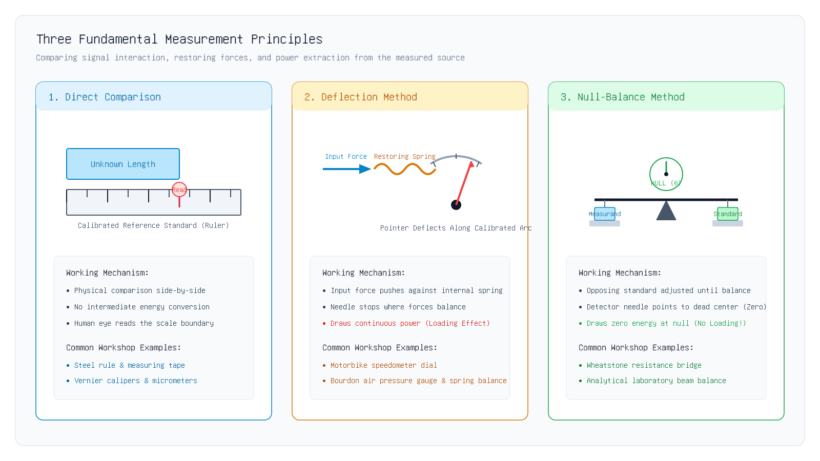
1.1 Methods
Visual Comparison: The Three Measurement Methods
Key Insight: Direct is manual, deflection is fast but draws power, null-balance is slow but has maximum accuracy.
Unit I · MEC 232 · Er. Saroj Chalise | Slide 18 of 94
Notes:
Walk students through Figure 1: Direct comparison on the left (ruler), deflection in the center (spring and pointer), and null-balance on the right (balanced pans and center zero meter).
[CORE TAKEAWAY]: Direct is manual, deflection is fast but draws power, null-balance is slow but has maximum accuracy.

Slide 19
1.1 Methods
Comparing the Three Methods: Engineering Trade-offs
Choosing the Right Method for the Job
Key Takeaway: Speed vs. Accuracy: Deflection gives speed; Null-Balance gives ultimate accuracy.
Unit I · MEC 232 · Er. Saroj Chalise | Slide 19 of 94
Notes:
Remind students that neither is "better" in all cases—they serve different engineering needs.
[CORE TAKEAWAY]: Speed vs. Accuracy: Deflection gives speed; Null-Balance gives ultimate accuracy.

Slide 20
1.1 Quiz
Check Your Understanding: Methods of Measurement
Concept Check 1.1
Key Takeaway: Zero current at balance means zero loading distortion on the measured source.
Unit I · MEC 232 · Er. Saroj Chalise | Slide 20 of 94
Notes:
Give students 30 seconds to answer before revealing. Reinforce the concept of zero current flow at balance.
[CORE TAKEAWAY]: Zero current at balance means zero loading distortion on the measured source.

Slide 21
1.2 Analog vs Digital
1.2 Analog vs. Digital Instruments
Section 1.2 · Continuous Pointers vs. Discrete Numbers · Resolution & Sampling
Core Pedagogical Objective:
Analog represents values as continuous physical movement; digital represents values as discrete numbers.
Unit I · MEC 232 · Er. Saroj Chalise | Slide 21 of 94
Notes:
Now let us move to Section 1.2: Analog vs. Digital Instruments. Almost all older instruments were analog. Today, almost everything uses digital screens and microcontrollers. Let us understand the engineering differences.
[CORE TAKEAWAY]: Analog represents values as continuous physical movement; digital represents values as discrete numbers.

Slide 22
1.2 Analog vs Digital
What is an Analog Instrument?
Continuous Physical Indication
• An analog instrument displays the measured value as a continuous physical movement.
• Examples:
• • A traditional mercury thermometer: The mercury column expands smoothly up the glass tube without jumping.
• • An analog clock: The minute hand glides continuously around the dial.
• • A moving-coil voltmeter: The needle swings smoothly along a curved scale line.
Key Takeaway: Analog output is smooth, continuous, and unbroken across time and amplitude.
Unit I · MEC 232 · Er. Saroj Chalise | Slide 22 of 94
Notes:
Point out that "analog" means the pointer position is analogous (similar) to the physical variable.
[CORE TAKEAWAY]: Analog output is smooth, continuous, and unbroken across time and amplitude.

Slide 23
1.2 Analog vs Digital
The Parallax Error Problem on Analog Dials
Why Human Eyes Misread Analog Pointers
• Have you ever looked at a car speedometer from the passenger seat?
• From the passenger side, the needle looks like it is pointing to 75 km/h.
• From the driver seat directly in front, the needle clearly points to 80 km/h!
• This reading error caused by viewing a pointer from an angle against a scale background is called Parallax Error.
• High-grade analog meters place a curved strip of mirror underneath the scale. You must line up the needle so it hides its own reflection before taking a reading.
Key Takeaway: Parallax error occurs whenever the observer eye is not perpendicular to the scale dial.
Unit I · MEC 232 · Er. Saroj Chalise | Slide 23 of 94
Notes:
Ask a student to come to the front and look at a meter from the side. Parallax is the number one human observation blunder in analog meters.
[CORE TAKEAWAY]: Parallax error occurs whenever the observer eye is not perpendicular to the scale dial.

Slide 24
1.2 Analog vs Digital
What is a Digital Instrument?
Direct, Unambiguous Numeric Readouts
• A digital instrument converts the continuous physical quantity into discrete numbers displayed on a screen (7-segment LED or LCD).
• Examples:
• • Digital multimeter (DMM) showing "230.4 V" in crisp black digits.
• • Digital kitchen weighing scale showing "542 g".
• • Digital clinical thermometer that beeps and displays "37.2 °C".
Key Takeaway: Digital displays provide clean, unambiguous numbers that eliminate human reading errors.
Unit I · MEC 232 · Er. Saroj Chalise | Slide 24 of 94
Notes:
Digital meters eliminate human interpolation guessing: you never have to estimate whether a needle is at 4.6 or 4.7.
[CORE TAKEAWAY]: Digital displays provide clean, unambiguous numbers that eliminate human reading errors.

Slide 25
1.2 Analog vs Digital
Common Student Myth: Does More Digits Mean More Accurate?
Separating Resolution from Accuracy
• A common misconception among beginner students is:
• "A digital scale displaying 6 digits (e.g. 12.3456 kg) must be 100% accurate!"
• This is completely FALSE!
• Resolution is the smallest step the screen can display (the number of decimal places).
• Accuracy is how close the reading is to the true physical weight.
Key Takeaway: Displaying 6 digits of resolution does not make a reading true if the sensor is miscalibrated.
Unit I · MEC 232 · Er. Saroj Chalise | Slide 25 of 94
Notes:
Stress this strongly: High resolution means fine detail; it does NOT guarantee accuracy.
[CORE TAKEAWAY]: Displaying 6 digits of resolution does not make a reading true if the sensor is miscalibrated.

Slide 26
1.2 Analog vs Digital
Understanding Digital Resolution: What is an ADC Bit?
How Computers Divide a Voltage Range into Distinct Steps
• Computers only count in binary bits (0s and 1s).
• An Analog-to-Digital Converter (ADC) with N bits can create 2^N distinct digital codes.
• • A 1-bit ADC can only distinguish 2 levels: 0 (Low) or 1 (High).
• • A 2-bit ADC can distinguish 2^2 = 4 levels: 00, 01, 10, 11.
• • A 3-bit ADC can distinguish 2^3 = 8 levels.
Key Takeaway: An N-bit converter divides the full-scale voltage span into 2^N discrete steps.
Unit I · MEC 232 · Er. Saroj Chalise | Slide 26 of 94
Notes:
Help students visualize bits as steps on a ladder. More bits means more steps packed into the same height, making each step smaller.
[CORE TAKEAWAY]: An N-bit converter divides the full-scale voltage span into 2^N discrete steps.

Slide 27
1.2 Analog vs Digital
Voltage Resolution Step Size
The Smallest Change the Digital Screen Can Detect
Equation 1.1 · ADC Voltage Resolution Step Size
Δ V = \fracV_FSR2^N - 1
Symbol | Parameter & Units | Engineering Meaning
Δ V | Resolution Step Size [Volts] | Smallest detectable voltage change
V_FSR | Full-Scale Range [Volts] | Total maximum input voltage span (e.g. 5V or 10V)
N | Number of ADC Bits [bits] | Binary word length of the converter
• The smaller the step size Δ V, the finer the detail your instrument can capture.
• If a voltage changes by less than one step size Δ V, the digital output does not change at all!
Key Takeaway: More bits (N) creates smaller step size (ΔV), giving sharper measurement resolution.
Unit I · MEC 232 · Er. Saroj Chalise | Slide 27 of 94
Notes:
Notice that the equation is displayed freely with clean whitespace. Walk through the symbols one by one: FSR is the span (like 0 to 5V), and N is the number of bits.
[CORE TAKEAWAY]: More bits (N) creates smaller step size (ΔV), giving sharper measurement resolution.

Slide 28
1.2 Worked Example
Worked Example: Calculating ADC Step Resolution
Step-by-Step Numerical Practice
Problem: A digital voltmeter uses a 10-bit Analog-to-Digital Converter (N = 10) to measure voltages between 0.0 Volts and 5.0 Volts (Full-Scale Range = 5.0 V). Calculate the smallest voltage change (resolution step size ΔV) that this meter can detect.
Step 1: Calculate Total Number of Steps
2^N - 1 = 2^10 - 1 = 1024 - 1 = 1023 steps
A 10-bit binary register counts from 0 to 1023, creating 1023 equal spacing intervals across the voltage range.
Step 2: Apply the Resolution Formula
Δ V = \fracV_FSR2^N - 1 = \frac5.000 V1023 = 0.004887 V
Divide the 5.0 Volt full-scale span by the 1023 intervals.
Step 3: Convert to Millivolts (mV) for Practical Clarity
Δ V ≈ 4.89 mV
Multiply by 1000 to express in millivolts.
Final Answer: ΔV = 4.89 mV per step
Unit I · MEC 232 · Er. Saroj Chalise | Slide 28 of 94
Notes:
Walk through the arithmetic carefully. Emphasize the practical meaning: any change smaller than 4.89 mV is invisible to this 10-bit meter.
[CORE TAKEAWAY]: A 10-bit 5V meter steps in increments of approximately 4.89 mV.

Slide 29
1.2 Analog vs Digital
What is Quantization Error?
The Inevitable Rounding Error of Digital Steps
• In the real physical world, voltage flows smoothly like water in a river.
• In a digital computer, voltage must snap to the nearest available staircase step.
• This difference between the true continuous analog voltage and the rounded digital step value is called Quantization Error.
• Because the converter always rounds to the nearest step, the worst-case error is never more than half a step:
• Max Quantization Error = ± (1) / (2) Δ V
Key Takeaway: Quantization error is the unavoidable rounding difference between smooth analog truth and digital steps.
Unit I · MEC 232 · Er. Saroj Chalise | Slide 29 of 94
Notes:
Compare quantization error to rounding your money: if an item costs 4.49 and you only have dollar bills, you round to 4.00, losing 0.49 in rounding.
[CORE TAKEAWAY]: Quantization error is the unavoidable rounding difference between smooth analog truth and digital steps.

Slide 30
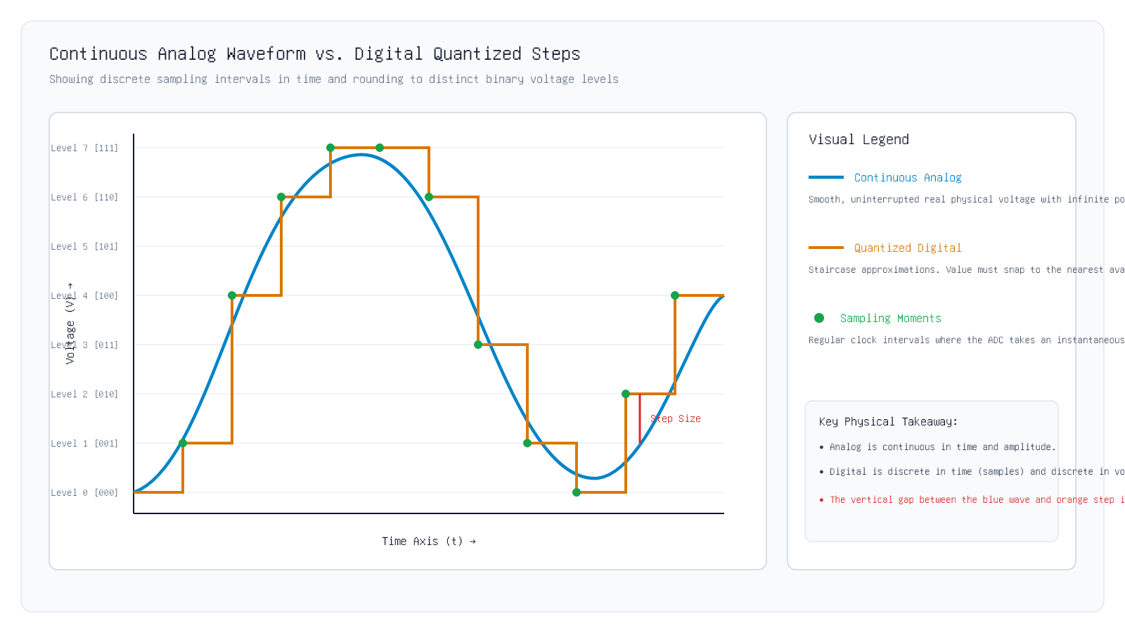
1.2 Analog vs Digital
Visualizing Analog vs. Digital Quantization
Key Insight: Digital instruments approximate smooth analog curves as stepped staircases.
Unit I · MEC 232 · Er. Saroj Chalise | Slide 30 of 94
Notes:
Show students Figure 2: The smooth blue line is true analog physical voltage. The stepped orange line is the digital approximation. Note the green dots showing the exact moments of sampling.
[CORE TAKEAWAY]: Digital instruments approximate smooth analog curves as stepped staircases.

Slide 31
1.2 Analog vs Digital
The Sampling Rule: Time Slicing
How Often Must We Read the Voltage?
• An analog dial shows the signal continuously at every microsecond.
• A digital meter takes snapshots (samples) at regular clock intervals (e.g. 1,000 times per second).
• Between samples, the digital meter is blind to what happens!
• If a signal is changing rapidly, taking samples too slowly creates completely false data.
• How fast must we take samples so that we do not lose the signal? Engineering mathematics gives us an exact rule.
Key Takeaway: Sampling rate (fs) determines how often the instrument takes a snapshot of the signal.
Unit I · MEC 232 · Er. Saroj Chalise | Slide 31 of 94
Notes:
Ask students: "If a light turns on and off 100 times a second and you only blink your eyes once a second, will you know how fast it is flashing?"
[CORE TAKEAWAY]: Sampling rate (fs) determines how often the instrument takes a snapshot of the signal.

Slide 32
1.2 Analog vs Digital
The Nyquist-Shannon Sampling Criterion
The Universal Rule for Digital Sampling
Equation 1.2 · Nyquist Sampling Rule
f_s ≥ 2 · f_max
Symbol | Parameter & Units | Engineering Meaning
f_s | Sampling Frequency [Hz (samples/second)] | How many readings the ADC captures each second
f_max | Highest Signal Frequency [Hz (cycles/second)] | The fastest frequency component in the measured wave
• Plain English Meaning: You must take at least 2 samples during every single wave cycle (at least one sample on the positive wave crest, and one on the negative wave trough).
• If you sample slower than twice the highest frequency, the signal gets corrupted!
Key Takeaway: Sampling frequency (fs) must be at least double the highest frequency in the signal (2 · fmax).
Unit I · MEC 232 · Er. Saroj Chalise | Slide 32 of 94
Notes:
Keep it memorable: At least 2 points per wave. If you don’t get at least 2 points per wave, you cannot tell the wave is oscillating.
[CORE TAKEAWAY]: Sampling frequency (fs) must be at least double the highest frequency in the signal (2 · fmax).

Slide 33
1.2 Analog vs Digital
What is Aliasing? The Wagon Wheel Illusion
When Fast Frequencies Disguise Themselves as False Low Frequencies
• Have you ever watched a Western movie or car commercial where the car speeds up, but the wheel spokes look like they are turning backward or standing still?
• That optical illusion is Aliasing!
• The movie camera records 24 frames per second. If the wheel spins faster than 12 revolutions per second, the camera cannot keep up.
• In instrumentation: If high-frequency machine vibration (e.g. 900 Hz) is sampled at only 1,000 Hz, the computer records a completely false slow 100 Hz hum!
• The high frequency has disguised itself (created an alias) as a low frequency.
Key Takeaway: Aliasing is when high-frequency signals sampled too slowly masquerade as false low-frequency ghosts.
Unit I · MEC 232 · Er. Saroj Chalise | Slide 33 of 94
Notes:
The car wheel analogy is universal. Every student has seen car wheels appear to turn backwards on video.
[CORE TAKEAWAY]: Aliasing is when high-frequency signals sampled too slowly masquerade as false low-frequency ghosts.

Slide 34
1.2 Analog vs Digital
Why Anti-Aliasing Filters Must Be Hardware
Placed Strictly in Front of the ADC
• Students often ask: "Can we not just write a computer program to remove the aliasing noise after recording?"
• The answer is an absolute NO!
• Once a high frequency aliases into a lower frequency during ADC conversion, it becomes completely indistinguishable from real low-frequency data.
• Therefore, every real data acquisition system must place an Analog Low-Pass Filter (Anti-Aliasing Filter) in hardware BEFORE the ADC chip.
• The hardware filter blocks all frequencies above f_s / 2 before the ADC ever touches the wire.
Key Takeaway: Anti-aliasing filtering must be done in physical analog hardware before conversion, never in software.
Unit I · MEC 232 · Er. Saroj Chalise | Slide 34 of 94
Notes:
Common exam pitfall: Students think digital filters can fix aliasing. Stress that once aliasing happens in the ADC, the data is permanently corrupted.
[CORE TAKEAWAY]: Anti-aliasing filtering must be done in physical analog hardware before conversion, never in software.

Slide 35
1.2 Quiz
Check Your Understanding: Sampling & Resolution
Concept Check 1.2
Key Takeaway: Always double the maximum frequency to find the minimum safe sampling rate.
Unit I · MEC 232 · Er. Saroj Chalise | Slide 35 of 94
Notes:
Give students 20 seconds. Simple multiplication: 2 times 5 kHz = 10 kHz.
[CORE TAKEAWAY]: Always double the maximum frequency to find the minimum safe sampling rate.

Slide 36
1.3 DAQ Pipeline
1.3 Data Acquisition Pipeline (DAQ)
Section 1.3 · The Complete Signal Chain From Sensor to Computer Screen
Core Pedagogical Objective:
A DAQ pipeline converts raw physical phenomena into clean, standardized digital information.
Unit I · MEC 232 · Er. Saroj Chalise | Slide 36 of 94
Notes:
Let us now investigate Section 1.3: Data Acquisition (DAQ) Systems. In modern industry, computers do the monitoring. But a computer processor cannot plug directly into a boiling steam pipe. Let us trace the complete chain of hardware needed.
[CORE TAKEAWAY]: A DAQ pipeline converts raw physical phenomena into clean, standardized digital information.

Slide 37
1.3 DAQ Pipeline
The Real-World Engineering Problem
Why Computers Cannot Read Sensors Directly
• Problem 1: Sensors output physical changes—a thermocouple creates tiny microvolts; a strain gauge changes resistance by a fraction of an ohm.
• Problem 2: Industrial environments are filled with electrical noise from 50 Hz power cables, welding arcs, and large electric motors.
• Problem 3: Microprocessors can only understand clean binary numbers (0s and 1s) between 0 and 3.3 Volts.
• Therefore, between the physical machine and the computer, we need a complete multi-stage pipeline called a Data Acquisition (DAQ) System.
Key Takeaway: DAQ systems bridge the gap between noisy, microscopic physical signals and digital microprocessors.
Unit I · MEC 232 · Er. Saroj Chalise | Slide 37 of 94
Notes:
Set the stage: The DAQ system is the bridge between dirty real-world physics and clean digital computers.
[CORE TAKEAWAY]: DAQ systems bridge the gap between noisy, microscopic physical signals and digital microprocessors.

Slide 38
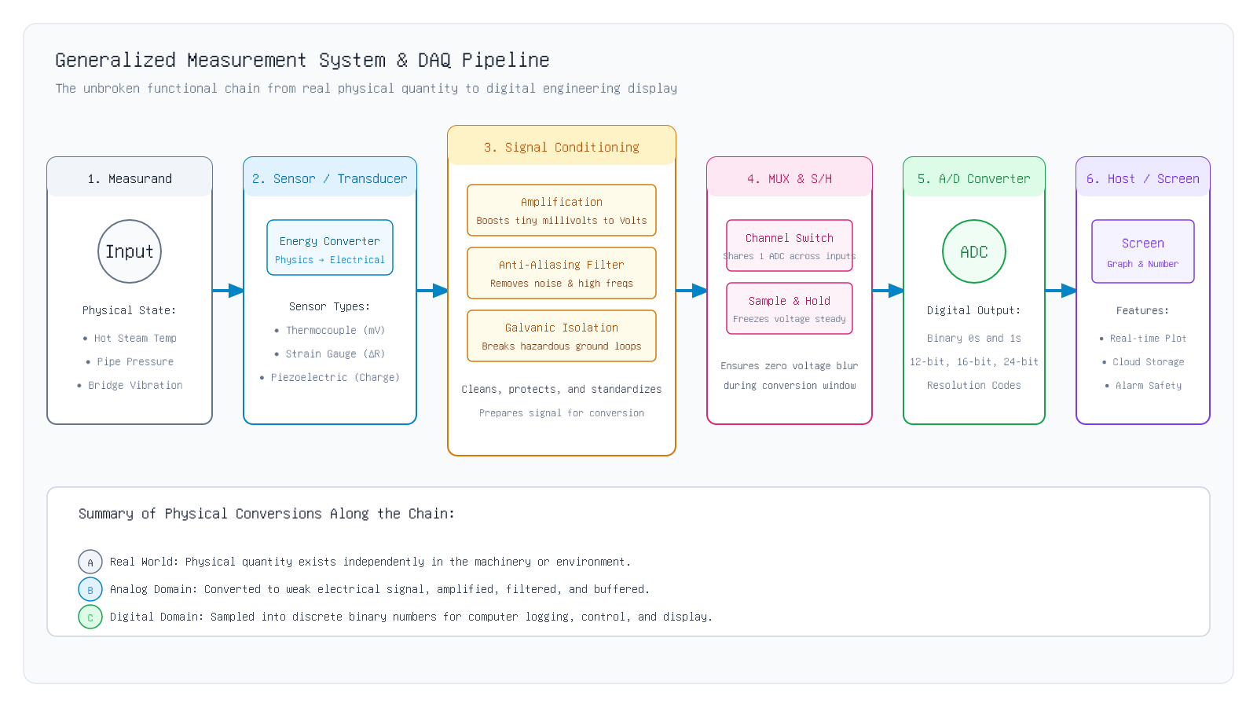
1.3 DAQ Pipeline
The Multi-Stage DAQ Architecture
Key Insight: Every block in Figure 3 performs a distinct physical or electronic transformation.
Unit I · MEC 232 · Er. Saroj Chalise | Slide 38 of 94
Notes:
Walk through Figure 3 block-by-block: 1. Measurand, 2. Transducer, 3. Signal Conditioning, 4. MUX & S/H, 5. ADC, 6. Processor & Display.
[CORE TAKEAWAY]: Every block in Figure 3 performs a distinct physical or electronic transformation.

Slide 39
1.3 DAQ Pipeline
Block 1 & 2: The Measurand & The Sensor/Transducer
Capturing Physics and Turning it into Electricity
• Block 1: Measurand — The physical variable in the real world: high boiler temperature, hydraulic pipe pressure, or crane arm load.
• Block 2: Sensor / Transducer — A physical device that responds to the measurand by changing an electrical property:
• • Thermocouple: Temperature difference creates a tiny voltage (microvolts, μV).
• • Strain Gauge: Mechanical stretching changes electrical resistance (Δ R).
• • Piezoelectric Crystal: Vibration shock squeezes electrostatic charge out of quartz (pico-Coulombs, pC).
Key Takeaway: The transducer translates physical energy (heat, force, pressure) into electrical signals (mV, Ω, pC).
Unit I · MEC 232 · Er. Saroj Chalise | Slide 39 of 94
Notes:
Differentiate sensor vs transducer simply: they turn physical energy into electrical signals.
[CORE TAKEAWAY]: The transducer translates physical energy (heat, force, pressure) into electrical signals (mV, Ω, pC).

Slide 40
1.3 DAQ Pipeline
Block 3: Signal Conditioning — The "Cleaning" Stage
Preparing the Weak, Noisy Signal for the Computer
• Raw sensor signals are far too weak and noisy for an ADC converter to read directly.
• The Signal Conditioning block performs three critical jobs:
• 1. Amplification: Boosts microscopic microvolts up to usable Volts (e.g. from 5 mV to 5 V).
• 2. Filtering: Removes 50 Hz power hum and high frequencies (anti-aliasing).
• 3. Galvanic Isolation: Builds an electrical barrier to protect the computer from lethal voltage spikes.
Key Takeaway: Signal conditioning amplifies, filters, and isolates the raw electrical signal.
Unit I · MEC 232 · Er. Saroj Chalise | Slide 40 of 94
Notes:
Compare signal conditioning to washing and peeling vegetables before cooking: you must clean and prepare the raw input before processing.
[CORE TAKEAWAY]: Signal conditioning amplifies, filters, and isolates the raw electrical signal.

Slide 41
1.3 DAQ Pipeline
Block 4: The Multiplexer (MUX) & Sample-and-Hold (S/H)
Sharing Resources and Freezing the Voltage in Time
• Analog Multiplexer (MUX):
• • Works like an electronic railway track switch.
• • Lets 8, 16, or 32 sensor channels share a single expensive ADC chip by switching between them in rapid sequence.
• Sample-and-Hold (S/H) Circuit:
• • An ADC takes several microseconds to convert an analog voltage into binary bits.
Key Takeaway: MUX switches multiple channels into one converter; S/H freezes the voltage steady during conversion.
Unit I · MEC 232 · Er. Saroj Chalise | Slide 41 of 94
Notes:
Use the camera shutter analogy for S/H: you need a steady image while the sensor records the light.
[CORE TAKEAWAY]: MUX switches multiple channels into one converter; S/H freezes the voltage steady during conversion.

Slide 42
1.3 DAQ Pipeline
Block 5 & 6: The ADC & The Digital Host Display
From Voltage to Numbers, Graphs, and Alarms
• Block 5: Analog-to-Digital Converter (ADC):
• • Takes the steady held voltage from the S/H circuit and outputs a stream of binary binary bits (e.g. 16-bit binary integer code).
• Block 6: Host Computer & Display:
• • The microprocessor or industrial PC receives the binary buffer over USB, PCIe, or Ethernet.
• • Software converts the raw integer codes back into physical engineering units (e.g., "152.4 bar").
Key Takeaway: The host computer scales binary codes into real engineering units (bar, °C, kg) and displays live data.
Unit I · MEC 232 · Er. Saroj Chalise | Slide 42 of 94
Notes:
Trace the complete journey: Boiler steam heat -> thermocouple microvolts -> amplified Volts -> frozen in S/H -> binary bits in ADC -> graph on the operator screen.
[CORE TAKEAWAY]: The host computer scales binary codes into real engineering units (bar, °C, kg) and displays live data.

Slide 43
1.3 Quiz
Check Your Understanding: Trace the DAQ Signal Path
Concept Check 1.3
Key Takeaway: S/H holds the analog voltage steady so the ADC can convert it without motion blur errors.
Unit I · MEC 232 · Er. Saroj Chalise | Slide 43 of 94
Notes:
Give students 20 seconds. Ensure everyone understands the purpose of holding the voltage steady.
[CORE TAKEAWAY]: S/H holds the analog voltage steady so the ADC can convert it without motion blur errors.

Slide 44
1.4 Calibration
1.4 Static Calibration & Characteristics
Section 1.4 · Establishing Trust in Measurements · Sensitivity · Drift · Hysteresis
Core Pedagogical Objective:
Calibration is the foundation of measurement integrity and legal traceability.
Unit I · MEC 232 · Er. Saroj Chalise | Slide 44 of 94
Notes:
Let us now study Section 1.4: Static Calibration and Instrument Characteristics. If you buy a brand new pressure gauge or weighing scale, how do you know the number it shows is real? That brings us to calibration.
[CORE TAKEAWAY]: Calibration is the foundation of measurement integrity and legal traceability.

Slide 45
1.4 Calibration
What is Calibration?
Comparing an Instrument Against a Trusted Standard
Term: Static Calibration
"An operation that establishes a relation between the quantity values provided by measurement standards and corresponding indications of the instrument under test."
Standard: ISO/IEC Guide 99 (VIM Metrology Standard)
Key Takeaway: Calibration = Testing an instrument against a certified standard and documenting its accuracy.
Unit I · MEC 232 · Er. Saroj Chalise | Slide 45 of 94
Notes:
Keep it concrete: Calibration means testing your meter against a certified master tool to find out its true error.
[CORE TAKEAWAY]: Calibration = Testing an instrument against a certified standard and documenting its accuracy.

Slide 46
1.4 Calibration
Why Do Instruments Go Out of Calibration?
Physical Wear, Temperature, and Aging
• No instrument stays accurate forever. Over time, physical changes occur:
• 1. Mechanical Wear & Tear: Pivot bearings wear down, springs weaken with fatigue, and gear teeth accumulate dirt.
• 2. Ambient Temperature Swings: Metal springs expand in hot summer weather, altering their spring stiffness.
• 3. Electronic Aging: Resistors and capacitors drift in value after years of operating heat.
• 4. Accidental Drops & Shocks: Dropping a tool or exposing a sensor to a pressure surge knocks its zero alignment out.
Key Takeaway: Wear, aging, temperature, and mechanical shock cause all instruments to drift over time.
Unit I · MEC 232 · Er. Saroj Chalise | Slide 46 of 94
Notes:
Ask students if they have ever dropped their phone and noticed the sensor acted weird. Equipment drifts with time and physical stress.
[CORE TAKEAWAY]: Wear, aging, temperature, and mechanical shock cause all instruments to drift over time.

Slide 47
1.4 Calibration
The Calibration Curve: Plotting Input vs. Output
How Engineers Visualize Instrument Response
• To calibrate an instrument, an engineer records data points in a table:
• • The Horizontal X-Axis: The known true standard input (e.g. certified applied pressure in bar).
• • The Vertical Y-Axis: The indicated output reading (e.g. electrical voltage or needle position).
• Plotting these points on a graph gives the Calibration Curve.
• In a perfect instrument, the calibration curve is a straight line passing through zero (y = S · x).
Key Takeaway: Calibration curve = Graph of Indicated Output (Y) plotted against True Input (X).
Unit I · MEC 232 · Er. Saroj Chalise | Slide 47 of 94
Notes:
Always remember: X is the true standard input; Y is what the instrument indicates.
[CORE TAKEAWAY]: Calibration curve = Graph of Indicated Output (Y) plotted against True Input (X).

Slide 48
1.4 Calibration
What is Static Sensitivity?
How Far Does the Needle Swing for Each Unit of Input?
Equation 1.3 · Static Sensitivity
S = (Δ y) / (Δ x) = \fracChange in OutputChange in Input
Symbol | Parameter & Units | Engineering Meaning
S | Static Sensitivity [Output Units / Input Units] | Slope of calibration line (e.g. mV/°C or Volts/bar)
Δ y | Change in Output [Output Units] | Difference between two output readings
Δ x | Change in Input [Input Units] | Difference between two applied input standards
• Plain English Meaning: Sensitivity tells you how responsive the meter is.
• If temperature changes by 1 ^\circC, does the meter output change by 10 mV or by 100 mV?
Key Takeaway: Sensitivity is the slope of the calibration curve: Output Change divided by Input Change.
Unit I · MEC 232 · Er. Saroj Chalise | Slide 48 of 94
Notes:
Sensitivity is simply the slope of the line. High slope = big output response; low slope = tiny output response.
[CORE TAKEAWAY]: Sensitivity is the slope of the calibration curve: Output Change divided by Input Change.

Slide 49
1.4 Worked Example
Worked Example: Calculating Sensor Sensitivity
Step-by-Step Numerical Practice
Problem: A factory pressure sensor is calibrated in the workshop. When the applied input pressure increases from 2.0 bar to 6.0 bar, the sensor output voltage rises from 1.0 Volt to 3.0 Volts. Calculate the static sensitivity of this pressure sensor.
Step 1: Calculate the Change in Input (Δx)
Δ x = x_2 - x_1 = 6.0 bar - 2.0 bar = 4.0 bar
Subtract the initial input pressure from the final pressure.
Step 2: Calculate the Change in Output (Δy)
Δ y = y_2 - y_1 = 3.0 V - 1.0 V = 2.0 V
Subtract the initial output voltage from the final voltage.
Step 3: Calculate Sensitivity (S = Δy / Δx)
S = (Δ y) / (Δ x) = \frac2.0 V4.0 bar = 0.50 V/bar
Divide output change by input change.
Final Answer: S = 0.50 V/bar (or 500 mV/bar)
Unit I · MEC 232 · Er. Saroj Chalise | Slide 49 of 94
Notes:
Point out the units: sensitivity always carries combined units (Volts per bar, millivolts per degree Celsius, etc.).
[CORE TAKEAWAY]: Sensitivity always has units of [Output Units] / [Input Units].

Slide 50
1.4 Calibration
Zero Drift vs. Sensitivity Drift
The Two Ways Temperature Alters a Calibration Line
• When the weather heats up in summer, two different calibration defects can happen:
• 1. Zero Drift (Baseline Offset Shift):
• • The pointer does not return to zero when input is zero.
• • The entire calibration line shifts up or down parallel to itself.
• • The slope does not change, but every reading is too high or too low by the same fixed offset.
Key Takeaway: Zero drift shifts the entire line up or down; sensitivity drift changes the slope angle.
Unit I · MEC 232 · Er. Saroj Chalise | Slide 50 of 94
Notes:
Use hand gestures: Zero drift shifts the whole ruler up. Sensitivity drift tilts the ruler like a seesaw.
[CORE TAKEAWAY]: Zero drift shifts the entire line up or down; sensitivity drift changes the slope angle.

Slide 51
1.4 Calibration
What is Hysteresis?
The Reading is Different Going Up vs. Coming Down!
• Have you ever weighed something on an old kitchen scale where you press down, release slowly, and the needle stops at a higher mark than before?
• That is Hysteresis!
• Hysteresis is the phenomenon where an instrument gives different output readings for the exact same input value, depending on whether the input was increasing (ascending) or decreasing (descending).
• Ascending run (loading): You increase pressure from 0 to 100%.
• Descending run (unloading): You decrease pressure from 100% back to 0%.
Key Takeaway: Hysteresis = The difference in reading between loading (going up) and unloading (going down).
Unit I · MEC 232 · Er. Saroj Chalise | Slide 51 of 94
Notes:
Compare hysteresis to memory: The material remembers that it was just stretched, so it takes longer to shrink back.
[CORE TAKEAWAY]: Hysteresis = The difference in reading between loading (going up) and unloading (going down).

Slide 52
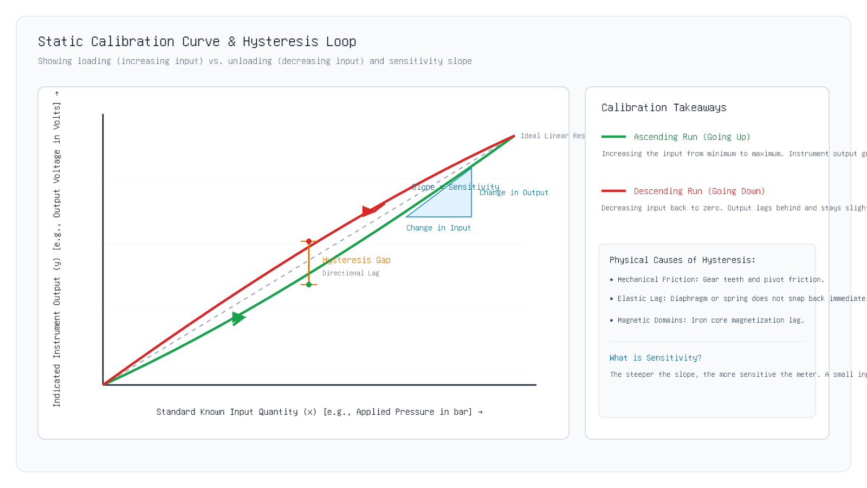
1.4 Calibration
The Calibration Curve & Hysteresis Loop
Key Insight: The gap between the ascending green curve and descending red curve represents hysteresis lag.
Unit I · MEC 232 · Er. Saroj Chalise | Slide 52 of 94
Notes:
Examine Figure 4: The green curve is ascending (loading). The red curve is descending (unloading). Point out the vertical gap in the middle—that gap is maximum hysteresis error.
[CORE TAKEAWAY]: The gap between the ascending green curve and descending red curve represents hysteresis lag.

Slide 53
1.4 Calibration
Formula: Percentage Maximum Hysteresis Error
How Engineers Quantify Hysteresis for Quality Control
Equation 1.4 · Percentage Hysteresis Error
% Hysteresis = \frac|y_down - y_up|_maxy_FSO × 100%
Symbol | Parameter & Units | Engineering Meaning
|y_down - y_up|_max | Max Hysteresis Gap [Output Units] | Largest difference between descending and ascending readings
y_FSO | Full-Scale Output (FSO) [Output Units] | Total output span (Maximum reading minus Minimum reading)
• FSO stands for Full-Scale Output (the total maximum reading span of the meter).
• Quality industrial pressure gauges maintain hysteresis below ± 0.5% of FSO.
Key Takeaway: % Hysteresis = (Max gap between up and down readings / Full Scale Output) × 100%.
Unit I · MEC 232 · Er. Saroj Chalise | Slide 53 of 94
Notes:
Explain FSO simply: If a scale goes from 0 to 100 kg, FSO is 100 kg. If the max gap is 1 kg, hysteresis is 1%.
[CORE TAKEAWAY]: % Hysteresis = (Max gap between up and down readings / Full Scale Output) × 100%.

Slide 54
1.4 Calibration
Accuracy vs. Precision: The Dartboard Analogy
Figure 5 (Right) · Why Repeatable Does NOT Mean Correct
• Think of throwing 4 darts at a target bullseye:
• • Case 1: High Accuracy & High Precision (Ideal): All 4 darts land tightly clustered right inside the center red bullseye.
• • Case 2: High Precision, POOR Accuracy (Systematic Bias): All 4 darts land tightly clustered together, but way off in the upper-right corner! Every throw was repeatable, but every throw was wrong!
• • Case 3: Poor Precision: Darts are scattered wildly all over the wall.
• In engineering: A digital meter that displays 5 decimal places is precise, but if its calibration zero is shifted, it is completely inaccurate!
Key Takeaway: Precision is repeatability (tight cluster); Accuracy is correctness (hitting the true bullseye).
Unit I · MEC 232 · Er. Saroj Chalise | Slide 54 of 94
Notes:
This dartboard visual is the most effective way to teach accuracy vs precision to below-average students.
[CORE TAKEAWAY]: Precision is repeatability (tight cluster); Accuracy is correctness (hitting the true bullseye).

Slide 55
1.4 Calibration
Threshold and Dead Band
The Minimum Nudge Needed to Move a Sticky Needle
• Have you ever tapped a sticky pressure gauge glass with your knuckle to make the needle jump?
• That happens because of Threshold and Dead Band:
• 1. Threshold: The absolute minimum input quantity needed before the needle moves at all from its resting zero position (overcoming static friction).
• 2. Dead Band (Dead Zone): A small range of input values over which the instrument produces zero output change.
• For example, if you gently tap a car accelerator pedal by 2 mm and the engine RPM does not change at all, that 2 mm is the dead band of the pedal mechanism.
Key Takeaway: Threshold = Minimum push to start moving; Dead band = Range where input produces zero response.
Unit I · MEC 232 · Er. Saroj Chalise | Slide 55 of 94
Notes:
Compare threshold to pushing a heavy wardrobe: you must push with a minimum force before it starts sliding.
[CORE TAKEAWAY]: Threshold = Minimum push to start moving; Dead band = Range where input produces zero response.

Slide 56
1.4 Quiz
Check Your Understanding: Calibration Metrics
Concept Check 1.4
Key Takeaway: Tightly repeatable readings with a constant offset show high precision with systematic zero bias.
Unit I · MEC 232 · Er. Saroj Chalise | Slide 56 of 94
Notes:
Praise students who identify that high precision allows an instrument to be easily corrected by adjusting zero bias.
[CORE TAKEAWAY]: Tightly repeatable readings with a constant offset show high precision with systematic zero bias.

Slide 57
1.5 Errors & Uncertainty
1.5 Measurement Errors & Uncertainty
Section 1.5 · Gross, Systematic & Random Errors · Statistics & ISO GUM Evaluation
Core Pedagogical Objective:
To report a professional measurement, you must state both the measured value and its uncertainty.
Unit I · MEC 232 · Er. Saroj Chalise | Slide 57 of 94
Notes:
Now we enter Section 1.5: Measurement Errors and Uncertainty according to ISO international standards. No measurement in science is 100% exact. Every number has some doubt. Let us learn how engineers classify and calculate that doubt.
[CORE TAKEAWAY]: To report a professional measurement, you must state both the measured value and its uncertainty.

Slide 58
1.5 Errors & Uncertainty
Error vs. Uncertainty: What is the Difference?
The Difference Between a Mistake and Inherent Doubt
• In everyday speech, people confuse "error" with "uncertainty". In engineering, they mean two different things:
• • Measurement Error: The difference between the measured reading and the true value (E = x_measured - x_true). Since the true value can never be known with infinite perfection, true error is never known exactly.
• • Measurement Uncertainty: A realistic doubt boundary (e.g. ± 0.5 mm) within which we are confident the true value lies.
• When you see a steel shaft specified as "50.00 ± 0.05 mm", the "± 0.05 mm" is the uncertainty.
Key Takeaway: Error = Reading minus True Value; Uncertainty = The ± interval where the true value reasonably lies.
Unit I · MEC 232 · Er. Saroj Chalise | Slide 58 of 94
Notes:
Make this distinction crystal clear: Error is the difference; Uncertainty is the doubt boundary (± band).
[CORE TAKEAWAY]: Error = Reading minus True Value; Uncertainty = The ± interval where the true value reasonably lies.

Slide 59
1.5 Errors & Uncertainty
The Three Classes of Measurement Errors
Gross, Systematic, and Random
• All measurement errors belong to one of three families:
• 1. Gross Errors: Human blunders, carelessness, or mistakes (e.g., misreading a dial, recording "25" instead of "52").
• 2. Systematic Errors: Predictable, repeatable biases caused by the equipment or environment (e.g., zero offset, loading effect).
• 3. Random Errors: Unpredictable microscopic fluctuations that scatter readings around the average (e.g., electrical noise, air drafts).
Key Takeaway: Errors are either Human Blunders (Gross), Repeatable Offsets (Systematic), or Noise (Random).
Unit I · MEC 232 · Er. Saroj Chalise | Slide 59 of 94
Notes:
Provide quick examples: Gross = human blunder; Systematic = instrument bias; Random = microscopic noise.
[CORE TAKEAWAY]: Errors are either Human Blunders (Gross), Repeatable Offsets (Systematic), or Noise (Random).

Slide 60
1.5 Errors & Uncertainty
Class 1: Gross Errors (Human Blunders)
Mistakes That Can and Must Be Avoided
• Gross errors are caused by human carelessness or improper use of equipment:
• • Reading from the wrong scale on a multi-scale dial (reading the 0–100V scale instead of the 0–250V scale).
• • Writing down the wrong number in the lab notebook (transcription error).
• • Connecting wires backward or using the wrong measurement units (confusing inches and centimetres).
• How to eliminate gross errors:
Key Takeaway: Gross errors are human mistakes; they cannot be treated with math—they must be prevented by care.
Unit I · MEC 232 · Er. Saroj Chalise | Slide 60 of 94
Notes:
Remind students of famous space missions that failed because one team used feet and the other used meters (Mars Climate Orbiter).
[CORE TAKEAWAY]: Gross errors are human mistakes; they cannot be treated with math—they must be prevented by care.

Slide 61
1.5 Errors & Uncertainty
Class 2: Systematic (Bias) Errors
Consistent, Repeatable Offsets in Magnitude and Sign
• Systematic errors are repeatable: every time you take a measurement, the reading is consistently too high or consistently too low by the same amount.
• Common causes:
• • Zero Error: The bathroom scale starts at +1.5 kg before anyone steps on it.
• • Ambient Temperature: A steel measuring tape expands in the hot sun and reads too short.
• • Circuit Loading: A low-resistance voltmeter pulls down the circuit voltage every time it is connected.
Key Takeaway: Systematic errors are repeatable biases; they can be discovered and removed by calibration.
Unit I · MEC 232 · Er. Saroj Chalise | Slide 61 of 94
Notes:
Key exam point: Systematic errors do not average out to zero! If your scale is +1 kg off, averaging 1,000 readings will still be +1 kg off.
[CORE TAKEAWAY]: Systematic errors are repeatable biases; they can be discovered and removed by calibration.

Slide 62
1.5 Errors & Uncertainty
Class 3: Random (Stochastic) Errors
Unpredictable Scatter Governed by Probability
• Even after you eliminate gross mistakes and calibrate away systematic offsets, repeated readings will still vary slightly!
• Why? Because of microscopic random effects in nature:
• • Thermal motion of electrons inside resistors (Johnson noise).
• • Tiny air pressure drafts blowing past an analytical balance.
• • Microscopic vibrations from passing road traffic.
Key Takeaway: Random errors scatter unpredictably above and below the truth; averaging cancels them out.
Unit I · MEC 232 · Er. Saroj Chalise | Slide 62 of 94
Notes:
Because random errors are equally likely to be positive or negative, mathematics (averaging) is our primary defense against them.
[CORE TAKEAWAY]: Random errors scatter unpredictably above and below the truth; averaging cancels them out.

Slide 63
1.5 Errors & Uncertainty
Handling Random Errors: The Sample Mean
The Average is the Best Mathematical Estimate of the True Value
Equation 1.5 · Sample Arithmetic Mean
x̄ = (1) / (N) ∑(i=1)^N x_i = (x_1 + x_2 + \dots + x_N) / (N)
Symbol | Parameter & Units | Engineering Meaning
x̄ | Sample Mean [Measurement Units] | Best statistical estimate of the true measured value
x_i | Individual Reading [Measurement Units] | The i-th recorded observation
N | Number of Observations [count] | Total number of repeated test samples
• By taking the sum of all readings and dividing by N, positive random noise cancels out negative random noise.
Key Takeaway: The arithmetic mean (average) cancels out random positive and negative fluctuations.
Unit I · MEC 232 · Er. Saroj Chalise | Slide 63 of 94
Notes:
Students already know how to calculate an average from school. Point out that in instrumentation, the mean is our best estimate of truth.
[CORE TAKEAWAY]: The arithmetic mean (average) cancels out random positive and negative fluctuations.

Slide 64
1.5 Errors & Uncertainty
Sample Standard Deviation: Measuring the Spread
How Wildly Are the Readings Scattering Around the Average?
Equation 1.6 · Sample Standard Deviation
s = \sqrt(1) / (N - 1) ∑(i=1)^N (x_i - x̄)^2
Symbol | Parameter & Units | Engineering Meaning
s | Sample Standard Deviation [Measurement Units] | Spread of individual measurements
x_i - x̄ | Deviation from Mean [Measurement Units] | Distance of each single reading from the average
N - 1 | Degrees of Freedom [count] | Number of independent data points remaining
• A small standard deviation s means readings are tightly clustered (high precision).
• A large standard deviation s means readings are scattering wildly.
Key Takeaway: Standard deviation (s) measures how widely your repeated readings are scattering.
Unit I · MEC 232 · Er. Saroj Chalise | Slide 64 of 94
Notes:
Explain that N - 1 is used instead of N for sample statistics because one degree of freedom was spent calculating the mean.
[CORE TAKEAWAY]: Standard deviation (s) measures how widely your repeated readings are scattering.

Slide 65
1.5 Errors & Uncertainty
Type A Standard Uncertainty: Standard Error of the Mean
How Confident Are We in the Average Value?
Equation 1.7 · Type A Standard Uncertainty
u_A = \fracs√(N)
Symbol | Parameter & Units | Engineering Meaning
u_A | Type A Uncertainty [Measurement Units] | Standard uncertainty of the sample mean
s | Sample Standard Deviation [Measurement Units] | Spread of individual observations
√(N) | Square Root of Sample Count [dimensionless] | Diminishing returns divider
• Notice the √(N) in the denominator!
• • If you take N = 4 readings, uncertainty is cut in half: √(4) = 2.
Key Takeaway: Taking N repeated samples reduces random uncertainty by a factor of √N.
Unit I · MEC 232 · Er. Saroj Chalise | Slide 65 of 94
Notes:
Emphasize the square root rule: to cut random noise by 10 times, you need 100 readings, not 10.
[CORE TAKEAWAY]: Taking N repeated samples reduces random uncertainty by a factor of √N.

Slide 66
1.5 Errors & Uncertainty
The Averaging Fallacy: Why More Samples Cannot Fix Bias
The Most Dangerous Mistake in Lab Testing
• Students often think:
• "If I take 10,000 readings, my measurement will be 100% perfect!"
• This is the famous Averaging Fallacy.
• Averaging reduces Random Noise (u_A = s / √(N)).
• Averaging DOES NOT touch Systematic Zero Error!
Key Takeaway: Averaging 10,000 readings reduces random scatter, but leaves systematic bias completely untouched!
Unit I · MEC 232 · Er. Saroj Chalise | Slide 66 of 94
Notes:
Repeat this key exam concept: Averaging reduces random error, but does NOT reduce systematic bias.
[CORE TAKEAWAY]: Averaging 10,000 readings reduces random scatter, but leaves systematic bias completely untouched!

Slide 67
1.5 Errors & Uncertainty
Type B Uncertainty: When You Have No Repeated Data
Evaluating Uncertainty from Manufacturer Datasheets
Equation 1.8 · Type B Standard Uncertainty (Rectangular Distribution)
u_B = \fraca√(3)
Symbol | Parameter & Units | Engineering Meaning
u_B | Type B Standard Uncertainty [Measurement Units] | Non-statistical standard uncertainty
a | Manufacturer Tolerance Bound [Measurement Units] | Stated manufacturer tolerance limit (± a)
√(3) | Uniform Distribution Divisor [constant (≈ 1.732)] | Divisor converting rectangular bound into standard uncertainty
• Type A = Derived from your own repeated experimental numbers in the lab.
• Type B = Derived from external knowledge: manufacturer calibration certificate, handbook data, or resolution limits.
Key Takeaway: Type A comes from repeated data; Type B comes from datasheets and certificates (uB = a / √3).
Unit I · MEC 232 · Er. Saroj Chalise | Slide 67 of 94
Notes:
Help students remember: Type A = Active experiment (mean and s). Type B = Book / Datasheet / Certificate.
[CORE TAKEAWAY]: Type A comes from repeated data; Type B comes from datasheets and certificates (uB = a / √3).

Slide 68
1.5 Errors & Uncertainty
Combined Uncertainty via Root-Sum-Square (RSS)
How Engineers Combine Type A and Type B Uncertainties
Equation 1.9 · ISO GUM Combined Standard Uncertainty
u_c = √(u_A^2 + u_B^2)
Symbol | Parameter & Units | Engineering Meaning
u_c | Combined Standard Uncertainty [Measurement Units] | Total combined 1-sigma uncertainty
u_A | Type A Uncertainty [Measurement Units] | Statistical scatter from repeated tests
u_B | Type B Uncertainty [Measurement Units] | Datasheet / calibration uncertainty
• Think of Pythagoras theorem: You square each uncertainty, add them together, and take the square root!
• This is called the Root-Sum-Square (RSS) method.
Key Takeaway: Combined uncertainty = √(uA² + uB²). Multiply by 2 for a 95% confidence interval.
Unit I · MEC 232 · Er. Saroj Chalise | Slide 68 of 94
Notes:
Pythagorean combination: Just like a right triangle, c = sqrt(a^2 + b^2). At k=2, we have 95% confidence.
[CORE TAKEAWAY]: Combined uncertainty = √(uA² + uB²). Multiply by 2 for a 95% confidence interval.

Slide 69
1.5 Worked Example
Worked Example: Full Uncertainty Calculation
Step-by-Step Solved Problem
Problem: A technician measures the temperature of an industrial furnace 9 times (N = 9). The sample mean is 150.0 °C and the sample standard deviation is s = 0.60 °C. The manufacturer certificate states the thermometer tolerance is ±0.30 °C. Calculate: (1) Type A uncertainty, (2) Type B uncertainty, (3) Combined uncertainty uc, and (4) Expanded uncertainty U for 95% confidence (k = 2).
Step 1: Calculate Type A Uncertainty (uA)
u_A = \fracs√(N) = \frac0.60 ^\circC√(9) = (0.60) / (3) = 0.20 ^\circC
Divide standard deviation by the square root of 9 (which is 3).
Step 2: Calculate Type B Uncertainty (uB)
u_B = \fraca√(3) = \frac0.30 ^\circC1.732 = 0.173 ^\circC
Divide the manufacturer tolerance 0.30 °C by the square root of 3.
Step 3: Calculate Combined Standard Uncertainty (uc)
u_c = √(u_A^2 + u_B^2) = √(0.20^2 + 0.173^2) = √(0.0400 + 0.0300) = √(0.0700) = 0.265 ^\circC
Combine using the Root-Sum-Square (RSS) formula.
Final Answer: Final Reported Value = 150.00 ± 0.53 °C (k = 2, 95% confidence)
Unit I · MEC 232 · Er. Saroj Chalise | Slide 69 of 94
Notes:
Walk through the numbers slowly. Show students that 0.60 / 3 = 0.20. Simple arithmetic that builds confidence.
[CORE TAKEAWAY]: Final report: Measured Mean ± Expanded Uncertainty (U = 2 · uc) with 95% confidence.

Slide 70
1.5 Quiz
Check Your Understanding: Uncertainty Types
Concept Check 1.5
Key Takeaway: Datasheet or calibration certificate uncertainty is always Type B.
Unit I · MEC 232 · Er. Saroj Chalise | Slide 70 of 94
Notes:
Reinforce: Test data = Type A. Sticker / datasheet = Type B.
[CORE TAKEAWAY]: Datasheet or calibration certificate uncertainty is always Type B.

Slide 71
1.6 Intrusive Sensing
1.6 Intrusive vs. Non-Intrusive Sensing
Section 1.6 · Touching vs. Observing From Outside · Circuit & Flow Loading
Core Pedagogical Objective:
Intrusive sensors penetrate the process; non-intrusive sensors measure from outside without contact.
Unit I · MEC 232 · Er. Saroj Chalise | Slide 71 of 94
Notes:
Now let us explore Section 1.6: Intrusive vs. Non-Intrusive Sensing. When we measure something, do we need to drill a hole in the pipe or cut the wire? Or can we measure from the outside without touching? Let us see.
[CORE TAKEAWAY]: Intrusive sensors penetrate the process; non-intrusive sensors measure from outside without contact.

Slide 72
1.6 Intrusive Sensing
What is Intrusive Sensing?
The Sensor Penetrates Directly into the Process Medium
• In intrusive sensing, the physical probe enters inside the pipe, tank, or electrical conductor.
• Examples:
• • Immersion Thermowell: A metal tube welded through a pipe wall directly into rushing hot steam.
• • Orifice Plate Flowmeter: A metal disc with a hole placed across a water pipe, forcing water through a constriction.
• • Series Ammeter: You must physically cut a circuit wire and connect the ammeter in line with the flowing current.
Key Takeaway: Intrusive sensing requires physical penetration into the fluid, pipe, or electrical circuit.
Unit I · MEC 232 · Er. Saroj Chalise | Slide 72 of 94
Notes:
Show that intrusive means inserting a physical object right into the flow or circuit.
[CORE TAKEAWAY]: Intrusive sensing requires physical penetration into the fluid, pipe, or electrical circuit.

Slide 73
1.6 Intrusive Sensing
The Drawbacks of Intrusive Sensing
Turbulence, Leaks, and Energy Losses
• While intrusive sensors are often simple and cheap, they cause serious engineering problems:
• 1. Pressure Drop & Energy Loss: Sticking a metal probe into a pipe obstructs fluid flow, creating turbulence and wasting pump power.
• 2. Wear & Chemical Corrosion: Abrasive slurry or corrosive acid wears out the probe tip over time.
• 3. High Leak Risk: Every hole drilled into a high-pressure pipe creates a potential point of catastrophic leak or fire.
• 4. Plant Shutdown Required: To replace a damaged intrusive sensor, you must shut down the factory pipeline!
Key Takeaway: Intrusive probes cause pressure drops, wear out from fluid abrasion, and create leak hazards.
Unit I · MEC 232 · Er. Saroj Chalise | Slide 73 of 94
Notes:
Ask students: "Would you want to drill a hole into a 200 bar boiling acid pipeline if you could avoid it?"
[CORE TAKEAWAY]: Intrusive probes cause pressure drops, wear out from fluid abrasion, and create leak hazards.

Slide 74
1.6 Intrusive Sensing
The Voltmeter Loading Effect Explained
How an Intrusive Electrical Meter Distorts Circuit Voltage
• When you connect a voltmeter across a component, you are placing the voltmeter in parallel with the circuit.
• Inside the voltmeter, there is an internal resistance R_m.
• Because R_m is connected, electric current flows through the meter.
• This extra current causes a voltage drop across the circuit internal source resistance R_s.
• As a result, the measured voltage V_measured is always LOWER than the true open-circuit voltage V_true!
Key Takeaway: Connecting a voltmeter draws current, causing the measured voltage to drop below the true value.
Unit I · MEC 232 · Er. Saroj Chalise | Slide 74 of 94
Notes:
Draw the voltage divider simply: the meter is just a resistor connected across the load.
[CORE TAKEAWAY]: Connecting a voltmeter draws current, causing the measured voltage to drop below the true value.

Slide 75
1.6 Intrusive Sensing
Formula: Voltmeter Circuit Loading
Calculating the Measured Voltage with Meter Resistance
Equation 1.10 · Voltmeter Loading Equation
V_measured = V_true × (R_m) / (R_s + R_m)
Symbol | Parameter & Units | Engineering Meaning
V_measured | Measured Voltage [Volts] | Voltage indicated on the meter screen
V_true | True Open-Circuit Voltage [Volts] | Actual voltage when meter is NOT connected
R_m | Voltmeter Internal Resistance [Ohms (Ω)] | Input impedance of the measuring instrument
R_s | Source Circuit Resistance [Ohms (Ω)] | Thevenin equivalent resistance of the circuit under test
• The Golden Rule for Voltmeters:
• To prevent loading error, the meter resistance R_m must be MUCH LARGER than the circuit resistance R_s (R_m \gg R_s).
Key Takeaway: A voltmeter must have huge internal resistance (Rm >> Rs) to avoid dropping the circuit voltage.
Unit I · MEC 232 · Er. Saroj Chalise | Slide 75 of 94
Notes:
Show that if Rm is infinite, Rm / (Rs + Rm) = 1.0, and Vmeasured = Vtrue. Ideal voltmeter resistance is infinite.
[CORE TAKEAWAY]: A voltmeter must have huge internal resistance (Rm >> Rs) to avoid dropping the circuit voltage.

Slide 76
1.6 Worked Example
Worked Example: Voltmeter Loading Error
Step-by-Step Numerical Practice
Problem: A circuit has an open-circuit voltage of Vtrue = 10.0 Volts and an internal source resistance of Rs = 100 kΩ (100,000 Ω). A cheap analog voltmeter with an internal resistance of Rm = 100 kΩ is connected across the terminals. What voltage will the meter indicate, and what is the percentage loading error?
Step 1: Apply the Voltmeter Loading Equation
V_measured = V_true × (R_m) / (R_s + R_m) = 10.0 V × \frac100 k\Omega100 k\Omega + 100 k\Omega
Substitute the given values into the voltage divider formula.
Step 2: Calculate Measured Voltage
V_measured = 10.0 V × (100) / (200) = 10.0 × 0.50 = 5.00 V
Because Rm equals Rs, exactly half the voltage drops across the internal source resistance!
Step 3: Compute Percentage Loading Error
% Error = \frac5.00 V - 10.00 V10.00 V × 100% = -50.0%
The meter reading is 50% lower than the true voltage!
Final Answer: Vmeasured = 5.00 V (Massive -50% Loading Error!)
Unit I · MEC 232 · Er. Saroj Chalise | Slide 76 of 94
Notes:
This is a dramatic example that students never forget: a working 10V circuit reads 5V just because the meter resistance was too low.
[CORE TAKEAWAY]: Never use a low-resistance meter on a high-resistance circuit, or you will cause huge loading errors!

Slide 77
1.6 Intrusive Sensing
The Ammeter Loading Rule
Ammeters Must Have Near-Zero Internal Resistance
• While a voltmeter is connected in parallel, an ammeter is connected in SERIES with the circuit.
• Because current flows through the ammeter, the meter adds its own internal resistance R_a to the circuit.
• The total circuit resistance increases from R_load to R_load + R_a.
• Because total resistance is higher, the circuit current decreases (I = V / (R_load + R_a)).
• The Golden Rule for Ammeters:
Key Takeaway: Voltmeter resistance must be HUGE (infinite); Ammeter resistance must be TINY (zero).
Unit I · MEC 232 · Er. Saroj Chalise | Slide 77 of 94
Notes:
Contrast voltmeters and ammeters: Voltmeter resistance must be infinite; Ammeter resistance must be zero.
[CORE TAKEAWAY]: Voltmeter resistance must be HUGE (infinite); Ammeter resistance must be TINY (zero).

Slide 78
1.6 Intrusive Sensing
What is Non-Intrusive Sensing?
Measuring Without Touching or Disturbing the Medium
• In non-intrusive sensing, the sensor measures from outside the process boundary with zero contact.
• Examples in Industry:
• 1. Clamp-On Hall-Effect Ammeter: You clamp plastic jaws around an insulated wire. It senses the magnetic field around the cable without cutting any wire or touching live copper!
• 2. Infrared (IR) Thermometer Gun: You point a laser at a hot spinning motor from 2 meters away. It reads the thermal infrared light waves emitted by the hot surface.
• 3. Clamp-On Ultrasonic Flowmeter: Two sound transducers clamp onto the outside of a metal pipe. Sound waves pass through the pipe wall into the water without any holes or pressure drop.
Key Takeaway: Non-intrusive sensors measure through fields (magnetic, acoustic, optical) without breaking the envelope.
Unit I · MEC 232 · Er. Saroj Chalise | Slide 78 of 94
Notes:
Bring a clamp meter or IR gun to class if possible. Non-intrusive means zero contact, zero risk, zero downtime.
[CORE TAKEAWAY]: Non-intrusive sensors measure through fields (magnetic, acoustic, optical) without breaking the envelope.

Slide 79
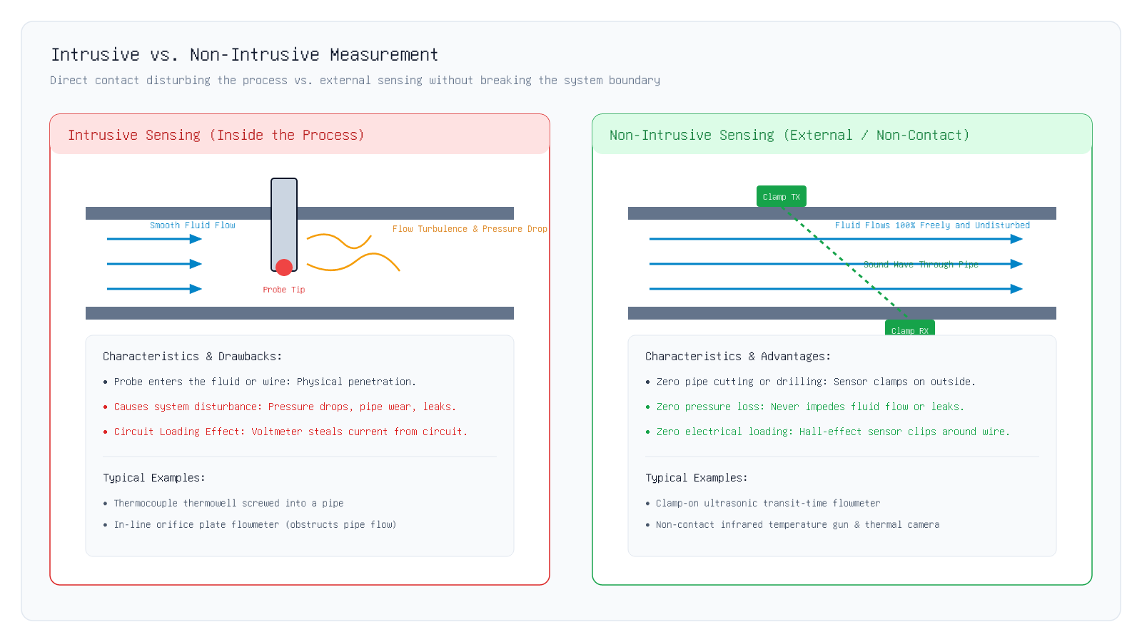
1.6 Intrusive Sensing
Visual Comparison: Intrusive vs. Non-Intrusive
Key Insight: Figure 6 contrasts intrusive fluid turbulence against smooth, non-intrusive external measurement.
Unit I · MEC 232 · Er. Saroj Chalise | Slide 79 of 94
Notes:
Walk through Figure 6: Left panel shows the intrusive probe causing eddies, turbulence, and pressure drop. Right panel shows clamp-on ultrasonic sensors passing sound through the pipe with smooth, undisturbed flow.
[CORE TAKEAWAY]: Figure 6 contrasts intrusive fluid turbulence against smooth, non-intrusive external measurement.

Slide 80
1.6 Intrusive Sensing
Intrusive vs. Non-Intrusive: Engineering Selection
When to Choose Which Method
Key Takeaway: Non-intrusive sensing is essential for hazardous, high-pressure, or sanitary pipelines.
Unit I · MEC 232 · Er. Saroj Chalise | Slide 80 of 94
Notes:
Point out the food and beverage industry: you cannot stick dirty metal probes into milk or beer pipes—you must use non-intrusive sanitary sensors.
[CORE TAKEAWAY]: Non-intrusive sensing is essential for hazardous, high-pressure, or sanitary pipelines.

Slide 81
1.7 Electrical Safety
1.7 Electrical Safety & Ground Loop Isolation
Section 1.7 · Protecting Equipment and Lives · Ground Loops · Optocouplers · IEC CAT Ratings
Core Pedagogical Objective:
Safety is non-negotiable: proper grounding and galvanic isolation protect both delicate sensors and human lives.
Unit I · MEC 232 · Er. Saroj Chalise | Slide 81 of 94
Notes:
Finally, we reach Section 1.7: Electrical Safety and Ground Loop Isolation. In factory automation, high voltages and long cables can cause equipment fires or lethal electric shocks if safety rules are ignored. Let us see how to stay safe.
[CORE TAKEAWAY]: Safety is non-negotiable: proper grounding and galvanic isolation protect both delicate sensors and human lives.

Slide 82
1.7 Electrical Safety
What is Earth Ground?
The 0-Volt Safety Anchor for Buildings and Machines
• In electrical engineering, "Ground" (or Earth) is a thick copper rod driven deep into the physical earth soil outside a building.
• The metal chassis of machines, drill presses, and electrical cabinets are connected by green-yellow wires to this earth rod.
• Purpose 1 (Human Safety): If a live wire shakes loose and touches the metal casing, the electric current rushes harmlessly into the earth rod, tripping the circuit breaker instead of shocking a worker.
• Purpose 2 (Signal Reference): Serves as the zero-volt (0.00 V) baseline reference for electronics.
Key Takeaway: Earth ground protects human life by safely directing fault currents into the soil.
Unit I · MEC 232 · Er. Saroj Chalise | Slide 82 of 94
Notes:
Ask students why plugs have three pins: the third longer pin is the earth ground safety pin.
[CORE TAKEAWAY]: Earth ground protects human life by safely directing fault currents into the soil.

Slide 83
1.7 Electrical Safety
What is a Ground Loop?
When "Zero Volts" is NOT Zero Volts Everywhere!
• Beginner engineers assume: "Ground is 0.00 Volts everywhere in the factory."
• In real life, this assumption is DANGEROUSLY WRONG!
• Imagine Machine A in Building 1 is connected to Earth Ground A.
• Machine B in Building 2 is connected to Earth Ground B 100 meters away.
• Because electric currents flow through the soil from factory motors, Ground A and Ground B are at slightly different voltages (e.g. Δ V_g = 5.0 Volts).
Key Takeaway: Ground Loop = A closed loop created when a signal cable connects two different earth ground points.
Unit I · MEC 232 · Er. Saroj Chalise | Slide 83 of 94
Notes:
Explain that soil has electrical resistance. When a 50 kW motor runs nearby, the ground potential rises.
[CORE TAKEAWAY]: Ground Loop = A closed loop created when a signal cable connects two different earth ground points.

Slide 84
1.7 Electrical Safety
The Real-World Dangers of Ground Loops
Loud Audio Hum, Noisy Sensor Data, and Melted Cables
• What happens when a ground loop current flows through your instrumentation system?
• 1. 50 Hz / 60 Hz Mains Hum: In audio systems and sensitive sensor lines, the circulating 50 Hz power current creates an annoying buzz that drowns out small millivolt signals.
• 2. Inaccurate Sensor Readings: The voltage drop across the cable ground wire adds directly to your sensor reading, giving false data.
• 3. Equipment Destruction & Fire: During a lightning strike or factory motor fault, thousands of amperes can surge through a thin signal cable shield, melting the wire and destroying the computer!
Key Takeaway: Ground loops cause 50 Hz electrical hum, sensor noise, and equipment destruction.
Unit I · MEC 232 · Er. Saroj Chalise | Slide 84 of 94
Notes:
Mention that ground loops are responsible for 80% of persistent noise problems in industrial instrumentation.
[CORE TAKEAWAY]: Ground loops cause 50 Hz electrical hum, sensor noise, and equipment destruction.

Slide 85
1.7 Electrical Safety
The Solution: Galvanic Isolation
Breaking the Continuous Metal Path
• How do we stop ground loop currents from circulating?
• We must physically BREAK the metal-to-metal connection between the sensor and the computer!
• This technique of allowing signals to pass while blocking direct electrical metal contact is called Galvanic Isolation.
• How can a signal pass through if there is no metal wire?
• We convert the electrical signal into another form of energy (like light or magnetic flux), send it across an insulating air/glass gap, and convert it back to electricity on the other side!
Key Takeaway: Galvanic isolation breaks the metal conductor loop, completely eliminating circulating ground currents.
Unit I · MEC 232 · Er. Saroj Chalise | Slide 85 of 94
Notes:
Galvanic isolation is like sending messages across a moat using a flashlight: the message gets across, but nobody can cross the moat.
[CORE TAKEAWAY]: Galvanic isolation breaks the metal conductor loop, completely eliminating circulating ground currents.

Slide 86
1.7 Electrical Safety
How an Optical Isolator (Optocoupler) Works
Electricity → Light → Electricity
• An Optical Isolator (Optocoupler) contains two tiny components sealed inside a small chip:
• 1. Transmitter (LED): An infrared Light Emitting Diode connected to the input sensor circuit. When sensor voltage rises, the LED shines brighter.
• 2. Receiver (Phototransistor): A light-sensitive transistor connected to the computer circuit. It detects the incoming light beam and turns it back into electricity.
• Between the LED and phototransistor is a transparent silicone glass barrier.
• There is ZERO copper wire between them. The barrier can withstand over 5,000 Volts without breaking down!
Key Takeaway: Optocouplers transmit signals using light beams across an insulating 5 kV barrier.
Unit I · MEC 232 · Er. Saroj Chalise | Slide 86 of 94
Notes:
Every modern industrial DAQ board uses optocouplers to protect computer motherboards from factory transients.
[CORE TAKEAWAY]: Optocouplers transmit signals using light beams across an insulating 5 kV barrier.

Slide 87
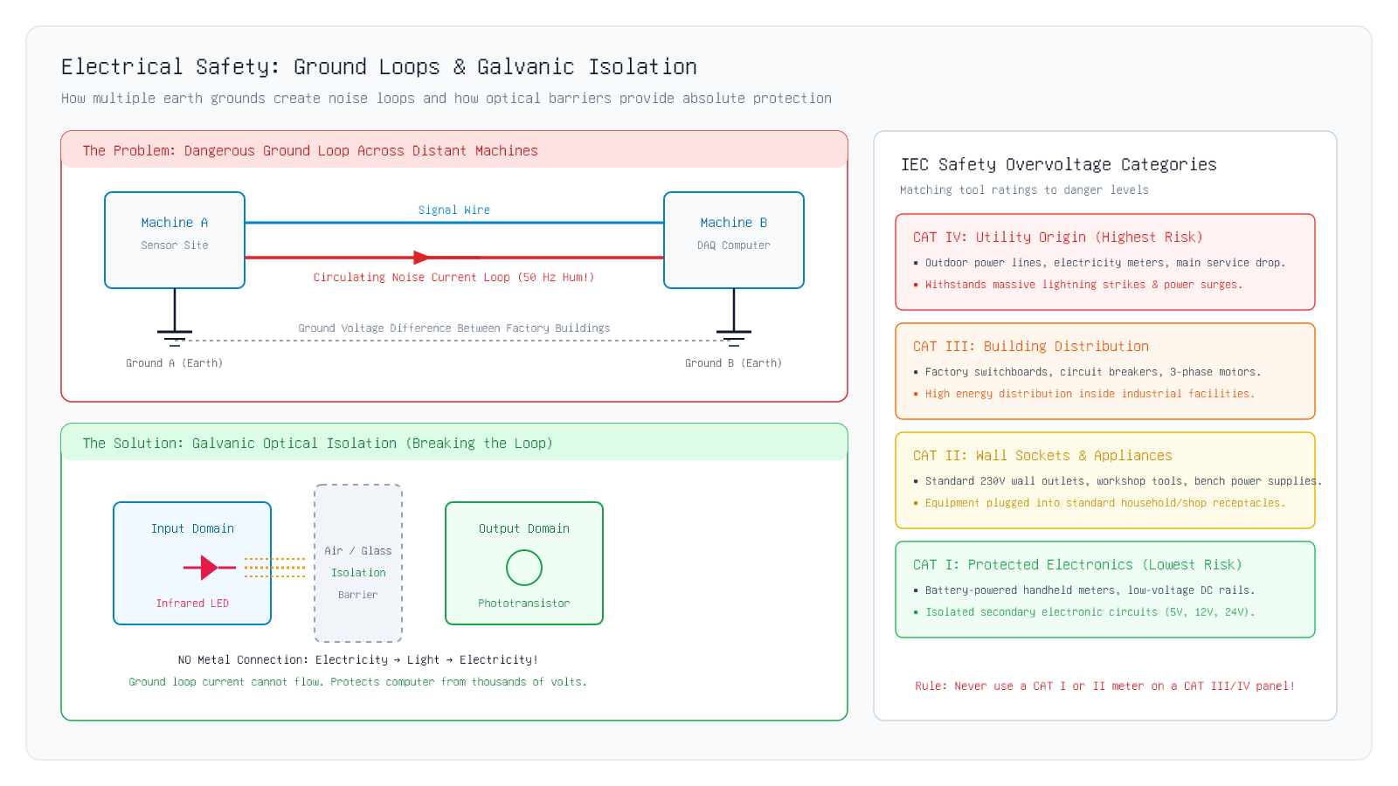
1.7 Electrical Safety
Visualizing Ground Loops & Galvanic Isolation
Key Insight: Figure 7 shows the circulating ground loop in red and the optical barrier solution in green.
Unit I · MEC 232 · Er. Saroj Chalise | Slide 87 of 94
Notes:
Examine Figure 7: Top panel shows the red circulating loop current flowing between Ground A and Ground B. Bottom panel shows how the optical isolator breaks the red line, stopping loop current dead.
[CORE TAKEAWAY]: Figure 7 shows the circulating ground loop in red and the optical barrier solution in green.

Slide 88
1.7 Electrical Safety
IEC 61010-1 Overvoltage Categories (CAT Ratings)
Figure 7 (Right) · Matching Tool Safety to Electrical Danger
• Look at the front face of any professional multimeter (e.g. a Fluke meter).
• You will see yellow stamped markings like "CAT III 1000V" or "CAT IV 600V".
• What do these CAT markings mean?
• The International Electrotechnical Commission (IEC 61010-1) created 4 Overvoltage Categories.
• They define where a tool can be safely used based on how close you are to the primary electrical power source and how violent lightning or switching surges can be.
Key Takeaway: CAT ratings specify the transient surge energy an instrument can withstand without exploding.
Unit I · MEC 232 · Er. Saroj Chalise | Slide 88 of 94
Notes:
Never grab an unrated cheap meter to test a factory 3-phase panel. It can explode in your hands from arc flash.
[CORE TAKEAWAY]: CAT ratings specify the transient surge energy an instrument can withstand without exploding.

Slide 89
1.7 Electrical Safety
The 4 IEC Overvoltage Categories Defined
From Low-Voltage Electronics (CAT I) to Utility Power Poles (CAT IV)
• CAT I (Protected Electronics): Low-voltage DC circuits, battery-operated devices, secondary regulated power rails (e.g. 5V, 12V circuits). Lowest danger.
• CAT II (Wall Sockets & Appliances): Standard 230V household wall outlets, portable power tools, bench equipment connected to local receptacles.
• CAT III (Building Distribution): Industrial factory switchboards, circuit breaker panels, 3-phase electric motors, busbars. High energy arc-flash risk!
• CAT IV (Utility Origin): Outdoor power lines, overhead utility wires, electricity service entrance meters. Highest lightning surge risk (transients up to 8,000 V)!
Key Takeaway: CAT I = Battery circuits; CAT II = Wall plugs; CAT III = Factory panels; CAT IV = Outdoor utility lines.
Unit I · MEC 232 · Er. Saroj Chalise | Slide 89 of 94
Notes:
The closer you are to the outdoor power lines, the higher the category must be: CAT I (safe battery) to CAT IV (power pole).
[CORE TAKEAWAY]: CAT I = Battery circuits; CAT II = Wall plugs; CAT III = Factory panels; CAT IV = Outdoor utility lines.

Slide 90
1.7 Electrical Safety
The Golden Safety Rule in the Electrical Lab
Never Use a Low-CAT Meter on High-CAT Circuits!
• A cheap 5 multimeter bought from an online shop is usually rated CAT I or CAT II at best.
• If you take that cheap meter and touch the probes to a 415V 3-phase factory distribution panel (CAT III):
• If an industrial motor switches on at that exact millisecond, a 4,000 Volt voltage spike surges into the meter.
• The internal traces inside the cheap meter vaporize instantly into superheated copper gas.
• An explosive Arc Flash fireball erupts in front of your face, causing severe third-degree burns or blindness!
Key Takeaway: Never use a CAT I or II meter on a CAT III/IV panel: an overvoltage spike will cause an explosive arc flash!
Unit I · MEC 232 · Er. Saroj Chalise | Slide 90 of 94
Notes:
Arc flash is a real industrial hazard. Safety begins with respecting the tool CAT rating.
[CORE TAKEAWAY]: Never use a CAT I or II meter on a CAT III/IV panel: an overvoltage spike will cause an explosive arc flash!

Slide 91
1.7 Quiz
Check Your Understanding: Electrical Safety & Isolation
Concept Check 1.7
Key Takeaway: Optical isolation is the standard industrial solution for long-distance ground loop noise.
Unit I · MEC 232 · Er. Saroj Chalise | Slide 91 of 94
Notes:
Conclude the safety topic with this practical installation scenario.
[CORE TAKEAWAY]: Optical isolation is the standard industrial solution for long-distance ground loop noise.

Slide 92
Summary Review
Unit I Comprehensive Summary: The Golden Rules
Review of Core Principles Across All 7 Sections
• 1.1 Methods: Direct is manual; Deflection is fast but causes loading; Null-Balance draws zero power at balance.
• 1.2 Analog vs. Digital: Analog has continuous resolution but parallax error; Digital gives clean numbers with quantization steps ΔV.
• 1.3 DAQ Pipeline: Measurand → Sensor → Conditioning (Amp, Filter, Isolate) → MUX & S/H → ADC → Display.
• 1.4 Calibration: Sensitivity S is the slope; Zero drift shifts the line; Hysteresis is the gap between going up and coming down.
• 1.5 Uncertainty: Gross = Blunder; Systematic = Bias (calibrated away); Random = Noise (reduced by √N averaging).
Key Takeaway: Mastering these 7 core principles gives you the foundation for all modern instrumentation engineering.
Unit I · MEC 232 · Er. Saroj Chalise | Slide 92 of 94
Notes:
Review these 7 golden rules with the class. Every rule directly answers a practical engineering challenge.
[CORE TAKEAWAY]: Mastering these 7 core principles gives you the foundation for all modern instrumentation engineering.

Slide 93
Formula Sheet
Unit I Master Formula Sheet
Clean Open Formulas for Exam Preparation
• ADC Step Resolution: Δ V = \fracV_FSR2^N - 1
• Nyquist Minimum Sampling Rate: f_s ≥ 2 · f_max
• Static Sensitivity Slope: S = (Δ y) / (Δ x)
• Maximum Hysteresis Percentage: %Hysteresis = \frac|y_down - y_up|_maxy_FSO × 100%
• Type A Standard Uncertainty: u_A = \fracs√(N)
Key Takeaway: These 7 standard formulas form the mathematical backbone of Unit I.
Unit I · MEC 232 · Er. Saroj Chalise | Slide 93 of 94
Notes:
Remind students: formulas are tools to calculate physical reality. Learn the physical meaning of each symbol.
[CORE TAKEAWAY]: These 7 standard formulas form the mathematical backbone of Unit I.

Slide 94
References
References & Author Information
Recommended Textbooks & Course Materials
• Bentley, John P. Principles of Measurement Systems, 4th Edition, Pearson Prentice Hall, 2005.
• Doebelin, Ernest O., and Manik, Dhanesh N. Measurement Systems: Application and Design, 6th Edition, McGraw-Hill, 2019.
• JCGM 100:2008 / GUM 1995: Evaluation of measurement data — Guide to the expression of uncertainty in measurement (ISO/IEC Guide 98-3).
• IEC 61010-1: Safety requirements for electrical equipment for measurement, control, and laboratory use.
• Author & Course Instructor: Er. Saroj Chalise · Lecture Slides: https://chalisesaroj.github.io/slide/
Key Takeaway: Review Bentley Chapters 1–3 and the ISO GUM guide for further industrial metrology standards.
Unit I · MEC 232 · Er. Saroj Chalise | Slide 94 of 94
Notes:
Thank the students for their attention. Encourage them to review the worked examples and run the interactive figures before the next class on Unit II (Digital Signal Processing).
[CORE TAKEAWAY]: Review Bentley Chapters 1–3 and the ISO GUM guide for further industrial metrology standards.

