Slide 1
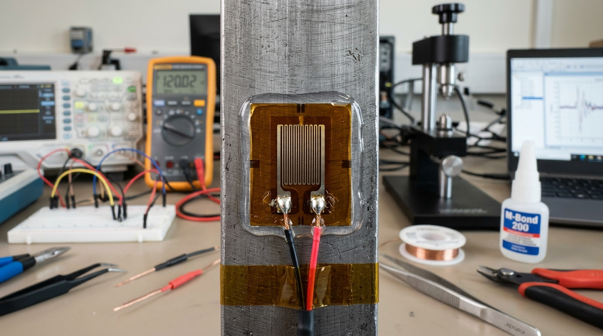
POKHARA UNIVERSITY · BE MECHANICAL · COURSE CODE: MEC 232
STRAIN GAUGES
Measuring the Invisible Deformation
Instructor:
Er. Saroj Chalise
BE Mechanical (IOE Pulchowk, 2014) · ME Mechanical (IOE Pulchowk, 2019)
10+ Years in Hydropower Machinery, Automotive Testing & Engineering Pedagogy
Course Specification:
MEC 232 (3-1-1) · 3 Credits · 45 Hours · Full Marks: 100 · Pass Marks: 45
Nature: Theory & Practical · Level: Bachelor · Program: BE Mechanical
Macro Photography: Precision constantan foil strain gauge (120 Ω) bonded to metallic test specimen with soldered leads.
Notes:
Welcome students to Unit III: Strain Gauges. In structural engineering, aerospace, and mechanical design, machines and structures experience invisible deformations under load. Today, we discover how to measure deformations smaller than a human hair using electrical resistance.
[CORE TAKEAWAY]: You cannot always see deformation, but with electrical resistance strain gauges, you can measure it with microstrain precision.

Slide 2
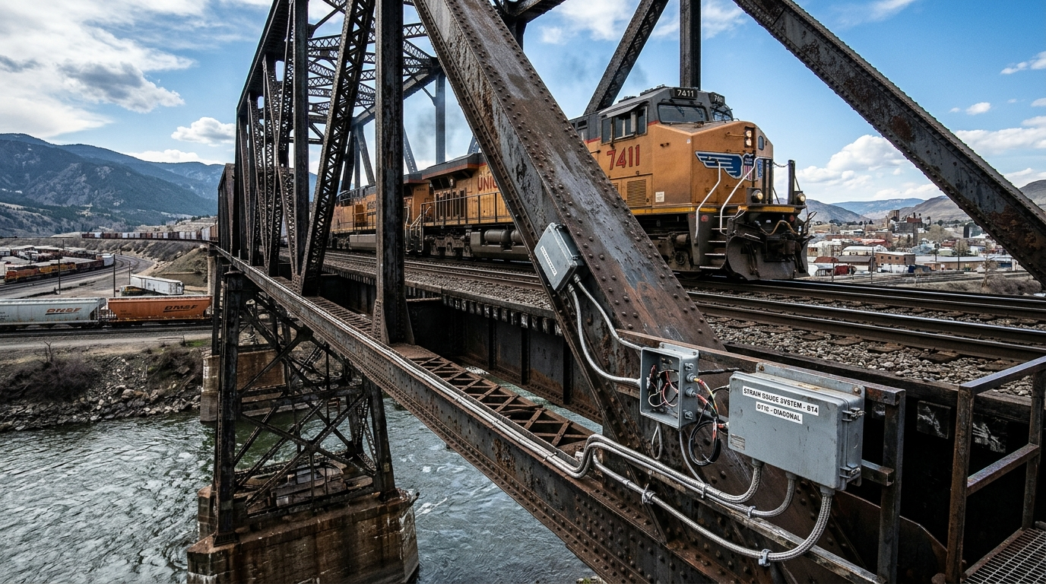
3.1 Gauge Factor
Can We See Deformation?
The physical limits of direct human observation in engineering structures
Δ L = (F · L_0) / (A · E) ≈ 10^-6 to 10^-3 m
• The Everyday Observation:: When a train crosses a massive steel truss bridge, or when an airplane taxis along a runway, do the heavy steel members visibly bend?
• The Physical Scale:: A 1000 mm structural steel bar under a heavy tensile working stress of 150 MPa elongates by only 0.75 mm (0.075%).
• The Dangerous Reality:: Human vision cannot detect whether a bridge girder is safely loaded at 20% capacity or on the verge of catastrophic fatigue failure at 95% yield.
• The Engineering Challenge:: How can we convert an invisible mechanical displacement into an electrical signal that a computer can log, plot, and monitor in real time?
Key Takeaway: Dangerous internal stresses manifest as imperceptible micro-deformations that require precision electronic transduction.
Structural Health Monitoring: Heavy steel truss railway bridge instrumented with strain gauge enclosures under train load.
Unit III · MEC 232 · Er. Saroj Chalise | Slide 2 of 36
Notes:
Begin with a provocative physical question: Can we see a steel rod becoming longer? The answer is: Yes, but the change is often far too small for human eyes. This motivates the need for electrical strain sensing.
[CORE TAKEAWAY]: Dangerous internal stresses manifest as imperceptible micro-deformations that require precision electronic transduction.

Slide 3
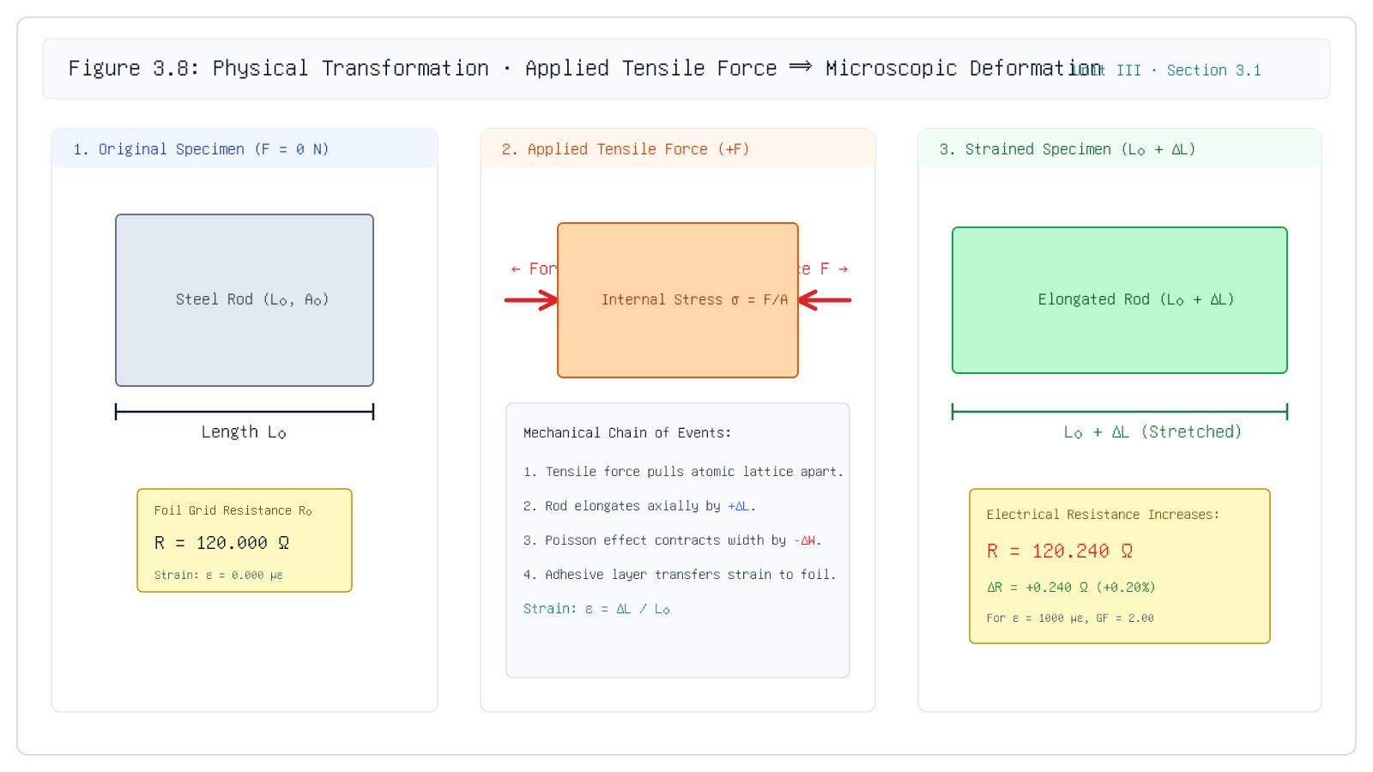
3.1 Gauge Factor
From Force to Mechanical Deformation
Key Insight: Every mechanical load produces simultaneous longitudinal elongation and transverse Poisson contraction.
Unit III · MEC 232 · Er. Saroj Chalise | Slide 3 of 36
Notes:
Direct students to Figure 3.0: Stage 1 shows the original resting bar of length L0. Stage 2 shows the application of tensile force F. Stage 3 shows axial elongation Delta L accompanied by lateral Poisson necking Delta D.
[CORE TAKEAWAY]: Every mechanical load produces simultaneous longitudinal elongation and transverse Poisson contraction.

Slide 4

3.1 Gauge Factor
Understanding Strain: The Governing Metric
Mathematical definition, dimensionless nature, and the microstrain (με) unit
Governing Relationship
ε = (Δ L) / (L_0) = \fracL_final - L_0L_0
Symbol | Parameter & Units | Engineering Meaning
ε | Engineering Strain [dimensionless (m/m)] | Ratio of total axial elongation to original resting length
Δ L | Elongation / Deflection [mm or μm] | Net physical change in specimen length under applied mechanical load
L_0 | Initial Gauge Length [mm or m] | Resting, unloaded baseline length of the component under test
με | Microstrain [10^-6 m/m] | Standard engineering unit: 1 με = 1 μm elongation per 1 meter of length
• Dimensionless Ratio:: Because strain is length divided by length ([L] / [L]), it has no physical units.
• Practical Engineering Range:: In civil and mechanical engineering, elastic metallic deformations are typically between 10^-6 and 10^-3. We define 1 με = 10^-6 m/m = 0.0001%.
Key Takeaway: Strain quantifies mechanical deformation independently of initial component dimensions.
Universal Testing Machine (UTM): High-precision tensile specimen instrumented with axial strain gauges and clip-on extensometer.
Unit III · MEC 232 · Er. Saroj Chalise | Slide 4 of 36
Notes:
Walk students through the numerical demonstration: 0.1 mm over 100 mm is 1000 microstrain. Emphasize that in structural steel, yield strain is approximately 1200 to 1500 microstrain.
[CORE TAKEAWAY]: Strain quantifies mechanical deformation independently of initial component dimensions.

Slide 5
3.1 Gauge Factor
What Happens to Electrical Resistance?
The bridge between mechanical elasticity and solid-state electrical conduction
R = ρ (L) / (A) ──[Tensile Strain]──> L \uparrow, A \downarrow, ρ ± ⇒ R \uparrow
• Governing Resistance Law:: Every conductor obeys R = (ρ · L) / (A), where ρ is material resistivity, L is length, and A is cross-sectional area.
• Mechanism 1 — Conductor Lengthening (L \uparrow):: Under tensile strain, the conductor lengthens. Electrons must traverse a longer conductive path, increasing electrical resistance.
• Mechanism 2 — Lateral Thinning (A \downarrow):: Conductor elongation causes Poisson lateral contraction, narrowing cross-sectional area A. A narrower channel restricts electron flow, further increasing resistance.
• Mechanism 3 — Piezoresistive Effect (ρ ±):: Mechanical atomic lattice deformation alters electronic band structures and electron scattering rates, causing intrinsic resistivity ρ to change.
• The Fundamental Breakthrough:: Mechanical deformation is directly transduced into an electrical resistance shift Δ R!
Key Takeaway: Mechanical deformation is directly mirrored by an electrical resistance change.
Unit III · MEC 232 · Er. Saroj Chalise | Slide 5 of 36
Notes:
Emphasize the physical link: as the wire stretches, it becomes longer and thinner, both of which force electrical resistance to increase.
[CORE TAKEAWAY]: Mechanical deformation is directly mirrored by an electrical resistance change.

Slide 6
3.1 Gauge Factor
What Is a Strain Gauge?
Formal engineering definition, operating principle, and physical anatomy
Term: Electrical Resistance Strain Gauge
"A passive electromechanical sensor that measures surface mechanical strain by transducing dimensional elongation and piezoresistive resistivity modulations into proportional variations in electrical resistance."
Standard: ASTM E251 / ISO 9513 Standard Test Methods for Performance Characteristics of Metallic Bonded Resistance Strain Gauges
• Metallic Foil Grid:: Photo-etched alloy foil (3–5 μm thick, Constantan or Karma) arranged in a serpentine loop to maximize active sensing length while canceling transverse strain.
• Insulating Carrier Backing:: Tough, flexible polyimide or epoxy film (25 μm thick) electrically isolating the grid from the conductive specimen.
• Bonding Adhesive Matrix:: High-shear cyanoacrylate, epoxy, or ceramic cement transferring surface deformation into the foil via pure shear stress.
• Solder Tabs:: Heavy copper-reinforced terminals allowing lead wires to be attached without mechanical strain pulling on the fragile sensing grid.
Key Takeaway: The strain gauge acts as an intimate physical extension of the specimen's crystalline surface.
Unit III · MEC 232 · Er. Saroj Chalise | Slide 6 of 36
Notes:
Present the formal definition clearly. Explain that the serpentine pattern packs several centimeters of active wire into an area smaller than a postage stamp.
[CORE TAKEAWAY]: The strain gauge acts as an intimate physical extension of the specimen's crystalline surface.

Slide 7
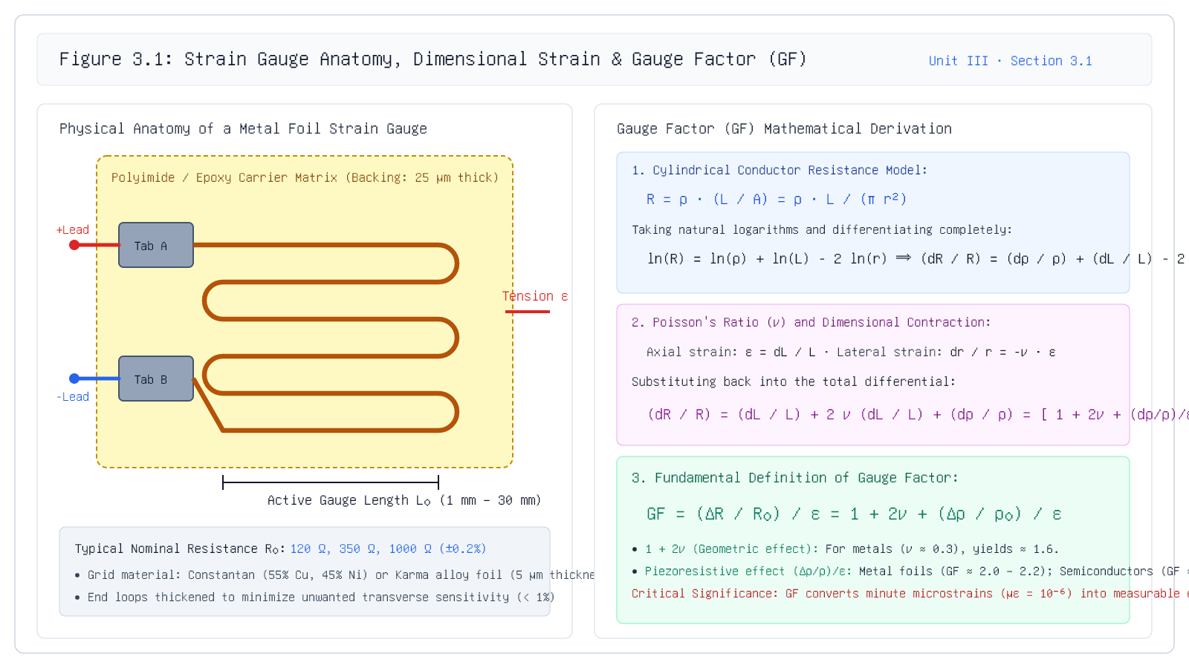
3.1 Gauge Factor
Gauge Factor (GF): The Fundamental Sensitivity
Governing Formula: GF = (Δ R / R_0) / (ε) = 1 + 2ν + (Δ ρ / ρ_0) / (ε)
Unit III · MEC 232 · Er. Saroj Chalise | Slide 7 of 36
Notes:
Review the derivation on Figure 3.1: ln R = ln rho + ln L - ln A. Differentiating yields dR/R = d rho/rho + dL/L - dA/A. Substituting dA/A = -2nuepsilon gives the 3 terms: axial elongation (1), lateral Poisson contraction (+2*nu), and piezoresistive shift ((drho/rho)/epsilon).
[CORE TAKEAWAY]: Gauge Factor quantifies the electrical sensitivity of a strain gauge material: higher GF means larger resistance change per microstrain.

Slide 8
3.1 Worked Example
Gauge Factor: Solved Numerical Problem
Quantitative verification of resistance shift on a structural beam
Problem: A standard metallic foil strain gauge with nominal resistance R_0 = 120.00 \Omega and gauge factor GF = 2.00 is bonded to a structural steel tensile member. When loaded, the strain gauge indicates a mechanical strain of ε = 0.00100 (1000 με). Determine: 1) The fractional change in resistance (Δ R / R_0). 2) The absolute resistance change (Δ R). 3) The total strained resistance (R_final).
Step 1: Calculate Fractional Resistance Change
(Δ R) / (R_0) = GF · ε = 2.00 × 0.00100 = 0.00200 = 0.20%
The fractional resistance change is the product of Gauge Factor and mechanical strain.
Step 2: Calculate Absolute Resistance Change Δ R
Δ R = R_0 · (GF · ε) = 120.00 \Omega × 0.00200 = +0.240 \Omega
Multiply nominal resting resistance by fractional shift.
Step 3: Determine Final Strained Resistance
R_final = R_0 + Δ R = 120.000 + 0.240 = 120.240 \Omega
The new resistance of the gauge under full tensile working load.
Final Answer: Δ R = +0.240 \Omega (R_final = 120.240 \Omega)
Unit III · MEC 232 · Er. Saroj Chalise | Slide 8 of 36
Notes:
Highlight the critical takeaway to students: 0.24 ohms out of 120 ohms is just 0.2%! This proves why ordinary meters are useless and Wheatstone bridges are essential.
[CORE TAKEAWAY]: Because mechanical strain produces only milliohm resistance shifts, specialized signal conditioning circuits are mandatory.

Slide 9
3.2 Bonded vs Unbonded
Part B: Bonded & Unbonded Strain Gauges
Section 3.2 — Construction taxonomy, strain transmission mechanics, and transducer integration
Core Pedagogical Objective:
The method of strain coupling—adhesive shear vs mechanical flexure—dictates frequency response, dynamic range, and transducer architecture.
Unit III · MEC 232 · Er. Saroj Chalise | Slide 9 of 36
Notes:
We now transition to Section 3.2: Bonded versus Unbonded strain gauges. We will contrast direct adhesive surface-mount gauges with suspended wire flexure mechanisms.
[CORE TAKEAWAY]: The method of strain coupling—adhesive shear vs mechanical flexure—dictates frequency response, dynamic range, and transducer architecture.

Slide 10
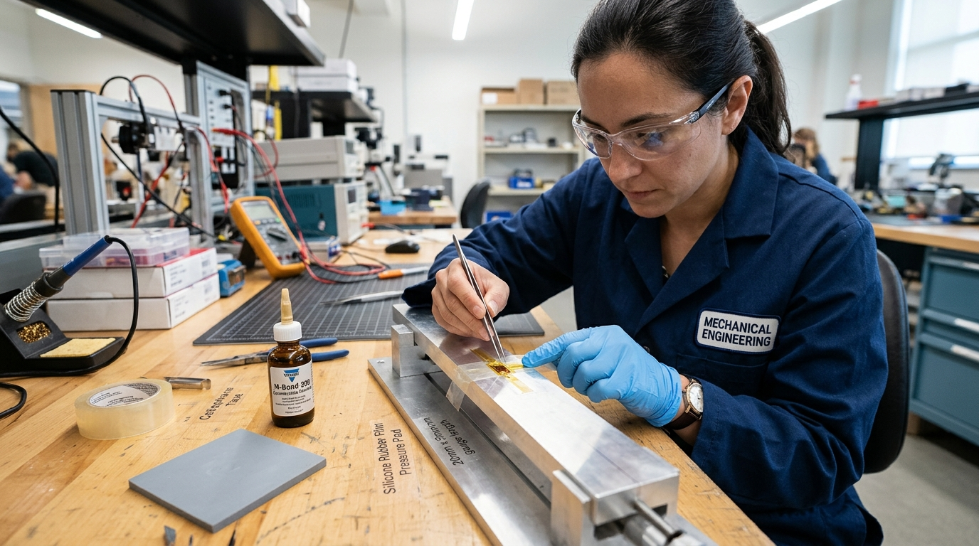
3.2 Bonded Gauges
Bonded Strain Gauge Construction
Multi-layered foil grid, polyimide carrier, adhesive matrix, and shear lag transmission
τ_adhesive(x) = G_glue \fracu_substrate(x) - u_foil(x)t_glue
• Structural Anatomy:: A bonded foil strain gauge consists of an ultra-thin (3–5 μm) etched metallic foil grid bonded to a polyimide carrier backing (25 μm).
• Strain Transfer Mechanism:: Unlike mechanical extensometers, there are no clamps or knife-edges. Strain is transferred from the specimen into the grid via shear stress developed in the thin adhesive layer.
• Adhesive Layer Requirements:: The bonding cement must have high shear modulus, zero void inclusions, excellent electrical insulation, and negligible viscoelastic creep over the operating temperature span.
• Transverse Sensitivity Suppression:: Serpentine grid end loops are deliberately widened to minimize resistance response to lateral cross-axis strains (< 1% cross-sensitivity).
Key Takeaway: Bonded gauges measure direct surface strain with high bandwidth (>100 kHz) but depend entirely on adhesive integrity.
Precision Surface Preparation & Mounting: Cyanoacrylate adhesive installation and clamping onto aluminum beam.
Unit III · MEC 232 · Er. Saroj Chalise | Slide 10 of 36
Notes:
Explain the shear lag theory: shear stress in the adhesive layer transfers normal strain from the substrate into the foil. That is why proper adhesive curing is essential.
[CORE TAKEAWAY]: Bonded gauges measure direct surface strain with high bandwidth (>100 kHz) but depend entirely on adhesive integrity.

Slide 11
3.2 Unbonded Gauges
Unbonded Strain Gauge Construction
Suspended wire filaments, movable flexure armatures, and zero adhesive creep
k_flexure · x = Δ F_wire ⇒ Δ R = R_0 · GF · (\fracxL_wire)
• Mechanical Architecture:: Fine resistance wire filaments (25 μm diameter, platinum-tungsten or nickel-chrome) are suspended under mechanical pre-tension between movable and stationary insulated posts.
• Operating Principle:: Displacement of an external flexure armature stretches one pair of wire loops (increasing tension and resistance) while simultaneously relaxing the opposing pair (decreasing tension and resistance).
• Zero Adhesive Creep:: Because no organic glue or polymer backing is used in the load path, unbonded gauges exhibit virtually zero viscoelastic creep and outstanding long-term zero stability.
• Primary Engineering Applications:: Internal sensing engines for high-precision pressure capsules, seismic geophones, biomedical blood pressure transducers, and flight accelerometers.
Key Takeaway: Unbonded gauges eliminate organic adhesive creep entirely, making them ideal for sealed pressure and inertial transducers.
Unit III · MEC 232 · Er. Saroj Chalise | Slide 11 of 36
Notes:
Clarify a common misconception: unbonded strain gauges are never glued directly onto a test beam. They are precision internal transducers inside sealed instruments.
[CORE TAKEAWAY]: Unbonded gauges eliminate organic adhesive creep entirely, making them ideal for sealed pressure and inertial transducers.

Slide 12
3.2 Bonded vs Unbonded
Comparative Analysis: Bonded vs Unbonded
Engineering trade-offs across installation, range, frequency, and hysteresis
Key Takeaway: Select bonded foil for structural stress mapping and modern load cells; use unbonded wire for high-stability pressure capsules.
Unit III · MEC 232 · Er. Saroj Chalise | Slide 12 of 36
Notes:
Highlight the engineering verdict: bonded foil gauges are universal in stress analysis, while unbonded wire mechanisms are used inside specialized instruments.
[CORE TAKEAWAY]: Select bonded foil for structural stress mapping and modern load cells; use unbonded wire for high-stability pressure capsules.

Slide 13
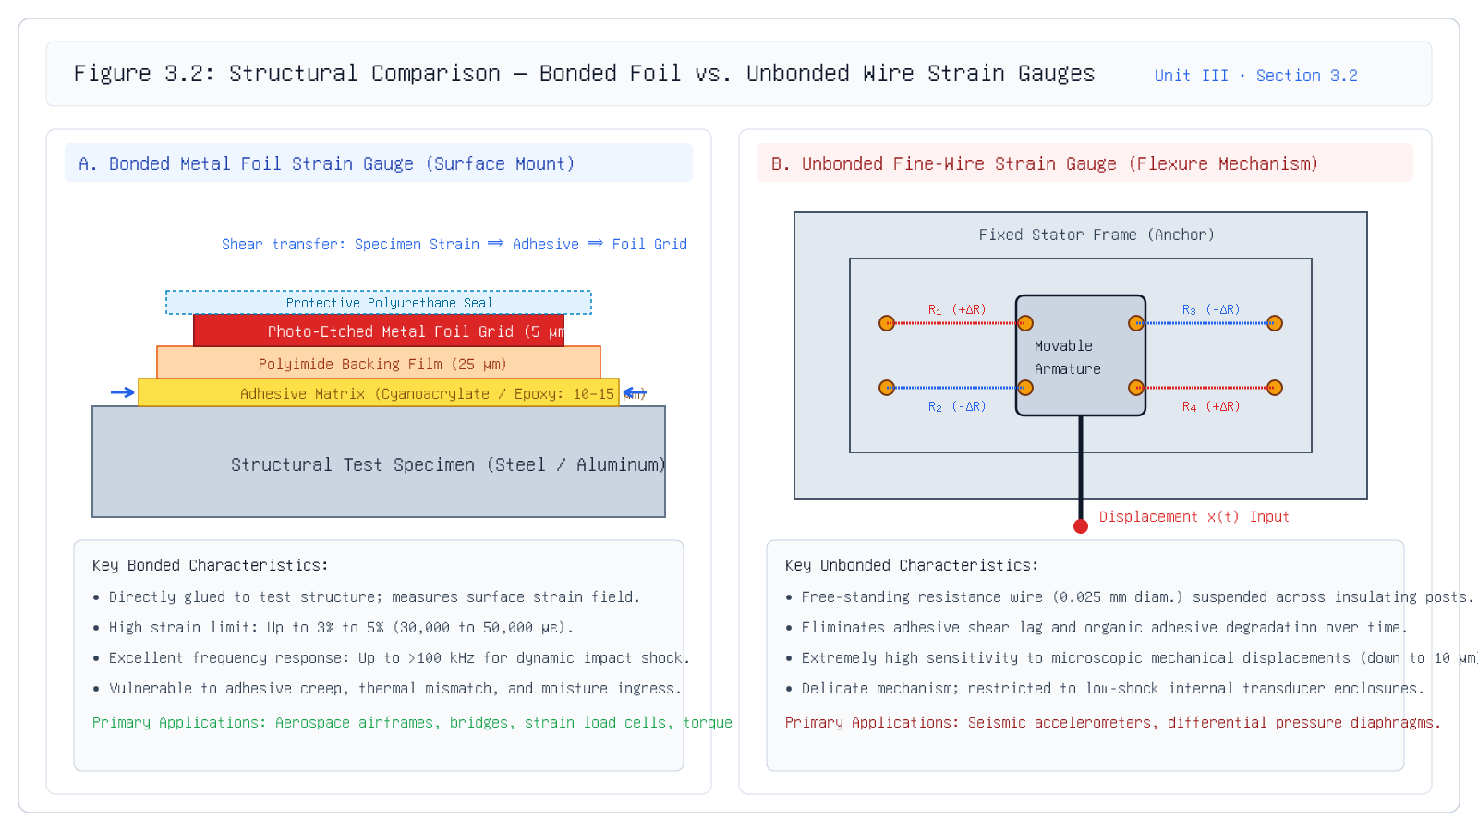
3.2 Bonded vs Unbonded
Figure 3.2: Structural Comparison: Bonded vs Unbonded
Key Insight: Bonded gauges couple strain through adhesive shear; unbonded gauges couple displacement through mechanical post deflection.
Unit III · MEC 232 · Er. Saroj Chalise | Slide 13 of 36
Notes:
Review Figure 3.2. Contrast the cross-sectional shear stress distribution in the bonded foil gauge with the 4-element push-pull unbonded flexure mechanism.
[CORE TAKEAWAY]: Bonded gauges couple strain through adhesive shear; unbonded gauges couple displacement through mechanical post deflection.

Slide 14
3.3 Circuit Configurations
Part C: Related Circuit Configurations
Section 3.3 — The measurement challenge: Resolving micro-ohm resistance shifts
Core Pedagogical Objective:
Signal conditioning circuits must convert tiny fractional resistance shifts (0.1%) into clean, amplified DC/AC voltage signals with zero baseline drift.
Unit III · MEC 232 · Er. Saroj Chalise | Slide 14 of 36
Notes:
We now enter Section 3.3: Circuit Configurations. We will study the Ballast circuit, Wheatstone Bridge circuits (Quarter, Half, Full), and Constant Current circuits.
[CORE TAKEAWAY]: Signal conditioning circuits must convert tiny fractional resistance shifts (0.1%) into clean, amplified DC/AC voltage signals with zero baseline drift.

Slide 15
3.3.1 Ballast Circuit
3.3.1 Ballast Circuit Configuration
Series voltage divider topology, transfer characteristics, and sensitivity optimization
\eta(m) = (m) / ((1+m)^2) ⇒ ≤ft.(d\eta) / (dm)\right|_m=1 = 0 ⇒ \eta_\max = 0.25
• Simplest Readout Circuit:: A DC excitation source V_s powers a fixed ballast resistor R_b in series with the active strain gauge R_g.
• Output Voltage:: Measured directly across the strain gauge: V_0 = V_s (R_g) / (R_b + R_g).
• Ballast Ratio (m = R_b / R_g):: When the gauge changes by Δ R, the output voltage changes by:
• Δ V_0 = V_s (m) / ((1+m)^2) (Δ R) / (R_0) = V_s · \eta(m) · (GF · ε)
• Maximum Sensitivity Condition:: Differentiating \eta(m) = (m) / ((1+m)^2) with respect to m proves that maximum circuit sensitivity occurs strictly when m = 1 (R_b = R_g): \eta_\max = (1) / ((1+1)^2) = (1) / (4) = 0.25.
Key Takeaway: A ballast circuit achieves maximum voltage sensitivity when the series ballast resistance exactly equals nominal gauge resistance (m = 1).
Unit III · MEC 232 · Er. Saroj Chalise | Slide 15 of 36
Notes:
Derive that maximum circuit sensitivity occurs when m = 1, meaning the ballast resistance equals the nominal gauge resistance. At m = 1, the circuit sensitivity factor is exactly 0.25.
[CORE TAKEAWAY]: A ballast circuit achieves maximum voltage sensitivity when the series ballast resistance exactly equals nominal gauge resistance (m = 1).

Slide 16
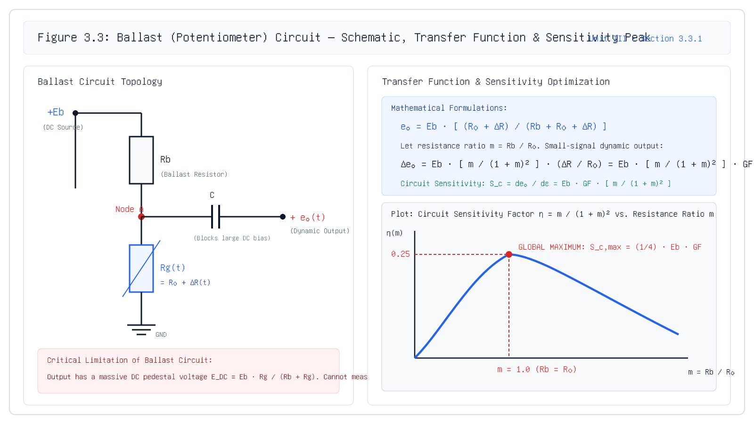
3.3.1 Ballast Circuit
Ballast Circuit Limitations & AC Coupling
Governing Formula: V_ac(t) = V_s (m) / ((1+m)^2) ( GF · ε(t) ), f_cutoff = \frac12π R_in C_b
Unit III · MEC 232 · Er. Saroj Chalise | Slide 16 of 36
Notes:
Direct students to Figure 3.3. Explain that while the ballast circuit is historically popular for dynamic vibration sensing, Wheatstone bridges completely eliminate the DC offset for static measurements.
[CORE TAKEAWAY]: Ballast circuits are unsuited for static loads due to their huge Vs/2 DC pedestal, but excel in AC vibration testing with capacitive DC blocking.

Slide 17
3.3.2 Bridge Circuits
Why Do We Need a Bridge Circuit?
The Wheatstone bridge: Differential null-balance topology eliminating the DC baseline
V_0 = V_EX [ (R_1 R_3 - R_2 R_4) / ((R_1 + R_2)(R_3 + R_4)) ] = 0 ⟺ R_1 R_3 = R_2 R_4
• The Differential Diamond:: Four resistive arms arranged in a closed loop. Excitation voltage V_EX is applied across nodes A and C; differential output V_0 is measured between nodes B and D.
• Governing Bridge Equation:: V_0 = V_B - V_D = V_EX ( (R_1) / (R_1 + R_2) - (R_4) / (R_3 + R_4) ).
• Null Balance Condition:: When the bridge is balanced (V_0 = 0.000 V):
• (R_1) / (R_2) = (R_4) / (R_3) ⟺ R_1 · R_3 = R_2 · R_4
• The Revolutionary Advantage:: Resting DC voltage is exactly zero volts (V_0 = 0 V). Any output voltage represents pure, unadulterated mechanical strain, completely eliminating the V_s/2 pedestal problem of the ballast circuit!
Key Takeaway: The Wheatstone bridge eliminates the DC offset entirely, producing an output voltage that is zero at rest and directly proportional to mechanical strain.
Unit III · MEC 232 · Er. Saroj Chalise | Slide 17 of 36
Notes:
Highlight that the differential nature of the Wheatstone bridge rejects common-mode excitation noise and establishes a true zero-volt baseline.
[CORE TAKEAWAY]: The Wheatstone bridge eliminates the DC offset entirely, producing an output voltage that is zero at rest and directly proportional to mechanical strain.

Slide 18
3.3.2 Bridge Circuits
Quarter Bridge (1× Configuration)
Single active gauge with completion resistors, small-strain approximation & non-linearity
V_0 = \fracV_EX4 · GF · ε (1× Sensitivity Multiplier)
• Circuit Topology:: Arm 1 contains the active strain gauge (R_1 = R_0 + Δ R), while arms 2, 3, and 4 are precision fixed completion resistors (R_2 = R_3 = R_4 = R_0).
• Exact Transfer Function:: Substituting into the bridge formula yields:
• V_0 = V_EX ( (R_0 + Δ R) / (2R_0 + Δ R) - (1) / (2) ) = V_EX ( (Δ R / R_0) / (4 + 2 (Δ R / R_0)) )
• Small-Strain Approximation:: Since Δ R / R_0 \ll 1, we drop 2(Δ R / R_0) in the denominator:
• V_0 ≈ \fracV_EX4 (Δ R) / (R_0) = \fracV_EX4 (GF · ε)
Key Takeaway: The quarter bridge is simple and cost-effective, but has 1x sensitivity, intrinsic non-linearity, and susceptibility to thermal drift.
Unit III · MEC 232 · Er. Saroj Chalise | Slide 18 of 36
Notes:
Demonstrate that the quarter bridge provides a sensitivity factor of 1/4. Point out the non-linearity term that arises from having Delta R in the denominator.
[CORE TAKEAWAY]: The quarter bridge is simple and cost-effective, but has 1x sensitivity, intrinsic non-linearity, and susceptibility to thermal drift.

Slide 19
3.3.2 Bridge Circuits
Half Bridge (2× Bending Configuration)
Two active complementary gauges: Doubled sensitivity, perfect linearity & thermal rejection
V_0 = \fracV_EX2 · GF · ε (2× Sensitivity Multiplier — Strictly Linear)
• Mechanical Placement:: Two active strain gauges mounted on opposite faces of a cantilever beam in pure bending: R_1 experiences tension (+ε), R_2 experiences compression (-ε).
• Exact Mathematical Cancellation:: In adjacent bridge arms, R_1 = R_0 + Δ R and R_2 = R_0 - Δ R:
• V_0 = V_EX ( (R_0 + Δ R) / ((R_0 + Δ R) + (R_0 - Δ R)) - (1) / (2) ) = V_EX ( (R_0 + Δ R) / (2R_0) - (1) / (2) ) = \fracV_EX2 (Δ R) / (R_0)
• Key Engineering Breakthroughs::
• 1. 2× Sensitivity Multiplier: Yields twice the voltage output of a quarter bridge.
Key Takeaway: Half bridge in bending doubles sensitivity, achieves perfect mathematical linearity, and automatically cancels ambient temperature drift.
Unit III · MEC 232 · Er. Saroj Chalise | Slide 19 of 36
Notes:
Emphasize the mathematical beauty: because the sum of R1 and R2 is exactly 2R0, all non-linearity in the denominator vanishes completely!
[CORE TAKEAWAY]: Half bridge in bending doubles sensitivity, achieves perfect mathematical linearity, and automatically cancels ambient temperature drift.

Slide 20
3.3.2 Bridge Circuits
Full Bridge (4× Bending Configuration)
Four active gauges providing maximum sensitivity, 4x SNR, and lead-wire immunity
V_0 = V_EX · GF · ε (4× Sensitivity Multiplier — Maximum Performance)
• Sensor Arrangement:: Four active strain gauges: two on the upper tensile surface (R_1 = R_3 = R_0 + Δ R) and two on the lower compressive surface (R_2 = R_4 = R_0 - Δ R).
• Differential Output Equation::
• V_0 = V_EX ( (R_0 + Δ R) / (2R_0) - (R_0 - Δ R) / (2R_0) ) = V_EX ( (2Δ R) / (2R_0) ) = V_EX (Δ R) / (R_0)
• The Gold Standard in Transducer Design::
• • 4× Sensitivity Multiplier: Four times the output voltage of a quarter bridge.
Key Takeaway: The full bridge is the gold standard of instrumentation: it provides 4x sensitivity, perfect linearity, and complete rejection of thermal drift.
Unit III · MEC 232 · Er. Saroj Chalise | Slide 20 of 36
Notes:
Explain that full bridge is universally utilized in precision industrial load cells, medical infusion pumps, and torque telemetry.
[CORE TAKEAWAY]: The full bridge is the gold standard of instrumentation: it provides 4x sensitivity, perfect linearity, and complete rejection of thermal drift.

Slide 21
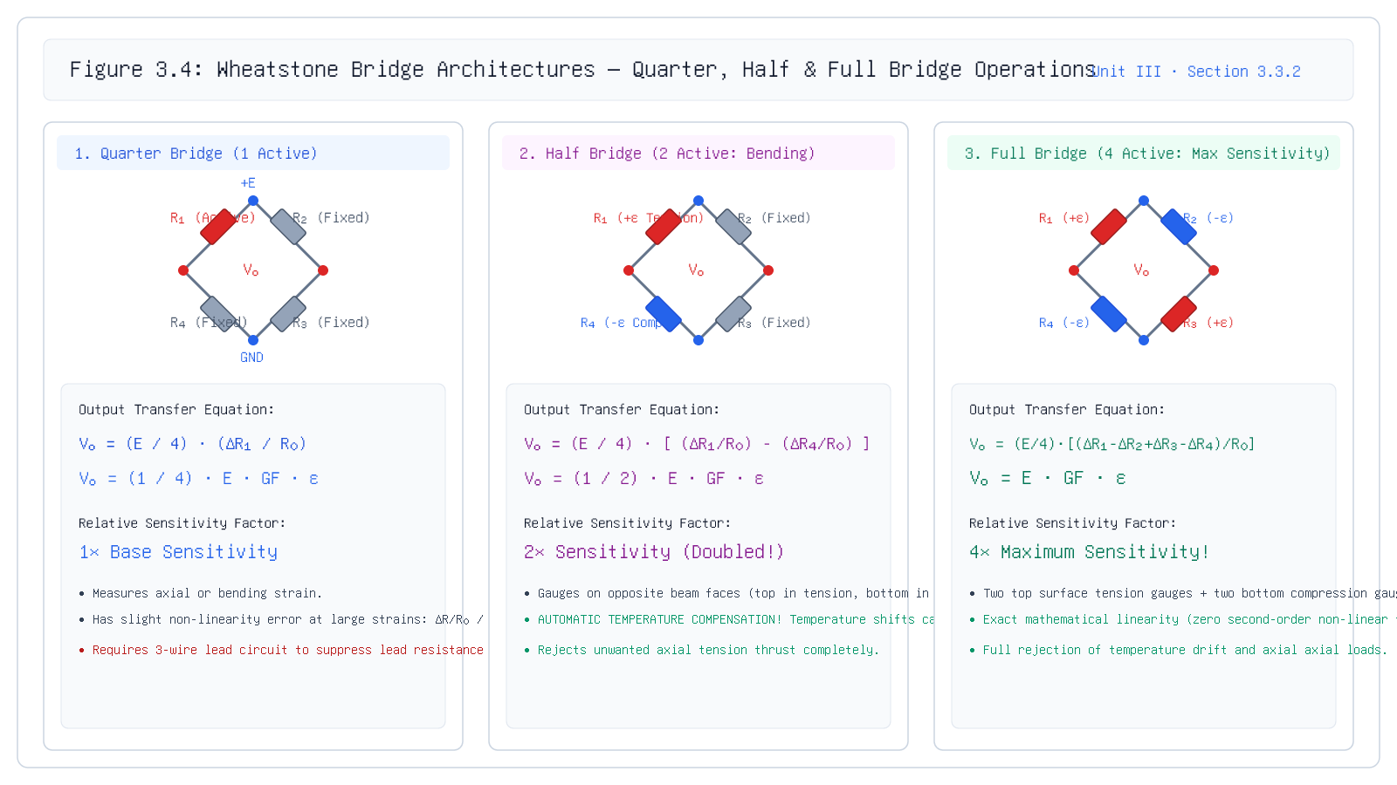
3.3.2 Bridge Circuits
Figure 3.4: Bridge Configurations Compared
Key Insight: Increasing active gauge count from 1 to 2 to 4 multiplies bridge sensitivity by 1x, 2x, and 4x while progressively eliminating non-linearity and thermal errors.
Unit III · MEC 232 · Er. Saroj Chalise | Slide 21 of 36
Notes:
Review Figure 3.4 carefully with students: compare the 1x quarter bridge, 2x half bridge bending configuration, and 4x full bridge configuration.
[CORE TAKEAWAY]: Increasing active gauge count from 1 to 2 to 4 multiplies bridge sensitivity by 1x, 2x, and 4x while progressively eliminating non-linearity and thermal errors.

Slide 22
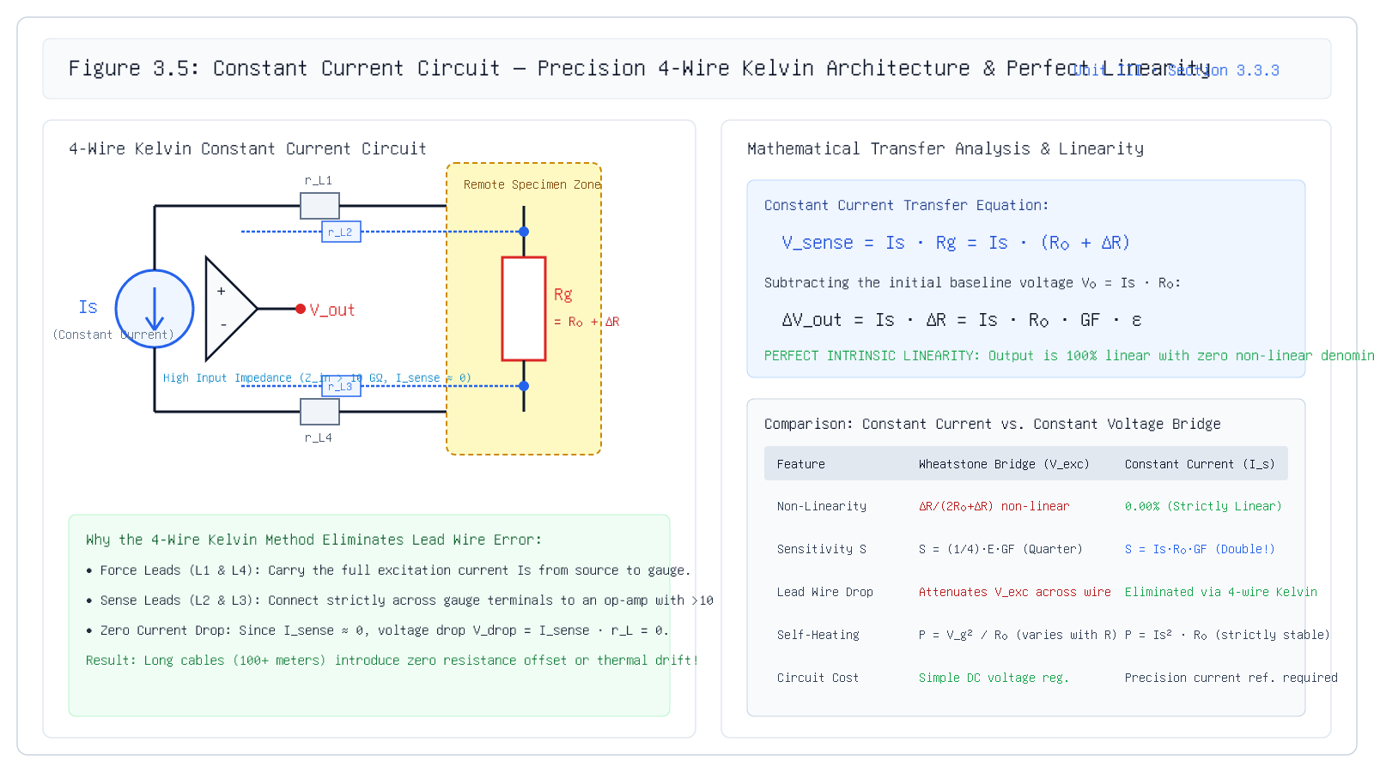
3.3.3 Constant Current
3.3.3 Constant Current Circuit Configuration
Governing Formula: Δ V_0 = I_0 · R_0 · GF · ε [Strictly Linear — Zero Lead Wire Attenuation]
Unit III · MEC 232 · Er. Saroj Chalise | Slide 22 of 36
Notes:
Walk through Figure 3.5. Show the drive current loop and the high-impedance sense lines that carry zero current.
[CORE TAKEAWAY]: The 4-wire Kelvin constant current circuit eliminates lead-wire attenuation entirely and achieves perfect mathematical linearity.

Slide 23
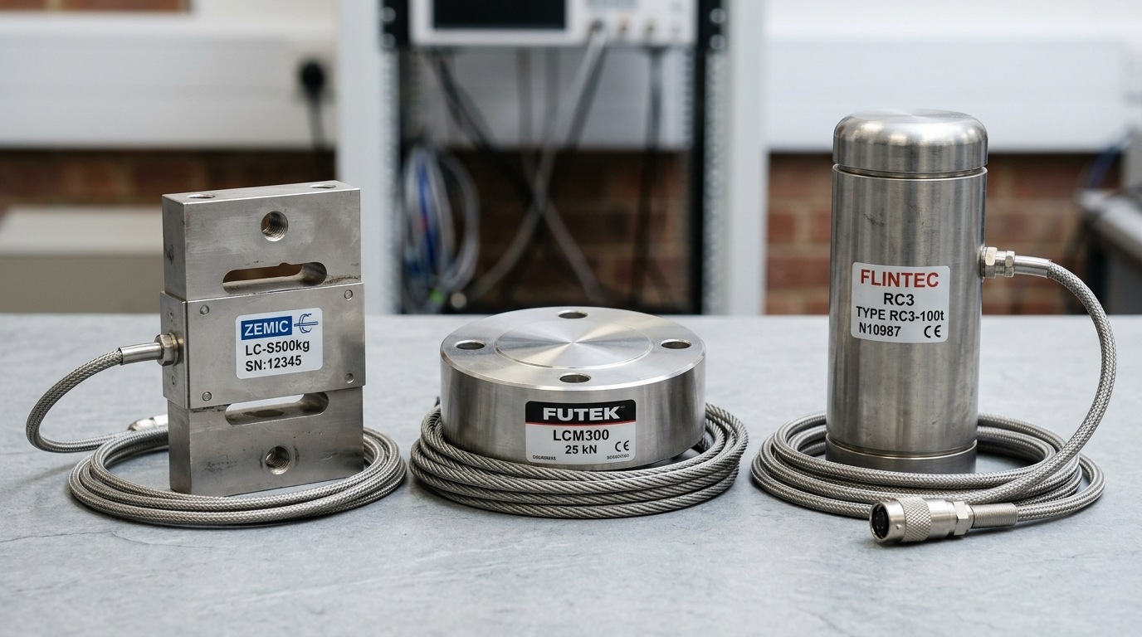
3.3 Summary Matrix
Circuit Selection Matrix & Industrial Architecture
Comprehensive engineering trade-off comparison across all five circuit topologies
Key Takeaway: Match the circuit topology to the mechanical loading mode and environmental cable constraints.
Industrial Transducer Enclosures: S-beam, shear-web pancake, and high-capacity canister load cells powered by full-bridge strain gauges.
Unit III · MEC 232 · Er. Saroj Chalise | Slide 23 of 36
Notes:
Review this comparison matrix before exams: emphasize the trade-offs between component cost, wiring complexity, and measurement accuracy.
[CORE TAKEAWAY]: Match the circuit topology to the mechanical loading mode and environmental cable constraints.

Slide 24
3.4 Temperature Compensation
Part D: Temperature Compensation
Section 3.4 — Understanding and neutralizing the two primary thermal error mechanisms
Core Pedagogical Objective:
Temperature changes produce resistance changes that mimic mechanical strain; compensation techniques eliminate this thermal apparent strain.
Unit III · MEC 232 · Er. Saroj Chalise | Slide 24 of 36
Notes:
We now address Section 3.4: Temperature Compensation Techniques. Thermal drift is the single greatest enemy of precision strain measurement.
[CORE TAKEAWAY]: Temperature changes produce resistance changes that mimic mechanical strain; compensation techniques eliminate this thermal apparent strain.

Slide 25
3.4 Temperature Compensation
Is Every Resistance Change Caused by Strain?
The thermal trap: How ambient temperature changes mimic mechanical loads
Δ R_total = Δ R_mechanical + Δ R_temperature ⇒ Δ R_temperature must be eliminated!
• The Real-World Scenario:: Suppose you mount a strain gauge on an unloaded steel beam lying freely in a workshop at 20^\circC. Overnight, the sun heats the room to 45^\circC.
• The Shocking Measurement:: The readout instrument indicates an apparent strain of +350 με—equivalent to 70 MPa of tensile stress! Yet no physical force was applied!
• Thermal Apparent Strain (ε_app):: Any resistance shift caused purely by temperature changes is termed thermal apparent strain.
• The Engineering Hazard:: In aerospace and civil structural health monitoring, failing to compensate for temperature leads to false alarms or disastrous undetected fatigue failures.
Key Takeaway: Uncompensated strain gauges cannot distinguish between a rising ambient temperature and a dangerous mechanical load.
Unit III · MEC 232 · Er. Saroj Chalise | Slide 25 of 36
Notes:
Start with the physical observation: heat alone changes resistance. If an engineer cannot separate thermal shift from mechanical load, the entire measurement is invalid.
[CORE TAKEAWAY]: Uncompensated strain gauges cannot distinguish between a rising ambient temperature and a dangerous mechanical load.

Slide 26
3.4 Temperature Compensation
The Physics of Thermal Apparent Strain
Two distinct physical mechanisms: Thermal coefficient of resistance vs differential expansion
Governing Relationship
ε_app = [ (β) / (GF) + (α_s - α_g) ] Δ T
Symbol | Parameter & Units | Engineering Meaning
ε_app | Thermal Apparent Strain [με] | Fictitious strain indicated by the instrument due strictly to temperature change
β | TCR of Gauge Alloy [ppm/^\circC] | Thermal Coefficient of Electrical Resistance: (ΔR/R0)/ΔT of the unconstrained wire
α_s | Substrate Expansion Coeff. [ppm/^\circC] | Coefficient of Thermal Expansion (CTE) of the test specimen material
α_g | Gauge Foil Expansion Coeff. [ppm/^\circC] | Coefficient of Thermal Expansion (CTE) of the unbonded foil alloy
• Mechanism 1 — Resistivity Drift (β · Δ T):: The electrical resistivity of the metal alloy changes naturally with temperature due to electron-phonon scattering.
• Mechanism 2 — Differential Thermal Expansion ((α_s - α_g)Δ T):: If the specimen expands at a different rate than the gauge foil, the substrate mechanically stretches or compresses the bonded foil, creating real mechanical strain from thermal expansion!
Key Takeaway: Thermal apparent strain arises from both electrical resistivity shift and differential thermal expansion between gauge and substrate.
Unit III · MEC 232 · Er. Saroj Chalise | Slide 26 of 36
Notes:
Explain that apparent strain consists of an electrical term (beta/GF) and a mechanical term (alpha_s - alpha_g). Both must be canceled.
[CORE TAKEAWAY]: Thermal apparent strain arises from both electrical resistivity shift and differential thermal expansion between gauge and substrate.

Slide 27
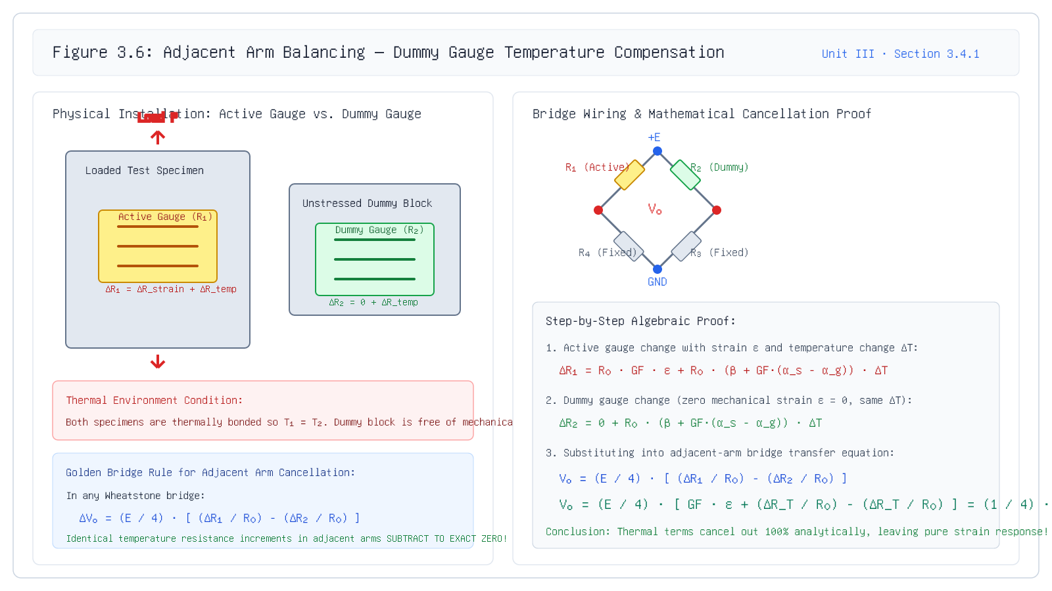
3.4.1 Adjacent Arm Balancing
3.4.1 Adjacent Arm Balancing (Dummy Gauge)
Governing Formula: Δ R_1 - Δ R_2 = (Δ R_mech + Δ R_T) - Δ R_T = Δ R_mech
Unit III · MEC 232 · Er. Saroj Chalise | Slide 27 of 36
Notes:
Direct attention to Figure 3.6. Emphasize that the dummy block must have identical thermal mass and material composition to the active specimen.
[CORE TAKEAWAY]: Adjacent arm balancing cancels temperature drift algebraically by subtracting the response of an identical unstressed dummy gauge.

Slide 28
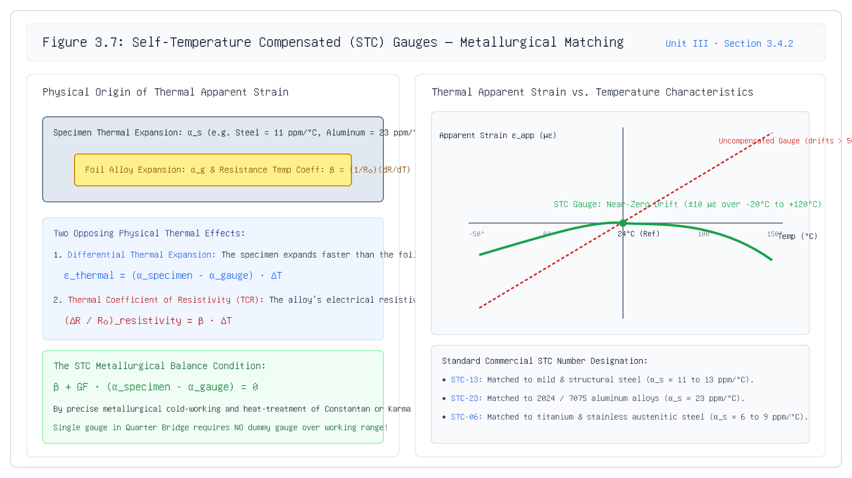
3.4.2 Self-Temperature Compensation
3.4.2 Self-Temperature Compensation (STC)
Governing Formula: β_alloy = -GF · (α_substrate - α_gauge) ⇒ ε_app ≈ 0
Unit III · MEC 232 · Er. Saroj Chalise | Slide 28 of 36
Notes:
Examine Figure 3.7. Point out the characteristic U-curve of STC gauges around room temperature and the disaster of material mismatch.
[CORE TAKEAWAY]: STC gauges eliminate the need for dummy blocks by tailoring the alloy's metallurgical composition to cancel the specific substrate's thermal expansion.

Slide 29
3.4 Comparison
Comparing the Two Compensation Techniques
Engineering selection criteria: Adjacent Arm Dummy Balancing vs Metallurgical STC
Key Takeaway: Use STC gauges for standard alloys; use adjacent arm dummy balancing for non-standard materials or high-temperature testing.
Unit III · MEC 232 · Er. Saroj Chalise | Slide 29 of 36
Notes:
Review this slide carefully: explain why mounting an STC-13 gauge on aluminum creates severe errors because the thermal expansions do not match.
[CORE TAKEAWAY]: Use STC gauges for standard alloys; use adjacent arm dummy balancing for non-standard materials or high-temperature testing.

Slide 30
3.4 Worked Example
Worked Example: Apparent Strain & False Stress
Quantifying temperature drift error on an aluminum beam calibrated at 20°C operating at 45°C
Problem: An uncompensated strain gauge (GF = 2.00, TCR β = +70 ppm/^\circC, α_g = 15 ppm/^\circC) is bonded to an aluminum aerospace beam (α_s = 23 ppm/^\circC, E = 70 GPa). The laboratory calibration is performed at 20°C, but the aircraft operates in desert heat at 45°C (Δ T = +25^\circC). Calculate: 1) The thermal apparent strain ε_app in με. 2) The equivalent false stress σ_false that an uncompensated instrument would report. 3) The result if an STC-23 matched gauge is used instead.
Step 1: Calculate Fractional Resistance Change from Temperature
(Δ R) / (R_0) = [β + GF(α_s - α_g)] Δ T = [70 + 2.00(23 - 15)] × 10^-6 × 25 = 2150 ppm
Compute the combined electrical resistivity shift and differential thermal expansion.
Step 2: Determine Thermal Apparent Strain
ε_app = (Δ R / R_0) / (GF) = (2150 με) / (2.00) = +1075 με
Divide fractional resistance shift by Gauge Factor to find indicated apparent strain.
Step 3: Compute Equivalent Fictitious Stress
σ_false = E · ε_app = (70 × 10^9 Pa) × (1075 × 10^-6) = 75.25 MPa!
In an unloaded beam, the instrument falsely reports over 75 MPa of tensile stress!
Final Answer: ε_app = +1075 με ⇒ σ_false = 75.25 MPa (STC-23 reduces error by 98.6%)
Unit III · MEC 232 · Er. Saroj Chalise | Slide 30 of 36
Notes:
This quantitative example leaves an indelible impression on students: 75 MPa could easily trigger a false structural alarm or mask a genuine overload.
[CORE TAKEAWAY]: Without temperature compensation, thermal apparent strain produces severe false stress readings (over 75 MPa in aluminum for a 25°C rise).

Slide 31
Applications & Chain
Part E: Applications & Complete Signal Chain
From physical force to digital display: Real-world engineering implementations
Core Pedagogical Objective:
Strain gauges serve as the universal primary sensing element across modern industrial instrumentation.
Unit III · MEC 232 · Er. Saroj Chalise | Slide 31 of 36
Notes:
We now conclude Unit III with Section E: Real-world applications, the end-to-end measurement chain, a formative quiz, and master formula review.
[CORE TAKEAWAY]: Strain gauges serve as the universal primary sensing element across modern industrial instrumentation.

Slide 32
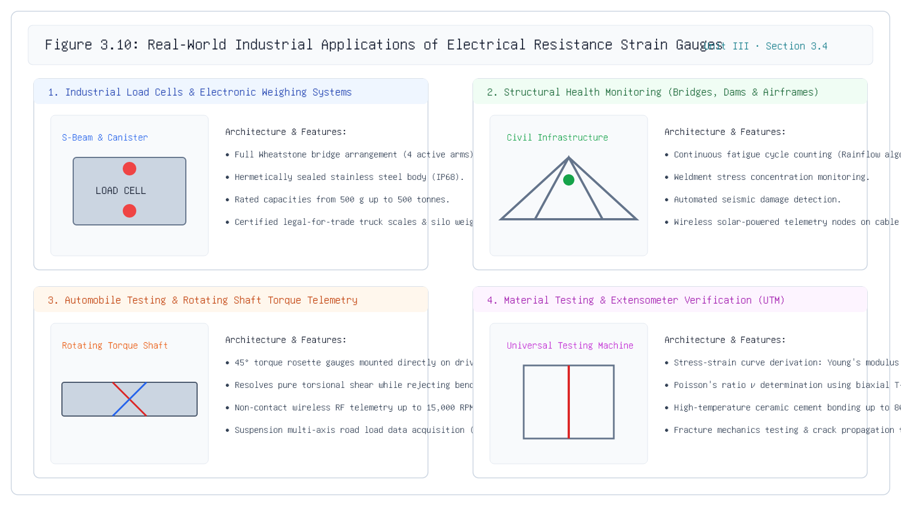
Applications
Real-World Applications of Strain Gauges
Key Insight: Strain gauges power industrial weighing, structural safety monitoring, powertrain vehicle testing, and materials science research.
Unit III · MEC 232 · Er. Saroj Chalise | Slide 32 of 36
Notes:
Review Figure 3.9: 1) S-beam and shear web load cells. 2) Civil bridge structural health monitoring. 3) Rotating shaft torque telemetry. 4) Universal Testing Machine (UTM) tensile stress-strain characterization.
[CORE TAKEAWAY]: Strain gauges power industrial weighing, structural safety monitoring, powertrain vehicle testing, and materials science research.

Slide 33
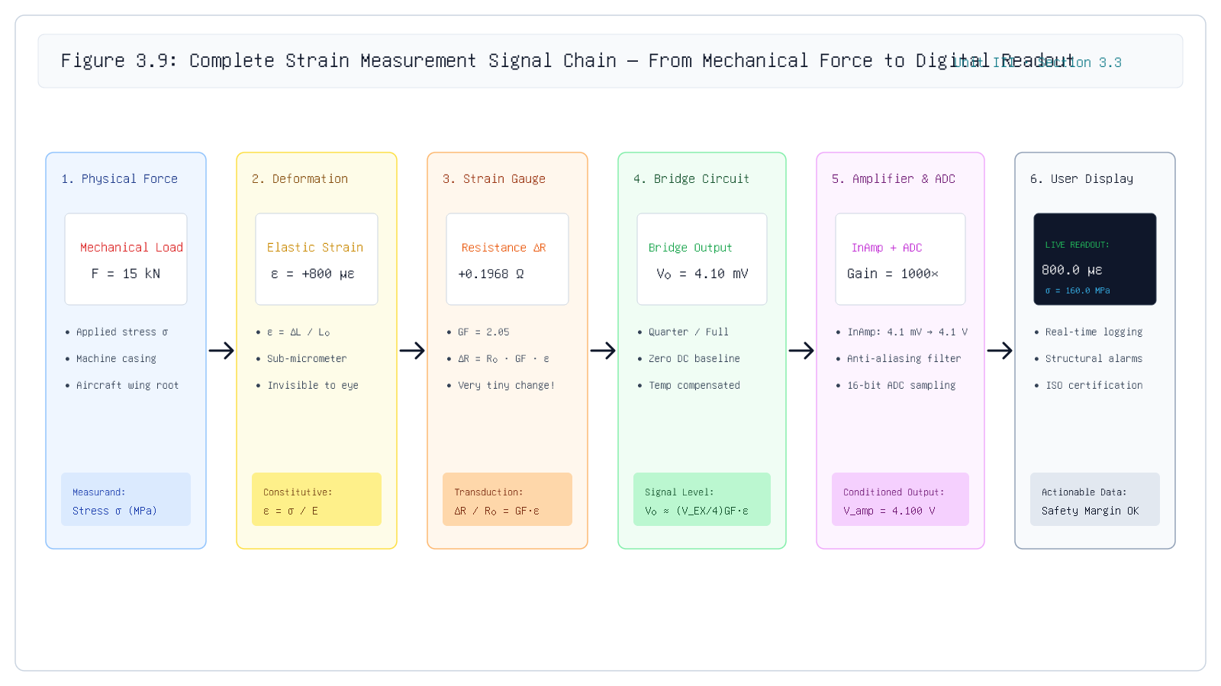
Measurement Chain
The Complete Strain Measurement Chain
Key Insight: Precision strain measurement requires seamless coordination between mechanical coupling, bridge topology, low-noise amplification, and high-resolution ADC conversion.
Unit III · MEC 232 · Er. Saroj Chalise | Slide 33 of 36
Notes:
Direct students to Figure 3.8: 1) Applied Force F. 2) Surface Strain epsilon. 3) Resistance shift Delta R. 4) Wheatstone bridge millivolt output. 5) Instrumentation amplifier & ADC. 6) Real-time PC display.
[CORE TAKEAWAY]: Precision strain measurement requires seamless coordination between mechanical coupling, bridge topology, low-noise amplification, and high-resolution ADC conversion.

Slide 34
Check Understanding
Check Your Understanding: Unit III Assessment
Formative quiz testing core principles of Gauge Factor, bridges, and temperature compensation
Key Takeaway: In half-bridge bending, equal and opposite resistance changes (+ΔR, -ΔR) keep the denominator strictly constant, ensuring perfect linearity.
Unit III · MEC 232 · Er. Saroj Chalise | Slide 34 of 36
Notes:
Have students select their answer before revealing the explanation. Emphasize that the denominator cancellation is a unique property of complementary push-pull configurations.
[CORE TAKEAWAY]: In half-bridge bending, equal and opposite resistance changes (+ΔR, -ΔR) keep the denominator strictly constant, ensuring perfect linearity.

Slide 35
Comprehensive Problem
Comprehensive Worked Numerical Problem
Full-Bridge Cantilever Load Cell: Voltage output, amplifier gain, and resolution calculation
Problem: A cantilever steel load cell (b = 25 mm, h = 10 mm, L = 200 mm, E = 200 GPa) is instrumented with four active 120 Ω strain gauges (GF = 2.10) in a full-bridge bending configuration. The bridge is excited by V_EX = 10.0 V DC. When a test force F = 500 N is applied at the tip: 1) Calculate surface strain ε at the gauge location. 2) Calculate bridge differential output voltage V_0. 3) Determine the amplifier gain required to scale V_0 to 5.0 V full-scale for a 16-bit ADC.
Step 1: Calculate Bending Moment and Surface Strain
M = F · L = 500 × 0.20 = 100 N·m, Z = (b h^2) / (6) = (0.025 × 0.010^2) / (6) = 4.167 × 10^-7 m^3
Calculate the section modulus Z and resulting bending stress σ = M / Z = 240 MPa.
Step 2: Determine Surface Strain ε
ε = (σ) / (E) = \frac240 × 10^6 Pa200 × 10^9 Pa = 1.200 × 10^-3 = 1200 με
Using Hooke's Law: ε = σ / E.
Step 3: Calculate Full Bridge Output Voltage
V_0 = V_EX · GF · ε = 10.0 V × 2.10 × 0.00120 = 25.20 mV
Full bridge provides 4x multiplier: V0 = VEX GF ε.
Final Answer: ε = 1200 με, V_0 = 25.20 mV, G_amp = 198.4
Unit III · MEC 232 · Er. Saroj Chalise | Slide 35 of 36
Notes:
Walk students through the complete mechanical-to-electrical pipeline: Force -> Moment -> Stress -> Strain -> Bridge Output -> Amplifier Gain -> ADC.
[CORE TAKEAWAY]: A full-bridge load cell delivers a robust millivolt signal that maps directly into modern ADC data acquisition hardware.

Slide 36
Master Review
Master Formula Reference & University Exam Review
High-yield summary of Unit III: Strain Gauges | MEC 232 | Pokhara University
• 1. Gauge Factor Definition & Derivation:: GF = (Δ R / R_0) / (ε) = 1 + 2ν + (Δρ / ρ_0) / (ε). For Constantan, GF ≈ 2.1; for Silicon, GF ≈ 120+.
• 2. Ballast Sensitivity:: \eta(m) = (m) / ((1+m)^2). Peak sensitivity \eta = 0.25 occurs at m = R_b / R_g = 1. High DC pedestal requires AC capacitive coupling.
• 3. Wheatstone Bridge Multipliers:: Quarter (V_0 ≈ \fracV_EX4 GF ε), Half Bending (V_0 = \fracV_EX2 GF ε, strictly linear), Full Bending (V_0 = V_EX GF ε, 4x SNR).
• 4. Constant Current 4-Wire Drive:: Δ V_0 = I_0 R_0 GF ε. Zero lead-wire attenuation and strictly linear transfer function.
• 5. Thermal Apparent Strain:: ε_app = [(β) / (GF) + (α_s - α_g)] Δ T. Compensate via adjacent arm dummy balancing (R_1 - R_2) or STC alloy matching (β = -GF(α_s - α_g)).
Key Takeaway: Mastering Gauge Factor, bridge topologies, and temperature compensation enables engineers to design trustworthy load cells and structural health monitoring systems.
Unit III · MEC 232 · Er. Saroj Chalise | Slide 36 of 36
Notes:
Congratulate students on completing Unit III: Strain Gauges. These six principles summarize the entire 6-hour curriculum, all typical exam problems, and industrial transducer best practices.
[CORE TAKEAWAY]: Mastering Gauge Factor, bridge topologies, and temperature compensation enables engineers to design trustworthy load cells and structural health monitoring systems.

