Slide 1
Home
Nav Bar
Logo Carrusel
Toddler
First Four on the database (for the Demo it will be part of the Hard-coded Store, then with Back end it will be part of a Fetch to the Database using the API)
More
Collectibles
More
Board Games
More
Footer

Slide 2
Toy Category
Nav Bar
Logo Jumbotron
All the elements in the Store, conditional rendering based on the product category (for the Demo it will be part of the Hard-coded Store, then with Back end it will be part of a Fetch to the Database using the API)
Toddler
Footer

Slide 3
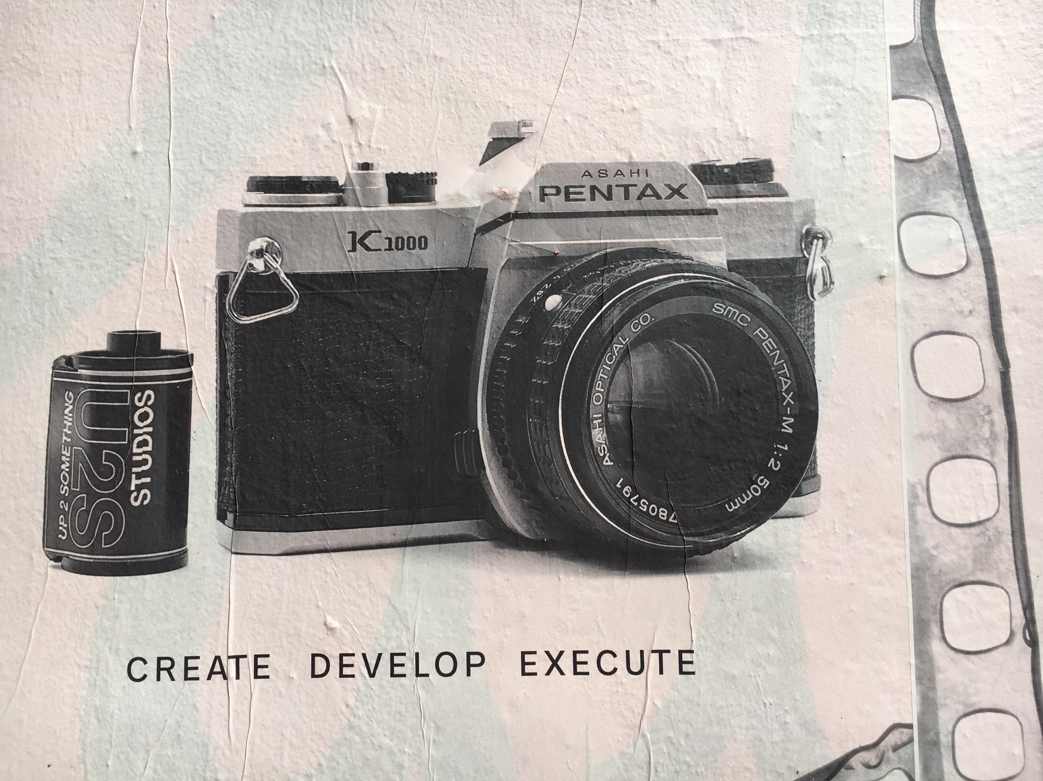
Card Component
Camera
$45
Add to Cart

