Slide 1

NopCommerce Automation Project
Prepared By: Pruthvi Naidu Challa
Techademy Platform

Slide 2
Project Overview
Project Name: NopCommerce Automation Testing
Objective: Build a robust Selenium Test Automation Framework for validating key e-commerce functionalities such as registration, login, search, cart, and wishlist.
Tools & Technologies: Java, Selenium WebDriver, TestNG, Maven, Extent Reports, Eclipse, Jira

Slide 3
Project Structure:
AutomationFramework/
│── pom.xml # Maven configuration file
│
├── src/
│ ├── main/
│ │ └── java/
│ │ └── utilities/ # Utility classes (helpers, config readers, base setup)
│ │
│ └── resources/
│ ├── config.properties # Project configuration (URL, browser, credentials)
│ └── log4j2.xml # Logging configuration
│
├── src/
│ ├── test/
│ │ └── java/
│ │ ├── base/ # Base classes (WebDriver setup, teardown)
│ │ ├── pages/ # Page Object Model classes
│ │ ├── tests/ # TestNG test classes
│ │ └── listeners/ # TestNG Listeners (Extent Reports, Retry logic)
│ │
│ └── resources/
│ ├── testng.xml # TestNG suite file
│ └── testdata/ # Test data files (Excel, JSON, CSV)
│
├── target/ # Auto-generated build output
│ └── extent-reports/ # HTML test reports
│
└── logs/ # Execution logs

Slide 4
Manual Test Cases
TC001: Login
TC002: Register New User
TC003: Search Product
TC004: Add Product to Cart
TC005: Remove Product from Cart
TC006: Update Cart Quantity
TC007: Checkout (Place Order)
TC008: Apply Coupon Code / Gift Card
TC009: View Order History
TC010: Logout

Slide 5
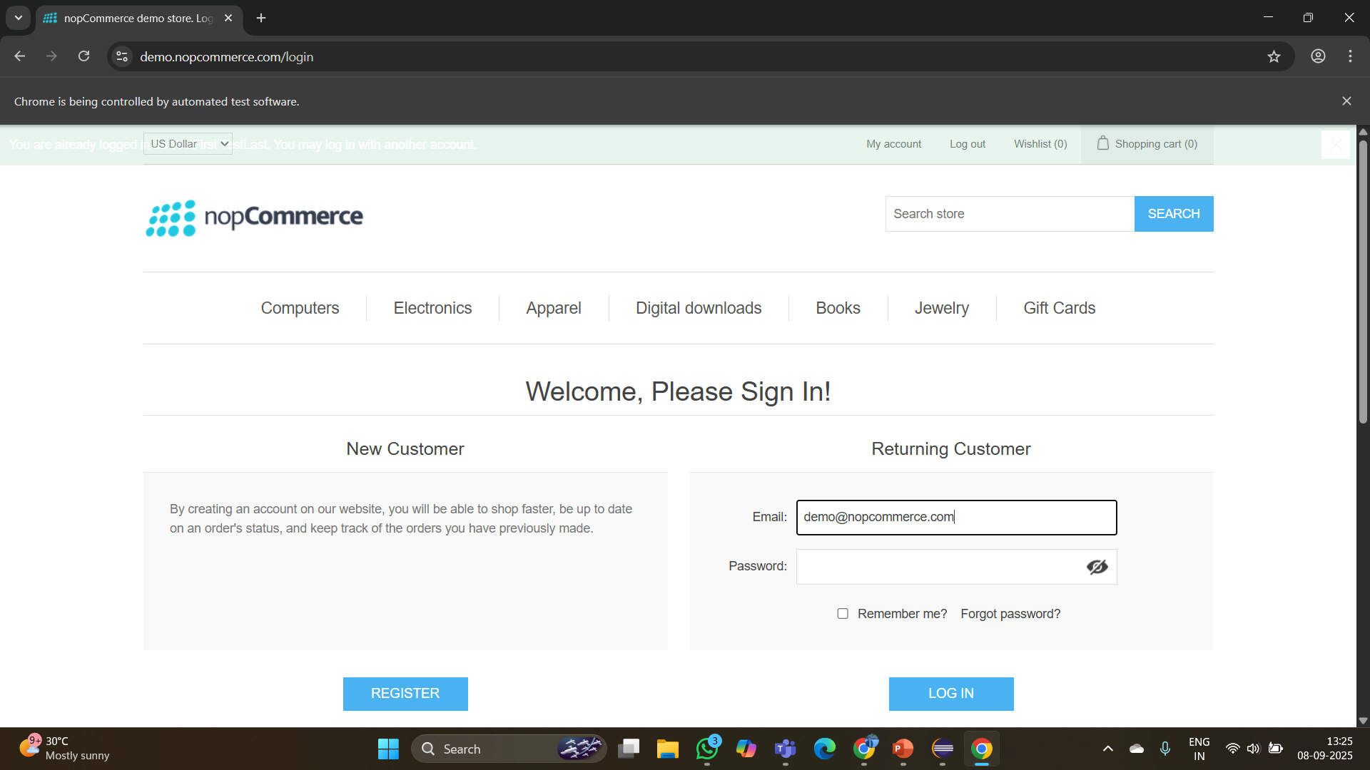
Test Case 1: Login (TC001)

Slide 6
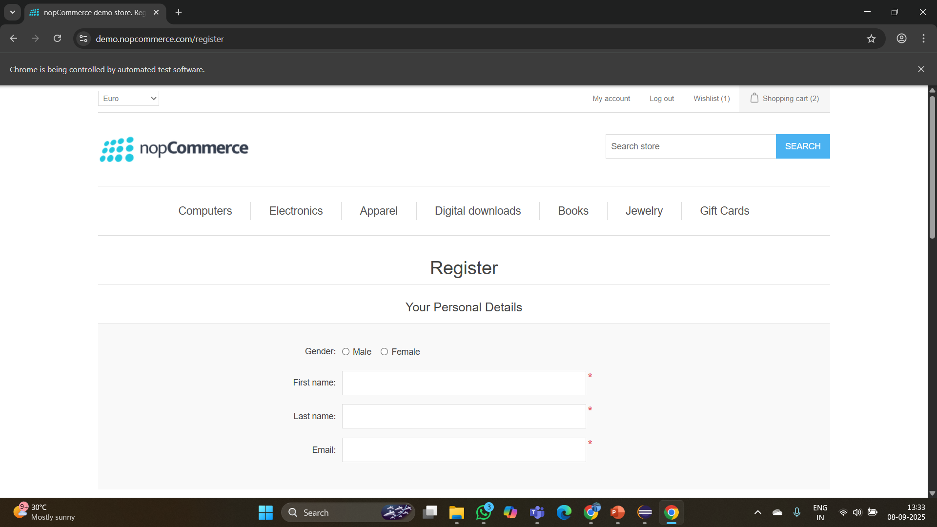
Test Case 2: Register New User (TC002)

Slide 7
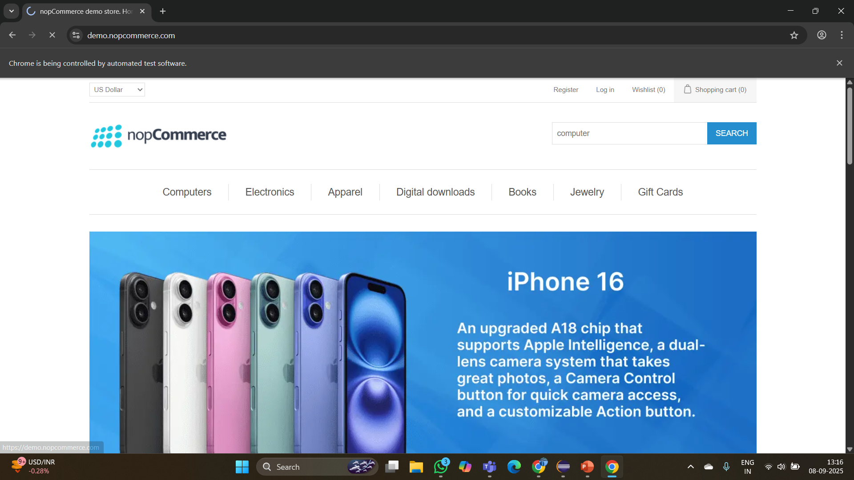

Test Case 3: Search Product (TC003)

Slide 8
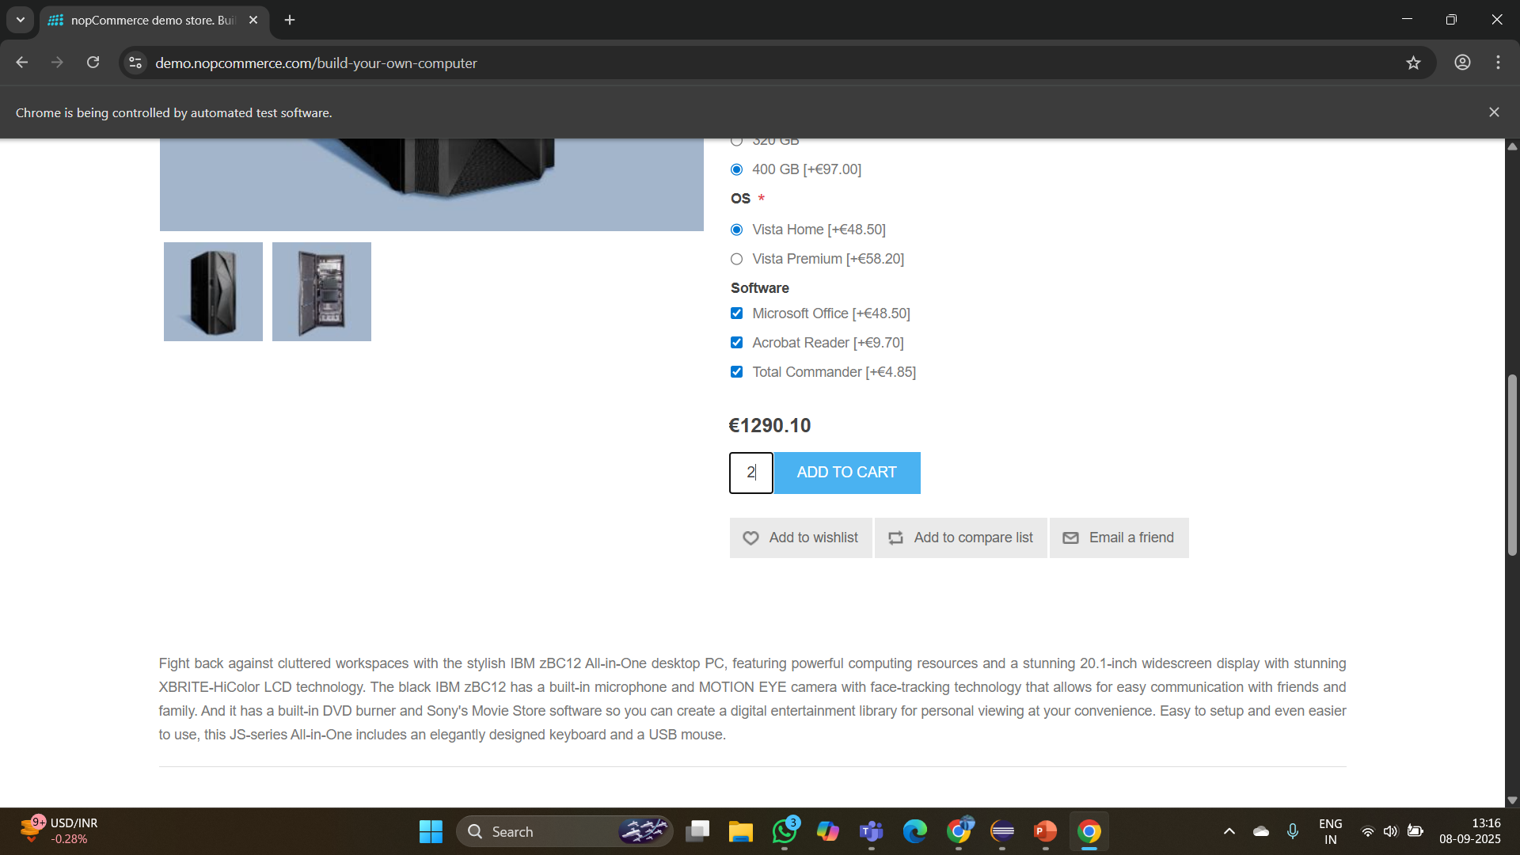


Test Case 4: Add Product to Cart (TC004)
1. Select a product from listing [Insert screenshot]
2. Click Add to Cart [Insert screenshot]
3. Verify product added in Cart [Insert screenshot]

Slide 9
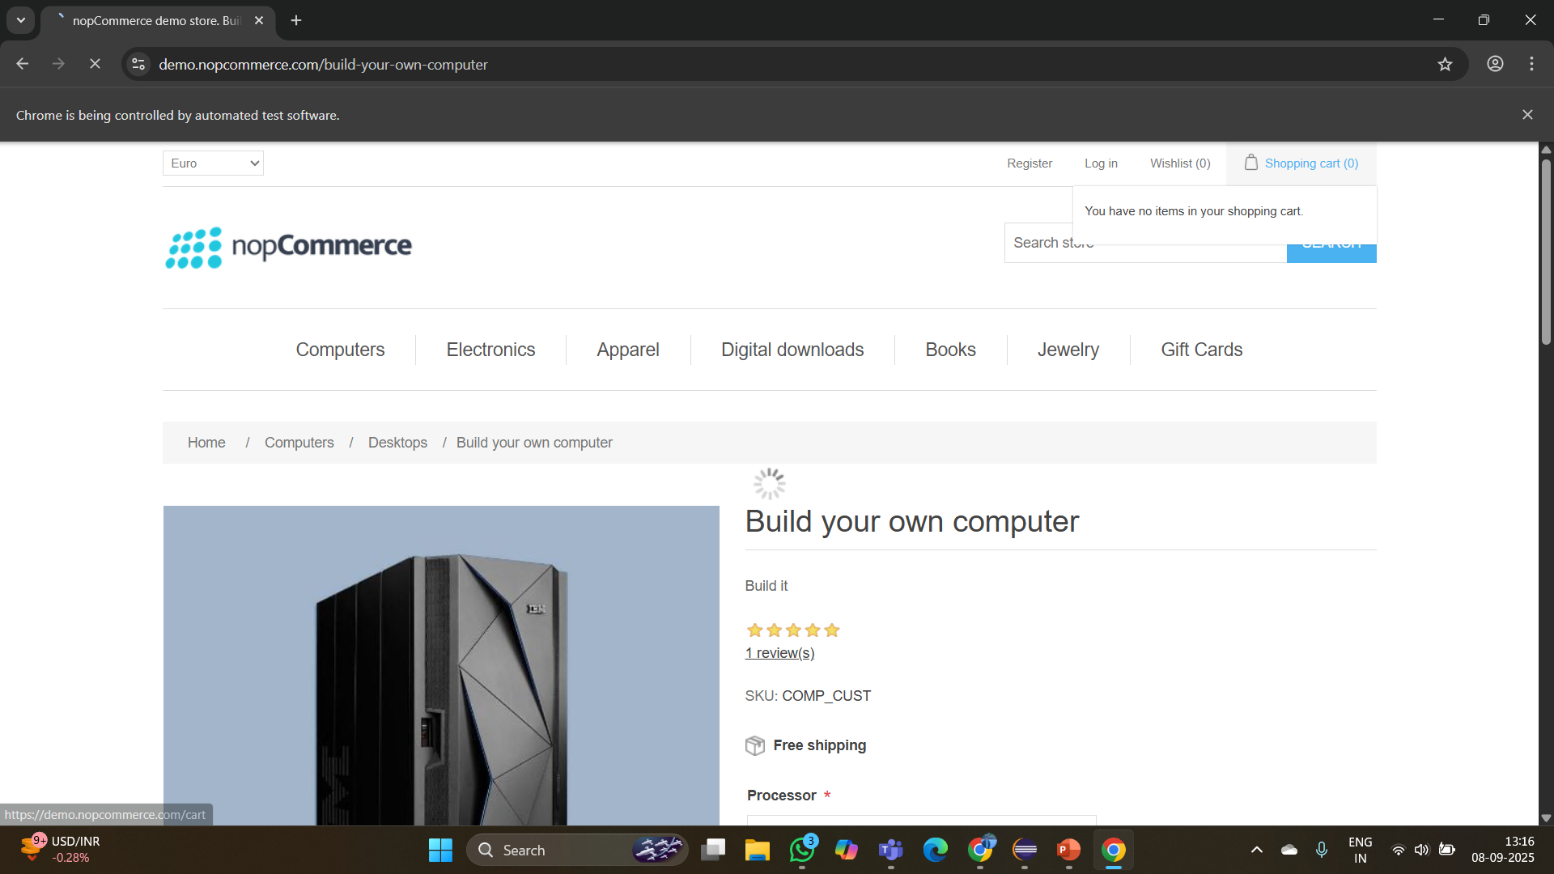





Test Case 5: Remove Product from Cart (TC005)

Slide 10

Test Case 6: Update Cart Quantity (TC006)

Slide 11
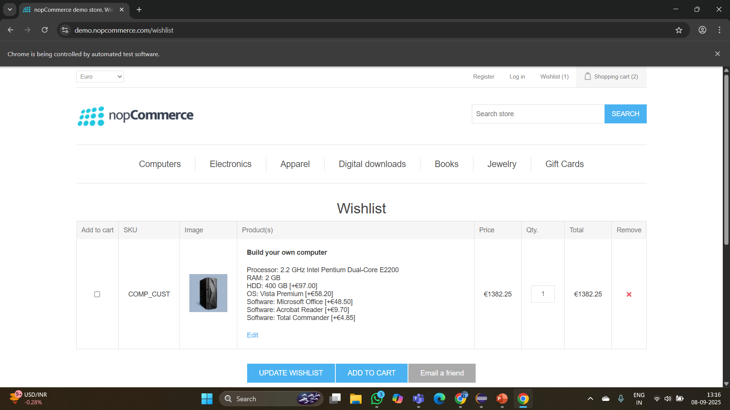
Test Case 7: Checkout (Place Order) (TC007)
1. Navigate to Cart → Click Checkout [Insert screenshot]
2. Enter Billing/Shipping Details [Insert screenshot]
3. Select Payment Method [Insert screenshot]
4. Place Order → Verify success [Insert screenshot]

Slide 12
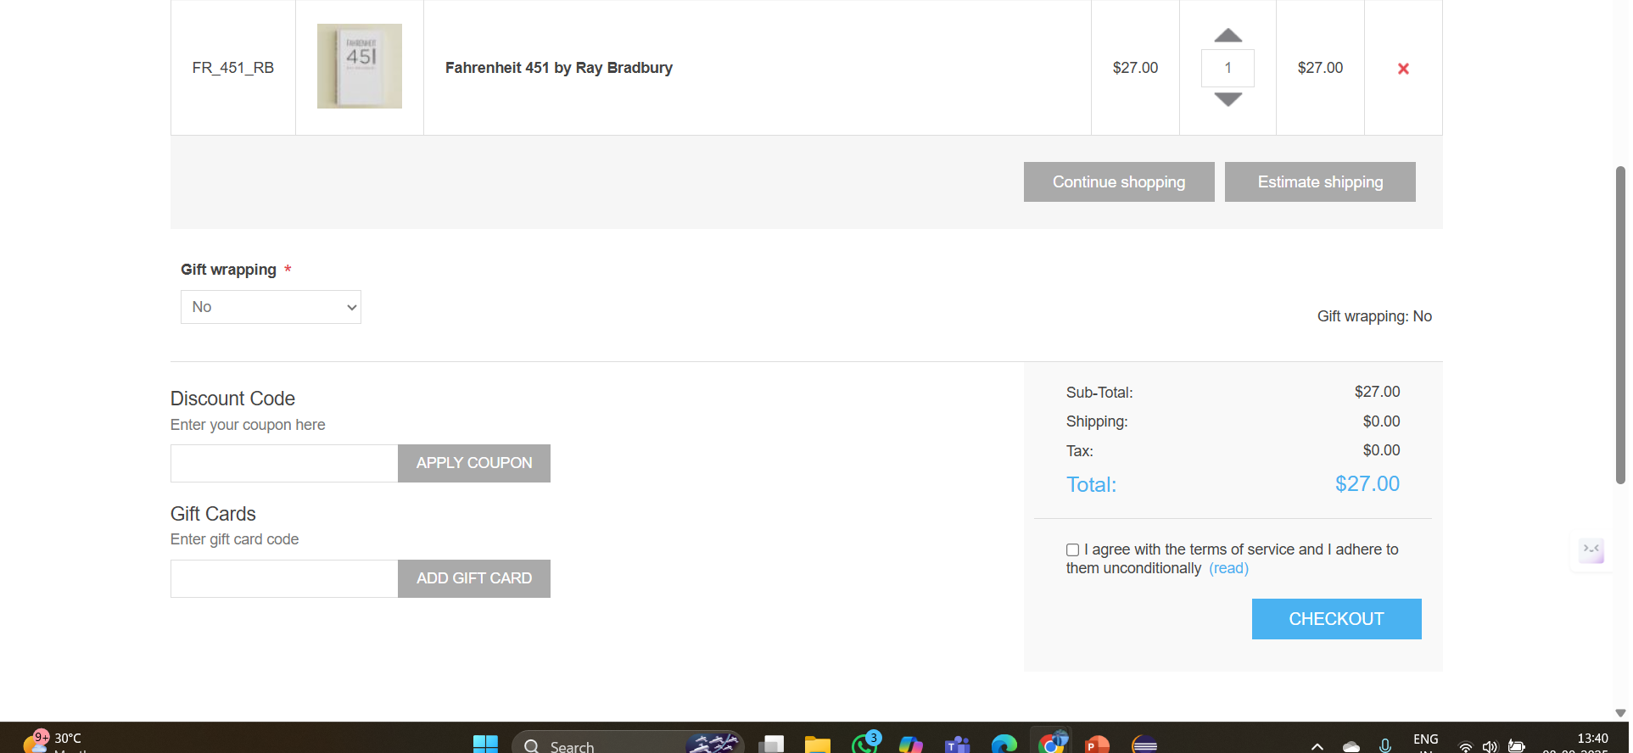
Test Case 8: Apply Coupon Code / Gift Card (TC008)

Slide 13
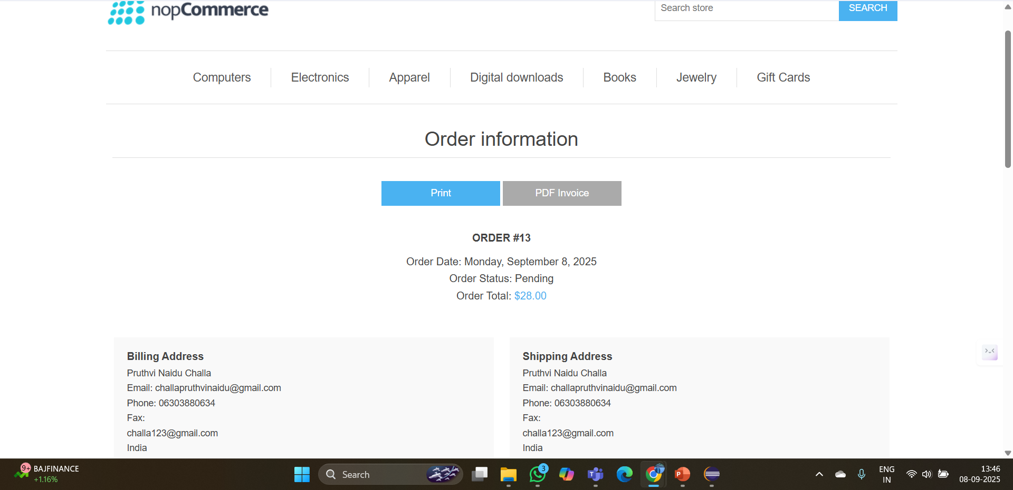
Test Case 9: View Order History (TC009)

Slide 14
Test Case 10: Logout (TC010)

Slide 15
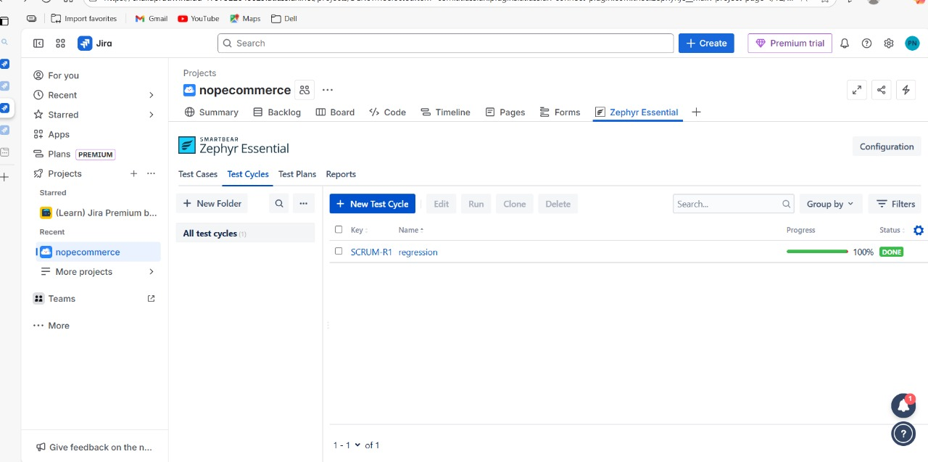
Working with JIRA

Slide 16
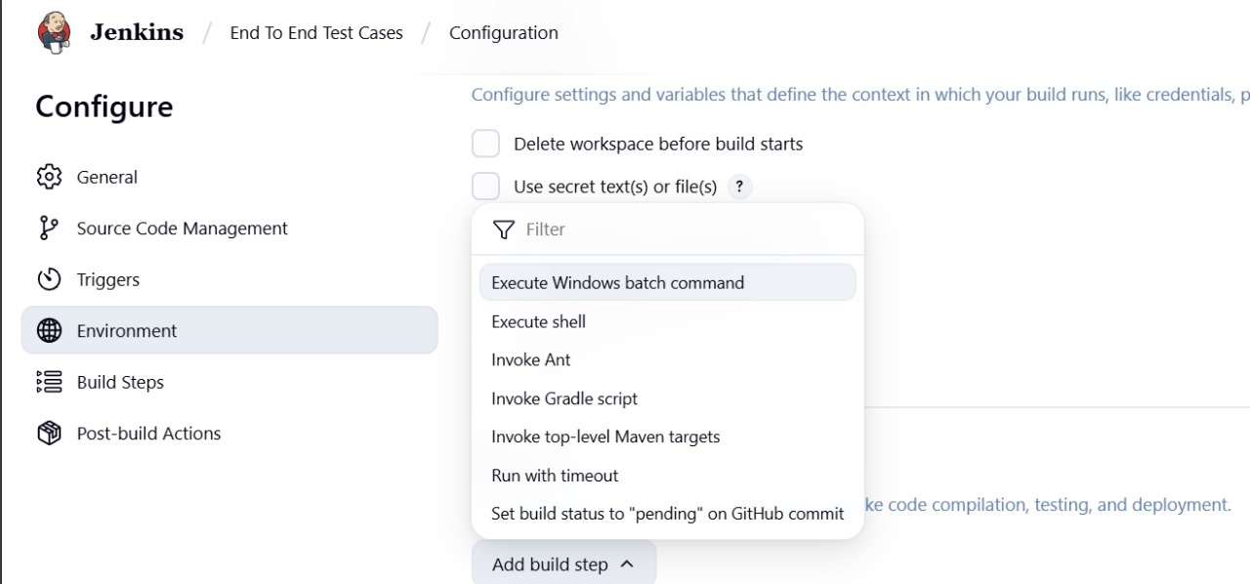
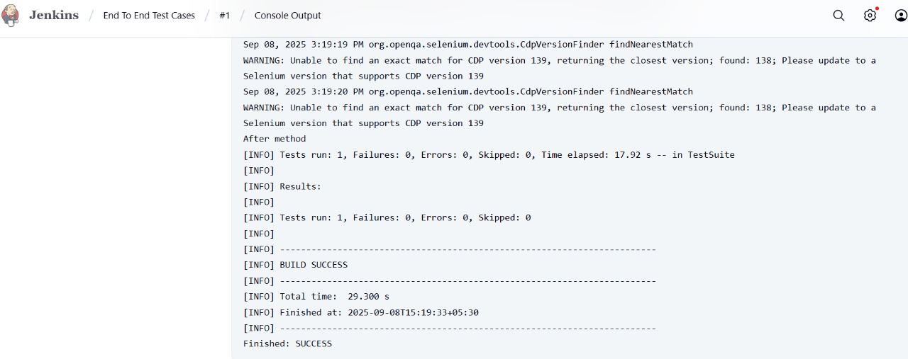
Jenkins :

Slide 17
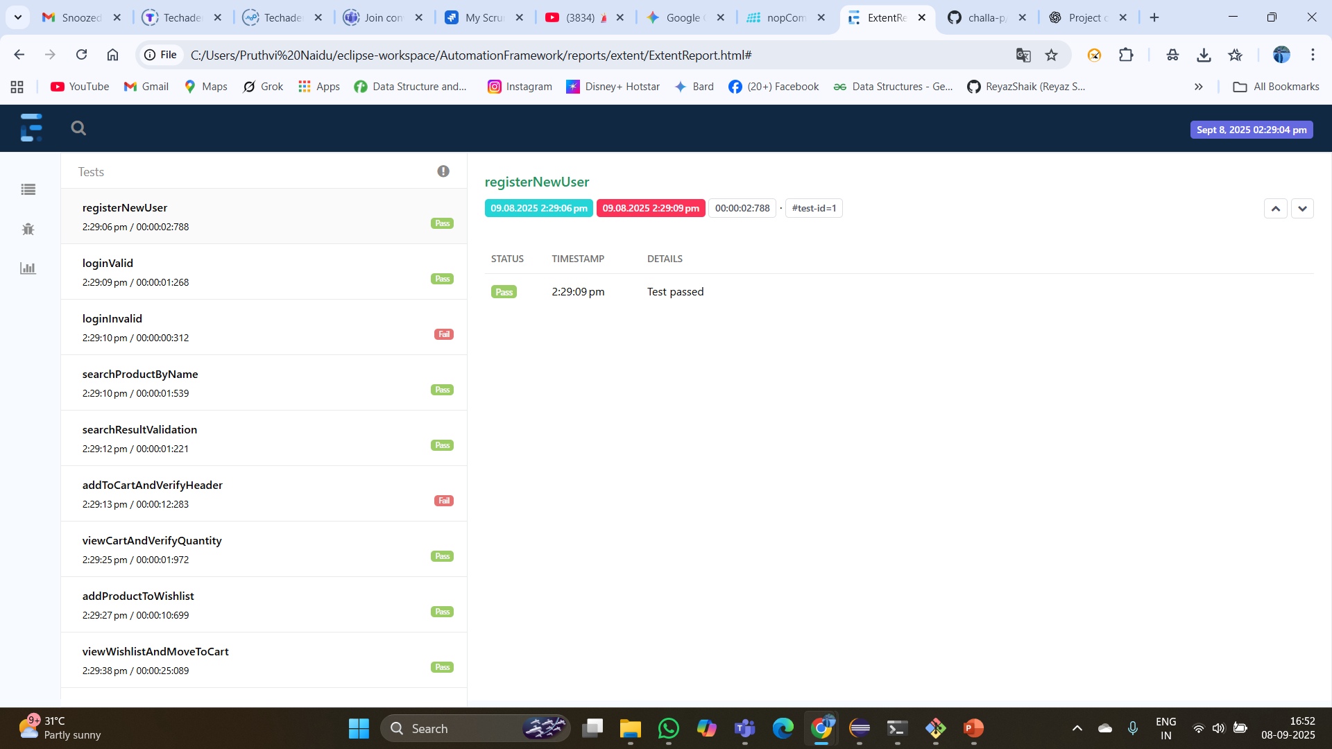
Reports:

Slide 18
Automation Scripts
• LoginTest.java
• RegisterTest.java
• SearchProductTest.java
• AddToCartTest.java
• RemoveFromCartTest.java
• UpdateCartTest.java
• CheckoutTest.java
• CouponTest.java
• OrderHistoryTest.java
• LogoutTest.java

Slide 19
Defect Testcases:
# | TC ID / Test Name | Module / Page | Error (short) | Environment | Time / Session ID | Severity
1 | TC_WL_01 — containsProductTitle | WishlistPage | Timeout waiting for visibility of table.wishlist .product-name a (12s). | Chrome 139 on Windows 11 (Java 21). | Session ID: bb5ed1300097cfdbeedd04e0dd3181ad | High
2 | TC_WL_02 — moveFirstToCart | WishlistPage | Timeout waiting for clickable table.wishlist input[type='checkbox'] (12s). | Chrome 139 on Windows 11 | Session ID: bb5ed1300097cfdbeedd04e0dd318

Slide 20
TestNG :
<!DOCTYPE suite SYSTEM "https://testng.org/testng-1.0.dtd" >
<suite name="NopCommerce Suite" verbose="1" preserve-order="true">
<test name="Smoke">
<classes>
<class name="testcases.RegisterTest"/>
<class name="testcases.LoginTest"/>
<class name="testcases.SearchTest"/>
<class name="testcases.ProductAndCartTest"/>
<class name="testcases.WishlistTest"/>
<class name="testcases.PriceFilterTest"/>
</classes>
</test>
</suite>

Slide 21
GithubLink :
https://github.com/challa-p/CapstoneWiproFinal

Slide 22
Conclusion
• Automation successful for 10 core modules of NopCommerce.
• Tools used: Selenium WebDriver, TestNG, Maven, Extent Reports, Java.
• Ensured coverage of Login, Registration, Cart, Checkout, and Order flows.
• Improved efficiency and reliability of testing process.

