Slide 1
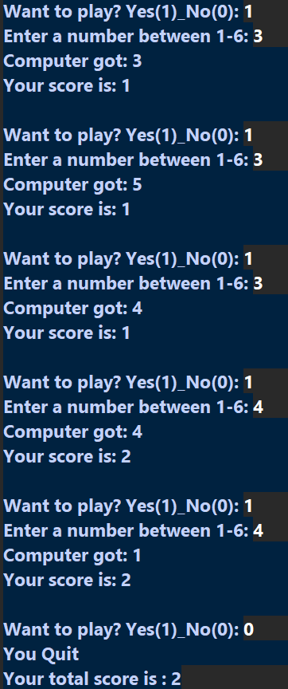
import random
c=0
while True:
d=int(input("Want to play? Yes(1)_No(0): "))
if d==1:
a=int(input("Enter a number between 1-6: "))
b=random.randint(1,6)
if a>=1 and a<=6:
if a==b:
c+=1
else:
pass
print(f"Computer got: {b}")
print(f"Your score is: {c}")
print()
else:
print("Invalid Input")
break
elif d==0:
print("You Quit")
print(f"Your total score is : {c}")
break
else:
print("Invalid Input")
break

