Slide 1
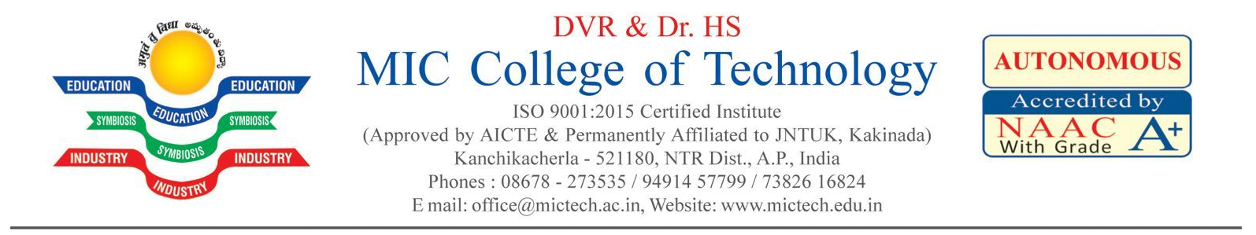
“Soil Moisture Detector Based On IOT”
Submitted By
M.Venkat Rao (22H71A0428)
K.Vinay (22H71A0424)
Sk.Nagoor Vali (22H71A0446)
Ch.pavan (23H75A0406)
Ch.Surya (23H75A0407)
Under the Esteemed Guidance of
Mr.G.V.P Chandra shekar
Associate Professor
DEPARTMENT OF ELECTRONICS AND COMMUNICATION ENGINEERING

Slide 2
CONTENTS
Overview
Community Service Part
Survey
Analysis of the gathered data
Studying about Project
Project Development
Applications
Photos and Video Link

Slide 3
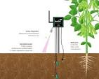
Overview:
An IoT-based soil moisture detector system utilizes sensors to measure soil moisture levels and transmits this data wirelessly to a central system for monitoring and control. This enables farmers and gardeners to optimize irrigation, prevent overwatering or under-watering, and improve crop yields.
Soil Moisture Sensors:
These sensors, typically consisting of probes inserted into the soil, measure the volumetric water content by detecting electrical conductivity or resistance.
Other Sensors (Optional):
Depending on the application, additional sensors like temperature, humidity, and nutrient sensors may be integrated to provide a more comprehensive view of the soil environment.

Slide 4
Community Service Part:
The IoT- enabled sensor is fitted into a pipe with holes and threshold levels are measured. The sensor collects the available soil moisture in real- time and extends advisory to the farmer when to START and STOP irrigating paddy fields.
Soil Monitoring with IoT uses technology to empower farmers and producers to maximise yield, reduce disease and optimise resources. IoT sensors can measure soil temperature, NPK, volumetric water content, photosynthetic radiation, soil water potential and soil oxygen levels. Data from the IoT sensors are then transmitted back to a central point (or the cloud) for analysis, visualisation and trend analysis.
The resultant data can then be used to optimise farming operations, identify trends and make subtle adjustments to conditions to maximise crop yield and quality. The use of IoT in agriculture is known as Smart Agriculture (or Smart Farming), and IoT is a central component of Precision Farming.

Slide 5
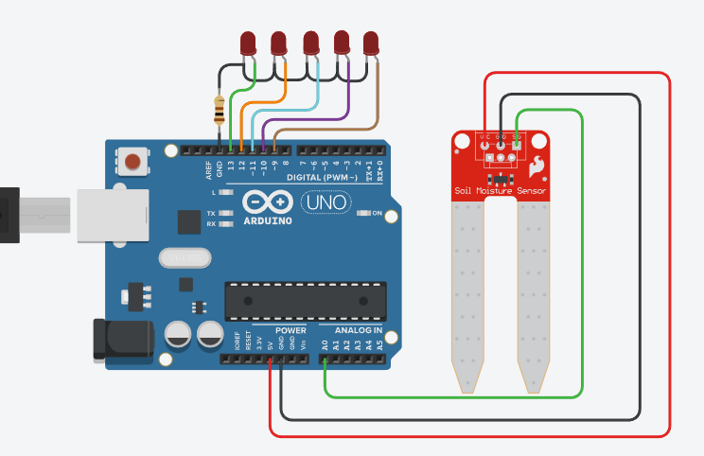
Survey and Questionnarie Format:
A soil moisture detection IoT survey and questionnaire format should focus on gathering information about the needs and experiences of farmers, gardeners, and other potential users of IoT-based soil moisture monitoring systems. The survey should cover topics like current irrigation practices, awareness of soil moisture monitoring benefits, and willingness to adopt new technologies. The questionnaire should be designed to be easy to understand and complete, while also capturing valuable data for understanding the market demand and potential applications of soil moisture monitoring systems.

Slide 6
1. What are the key components of a soil moisture detection IoT system?
Sensors: Soil moisture sensors (e.g., resistive, capacitive, or TDR) that measure the water content in the soil.
Microcontroller: A small computer (e.g., Arduino, Raspberry Pi) that processes data from the sensors.
Wireless Communication Module: Allows the device to transmit data (e.g., Wi-Fi, LoRaWAN, GSM).
Data Platform: A cloud-based platform or local server to store and analyze data.
2. What types of soil moisture sensors are commonly used?
Resistive sensors:
Capacitive sensors:
TDR (Time Domain Reflectometry) .

Slide 7
3. How do I choose the right soil moisture sensor for my application?
Accuracy: Consider the required accuracy for your specific needs.
Cost: Resistive sensors are often more affordable, while TDR sensors can be more accurate.
Measurement Range: Choose a sensor that can measure the desired range of moisture
4. How can I use the soil moisture data collected by an IoT system?
Optimize Irrigation:
Adjust irrigation schedules based on real-time soil moisture readings to prevent overwatering or underwatering.
Improve Crop Yields:
Ensure plants have the optimal amount of water for healthy growth and development.
Conserve Water Resources:
Reduce water waste by irrigating only when necessary.
Track Soil Conditions:

Slide 8
Analysis:
Here's a detailed analysis of soil moisture detector-based IoT systems:Benefits1. Improved Crop Yields: Optimal soil moisture levels lead to healthier crops and increased yields.2. Water Conservation: Precise irrigation scheduling reduces water waste and conserves this precious resource.3. Reduced Energy Consumption: Optimized irrigation systems consume less energy, reducing costs and environmental impact.4. Enhanced Decision-Making: Real-time data enables farmers to make informed decisions about irrigation, fertilization, and pest management.Key Components1. Soil Moisture Sensors: Measure soil moisture levels using various technologies (e.g.,
.

Slide 9
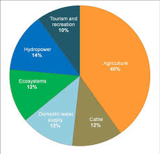

Slide 10
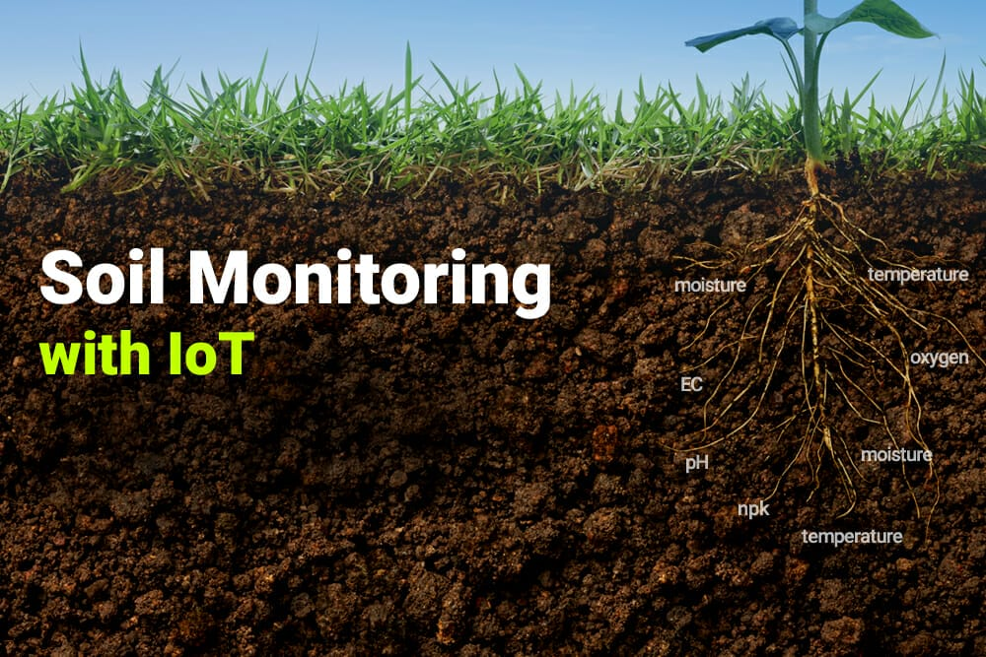
Study About Project:
The moisture content of soil can also be monitored using buried probes with electrodes. In hydrology, soil science and agricultural moisture content play a vital role in soil chemistry, plant growth and groundwater recharge. Soil moisture content is essential for several reasons:
Water in the soil serves as a critical nutrient for all crops and plants.
Water is an essential component of photosynthesis.
Crop yield is heavily influenced by the availability of water in the soil.
Soil water is an important carrier of soluble food nutrients for plant growth.
Soil water helps regulate soil temperatures.

Slide 11
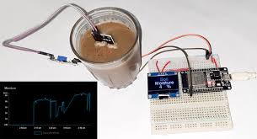
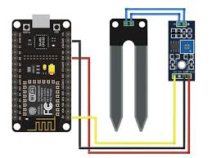

Slide 12
Applications:
Precision Agriculture: Enables precision agriculture by providing accurate soil moisture data.
2. Smart Irrigation: Optimizes irrigation systems by detecting soil moisture levels.
3. Crop Management: Helps farmers make informed decisions about crop management.

Slide 13
Thank You

