Slide 1









Shared Memory Data Exchange System
Stop copying data. Start sharing it.
2520090083-Sampati Varun Sridhar Reddy
2520090075-B Guru Sai
252008002-C.V Jaswanth Reddy
TEAM-24
Notes:
Open with the hook: every time two local processes talk through a pipe or socket, the data gets copied through the kernel. We removed that step. Introduce the team and the one-line promise: stop copying data, start sharing it.

Slide 2

Introduction
Inter-Process Communication (IPC) is a mechanism that allows independent processes to exchange information and coordinate their activities.
Shared memory is one of the fastest IPC mechanisms because multiple processes can access a common memory region.
This project implements a Shared Memory Based Data Exchange System using C programming and Linux system calls. It demonstrates two-way communication between a parent process and a child process.
The parent sends a message to the child, and the child sends a reply back through the same shared memory segment.
Notes:
Pipes, sockets and message queues all push data through the kernel: one copy in, one copy out, plus system calls on every message. That is fine for small, rare messages, but it becomes the bottleneck as payload size and message rate grow.

Slide 3
Probem Statement & Objectives
Processes in an operating system generally have separate address spaces, which makes direct data exchange difficult.
A suitable Inter-Process Communication mechanism is required to transfer information between processes efficiently.
The proposed system uses shared memory to provide a common communication region for a parent and child process, enabling message exchange with basic coordination and resource cleanup.
Objectives
  To understand Inter-Process Communication in Linux.
  To create and manage shared memory using System V IPC.
  To create a child process using the fork() system call.
  To implement two-way communication between parent and child processes.
  To coordinate message exchange using status flags.
  To release shared memory resources after communication.
Notes:
Pipes, sockets and message queues all push data through the kernel: one copy in, one copy out, plus system calls on every message. That is fine for small, rare messages, but it becomes the bottleneck as payload size and message rate grow.

Slide 4
Existing System vs Proposed System
Existing System
  Processes have separate address spaces by default.
  Data exchange requires a suitable IPC mechanism.
  Communication may involve intermediate channels or additional data copying.
Proposed System
  Uses System V shared memory for data exchange.
  Enables parent-to-child and child-to-parent communication.
  Uses shared message buffers and status flags.
  Demonstrates process creation, coordination, and memory cleanup.
Outcome: A simple, interactive demonstration of two-way IPC using shared memory.
Notes:
The core idea: map the same region of memory into both processes. Data is written once and read in place. We built it on POSIX shared memory with semaphores, and the three features at the bottom are what make it usable: a ring buffer for streaming, safe concurrent access, and clean teardown.

Slide 5
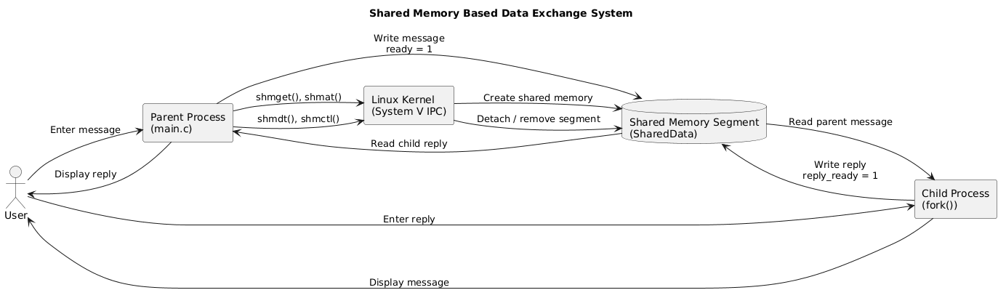
Stystem Architecture
Notes:
Walk left to right. The producer creates and initializes the segment, the consumer attaches to it. In the middle is the shared region: a ring buffer plus three semaphores (empty, full, mutex). The kernel only sets up the mapping at the start. Tech stack: C, POSIX shared memory and process-shared semaphores on Linux.

Slide 6
Technologies & Libraries Used
Technologies
  Programming Language: C
  Operating System: Linux / Ubuntu
  Compiler: GCC
  Build Tool: GNU Make
  IPC Technique: System V Shared Memory
Libraries and Header Files
  stdio.h — Input/output operations
  string.h — String manipulation
  sys/ipc.h — IPC definitions
  sys/shm.h — Shared memory system calls
  sys/wait.h — Child process waiting
  unistd.h — Process creation and system interfaces
  sched.h — Processor scheduling interface
  shared.h — Custom shared data structure
Notes:
This is the classic bounded-buffer pattern. Producer waits on 'empty', takes the mutex, writes and advances the in index, releases the mutex and posts 'full'. The consumer mirrors that with 'full' and 'empty'. The ring buffer below shows in and out chasing each other around the slots.

Slide 7
Important System Calls
Important System Calls
System Call / FunctionPurpose
shmget()
Creates a shared memory segment
shmat()
Attaches shared memory
fork()
Creates a child process
sched_yield()
Yields processor time while waiting
waitpid()
Waits for child termination
shmdt()
Detaches shared memory
shmctl()
Controls shared memory and requests removal
These system calls form the core of the shared memory communication workflow.
Notes:
The chart shows the structural difference: pipes, sockets and message queues copy each message through the kernel, shared memory does not. For the live talk, add your own measured throughput and latency results for pipe vs Unix socket vs shared memory at 64 B, 4 KB and 1 MB, and show the gap widening with message size.

Slide 8
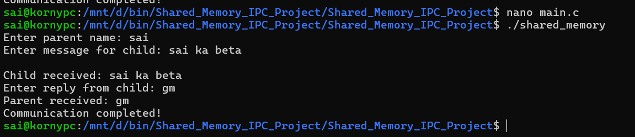
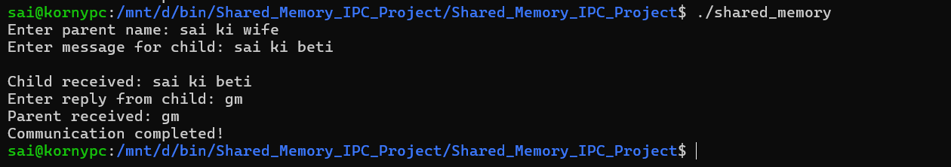
Sample outputs
Notes:
Three directions. Scale: multiple producers and consumers, and a lock-free ring buffer. Harden: crash recovery, detecting stale segments, permissions and validation. Extend: two-way exchange and language bindings so other teams can adopt it easily.

Slide 9

Conclusion
The Shared Memory Based Data Exchange System demonstrates Inter-Process Communication using System V shared memory in Linux.
The project enables a parent process to send a message to a child process and receive a reply through a common memory region.
It demonstrates shared memory creation, process creation using fork(), message exchange, basic synchronization, and resource cleanup.
This project provides practical knowledge of Linux system programming and IPC mechanisms.
Notes:
Three things to remember: shared memory is the fastest local IPC, synchronization is what makes it safe, and we have a working implementation.

Slide 10
THANK YOU
Notes:
Prepared answers. Threads: processes give isolation and independent lifecycles or languages. Crash mid-write: the mutex could be left held, so a future version adds recovery and robust synchronization. Versus sockets or file-backed mmap: shared memory skips the kernel copy; file-backed mmap adds file semantics you don't need here.

