Slide 1

E-Commerce Customer & Sales Analytics
KLH UNIVERSITY
Final Project Review | Department of CSE | KLH UNIVERSITY
TEAM MEMBERS
2420030629 – CH. HARINI
2420030426 – B. NAGESHWARI
2420030086 – R. ANANYA
Guide: DR. N. SUNANDA | Academic Year: 2025–2026
Notes:
Title slide. Replace all bracketed text. Use the full project title, list every team member with registration number, and name your guide. Insert the institution logo in the dashed box.

Slide 2
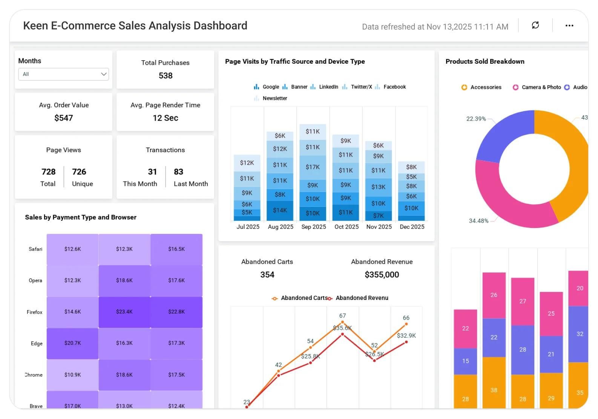



Introduction & Problem Statement
Interactive sales analytics dashboard
Background
E-commerce platforms generate large volumes of customer, product and transaction data. Analyzing this information helps businesses understand buying behaviour, monitor sales trends and improve profitability.
Problem Statement
Businesses often find it difficult to convert large sales datasets into clear decisions. This project analyzes customer behaviour, sales performance, product categories and regional trends through an interactive analytics dashboard.
Motivation / Need
The dashboard brings important business metrics into one place, helping users identify high-performing categories, compare regions, detect unusual profit values and make data-driven decisions.
Notes:
State the domain, the exact problem and why it matters. Keep it to about 2 minutes. Add one real-world statistic if you can, with a citation.

Slide 3


Objectives & Scope
Objectives
1
Analyze sales, profit and order trends over time.
2
Explore customer purchasing behaviour and customer-level patterns.
3
Compare product categories, regions and customer contributions.
4
Build an interactive dashboard with filters, KPIs and visual insights.
Notes:
Objectives should be measurable and start with action verbs. The scope slide tells the panel what you did and did not attempt.

Slide 4

Literature Survey
S.No | Author(s) & Year | Method / Technique | Key Findings | Limitation / Gap
1 | Verhoef et al. (2015) | Omni-channel retail analysis | Digital channels influence customer behaviour and purchase decisions. | Limited integrated sales and product performance analysis.
2 | Akter & Wamba (2016) | Big data analytics review | Analytics can improve e-commerce performance and decision-making. | Broad focus; limited operational customer-sales integration.
3 | Wedel & Kannan (2016) | Marketing analytics | Data analytics supports personalization and marketing decisions. | Does not provide one complete sales analytics workflow.
4 | Gomes & Meisen (2023) | Customer segmentation / clustering | RFM and clustering help understand customer groups. | Focuses more on segmentation than overall sales performance.
Research Gap
Existing work often examines customer segmentation, marketing analytics or sales trends separately. This project combines sales KPIs, customer and regional views, category performance, profit distribution and interactive filtering in one dashboard.
Notes:
Summarise four to six relevant papers or existing systems. End with the research gap, because that gap justifies your project.

Slide 5





Proposed System & Methodology
STEP 1
STEP 2
STEP 3
STEP 4
STEP 5
Define Problem
Collect Data
Design
Implement
Test & Evaluate
Identify customer behavior, sales trends, and business performance analysis requirements
Load the Superstore CSV dataset and inspect its fields.
Check data types, missing values and duplicates; derive sales and profit summaries.
Build interactive charts, filters and KPI cards using Python and Streamlit.
Check filter behaviour, calculations, chart outputs and dashboard usability.
Key Novelty / Contribution
Provides an integrated analytics solution to understand customer purchasing behavior, identify sales trends, and generate actionable business insights through interactive dashboards.]
Notes:
Walk through the five steps left to right. Rename the steps to match your project (for example, Requirement Analysis, Design, Coding, Testing, Deployment). End with your novelty.

Slide 6
System Architecture
DATA SOURCE
Kaggle Superstore CSV
↓
DATA PROCESSING
Pandas · NumPy · Cleaning · Aggregation
↓
ANALYSIS
KPIs · Customer patterns · Sales & profit trends
↓
DASHBOARD OUTPUT
Streamlit · Interactive charts · Filters
Components
1
1 Data Input
CSV upload and sample dataset
2
2 Data Processing
Validation, cleaning and transformation
3
3 Analytics Engine
KPIs, grouping and outlier analysis
4
4 Visualization Layer
Charts, filters and dashboard
Notes:
Insert a clear block diagram: input, processing, storage, output. Number each block and explain them on the right. Redraw the figure yourself rather than copying it.

Slide 7


Hardware & Software Requirements
Hardware
Software & Tools
Libraries / Frameworks
Processor: Intel Core i5 or above
RAM: Minimum 8 GB
Storage: 256 GB SSD
GPU: Not required
OS: Windows 10/11
Python 3.11
VS Code
Streamlit
Pandas & NumPy
Plotly / charting tools
Streamlit
CSV data handling
Deployment / Platform: Local machine · Streamlit app · VS Code
Notes:
List only what you actually used, with versions. For a pure software project, shorten the hardware list and add cloud or deployment resources.

Slide 8
Dataset / Data Understanding
Dataset fields include Order Date, Customer ID, Region, Category, Sales, Quantity, Discount and Profit.
9,994
21
Records (rows)
Features (columns)
Verify on upload
N/A
Missing values
Target classes
Source: Kaggle – Sample Superstore dataset
Features: Order, customer, region, category, sales, quantity, discount and profit fields.
Quality: Validate missing values, duplicates, data types and date formats after loading.
Notes:
Explain where the data came from and what it contains. Show a screenshot of the first rows or the info summary. For non-data projects, replace this slide with “Requirement Analysis” or “Input Specification”.

Slide 9



Data Preprocessing & Exploratory Analysis
EDA: Sales and profit distributions
EDA: Regional/category comparisons and profit outliers
Cleaning
Transformation
Feature Selection
Inspect null values, duplicates, invalid dates and numeric ranges; retain genuine loss-making transactions.
Parse dates, standardize column names and create month/year fields for trend analysis.
Select date, customer, region, category, sales and profit fields for business analysis.
Notes:
Show two or three plots that tell a story: distributions, correlations, outliers. Explain what each plot told you and what you did about it.

Slide 10
Module-wise Description
1
Dataset Loading & Filters
2
Data Preparation
Purpose: Load CSV and apply date, region and category filters.
Input → Output: CSV → filtered records.
Developed by: CH. Harini
Purpose: Validate data and prepare date/numeric fields.
Input → Output: raw data → analysis-ready data.
Developed by: B. Nageshwari
3
Sales & Customer Analytics
4
Dashboard & Insights
Purpose: Calculate KPIs and summarize customer, category and region performance.
Input → Output: records → business metrics.
Developed by: R. Ananya
Purpose: Display trends, profit distribution and key observations.
Input → Output: metrics → interactive dashboard.
Developed by: Team
Notes:
Divide the project into three to five modules. For each, state its purpose, inputs, outputs and who built it. Duplicate a card if you have more modules.

Slide 11

Algorithms & Technologies Used
Exploratory Data Analysis
KPI & Aggregation Analysis
Interactive Visualization
Exploratory Data Analysis (EDA)
Why chosen
Reveals trends, distributions and unusual values.
Key parameters
Group by date, region, category and customer; aggregate Sales and Profit.
KPI & Aggregation Analysis
Why chosen
Summarizes business performance in clear measures.
Key parameters
Total Sales, Total Profit, Orders, Customers, Average Order Value and Profit Margin.
Interactive Visualization
Why chosen
Makes results easy to explore through charts and filters.
Key parameters
Streamlit dashboard; date, region and category filters; line, bar, donut and histogram charts.
Selection criteria: Clear business insights · correct aggregation · interactive filtering · ease of use
Notes:
Name each model, algorithm or technology, say why you chose it, and list the key settings. Then explain how you picked the final one.

Slide 12
Implementation / Model Building
Feature Selection
Code snippet / pseudocode
Order date, region, category, customer, sales, quantity, discount and profit.
df = pd.read_csv(uploaded_file)
df['Order Date'] = pd.to_datetime(df['Order Date'])
sales = df['Sales'].sum()
profit = df['Profit'].sum()
orders = df['Order ID'].nunique()
customers = df['Customer ID'].nunique()
Preprocessing Pipeline
Load CSV → inspect schema → validate values → parse dates → filter records → aggregate KPIs.
Data Splitting
Not a supervised model. The dashboard analyzes selected data directly; no train/test split is used.
Configuration
User-selected date range, regions and product categories; metrics recalculate based on active filters.
Notes:
Describe the build in the order you did it. Paste only the most important code or pseudocode, not entire files. For hardware projects, show the circuit or wiring summary instead.

Slide 13
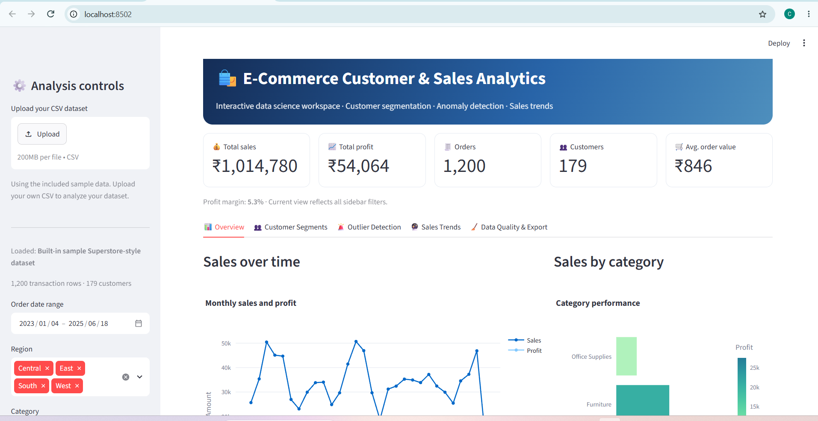
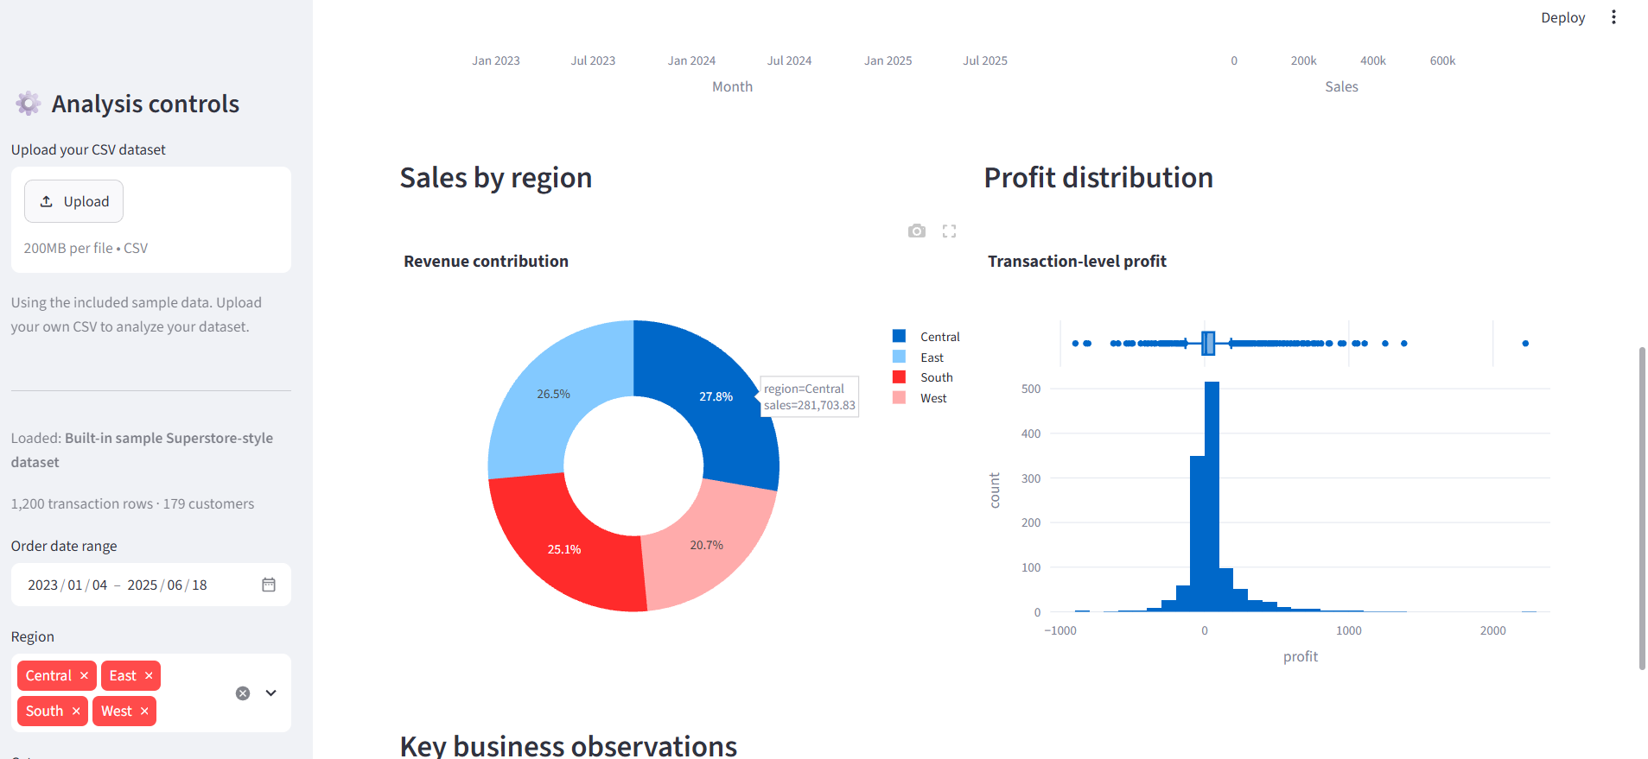
Working Prototype / Output Screens
DASHBOARD FEATURES
• CSV upload (up to 200 MB)
• Date-range filtering
• Region and category filters
• Sales and profit KPIs
• Customer segmentation view
• Outlier detection
• Monthly sales trends
• Data quality and export
Dashboard Overview
KPI cards, monthly sales and category performance.
Regional & Profit Analysis
Regional revenue share and transaction-level profit distribution.
Key Interactive Features
Upload, filter, explore and export analytical results.
Notes:
Show real screenshots, photos of the hardware or a short demo video link. Caption each one with what the viewer should notice.

Slide 14
Results & Performance Comparison
Metric | Dashboard Value | Meaning | Source
Total Sales | ₹1,014,780 | Revenue in current dashboard view | Screenshot
Total Profit | ₹54,064 | Profit in current dashboard view | Screenshot
Orders | 1,200 | Transactions displayed | Screenshot
Customers | 179 | Unique customers displayed | Screenshot
Avg. Order Value | ₹846 | Average order value displayed | Screenshot
Current dashboard view: Profit margin = 5.3% | Average order value = ₹846
Values shown are from the submitted dashboard screenshots and reflect the active sample-data view.
Notes:
Right-click the chart and choose Edit Data to enter your real numbers. Replace the metrics with the ones that fit your project (accuracy, latency, power, throughput, user rating). State clearly which option performed best.

Slide 15
Analysis & Key Findings
Dashboard evidence
Monthly sales & profit trend
Sales by category and region
Profit distribution
5.3%
Profit margin in current dashboard view
Interpretation: Dashboard reports ₹1,014,780 sales and ₹54,064 profit in the displayed view.
Error analysis: Profit distribution includes negative and unusually high transaction values.
Key drivers: Date, region, category, customer, sales and discount.
Notes:
Explain what the numbers mean. Use a confusion matrix, ROC curve, feature-importance chart or output comparison. Be honest about weak results; panels value that.

Slide 16

Testing & Validation
Test ID | Test Description | Expected Result | Actual Result | Status
TC-01 | Load sample CSV | Dataset loads successfully | Dashboard shows 1,200 rows | Observed
TC-02 | Apply region filter | KPIs/charts update | Region selection is available | Observed
TC-03 | Apply date range | Only selected dates are analyzed | Date-range control is available | Observed
TC-04 | Review KPI cards | Sales, profit and order metrics display | KPI cards visible in screenshot | Observed
Functional Testing
Validation Method
Performance Testing
Checked CSV loading, filters, KPI cards and chart rendering.
Compared dashboard values with visible KPI cards and chart outputs.
Verified that controls and visualizations are available in the running local dashboard.
Notes:
List representative test cases with expected and actual outcomes. Name the validation methods you used. Delete rows you do not need.

Slide 17


Challenges & Limitations
Challenges Faced
Limitations
• Data cleaning → Validate missing values, duplicates and data types.
• Data filtering → Ensure selected dates, regions and categories affect the view.
• Data visualization → Present multiple metrics without overcrowding the dashboard.
Data availability – Findings depend on the uploaded or included dataset.
Data accuracy – Incorrect or incomplete records can affect KPI values.
Sample view – Screenshots show a built-in sample-data view, not necessarily the full Kaggle dataset.
Generalization – Results may differ with another uploaded CSV.
Notes:
Be candid. Pair every challenge with how you solved it, and list limitations that the panel would otherwise spot themselves.

Slide 18

Conclusion
Developed an interactive E-Commerce Customer & Sales Analytics dashboard using a Superstore-style CSV dataset and Python-based data analysis.
1
Final Outcome
Displayed view: ₹1,014,780 sales, ₹54,064 profit, 1,200 orders and 179 customers.
5.3%
2
Profit margin in displayed view
Objectives addressed: sales, customer, category and regional analytics.
Combines sales trends, category and regional comparisons, customer analysis and profit distribution to support data-driven decisions.
3
Notes:
Revisit each objective and say whether you met it. Quote your headline result with numbers. Do not introduce new material here.

Slide 19



Future Scope & Applications
m
Applications
Retail sales monitoring
Customer targeting and retention
Product and regional planning
Retailers, e-commerce teams and business analysts
x
e
c
Notes:
Give concrete next steps, ideally tied to the limitations. Then name two or three real-world uses.

Slide 20
Team Contribution
Reg. No. | Name | Contribution / Modules Handled
2420030629 | CH. Harini | Dashboard structure, data analysis and integration
2420030426 | B. Nageshwari | Dataset preparation, preprocessing and analysis
2420030086 | R. Ananya | Visualization, testing and project documentation
— | Team | Integration, review and presentation
Notes:
Show that work was planned and shared. Every member should be able to explain their own module.

Slide 21

References
[1] P. C. Verhoef, P. K. Kannan and J. J. Inman, “From Multi-Channel Retailing to Omni-Channel Retailing,” Journal of Retailing, 2015.
[2] S. Akter and S. F. Wamba, “Big Data Analytics in E-commerce,” Electronic Markets, 2016.
[3] M. Wedel and P. K. Kannan, “Marketing Analytics for Data-Rich Environments,” Journal of Marketing, 2016.
[4] Kaggle, “Superstore Dataset.” Available: https://www.kaggle.com/datasets/vivek468/superstore-dataset-final
Project Links
GitHub: https://github.com/NageshwariBingi/Data-Science-2420030426
Dataset: https://www.kaggle.com/datasets/vivek468/superstore-dataset-final
Dashboard: Local Streamlit application (localhost:8502)
Notes:
Use IEEE style, numbered in order of first citation in the deck. Include datasets, documentation and code repositories.

Slide 22
THANK YOU
Questions & Discussion
Project Team | Department of CSE
Guide: Dr. N. Sunanda | KLH University
Notes:
Leave this slide up during questions. Make sure every team member can answer questions about their own module.

