Slide 1
Knowledge is Power
Create digital solutions to empower business innovation
29-5-2002

Slide 2
Why?
Why did you decide to solve this Problem statement?
The problem statement was quite intresting to our team. And we found that concept will enhance the bussiness outcomes. The more intrested part in this problem is undertanding the customer level feedback which becomes the voice of customer. We are expecting good results as we have already studied the concept the customer behaviour and product analysis in market through a concept of sentimental analysis as a part of our academics. We found the scope of implementing the idea with some relatable and good knowledge. These are the follwoing reasons that we decided to solve this problem statement.

Slide 3
User Segment & Pain Points
Which user /advertiser segment would be early adopter of your product & why?
We will choose or adpot the early adopters those who normally have a reasonably high social status (which in turn enables thought leadership), reasonable access to finances (beyond those of later adopters), high levels of education and a reasonable approach to risk. However, they do not take as many risks as innovators and tend to make more reasoned decisions as to whether or not to become involved in a particular product. They will try to obtain more information than an innovator in this decision making process.

Slide 4
Current Landscape
What are the alternatives/competitive products for the problem you are solving?
We belive in the development and we always never steps into competion. If we concentrate much on competition apart of enhancing the bussiness. We may face the following issues.
You Will Lack Differentiation - When competitors look at each other, they will gravitate towards the same features, the same messaging, even the same design.
You Will Play Too Small of a Game - Alternatives typically have 10X to 1000X the usage of competitors. It is a much bigger ocean to fish in.
You Won't Understand Real Psychology Of Your Users - Most of your audience has a habit built around the alternative with very specific actions, workflows, and motivations. You need to build against those things to break the habit with the alternative and establish it with your product.

Slide 5
DEMO
Present your solution, talk about methodology, architecture & scalability.
We belive that our solution is robust since the data is primary assest in our architecture because it was collected from the customers directly. The idea is to collect the reviews and comments. And questions and answers on products by we scrapping method will be collected and prepossesed.To perform the sentiment analysis using the BERT auto tockenizer machine learning concepts in order to fetch the results and rating over the customers voice. Once the ratings and sentiment analysis result was measured. We start performing the conditional probability and conditional probability and various statistcs caluclations inorder to extract results of product that how well its going in the market and reach of product in public.
The architecture of our concept as show below :

Slide 6
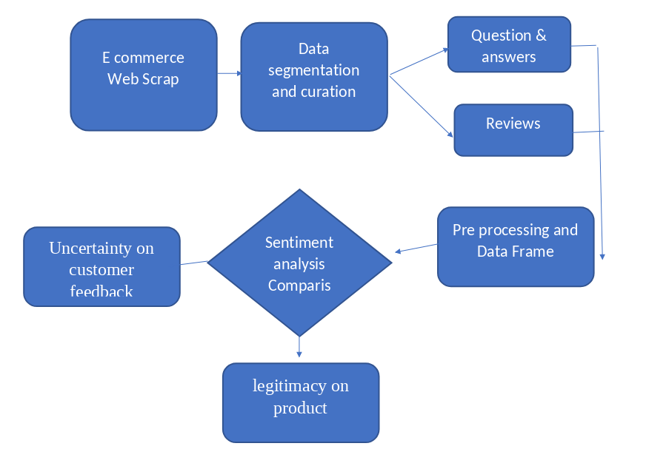
DEMO

Slide 7
Key Differentiators & Adoption Plan
How is your solution better than alternatives and how do you plan to build adoption?
In our view the data used to solve the problem will play key role in any bussiness idea or analysis. And we also belive that data is the primary asset of any company, institution and organizations. Since we are collecting the data in realtime and direct words of customer through reviews, question, answers and comments on product that we are performing our measures. We came to conclusion that we are having a robust solution for the problem statement. By providing the statistical proofs along with the rating of a product with customers words can be a accurate result in our solution.

Slide 8
Future Vision
How far it can go?
Our solution can be performed on thousand of web pages to scrap information and analyse the product sentiment in order to extract results. This can be implemted with much more compute power to fetch the past and historical data on products by web scrapping the millions of web page if the solution was implemented in cloud compting domain by using the aws ec2, aws athena for insights and aws rds storage systems. For higher computation power the cloud services will became the mile stone of complete analysis on a product. The solution can be more benifical by analysing the past and current and future prediction and measures can be visualized. The implementation of the solution on cloud can results a nice interactive dash board for product analysis and customer feedback.

Slide 9
Your Aha Moment!
Add some humour :)
Exaggeration is a good way to get some chortles when it comes to faces and bodies and this billboard has been angled to make the overweight man seem to tip it off balance.

Slide 10
Thank You
Team member names

