Slide 1
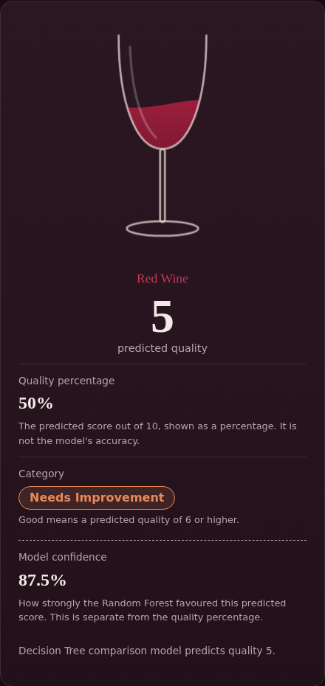
MACHINE LEARNING PROJECT
Wine Quality Prediction Using Machine Learning
Random Forest classifier with a Flask web app
Students: C. Poojitha-2520090236
S. Rishitha Reddy-2520090039
Guide: IV Lakshmi Haritha
Department: CSIT
KL University | 2026-2027
The project's actual web app output
Notes:
Introduce the project, team and guide. Fill the bracketed fields before presenting.

Slide 2



Introduction
Background
Machine Learning
Lab Measurements
Red wine quality is scored on a 0 to 10 scale by sensory panels.
Algorithms learn patterns from past data to predict new cases.
11 physicochemical properties describe each wine sample.
Why it is needed
Quality checks are slow, costly and depend on human tasters
A model gives a fast, consistent estimate from measurable data
Notes:
Wine quality is traditionally judged by experts. ML lets us estimate it from lab measurements.

Slide 3


Problem Statement
Existing Problem
Who Is Affected
Wine quality depends on expert tasting, which is hard to repeat consistently.
Producers, quality-control labs, retailers and buyers.
Challenges of traditional assessment
Subjective: different tasters can score the same wine differently
Slow and costly: needs trained experts and time
Hard to apply to every batch at large scale
Notes:
The problem: manual assessment does not scale and is subjective.

Slide 4



Motivation
Why This Project
Real-World Need
Research Motivation
Combines a practical problem with a complete ML workflow: data, model and web app.
Wineries need quick quality screening from routine lab measurements.
Wine quality prediction is a widely studied classification problem in data science.
Goal: turn routine lab measurements into a fast, repeatable quality estimate.
Notes:
Why we chose it: a real quality-control need and a clean, well-known dataset.

Slide 5
Objectives
Main objective: predict red wine quality from 11 lab measurements using machine learning.
Train a Random Forest model on the red-wine dataset
Compare it with a Decision Tree model
1
2
Build a Flask web app for single and CSV predictions
Show quality score, category and model confidence
3
4
Notes:
One main objective, four specific ones.

Slide 6


Existing System
Current Approach
Existing Methods
Trained tasters score wines; lab tests measure chemistry separately.
Sensory evaluation panels and manual physicochemical analysis.
Limitations
Subjective and inconsistent between tasters
Time-consuming and expensive
Lab values are not turned into a quality estimate automatically
Notes:
Traditional approach: sensory panels and lab analysis.

Slide 7


Proposed System
Our Solution
Outputs
A Random Forest model, served by a Flask web app, predicts quality from 11 measurements.
Predicted quality, quality %, Good / Needs Improvement, model confidence.
How it addresses the limitations
Objective: same inputs always give the same prediction
Fast: instant result, plus batch prediction from a CSV file
Warns when inputs fall outside the training data range
Notes:
Our system turns 11 lab values into a predicted quality score.

Slide 8





System Architecture
Dataset / Input
Preprocessing
Feature Processing
ML Model
Prediction
Quality Output
1,600 records, 11 features
Numeric check, CSV column match
11 features, fixed order
Random Forest (200 trees)
Score 4 to 7 + confidence
Score, %, category
A Decision Tree model also predicts on the same input, as a comparison model shown in the result panel.
Notes:
Flow as implemented in the project: dataset and model come from Colab; app.py serves predictions.

Slide 9
Methodology / Workflow
Dataset collection
Data loading
Preprocessing
1
2
3
Red-wine CSV, 1,600 records
Dataset read with pandas
Colab steps: not in files
Feature selection
Train-test split
Model training
4
5
6
All 11 features used
Not in provided files
RF and DT, trained in Colab
Prediction
Model evaluation
Final output
7
8
9
Flask /predict endpoint
Metrics: not in files
Score, %, category, confidence
Notes:
Steps marked Colab happened outside the uploaded files, so their details are not available.

Slide 10






Technology Stack
Language
Framework
ML Library
Python, JavaScript
Flask 3.x
scikit-learn 1.6.1
Data Libraries
Front End
Environment
pandas, NumPy, joblib
HTML, CSS, JS
Google Colab, VS Code
Dataset: red-wine CSV (1,600 rows). Fonts: Fraunces and Instrument Sans (Google Fonts). Database: none used.
Notes:
Only technologies found in requirements.txt, app.py and the front-end files.

Slide 11




System Modules / Components
Data Module
ML Model Module
Prediction Module
dataset/ CSV files
random_forest_model.pkl, decision_tree_model.pkl
/predict and /predict-csv in app.py
Validation
User Interface
Reporting
Numeric checks, range warnings
index.html, style.css, script.js
CSV results table and download
Notes:
Each module maps to real files in the project.

Slide 12
Implementation
Load both .pkl models with joblib at start
Check features match the 11 expected, in order
/predict reads JSON and validates each number
Random Forest gives score and confidence
Decision Tree score is shown for comparison
Warn if a value is outside the training range
def predict_frame(df):
X = df[EXPECTED_FEATURES]
rf_pred = rf_model.predict(X)
rf_conf = rf_model.predict_proba(X).max(axis=1)
dt_pred = dt_model.predict(X)
return rf_pred, rf_conf, dt_pred
Excerpt from app.py (code font kept small to fit). Category rule: predicted quality 6 or higher is Good.
Notes:
Models are loaded once at start-up; each request builds a DataFrame and predicts.

Slide 13
Dataset / Input Data
1,600
11
1
0
records
features
target: quality
missing / duplicates
Feature | Min | Max | Feature | Min | Max
fixed acidity | 4.5 | 13.73 | total sulfur dioxide | 6 | 196.4
volatile acidity | 0.12 | 1.237 | density | 0.9908 | 1.0039
citric acid | 0 | 0.86 | pH | 2.76 | 3.8
residual sugar | 0.8 | 12.24 | sulphates | 0.3 | 1.42
chlorides | 0.025 | 0.239 | alcohol | 8.5 | 13.8
free sulfur dioxide | 1 | 46.5 | quality (target) | 4 | 7
Note: the separately uploaded winequality-red.csv has 1,599 rows (scores 3 to 8, 240 duplicates). The models use the 1,600-row project file.
Notes:
Training file in the project: dataset/winequality-red-project.csv. Statistics computed from that file.

Slide 14
Dataset Analysis
Data checks
Missing values: 0
Duplicate rows: 0
Target: quality, classes 4 to 7
Outlier analysis: Not available in the provided project files
Colab preprocessing: Not available in the provided project files
Notes:
Class balance matters: scores 5 and 6 dominate; score 7 is rare.

Slide 15

Algorithm / Model
Random Forest (main)
Decision Tree (comparison)
Many decision trees vote; the majority class is the prediction.
One tree of if-else splits on feature values.
Random Forest | Value
n_estimators | 200
criterion | gini
max_features | sqrt
max_depth | None
random_state | 42
Decision Tree | Value
criterion | gini
max_depth | None (grown to depth 23)
leaves | 391
random_state | 42
Why: project metadata names Random Forest as the best model. Ensembles are generally more stable than a single tree.
Notes:
Random Forest is the main model; Decision Tree is the comparison. Parameters read from the saved .pkl files.

Slide 16
Results: Evaluation Metrics
Accuracy
Precision
Recall
Not available in the provided project files
Not available in the provided project files
Not available in the provided project files
F1-score
Confusion matrix
Model comparison metrics
Not available in the provided project files
Not available in the provided project files
Not available in the provided project files
What the files do confirm: project metadata lists Random Forest as the best model, and both models were exported from Google Colab. Numeric scores were not included, so none are shown here.
Notes:
Be upfront: the uploaded files contain the trained models but not the Colab evaluation output.

Slide 17
Results: Model Outputs
Importance is spread evenly (about 8% to 10% each)
Both models agreed on all 10 sample rows
Sample batch: 3 Good, 7 Needs Improvement
Notes:
Both charts are computed from the saved models in the project.

Slide 18
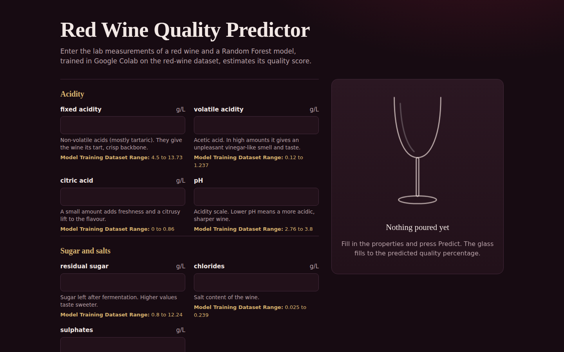
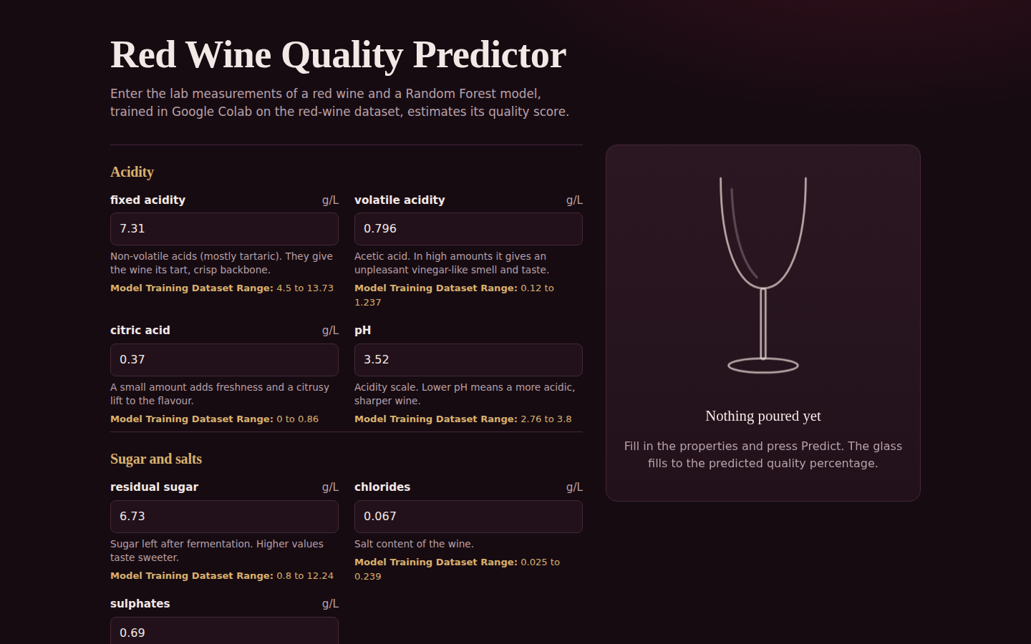
Screenshots: Home and Input
Home page: empty input form
Input screen: 11 values entered
Inputs are grouped (acidity, sugar and salts, sulfur dioxide, body) and each shows its training range. A separate processing screen is not implemented: prediction runs on the server when Predict is pressed.
Notes:
Real screenshots of the Flask app running locally.

Slide 19
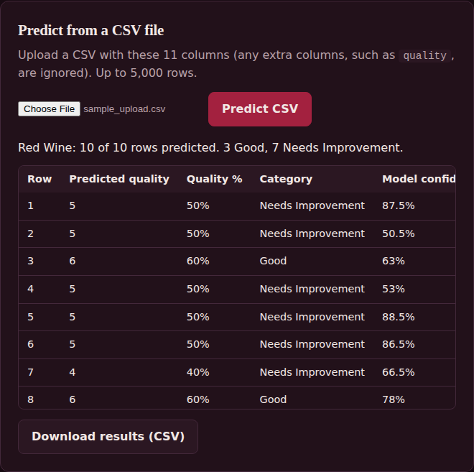
Screenshots: Prediction and CSV
Shown on the result card
Predicted quality
Quality percentage
Category
Model confidence
Decision Tree score
Prediction output
CSV batch prediction
Notes:
Result card for one wine, and batch prediction using the project's sample_upload.csv.

Slide 20




Advantages
Fast
Consistent
Batch Ready
Instant prediction from lab values
Same input, same output
Up to 5,000 rows per CSV
Transparent
Easy to Use
Comparable
Confidence and range warnings
Simple web interface
Two models side by side
Notes:
Benefits of the ML approach over manual assessment.

Slide 21



Applications
Wine Industry
Quality Control
Quick screening of batches before expert tasting.
Flag samples that need a closer look.
Research and Teaching
Producers and Retail
Demonstrates classification on real tabular data.
Support decisions on grading and selection.
Notes:
Who could use a system like this.

Slide 22
Limitations
Data: red wine only; scores 4 to 7, so extremes (below 4, above 7) are not predicted
Data: score 7 has only 24 examples, so it is rarely predicted well
Model: accuracy, precision, recall and F1 are not available in the provided project files
Model: confidence is how strongly the forest favoured a score, not accuracy
Prediction: estimates only, not a replacement for expert tasting
Technical: runs on the Flask development server, local use only
Notes:
Honest limits: relevant for viva questions.

Slide 23


Future Scope
Better Models
Larger Data
Gradient boosting, tuning, cross-validation
More wines, including white wine
Deployment
Real-Time Use
Host online with a production server
Connect lab sensors or instruments
Notes:
Possible next steps.

Slide 24

Conclusion
Achieved
Key Outcome
Contribution
A working Flask app that predicts red wine quality from 11 lab measurements
Random Forest as the main model, Decision Tree as comparison
A simple, repeatable alternative to purely manual assessment
Notes:
Wrap up: what was built and why it matters.

Slide 25

Thank You
Questions?
Wine Quality Prediction Using Machine Learning | KL University
Notes:
Invite questions.

