Slide 1
MULTI-VENDOR MARKETPLACE
A Full-Stack Web Application for Online Product Management and Shopping Presented By:
23AK1A3622 - LIKHITHA .P
23AK1A3623 - MANASA .C
23AK1A3642 - TEJASWINI .G

Slide 2
Project Objective:
The objective of the Multi-Vendor Marketplace project is to develop a web-based platform that allows multiple vendors to register, manage, and sell their products online while enabling customers to browse products, add items to the cart, place orders, and view order history. The system aims to provide a simple, efficient, and user-friendly online marketplace using modern web technologies.
Short Description:
The Multi-Vendor Marketplace is a full-stack web application developed using React.js, Node.js, Express.js, and MongoDB. The application provides separate modules for vendors and customers. Vendors can register, log in, and manage products by adding, editing, and deleting them. Customers can register, log in, browse products, add products to the cart, place orders, and view their order history. The system also includes authentication, protected routes, and cart management features to ensure a secure and seamless shopping experience.

Slide 3
Technologies Used
Frontend Technologies
React.js
HTML5
CSS3
JavaScript
Backend Technologies
Node.js
Express.js
Database
MongoDB
MongoDB Atlas
Development Tools
Visual Studio Code
Git
GitHub
Purpose of Technologies
. React.js - Used to build the user interface.
. Node.js & Express.js - Used for backend development and API creation.
. MongoDB - Used to store customer, vendor, product, and order information.
. Git & GitHub - Used for version control and project management.

Slide 4
System Architecture
The Multi-Vendor Marketplace system follows a three-tier architecture consisting of the Presentation Layer, Application Layer, and Database Layer.
👤 Users (Customers & Vendors)
⬇
🖥 Frontend (React.js) User Interface Product Display Cart Management
Authentication Pages
⬇
⚙ Backend (Node.js + Express.js) REST APIs
User Authentication Product Management Order Management
⬇
🗄 Database (MongoDB Atlas) Customer Data
Vendor Data Product Data Order Data

Slide 5
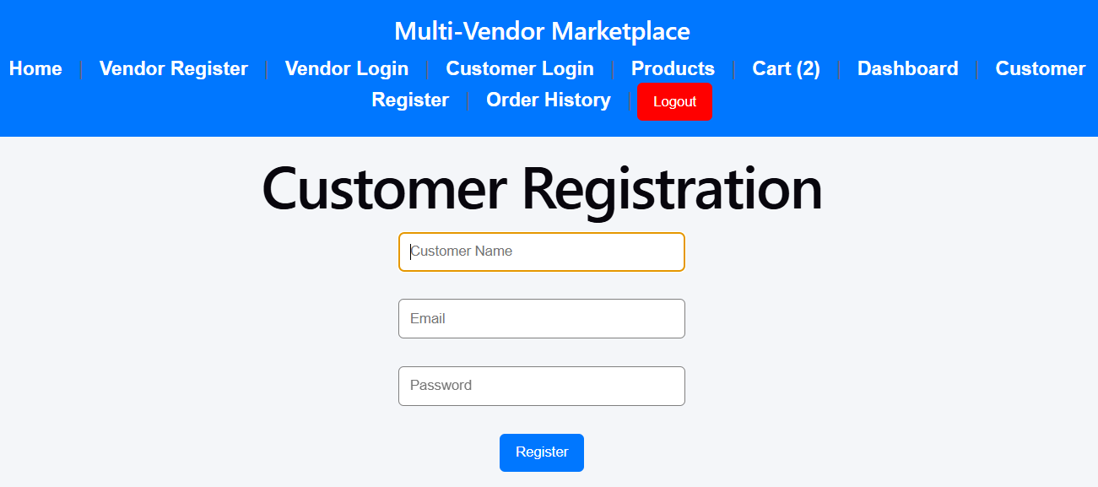
Authentication Module
The Authentication Module provides secure access to the Multi-Vendor Marketplace by allowing both customers and vendors to register and log in to the system.
Features:
✅ Customer Registration
New customers can create an account by providing their details.

Slide 6
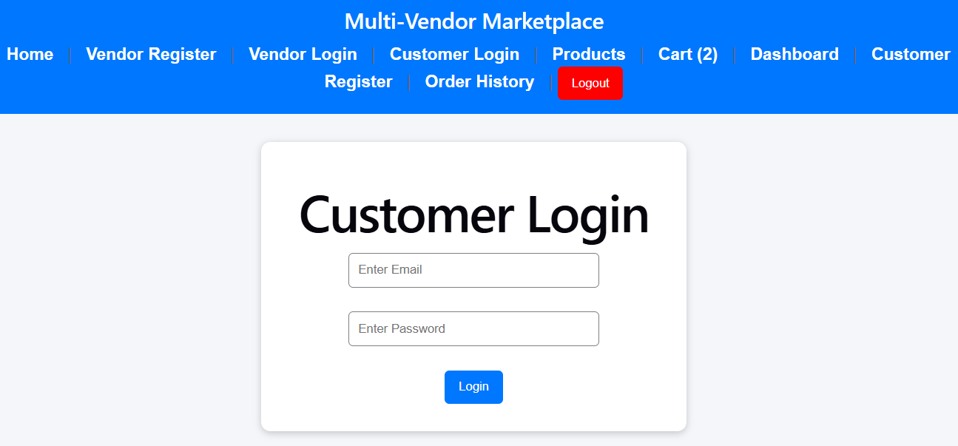
✅ Customer Login
Registered customers can log in using their email and password.

Slide 7
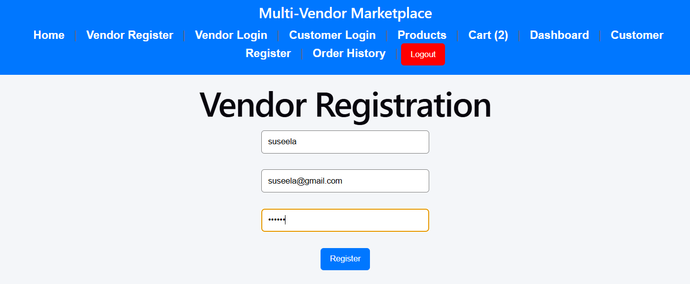
✅ Vendor Registration
Vendors can register to sell their products on the platform.

Slide 8
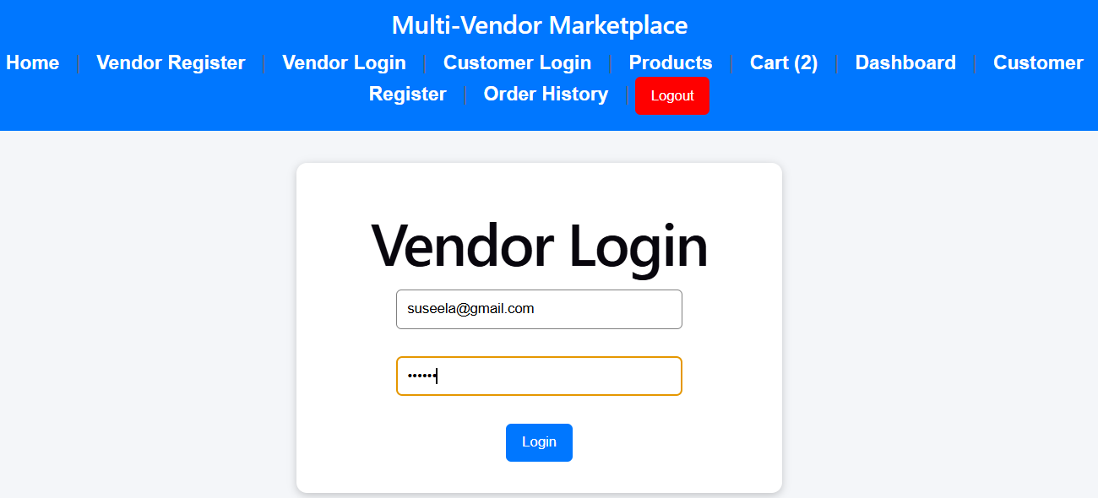
✅ Vendor Login
Registered vendors can securely access the Vendor Dashboard.

Slide 9
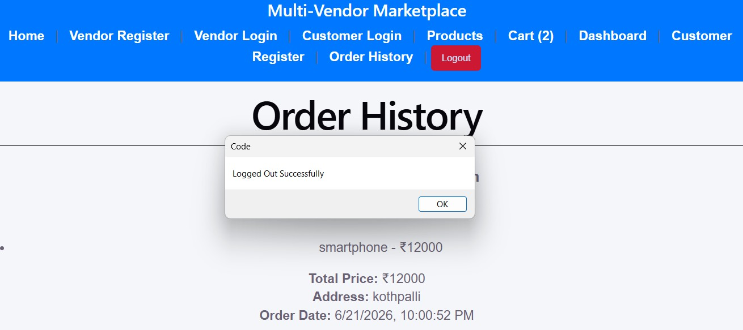
✅ Logout Functionality
Users can securely log out from the application.
✅ Protected Routes
Unauthorized users cannot access restricted pages such as Cart,Checkout, Orders, and Vendor Dashboard.

Slide 10
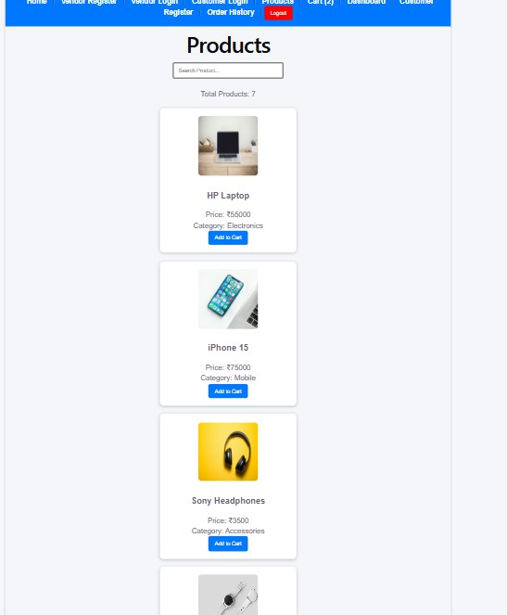
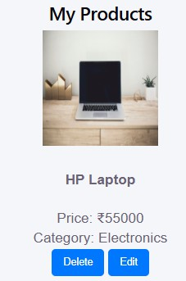
Vendor Module
The Vendor Module allows vendors to manage their products efficiently through the Vendor Dashboard.
Features:
✅ Vendor Registration and Login
✅ Add New Products
✅ Update Existing Products
✅ Delete Products
✅ Upload Product Images
✅ Manage Product Information
Vendor Dashboard Functions:
Add Product
Edit Product
Delete Product
View Product List

Slide 11
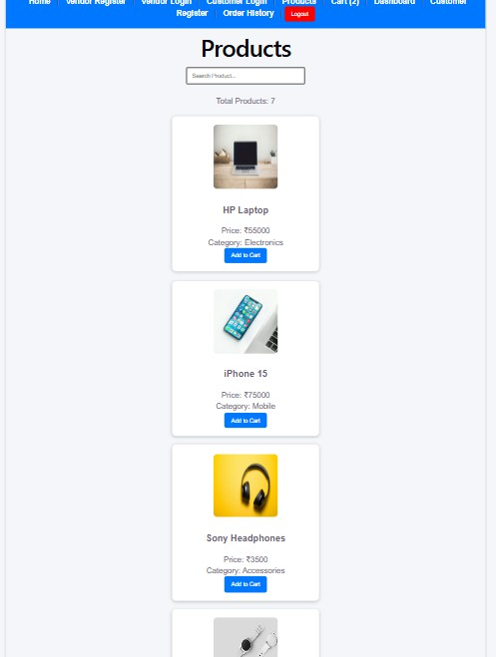
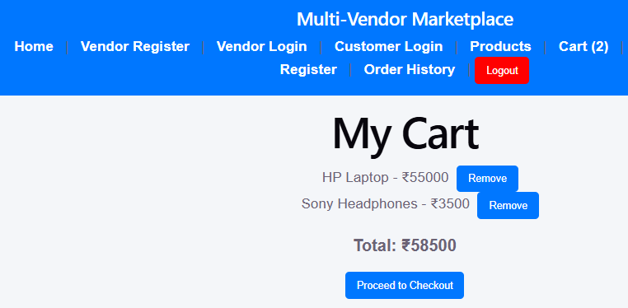
Customer Module
The Customer Module provides a seamless shopping experience for users.
Features:
✅ Customer Registration and Login
✅ Browse Available Products
✅ Search Products
✅ Add Products to Cart
✅ View Cart Details
Customer Functions:
View Products
Search Products
Add to Cart
Manage Shopping Cart

Slide 12
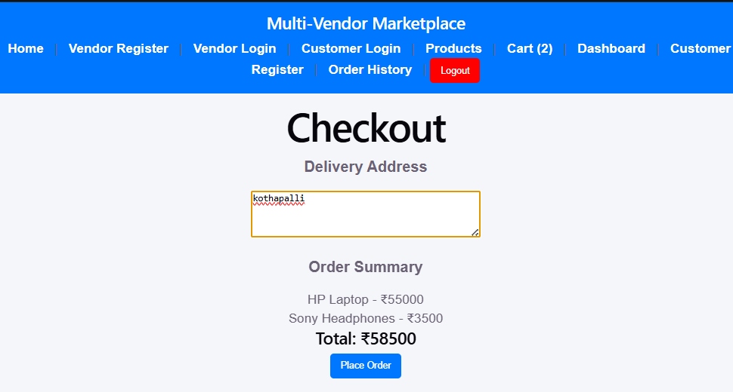
Order Management
The Order Management Module handles the complete purchasing process.
Features:
✅ Checkout Process
✅ Place Orders
✅ Store Order Details
✅ View Order History
Order Process Flow:
Products → Cart → Checkout → Place Order → Order History

Slide 13
Future Enhancements
Online Payment Gateway Integration
Product Rating and Review System
Email Notifications for Orders
Advanced Product Filtering and Sorting
Inventory Management System
Vendor Sales Analytics Dashboard
Wishlist Functionality
Real-Time Order Tracking
These enhancements can further improve the user experience and make the application more scalable.

Slide 14
THANK YOU
Thank You for Your Valuable Time and Attention.
Questions and Suggestions are Welcome.

