Slide 1
Integrating Chemistry Scholarship with Web Architectures, Grid Computing and Semantic Web
Sashi Kiran Challa
Indiana University, Bloomington
May 24th, 2010

Slide 2
Outline
Terminology
Background
Data, Dataflow/Workflow
Objective
RESTful Web services
Grid Computing
TeraGrid, Dryad
Semantic Web (Triple Store, SPARQL)

Slide 3
Terminology
RDF Triples: subject, predicate, object statements
Moiety: a half of a molecule. One or more moieties constitute a Crystal.
GAUSSIAN 03(Gaussian) is a general purpose ab-initio electronic structure package that is capable of computing energies, geometries, vibrational frequencies, transition states, reaction paths, excited states, and a variety of properties based on various uncorrelated and correlated wave functions.
http://companies.com#LifeTechnology
http://example.com#isLocatedIn
“San Francisco”

Slide 4
Background

Slide 5
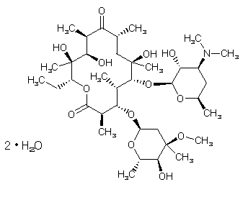

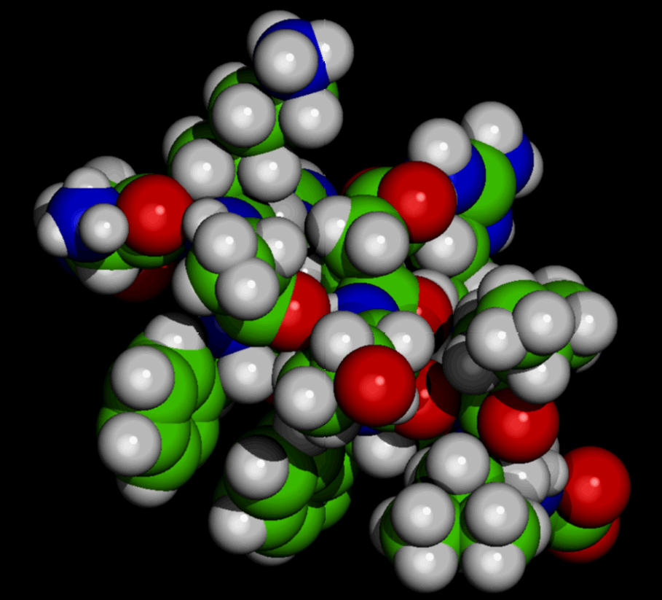
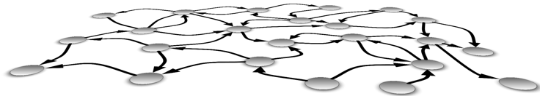
Experiments, Protocols ???
(Experimental Data)
Moieties’, their energies, latent heats of fusion, vibrational frequencies ?
(Molecular Properties,etc)
Who ? Where ? When ?
(Bibliographic Data)

Slide 6
OAI-ORE
Open Archive Initiative – Object Reuse and Exchange
defines standards for the description and exchange of aggregations of Web resources.
based around the ORE-Model which introduces the Resource Map (ReM) that makes it possible to associate an identity with aggregations of resources and make assertions about their structure and semantics.
ReMs are expressed in ATOM/XML, RDF/XML, n3, turtle formats.

Slide 7






Microsoft Research’s ORECHEM Project
“A collaboration between chemistry scholars and information scientists to develop and deploy the infrastructure, services, and applications to enable new models for research and dissemination of scholarly materials in the chemistry community.”
http://research.microsoft.com/en-us/projects/orechem/

Slide 8
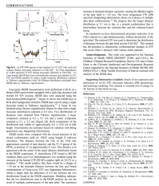

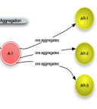





Bibliographic metadata
Citations
Figures
Tables
Chunks
NMR Spectra and Structural Data
Experiment data
PSU
Southampton
Reactions
Molecular Compounds
Cambridge
Computational Chemistry (Gaussian)
Indiana
Triplestore
On Azure Cloud
Carl Lagoze’s OreCHEM eScience Presentation Slides

Slide 9
Data Dataflow/Workflow

Slide 10
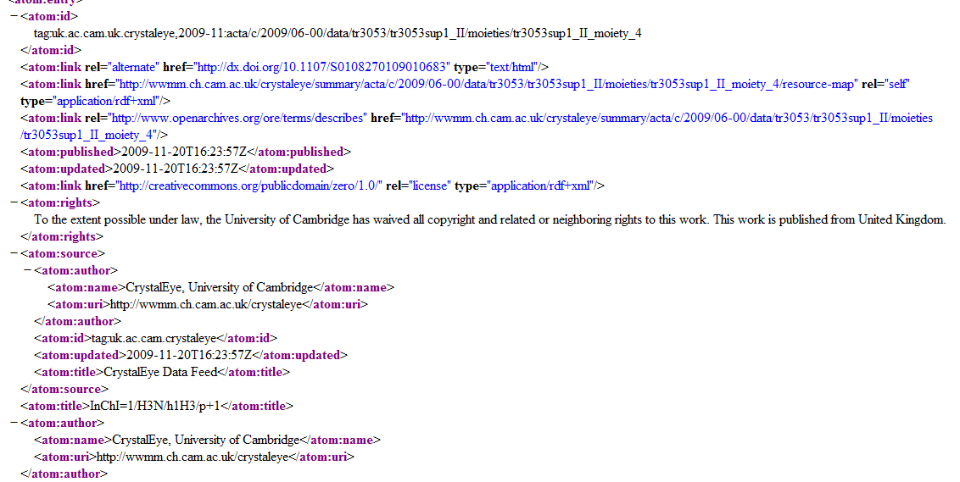
OAI-ORE ATOM based Resource Maps

Slide 11
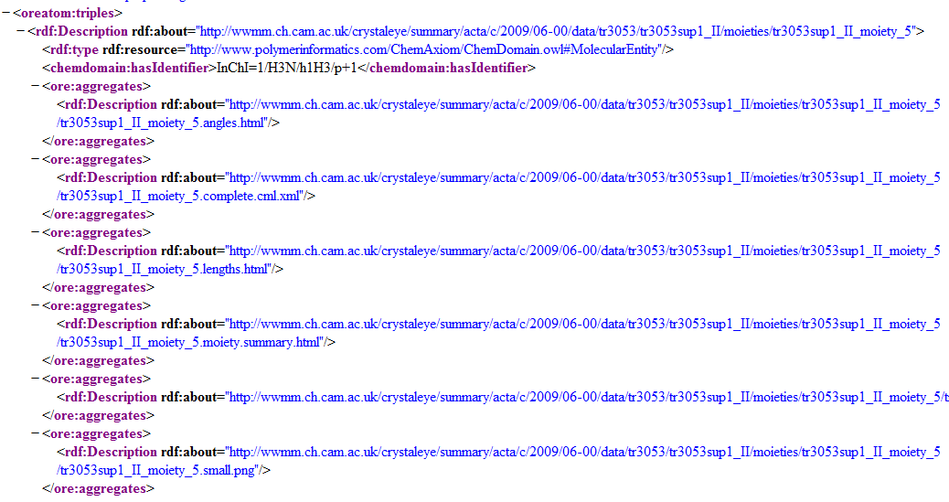
Experimental Ontology
ChemAxiom Ontology
Computational Process Ontology

Slide 12
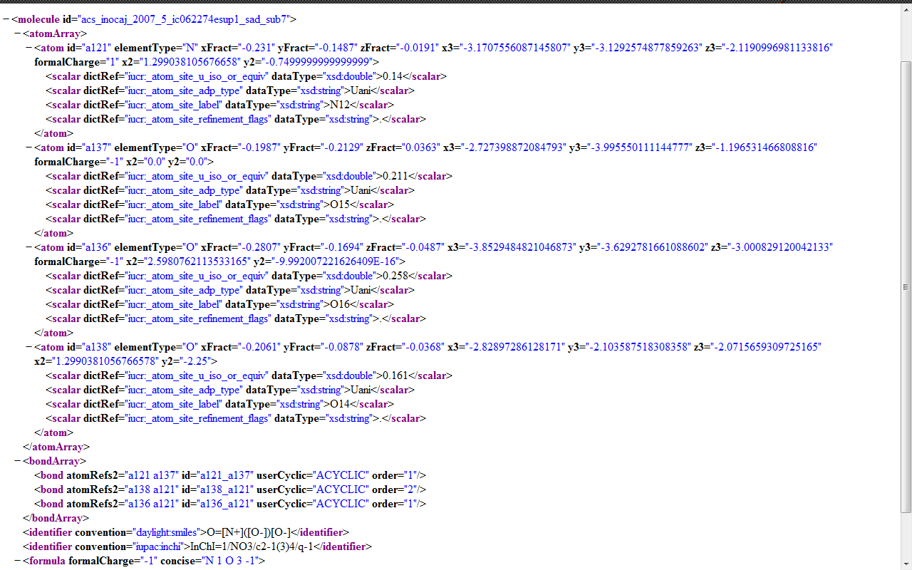
Moiety and its 3D co-ordinates.
every atom & it’s X,Y,Z co-ordinates.
Currently ~30000 moieties in Crystal Eye Repository
bond order , Smiles & InChI representations

Slide 13
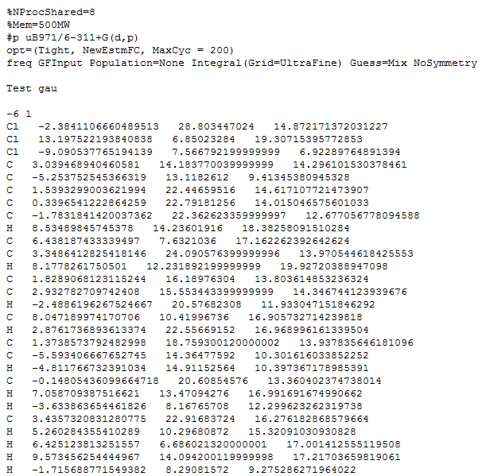
Gaussian Input File

Slide 14
Dataflow/Workflow
Moiety feeds in CML format
CML to Gaussian Input format
ATOM Feeds from PSU, Southampton, Cambridge
Gaussian on
TeraGrid
Gaussian Output to RDF triples
ATOM/XML to RDF/XML
Triplestore
Implemented
Yet to Implement
In Progress

Slide 15
Objective
To build a pipeline to:
Fetch ATOM feeds
Transform ATOM feeds into triples and store them into a triple store ( Using GRDDL/Saxon HE)
Extract Crystallographically obtained 3D coordinates information
Submit compute intensive electronic structure calculations, geometry optimization tasks to tools like Gaussian on HPC clusters
Transform the Gaussian output into triples and store them into a triple store

Slide 16
REST Services

Slide 17
RESTful Web services
REST is the way the Web already works.
URI for a resource.
HTTP GET/POST/PUT/DELETE
Very easy to build one using Java APIs
(JAX-RS Jersey (server & client))

Slide 18
Jersey
@Singleton
@Path("/cml3d")
public class MoietyHarvester {
@GET @Path("/csv")
@Produces("text/plain”)
public String harvestfeeds(@QueryParam("harvester") String harvester,
@DefaultValue("10") @QueryParam("numofentries") String num_entries){
.........
}
@GET @Path("/json")
@Produces("application/json")
public JSONArray harvestfeedsJSON(@QueryParam("harvester") String harvester, @DefaultValue("10") @QueryParam("numofentries") String num_entries){
..........
}
}
http://gf18.ucs.indiana.edu/FeedsHarvester/cml3d/csv?parameters
http://gf18.ucs.indiana.edu/FeedsHarvester/cml3d/json?parameters

Slide 19
ORECHEM REST Services
Web service | Description | Input | Output
InChIExtractor | Extracts InChIs by parsing the ATOM Feed entries | ATOM feed URL | String of InChI’s
InChIto3D | Generates 3D coordinates of an InChI. (Open Eye Babel) | InChI string | 3D coordniates in CML format
CML2Gauss | Generates Gaussian input file. (Jumbo Converters) | 3D coordinates (CML) | Gaussian input file URL
ATOM2RDF | ATOM to RDF/XML SAXON-XSLT (or GRDDL transformation) | ATOM feed URL | RDF/XML triples file URL
RDFIntoVirtuoso | Put the triples into Triple Store. (Jack-rabbit WEBDAV Client) | POST RDF/XML triples file URL | GRAPH IRI for SPARQL queries

Slide 20
ORECHEM REST Services
Web service | Description | Input | Output
FeedsHarvester | Fetch the moiety feeds from Crystal Eye. (crystal-eye harvester) | harvester name, number of feeds to be fetched | URLs of the cml.xml files
CML2GaussianSemCompChem | Generate Gaussian Input file. (Semantic Comp Chem) | POST cml.xml file URL | URL of the Gaussian Input file
http://gf18.ucs.indiana.edu:8146/FeedsHarvester/cml3d/csv?harvester=moiety&numofentries=5
http://gf18.ucs.indiana.edu:8146/CML2GaussianSemCompChem/gauss/inputgenerator

Slide 21
Testing Services
public class JerseyClient{
public static void main(String[] args) {
Client client = Client.create();
WebResource cml2gauss = client.resource ( " " +
"http://localhost:8080" +
"/CML2GaussianSemCompChem/gauss/inputgenerator“ );
String cmlfileURL= "http://gridfarm018.ucs.indiana.edu/" +
"orechem/moieties/ic0620900sup1_comp9_” +
moiety_1.complete.cml.xml";
String gaussURL = cml2gauss.accept(MediaType.TEXT_PLAIN_TYPE,MediaType.APPLICATION_XML_TYPE).post(String.class,cmlfileURL);
System.out.println(gaussURL);
}
}
Jersey Client API

Slide 22
Testing Services
Build a WAR, deploy on gf18 server & test
using ‘curl’:
HTTP GET
CMLUrls=`curl http://gf18.ucs.indiana.edu:8146/FeedsHarvester/crystaleye/cml3d/c
sv?harvester=moiety&numofentries=10`
echo $CMLUrls
HTTP POST
gaussURL = `curl -d "$1" -H "Content-type:text/plain" http://gf18.ucs.indiana.edu:8146/CML2GaussianSemCompChem/gauss/inputgenerator`
echo $gaussURL

Slide 23
FeedsHarvester Testcase
@Test
public void testHarvestfeedsintoJSON() {
Client client = Client.create();
WebResource ceyeharvest = client.resource(Projectconstants.SERVERLOCATION + "/FeedsHarvester/crystaleye/cml3d/json");
MultivaluedMap<String, String> queryParameters = new MultivaluedMapImpl();
queryParameters.add("harvester", "moiety");
queryParameters.add("numofentries","2");
JSONArray jsonoutput = ceyeharvest.queryParams(queryParameters).accept(MediaType.APPLICATION_JSON).get(JSONArray.class);
//int expected = 2;
//int actual = jsonoutput.length();
assertNotNull(jsonoutput);
//assertEquals(expected,actual);
}

Slide 24
Grid Computing
Or
Cloud Computing

Slide 25
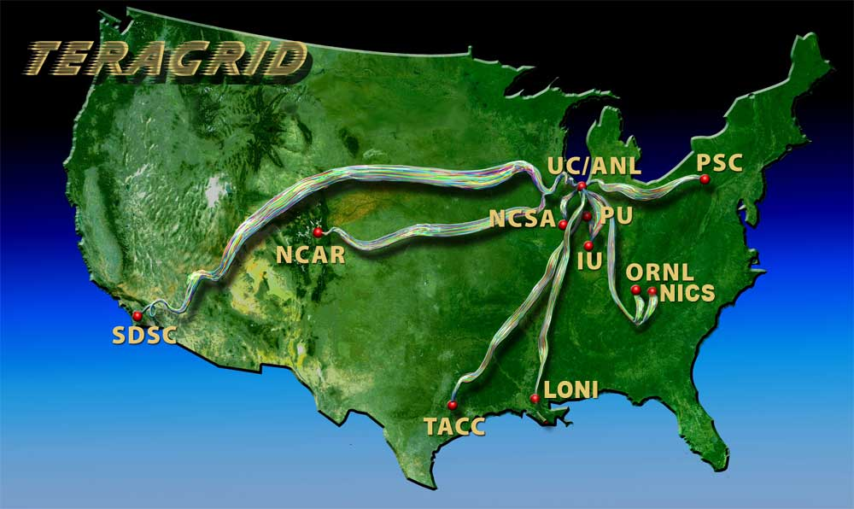
TeraGrid
OGCE Workflow Toolkit for Multi-Disciplinary Science Applications, Suresh Marru’s Presentation.

Slide 26
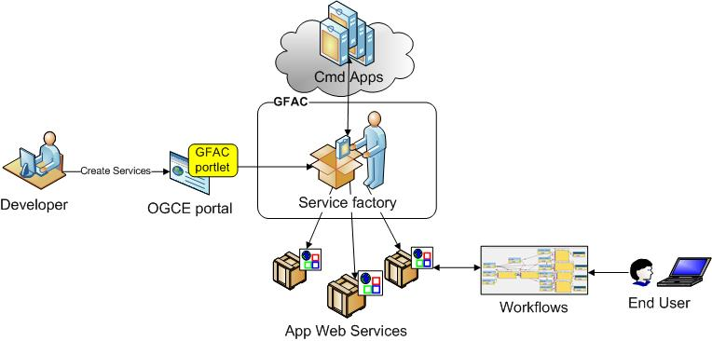
OGCE-Workflow Suite
OGCE Workflow Toolkit for Multi-Disciplinary Science Applications, Suresh Marru’s Presentation.

Slide 27
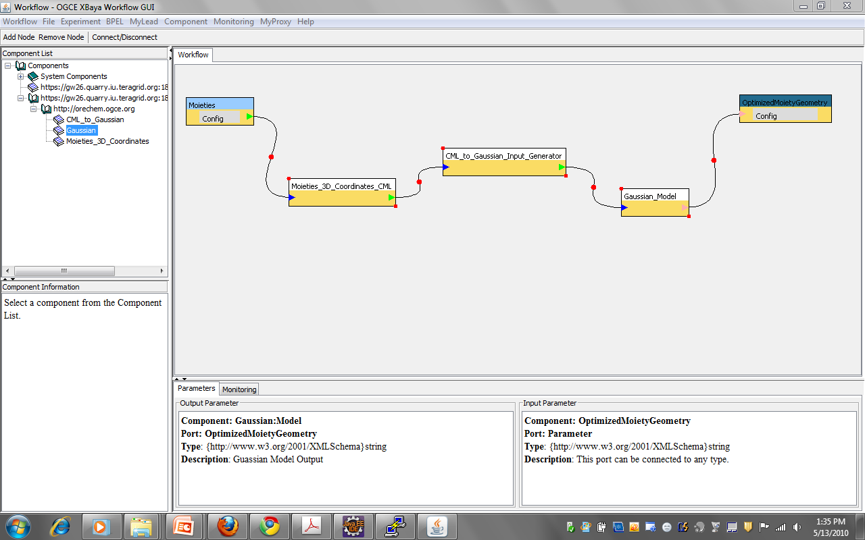
XBaya Workflow Composer
Video Demo

Slide 28
Dryad and DryadLINQ
Dryad : high-performance, general-purpose distributed computing engine on windows clusters.
DryadLINQ : extended version of the LINQ programming model and API.
Dryad and DryadLINQ An Introduction version 1.0. June 30, 2009. by Microsoft Research

Slide 29
Dryad and DryadLINQ
Distributing Files onto all the nodes :
manually place the files in every node or
Write a C# code that uses DryadLINQ partitioning operators like Hash Partition<T,K> or Range Partition<T,K>
A partitioned data set consists of 2 types of files:
*A metadata file (.pt as extension) containing metadata that describes the partitions
\DryadData\UserName\InputData (file path and name)
4 (number of partitions depending on number of nodes available)
0,2000,NODE01 (Partition files: Partition number, size(in bytes), node name : File path)
1,2000,NODE02,NODE03
2,2000,NODE03,NODE04
3,2000,NODE04
*Set of partition files, one for each data partition.

Slide 30
Dryad and DryadLINQ
From the head node distributed the files into all the nodes using C# code.
Files include the Input files, ‘.exe file’.
Output files were written to a directory on the head node.
LINQ queries on the PartitionTable object are executed on the Cluster.
IQueryable<LineRecord> filenames = PartitionedTable.Get<LineRecord> (filepathuri);
IQueryable<outputinfo> outputs = filenames.Select(s => ExecuteProcess( execFileName, s.line));

Slide 31
Semantic Web Technologies

Slide 32
Triple Store
A triple store is framework used for storing and querying RDF data. It provides a mechanism for persistent storage and access of RDF graphs.
Commercial: Allegrograph, BigOWLIM, Virtuoso
Open Source: Jena SDB, Sesame, Virtuoso, Intellidimension

Slide 33
Virtuoso Triple Store
ORDBMS extended into a Triple store.
Command line loaders; isql utility (interactive sql access to a database)
Support for SPARQL and web server to perform SPARQL queries
Uploading of data over HTTP, WEBDAV browser.
http://virtuoso.openlinksw.com/dataspace/dav/wiki/Main/VOSRDFWP

Slide 34
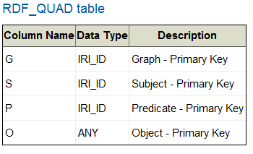
Virtuoso Triple Store
Windows and Linux versions are installed and tested.
Currently Linux version being used.
Conductor: http://gf18.ucs.indiana.edu:8890/conductor
Sparql endpoint : http://gf18.ucs.indiana.edu:8890/sparql
Implementing a SPARQL compliant RDF Triple Store using a SQL-ORDBMS. http://virtuoso.openlinksw.com/dataspace/dav/wiki/Main/VOSRDFWP

Slide 35
Virtuoso Triple Store
GRAPH IRI : used to perform sparql query on the RDF triples.
* Unique for every file uploaded.
http://local.virt/DAV/home/schalla/rdf_sink/oreatomfeed_102.rdf
* A common GRAPH IRI for all the data uploaded into rdf_sink .
(virt:rdf_graph, virt:rdf_sponger)
http://localhost:8890/DAV/home/schalla/rdf_sink/

Slide 36
Finally What’s in Triple Store
RDF Graph
Experiments performed on a particular crystal
Journals containing this crystal (research groups working with the crystal)
Moieties in the crystal, their energies geometries, vibrational frequencies, etc.
All this information in the triple store can be queried on, using a single GRAPH IRI.

Slide 37
Future Work
Google’s PubSubHubbub :
As soon as a feed is published, hub notifies the subscriber. Thus get the new entry and start the pipeline.
Publisher
Hub
Subscriber
http://code.google.com/p/pubsubhubbub/

Slide 38
Future Work
Wrap the tool that generates triples from gaussian output, into a REST service.
Install Virtuoso triple store on the Azure cloud.
Fetch & process the feeds from Southampton, Penn State.

Slide 39
Acknowledgements
Dr. Marlon Pierce
Assistant Director,
Community Grid Labs,
Pervasive Technology Institute,
Indiana University
Dr. David J.Wild
Assistant Professor of Informatics & Computing Director of Cheminformatics Program School of Informatics and Computing,
Indiana University
Orechem Group :
Dr. Carl Lagoze (Cornell University),
Dr. Peter Murray Rust, Nick Day,
Jim Downing (University of Cambridge),
Mark Borkum (University of Southampton),
Na Li (Penn State),
Alex, Lee Dirks (Microsoft Research)
Suresh Marru
Research Scientist,
Pervasive Technology Institute,
Indiana University
Jaliya Ekanayake, Scott Beason,
All the members in Pervasive Technology Institute

Slide 40
Thank You

Slide 41

Questions ??

Slide 42

ATOM to RDF/XML
GRDDL Transformation: (Jena GRDDL Reader)
GRDDL is a mechanism for Gleaning Resource Descriptions from Dialects of Languages.
atom-grddl.xsl - XSLT stylesheet
GRDDLReader grddl=new GRDDLReader();
grddl.read (defaultmodel, atomfeedURL);
GRDDL W3C documentation: http://www.w3.org/TR/grddl/

Slide 43
ATOM to RDF/XML
Saxon XSLT Tranformation :
ByteArrayOutputStream transformOutputStream = new ByteArrayOutputStream();
TransformerFactory factory = TransformerFactory.newInstance();
StreamSource xslSource = new StreamSource(xslstream);
StreamSource xmlSource = new StreamSource(atomstream);
StreamResult outResult = new StreamResult(transformOutputStream);
Transformer transformer = factory.newTransformer(xslSource);
transformer.transform(xmlSource, outResult);
transformOutputStream.close();

Slide 44
OGCE-Workflow Suite
Tools to wrap command-line applications as light weight web services, compose workflows from those web services and, execute and monitor the workflows.
1) GFAC : allows users to wrap any command-line application as a web service.
2) XRegistry :XRegistry is the information repository of the workflow suite enabling users to register, search and access application service and workflow deployment descriptions.
3) XBaya :Java webstart workflow composer. Used for composing workflows from web services created by the GFAC, and running and monitoring those workflows.
Open Grid Computing Environments Wiki
http://www.collab-ogce.org/ogce/index.php/Workflow

Slide 45
DryadLINQ Programming Guide version 1.0. June 30, 2009. by Microsoft Research

Slide 46
Client Workstation: runs DryadLINQ application.
DryadLINQ Provider creates a Windows HPC job on the cluster to handle the Dryad processing, receives the results, and returns them to the application.
Job Manager: Windows HPC task that manages execution of associated Dryad job on the cluster.
Head Node: manages the cluster, hosts the Windows HPC Administration Console and Dryad management service.
Vertices: perform the data processing on the compute nodes.

Slide 47
Dryad and DryadLINQ An Introduction version 1.0. June 30, 2009. by Microsoft Research

Slide 48
Dryad and DryadLINQ
Distributing Files onto all the nodes :
manually place the files in every node or
Write a C# code that uses DryadLINQ partitioning operators like Hash Partition<T,K> or Range Partition<T,K>
A partitioned data set consists of 2 types of files:
*A metadata file (.pt as extension) containing metadata that describes the partitions
\DryadData\UserName\InputData (file path and name)
4 (number of partitions depending on number of nodes available)
0,2000,NODE01 (Partition files: Partition number, size(in bytes), node name : File path)
1,2000,NODE02,NODE03
2,2000,NODE03,NODE04
3,2000,NODE04
*Set of partition files, one for each data partition.

