Slide 1
Topic
Genetic Algorithms for
Feature Selection
(especially in QSAR models)

Slide 2
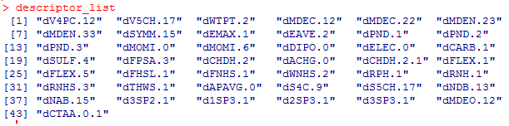
Introduction
A QSAR model is a mathematical relationship between a set of physicochemical descriptors ( structural, geometric, etc) and a property (biological activity, solubility, etc).
Linear method or Non-linear method ???? - that is based on the property to be predicted.
Data provided: 79 compounds’ 43 descriptors
Boiling point is the property to be predicted.

Slide 3
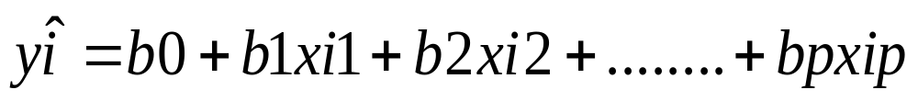
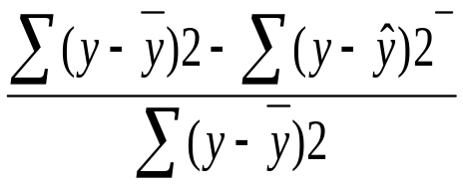
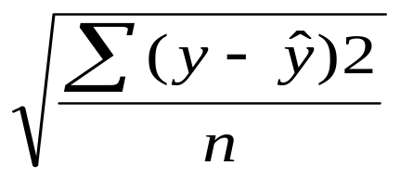
Some Statistics
Multiple Linear Regression:
Y_{i} = β₀ + β₁x_{i1} + β₂x_{i2} +..……….+ β_{p}x_{ip} i=1,2,….n
Model Fitness is evaluated by R² or RMSE
R² = (relative measure of fit)
RMSE= (absolute measure of fit)

Slide 4
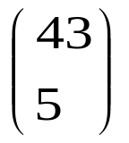
Why Genetic Algorithm
Say for best 5-subset descriptor:
(i.e. 962598) combinations have to be
evaluated.
Genetic Algorithm here is used to obtain the best set of descriptors from a pool of descriptors, that can best predict the boiling point of a compound.
Thus GA’s play role in optimizing the running time and memory.

Slide 5
Objective
To examine how fast the Genetic Algorithm reaches the global best model.
Steps to be executed for the above objective:
Do a brute force calculation to evaluate all possible 3-descriptor models.
Execute genetic algorithm to find best 3-descriptor model.
Check if the best model from GA is the global best model.
Calculate how many generations are required to reach the global best model.
Use different objective functions (RMSE, R² ) and check which function shows better convergence.

Slide 6
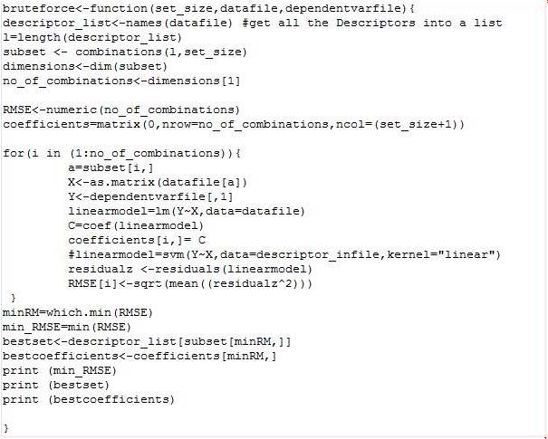
Brute Force

Slide 7
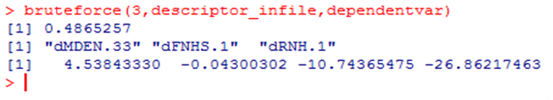


Brute Force
descriptor_infile<-read. table(“pdgfr-desc.txt",header=TRUE)
dependentvar<-read. table(“pdgfr-depv.txt",header=TRUE)

Slide 8
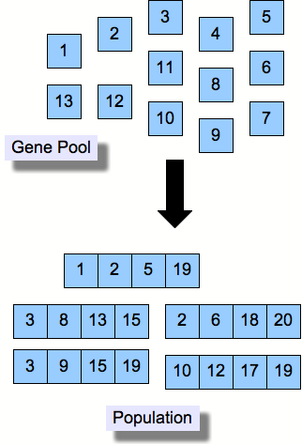

Genetic Algorithm
Initialization :

Slide 9
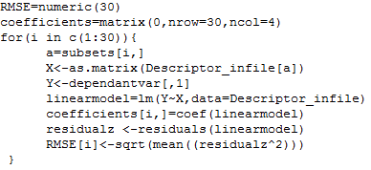
Genetic Algorithm
Build a model with every chromosome and evaluate the objective fitness function
i.e. RMSE for every individual

Slide 10

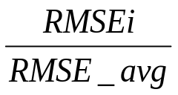

Genetic Algorithm
Calculate fitness of every individual and based on fitness values generate a Mating Population (Process called Parent Selection)
Fitness function=
Calculate average fitness and make sure all the individuals with fitness value above the avg value are taken into Mating Population (Elitism)

Slide 11
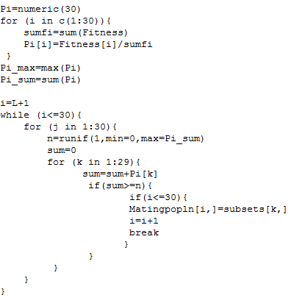
Rest of the Mating Population can be filled by either Roulette-Wheel Selection, or Tournament selection, or Stochastic Universal Sampling.
Roulette- Wheel method:-

Slide 12
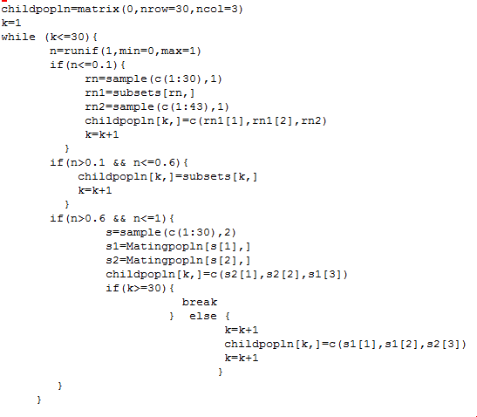
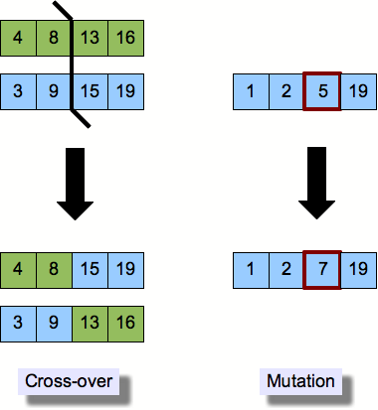
Apply genetic operators (crossover and mutation)

Slide 13
Replace the original population with the child population.
Repeat the cycle for user specified number of times.
Over time fittest individuals dominate the population.
Objective function converges. RMSE value goes minimum and remains constant for 100-200 generations then it can be said that the population has converged.
Premature convergence and slow finishing are two issues with fitness range.
Genetic Algorithm may or may not give the global optimum value and that depends on the factors like Fitness function, size of the initial population, parent selection procedure.

Slide 14
Thank You
Have a good day ☺

