Slide 1
Statistical Methods for Detecting Differentially Abundant Features in Clinical Metagenomic Samples
James Robert White, Niranjan Nagaranjan, Mihai Pop
PLoS COMPUTATIONAL BIOLOGY

Slide 2
Outline
Hypothesis Testing
Materials and Methods
Results
Discussion

Slide 3
Hypothesis Testing
Null Hypothesis vs. Alternative Hypothesis
Consider a situation where our interest is performing statistical hypotheses testing on each of thousands of features represented in a genome.
Features can be genes or all nucleotide words of certain length, single-nucleotide polymorphism markers, etc.
Eg: Detecting Differentially Expressed Genes

Slide 4
Multiple Hypothesis Testing
For each feature :
Null hypothesis vs Alternative Hypothesis
accept or reject null hypothesis.
significant feature
John.D.Storey and Robert Tibshirani . ‘Statistical Significance for genomewide studies’, PNAS Aug 2003

Slide 5
Multiple Hypothesis Testing
Measure of significance:
p-value : based on false positive rate
“rate that truly null features are called significant”
Pr(feature i is significant | feature i is truly null)
Eg: FPR of 5% means that on average 5% of the truly null features in the study will be called significant.
q-value : based on False Discovery rate FDR
“rate that significant features are truly null”
Pr(feature i is null | feature i is significant)
FDR of 5% means that among all features called significant 5% of these are truly null on average.
John.D.Storey and Robert Tibshirani . ‘Statistical Significance for genomewide studies’, PNAS Aug 2003

Slide 6
q-value
q-value provides a measure of each feature’s significance, automatically taking into account the fact that thousands are simultaneously being studied.
Proportion of significant features that turn out to be false leads.
q-value of a particular feature is the expected proportion of false positives incurred when calling that feature significant.
FDR = E[(no. of false positives)/(no. of significant features)]
John.D.Storey and Robert Tibshirani . ‘Statistical Significance for genomewide studies’, PNAS Aug 2003

Slide 7
q-value
Given p-values, q-values can be calculated. FDR needs to be estimated first.
For a threshold t, where 0<t ≤1. (all features with p-value less than t are significant)
Also given m p-values p₁ ,p₂ ,……,p_{m} let
F(t) = #{null p_{i} ≤ t; i = 1,….,m}
S(t) = # {p_{i} ≤ t ; i = 1,…,m}
FDR(t) = E[F(t)/S(t)]
for large m FDR(t) ≈ E[F(t)]/E[S(t)]
E[S(t)] = observed S(t) = #{p_{i} ≤ t}
E[F(t)] = number of true nulls * probability that a true null p-value is ≤ t
= m₀ * t
m₀ is unknown. Proportion of features that are truly null (π₀ = m₀ /m) is estimated
John.D.Storey and Robert Tibshirani . ‘Statistical Significance for genomewide studies’, PNAS Aug 2003

Slide 8

q-value
Estimate of π₀ is quantified as
Estimate of FDR(t) = Estimate of π₀ * m *t / #{p_{i} ≤ t}
Mathematical defn of q value is the minimum FDR that can be attained when calling that feature significant.
John.D.Storey and Robert Tibshirani . ‘Statistical Significance for genomewide studies’, PNAS Aug 2003

Slide 9

q-value
Fit π̂₀ = f̂(1) with a cubic spline with 3 df, (limiting its curvature to be a quadratic function)
Calculate q̂(p_{(m)} ) = min (p_{(m)} x π̂₀ ,1)
For i = m-1, m-2, …,1
John.D.Storey and Robert Tibshirani . ‘Statistical Significance for genomewide studies’, PNAS Aug 2003

Slide 10
What is this paper all about ???
A statistical method called Metastats, for comparing clinical metagenomic samples from two different populations on the basis of count data to detect differentially abundant features.
Metastats :
-employs FDR to improve the specificity in high-complexity environments
-handles sparsely-sampled features using Fisher’s exact test.
Demonstrates utility of Metastats on :
-16S rRNA survey of obese and lean human gut microbiomes
-COG functional profiles of infant and mature gut microbiomes
-bacterial and viral subsystem data inferred from random sequencing of 85 metagenomes.

Slide 11
“Two samples” is a limitation for many of the tools seen earlier (MEGAN)
In Clinical setting often there are two treatment populations, each comprising multiple samples or individuals.
Eg: sick and healthy human gut communities, or individuals exposed to different treatments
For each sample, count data representing the relative abundance of specific features within each sample, e.g. number of 16S rRNA clones assigned to a specific taxon, or number of shotgun reads mapped to a specific biological pathway or subsystem is to be provided. This corresponds to Feature Abundance Matrix.

Slide 12
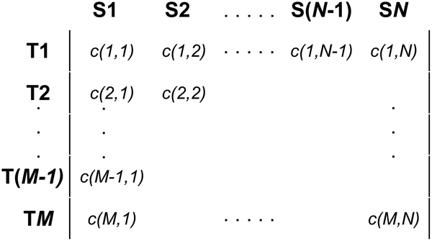
Feature Abundance Matrix
Rows = specific features,
Columns = individual metagenomic samples.
c( i, j) = number of observations of feature i in sample j
Data Normalization: raw abundance measure is converted to fraction representing relative contribution of each feature to each of the individuals.
Now c( i, j)( f_{ij} ) = proportion of taxon i observed in sample j

Slide 13
“Our goal is to identify features whose abundance in the two populations is different.”

Slide 14

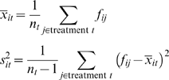
Analysis of Differential Abundance
For each feature i, they compare its abundance across the two treatment populations by computing a two-sample t-statistic. Features whose t statistics exceeds a specified threshold are inferred to be differentially abundant across the two treatments.

Slide 15
Assessing Significance
Minimize # of false positives
Choose a p-value and perform multiple hypotheses testing to identify significant features
While performing two sample t-statistic the underlying assumption is that the distributions of variables involved is normal. However here in Metastats this assumption is not made and the null distribution of t_{i} is calculated non-parametrically using a permutation method.
Randomly permute the treatment labels of the columns of the abundance matrix and recalculate the t-statistics. By performing permutation B times we get B sets of t statistics.
t₁^{0b}, …, t_{M}^{0b}, b = 1, …, B, where M is the number of rows in the matrix

Slide 16

Assessing Significance
For each feature, p-value associated with the observed t statistic is calculated as the fraction of permuted tests with a t-statistic greater than or equal to the observed t_{i} .
B value is chosen as a function of the significance threshold.

Slide 17
Multiple Hypothesis Testing Correction
For datasets with large number of features, direct application of t statistic can lead to large number of false positives.
E.g: If FPR is the error used and say p-value 0.05 is used as threshold, then number of false positives in a dataset comprising 1000 organisms is 50.
i.e. E[F] ≤ 0.05 * no. of features (F = no. of False Positives)
By using Bonferroni corrrection only those features with p-values ≤ (0.05/no.of features) are called significant and hence will cause reduction in number of false positives.
Alternative approach is to use FDR and have q-values for every feature.

Slide 18
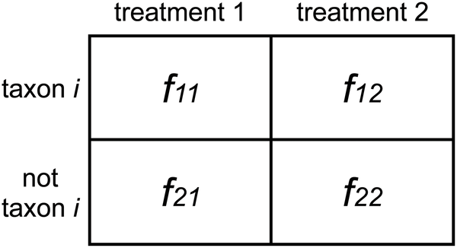
Handling Sparse Counts
For low frequency features nonparametric t-test is found to be not accurate. In this case Fisher’s exact test is used. It models the sampling process according to hypergeometric distribution. The frequencies are pooled to create a 2x2 contingency table and that is used as input for the Fisher’s test.

Slide 19

Handling Sparse Counts

Slide 20
Data
Human gut 16S rRNA sequences available in Genbank
COG Profiles of 13 human gut microbiomes
Functional profiles of 85 metagenomes

Slide 21
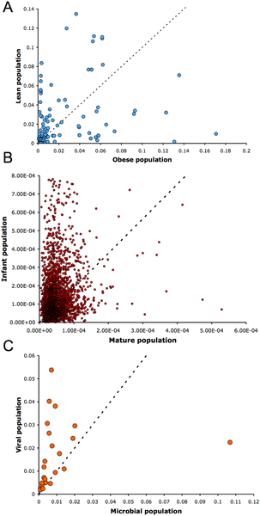
Dispersion Estimates for Chosen Datasets

Slide 22
Comparison with Statistical Methods
They designed simulations and compared the results with Student’s t-test, log-linear model and negative-binomial model.
First Simulation:
They selected sequences from a beta binomial distribution with variable dispersions (i.e. different dispersion for each population), and group mean proportions p₁ & p₂. For each set of parameters they simulated 1000 trials, 500 under null hypothesis (p1=p2), and the remainder with differential abundance where a*p₁ = p₂
p=0.1 and a=2 => features comprising 20% of the population that differ two-fold in abundance between two populations of interest.
➔Metastats performs as well as other methods.

Slide 23
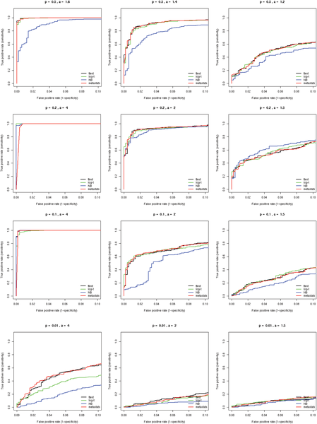
ROC Curves for First Simulation Study

Slide 24
Comparison with Statistical Methods
Second Simulation Study:
To examine the accuracy of each test under extreme sparse sampling.
( a feature not having any observations in one of the two populations)
Like above, from Beta binomial distribution, with variable dispersions samples were simulated.
a =0 and 0.01 (significantly reduced observations of a feature in one of the populations)
➔ Metastats outperforms other methods.

Slide 25
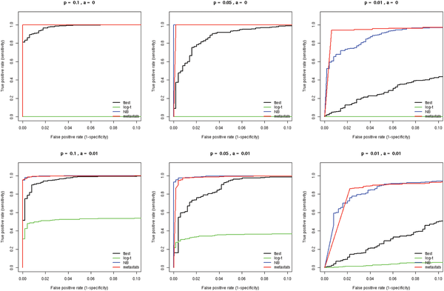
ROC Curves Second Simulation Study

Slide 26
Comparison with Statistical Methods
They selected a subset of Dinsdale et al* metagenomic subsystem data and randomly assigned 20 subjects to one of the two populations. Since all subjects are from same metagenomic subsystem, there is no feature that is differentially abundant.
They ran each of the 4 methods and recorded the computed p-values for each feature. They did this 200 times for 5200 null features.
They counted the number of false positives incurred by each methodology given different p-value thresholds.
Negative binomial models results in high number of false positives.
Students t-test and Metastats perform equally well.
Log-t performs better of than Students t-test and Metastats.
*Dinsdale EA, Edwards RA, Hall D, Angly F, Breitbart M, et al(2008) Functional metagenomics profiling of nine biomes. Nature 452:629-632.

Slide 27
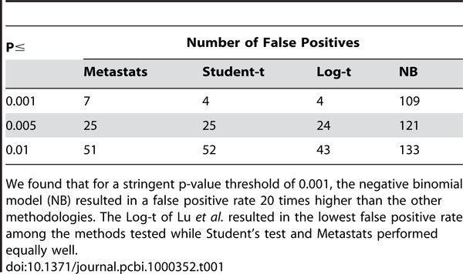
Comparison with Statistical Methods

Slide 28
16S rRNA Survey of Obese and Lean
Human Gut Microbiomes
Metastats helped find new Taxa found to be associated with Obesity
Originally Ley et al* by using Student’s t-test identified only Fermicutes and Bacteroidetes as being differently available in the guts of Obese and lean people with higher amounts of Fermicutes in Obese people and lower relative abundance of Bacteroidetes than the lean subjects.
Metastats due to its high sensitivity revealed that Actinobacteria also were over abundant in obese subjects.
*Ley R E, Turnbaugh PJ, Klein S, Gordon JI(2006) “Microbial ecology: human gut microbes associated with obesity. Nature 444: 1022-1023

Slide 29
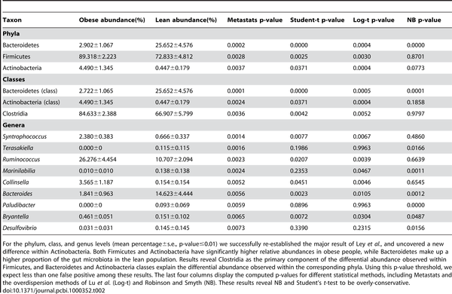

Slide 30
Differentially Abundant COGs between Infant and Mature Human Gut Microbiomes
Metastats was used to discover differentially abundant COGs between infants and mature (>1 year old) gut microbiomes.
Using pooling option, 100 permutations, p-values and q-values were calculated. Using a q-value threshold of 0.05, 192 COGs were found to be differentially abundant between these two populations.

Slide 31
Differentially Abundant Metabolic Subsystems in Microbial and Viral Metagenomes
Functional profiles from 45 microbial and 40 viral metagenomes that were analyzed in a study by Dinsdale et al* were taken and analyzed using Metastats.
13 out of 26 subsystems were found to be significantly different between microbial and viral samples.
Subsystems for RNA and DNA metabolism were significantly more abundant in viral metagenomes illustrating their need for a self sufficient source of nucleotides.
Nitrogen metabolism, membrane transport, carbohydrates were all enriched in microbial communities.
*Dinsdale EA, Edwards RA, Hall D, Angly F, Breitbart M, et al(2008) Functional metagenomics profiling of nine biomes. Nature 452:629-632.

Slide 32
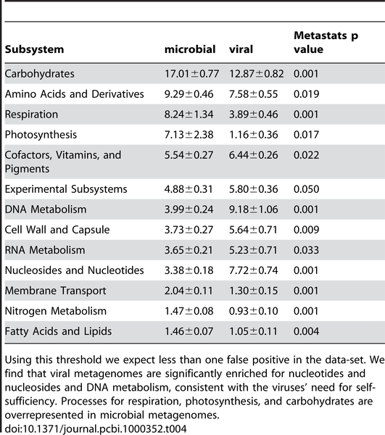
Differentially Abundant Metabolic Subsystems in Microbial and Viral Metagenomes

Slide 33
Discussion
This method can be applied to the analysis of any count data generated through molecular methods, including random-shotgun sequencing of environmental samples, targeted sequencing of specific genes in a metagenomic sample, digital gene expression surveys, or whole-genome shot gun data.
If more than two populations, one way ANOVA could be used.
If only a single sample from each treatment is available, a chi-squared test can be used instead of t-test.

Slide 34
Thank You.

