Slide 1
Comparison of microbial diversity in gut-metagenomic samples using 16s rRNA and recA
Rahul Gupta
Rajeswari Swaminathan
Sashikiran Challa
Sushmitha Paulraj

Slide 2
Outline
Introduction
Goal
Materials & Methods
Results
Discussion & Conclusion

Slide 3
Introduction
Estimating species diversity in environmental samples is a common type of study in metagenomics
Diversity patterns of microorganisms can be used for monitoring and predicting environmental conditions and changes in the same
Common approach is to use phylogenetic markers
“A fragment (locus) of either coding or non-coding DNA which is known to have no or predictable variation within a given species and for which sequences are available in most or all species in a genus”
www.isth.info/tools/blast/markers.php

Slide 4
16S rRNA
16S rRNA is the widely studied and commonly used phylogenetic marker for diversity estimation
1542 nt long ribosomal subunit
Highly conserved
Limitations
Multiple copies found in some species (which might lead to overrepresentation)
Since 16S rDNA does not encode a protein, the occurrence of indels can introduce problems with sequence alignments
Identification and Phylogenetic sorting of bacterial lineages with universally conserved genes and proteins. Santos SR et al. Environmental Microbiology, 2004

Slide 5
Other Phylogenetic Markers
Several other markers have been identified to be conserved across different bacterial species
Single copy phylogenetic markers
fusA ileS
lepA leuS
pyrG recA
recG rpIB
rpoB
Identification and Phylogenetic sorting of bacterial lineages with universally conserved genes and proteins. Santos SR et al. Environmental Microbiology, 2004

Slide 6
recA
Multifunctional protein contributing to homologous recombination, DNA repair and maintenance
Highly Conserved amino acid sequence
At nucleotide level recA can tolerate mutations thus enabling it to be used for evaluating phylogenetic relationships among recently diverged species

Slide 7
Goal
“To compare the microbial diversity in 13 human gut metagenomic samples using 16S rRNA and recA”

Slide 8
MATERIALS & METHODS

Slide 9
Metagenomic Samples
Sample | Age | No. of Contigs | No. of Singlets | Average Length of Contigs
In-A | 45 Years | 5410 | 16330 | 2809
In-B | 6 months | 1721 | 8481 | 3701.6
In-D | 35 Years | 7613 | 36312 | 2159.1
In-E | 3 months | 4819 | 16838 | 2301.1
In-M | 4 months | 4794 | 15541 | 3375.1
In-R | 24 Years | 8935 | 36524 | 1920.6
F1-S | 30 Years | 7545 | 28038 | 2153.6
F1-T | 28 Years | 7389 | 37458 | 1980.4
F1-U | 7 months | 4854 | 14430 | 2779.4
F2-V | 37 Years | 7919 | 38442 | 2008.7
F2-W | 36 Years | 6778 | 30550 | 2289.8
F2-X | 3 Years | 5032 | 34252 | 2296
F2-Y | 18 months | 9159 | 32461 | 2044.2

Slide 10
WORKFLOW
16S rRNA Aligned Sequences (~5000)
13 Gut Samples
recA nucleotide sequences (~8000) as database
HMMBUILD
& HMMSEARCH
BLAST sample vs. recA db(e-5) & extract top-most hits
BLAST against NT database
(e-5)
Phylum & Species Diversity Comparison

Slide 11
RESULTS

Slide 12
Average-Hit-Length-Coverage

Slide 13
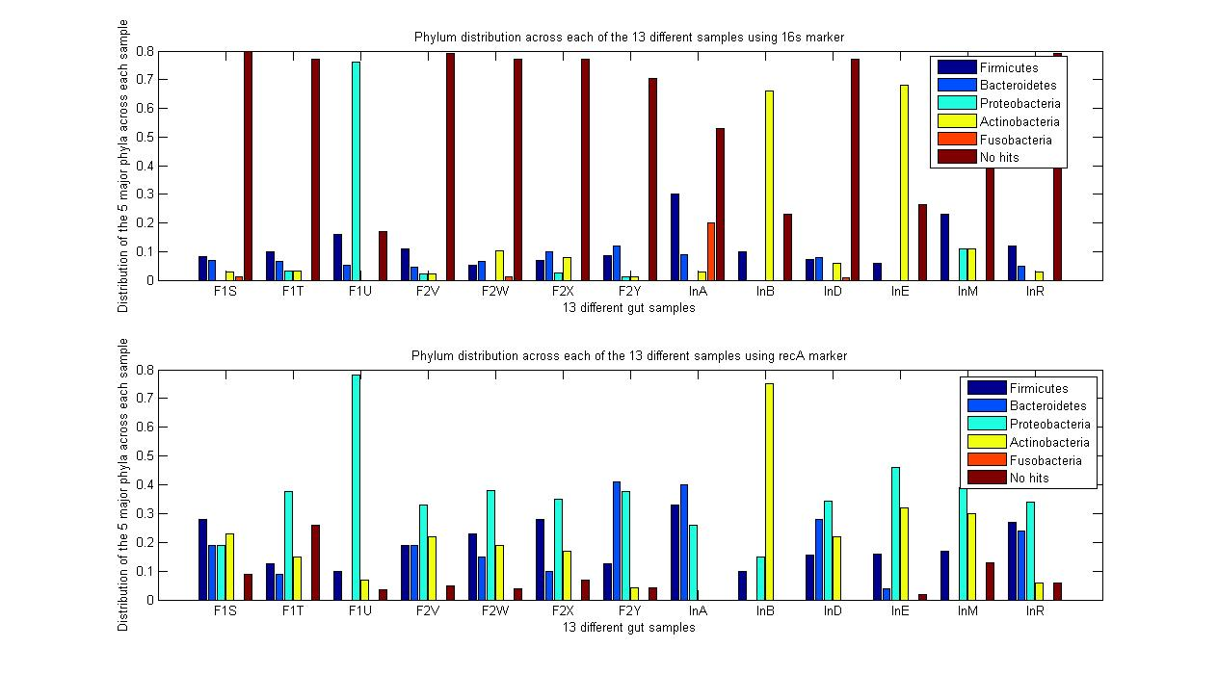
16S rRNA & recA Comparison Plot

Slide 14
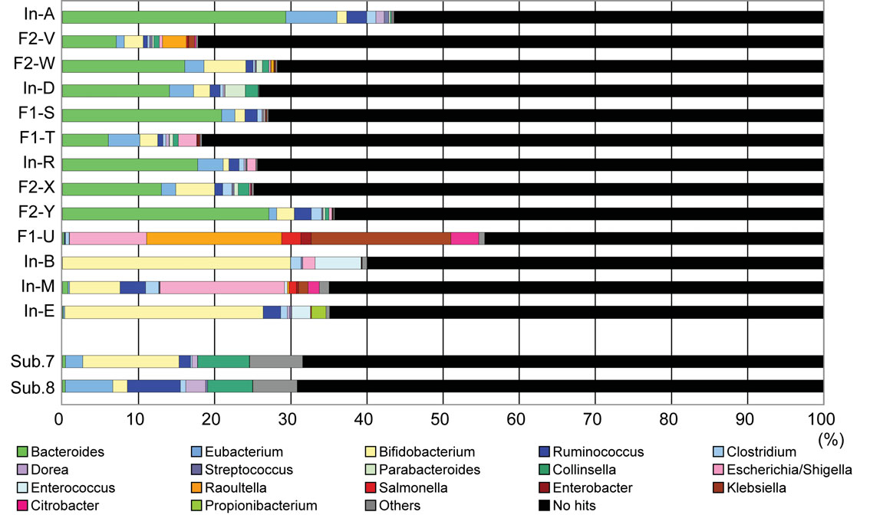
DISTRIBUTION RESULTS FROM KUROKAWA’s PAPER
Comparitive Metagenomics Revealed Commonly Enriched Gene sets in Human Gut Microbiomes, DNA Research 2007

Slide 15
Genus Distribution by16SrRNA

Slide 16
Genus Distribution by recA

Slide 17
Discussion & Conclusion
Diversity observed in the samples using 16S rRNA and recA had good overlap at the Phylum level
Diversity observed in the samples at the genus level using 16S rRNA had good agreement with Kurokawa’s paper
Difference in the predictive power of the phylogenetic markers 16S rRNA and recA might be due to
Difference in the BLAST approach
Difference in the average length of 16S rRNA sequences and recA sequences

Slide 18
Future Work
Using the amino acid sequences for recA to estimate diversity
To further evaluate the predictive power of 16s and recA at the genus and species levels
Perform a similar analysis on a different environmental habitat

Slide 19
Acknowledgements
Prof.Yuzhen Ye, Assistant Professor, School of Informatics, IUB
Neethu Shah, IUB

Slide 20

QUESTIONS??
THANK YOU!!

